Slide 1

CMPE-255 Sec 48 - Data Mining
Real Estate Investment Opportunities in the State of Texas
Shivam Tomar
Gunjan Srivastava
Anupama Kurudi
Krishna Jha

Slide 2

Real Estate Investment Texas
A Study for investment in housing property in state of Texas based on dataset provided by Zillow housing. Using CRISP-DM methodology with MLOps.

Slide 3
TABLE OF CONTENTS
01
02
03
04
05
06
Business Understanding
Data Understanding
Data Preparation
What does the business need?
What data do we have / need? Is it clean?
How do we organize the data for modeling?
Model building
Testing and Evaluation
Deployment/MLOps
What modeling techniques should we apply?
Which model best meets the business objectives?
How do stakeholders access the results?

Slide 4
01
Business Understanding

Slide 5
Business Understanding
Texas has a population of over 28 million, The Lone Star State is the most populated state in the US. A large population brings with it many real estate investment opportunities. So it’s natural for property investors from all across the US to show interest in the Texas real estate market. Texas real estate market provides plenty of opportunities for traditional long-term rentals and investment.

Slide 6
02
Data Understanding

Slide 7
Data Understanding
This is the base data set which contains the various property details in Texas from Zillow.com
Owner monthly mean non mortgage cost to owners in various Texas counties.
TX city to county contains the mapping of cities to counties in Texas.
TX income cities contains the mean household income in various Texas cities
US zips contains the mapping of Texas zip code and cities.

Slide 8
03
Data Preparation

Slide 9
Data Preparation
Data Cleaning and dimension and attribute deduction to reflect on the relationship between attribute and factors like square feet and sales price by addressing key considerations such as the comparison between Texas selected region and Texas homes in the United States, as well as analyzing how the slope can help identify price changes, how the regression equation can help identify appropriate listing prices of Texas real estate.

Slide 10
04
Model building

Slide 11
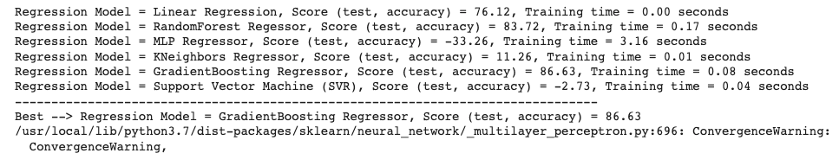
Model building
GBM Classifier.
Linear Regression
MLP Regression
RandomForest Regression
KNeighbor and SVR
Decision tree classifier

Slide 12
05
Testing and Evaluation

Slide 13
Evaluation of Study
Texas, the price of the houses with square feet area ranging between 2100 to 2500 sqft cost between 310k to 340k.
The house price prediction becomes more accurate when we introduced the latent variables from a different dataset.
The Regression score was better when we ran it with the latent variables. The variance of the data got improved.
It can be concluded that the house prices goes high when the school ranking is better which means as the school popularity increases, the property prices increases.
Through fractal clustering, we found that there are properties with number 15 that has low price per square feet with high school ranking that would be an ideal buy for any investor.
Finally Any investor who is interested in buying a property in Texas, can easily find a house ranging between 310 - 340k with a square feet area of around 2400 and with a high school ranking

Slide 14
06
Deployment/MLOps

Slide 15
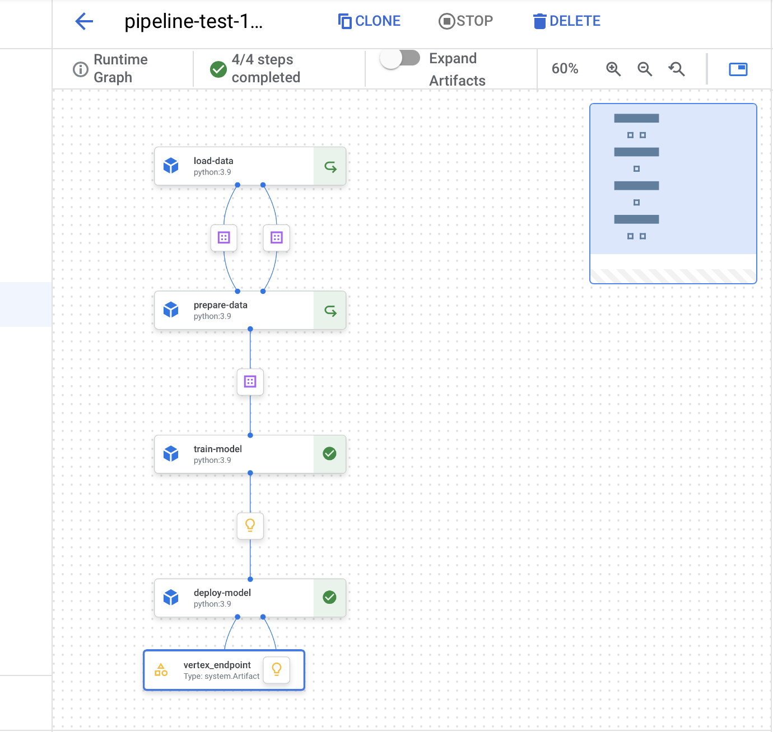
Deployment/MLOps
MLOps Pipeline has been implemented using Google Vertex AI which is industry standard for ML deployment pipeline.

Slide 16
Deployment/MLOps
Pipeline Steps
Load Dataset
Clean Dataset
Train Model
Deploy Model

Slide 17
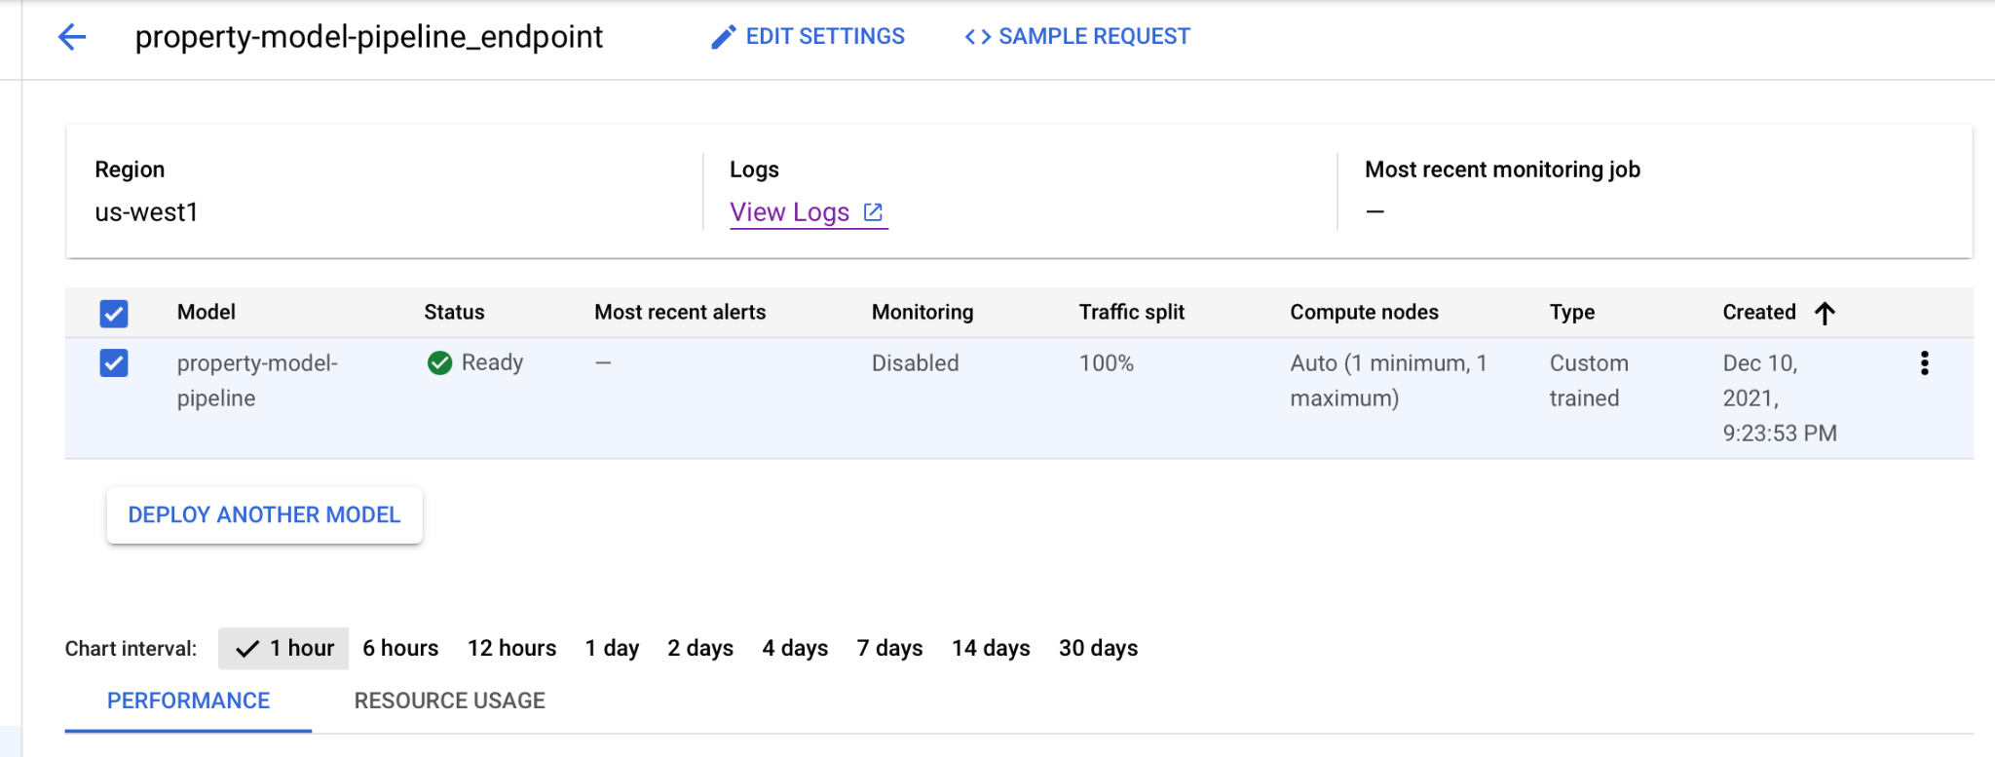
Deployment/MLOps
Endpoint has been created to access the deployed model

Slide 18
References
References
[1] https://www.politieacademie.nl/kennisenonderzoek/kennis/mediatheek/PDF/86218.pdf
[2] https://arxiv.org/abs/1805.03620
[3]https://papers.ssrn.com/sol3/papers.cfm?abstract_id=3393434

Slide 19
THANKS
DO YOU HAVE ANY QUESTIONS?

