Slide 1
Presentation
File created on: 1/6/2022 9:17:54 PM

Slide 2
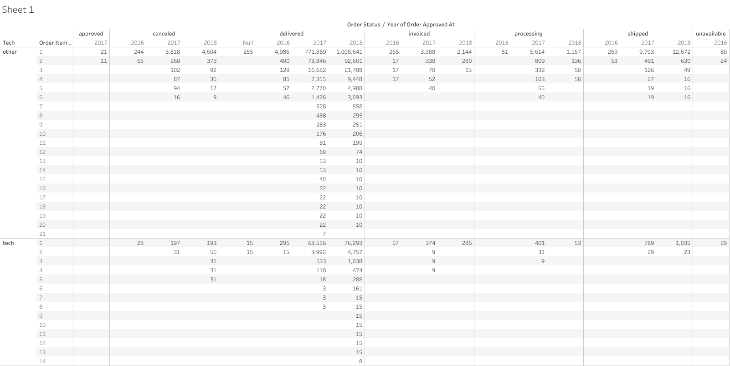

Slide 3
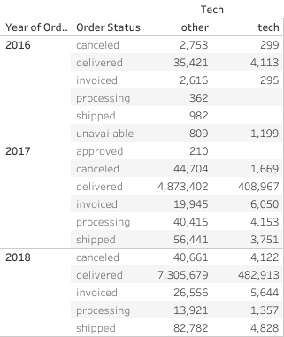

Slide 4
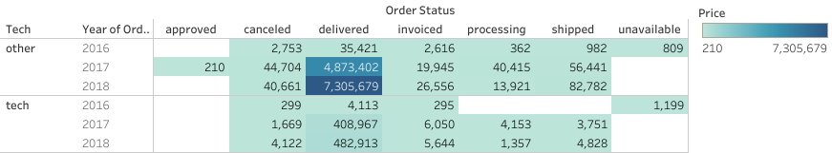

Slide 5
Product Name | Sum of delivered
audio | 50570.6
cine_photo | 6690.37
computers | 218684.14
computers_accessories | 875321
consoles_games | 147252.08
electronics | 154501.99
pc_gamer | 1306.95
tablets_printing_image | 7528.41
telephony | 309457.47

Slide 6
 |  | Order Status_Tech_products
Delivery Date | Product Name | approved | canceled | delivered | invoiced | processing | shipped | unavailable
2016 | audio |  |  | 157
 | consoles_games |  |  | 3,619 | 263
 | computers_accessories |  |  | 669 | 730
 | electronics |  |  | 108 |  |  |  | 1,199
 | telephony |  | 299 | 228 | 32
2017 | audio |  | 20 | 14,855 |  |  | 98
 | cine_photo |  |  | 695
 | computers |  |  | 138,799 | 1,650 |  | 1,300
 | computers_accessories | 40 | 4,588 | 351,271 | 2,191 | 3,107 | 2,744
 | consoles_games |  | 1,125 | 75,048 | 3,089 | 527 | 507
 | electronics |  | 40 | 47,806 | 60 | 148 | 544
 | pc_gamer |  |  | 520
 | tablets_printing_image |  |  | 6,191
 | telephony |  | 484 | 125,054 | 1,251 | 3,478 | 1,302
2018 | audio |  |  | 35,559
 | cine_photo |  |  | 5,995 | 90 |  | 169
 | computers |  |  | 79,885 |  |  | 1,329
 | computers_accessories |  | 3,044 | 523,381 | 688 | 776 | 5,171
 | consoles_games |  | 1,413 | 68,585 | 2,067 | 360 | 112
 | electronics |  | 1,928 | 106,588 | 116 |  | 1,168
 | pc_gamer |  | 239 | 787
 | tablets_printing_image |  |  | 1,338
 | telephony |  | 542 | 184,175 | 3,371 | 997 | 2,051

Slide 7
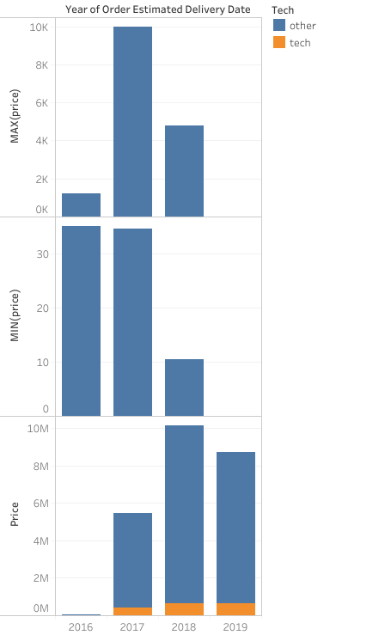
Price prediction based on price fluctuations in different years

