Slide 1
DESIGN AND IMPLEMENTATION OF VOLTAGE STABLIZER USING DC MOTOR
PROJECT GROUP-ll
MAIN GUIDE:
MR.JAISON JAMES
HOD OF EEE DEPARTMENT
CO-GUIDES:
MS.ANJU P
ASST. PROF. EEE
MS.SHRUTHI S NAIR
ASST.PROF.EEE
MR. DEEPU VS
ASST.PROF.EEE
GROUP MEMBERS:
AKSHAY MOHANDAS
ANUPAMA REJY
ERWIN THOMAS
MILAN SYAM
SHEENA SEBASTIAN

Slide 2
CONTENTS
INTRODUCTION
OBJECTIVE
HARDWARE SETUP
METHODOLOGY
ALGORITHM
RESULTS
CONCLUSION

Slide 3
INTRODUCTION
Why Voltage Stabilization is Important?
Electrical systems often experience voltage fluctuations due to factors like power grid issues, weather, or heavy load conditions.
What does a Voltage Stabilizer do?
The voltage stabilizer is designed to maintain a stable output voltage by adjusting to the fluctuating input voltage levels.
Here in the setup we use a DC motor to control an autotransformer.

Slide 4
OBJECTIVE
“To design, develop, and evaluate a voltage stabilizer that effectively regulates output voltage by dynamically compensating for fluctuations in input voltage”.
This ensures the safe and reliable operation of electrical equipment. The stabilizer works by dynamically adjusting the output voltage with the help of a DC motor and an autotransformer.

Slide 5
HARDWARE SETUP
BLOCK DIAGRAM
INPUT AC VOLTAGE
INPUT AND OUTPUT VOLTAGE SENSOR
MICROCONTROLLER
MOTOR DRIVER
OUTPUT VOLTAGE
AUTOTRANSFORMER
MOTOR

Slide 6
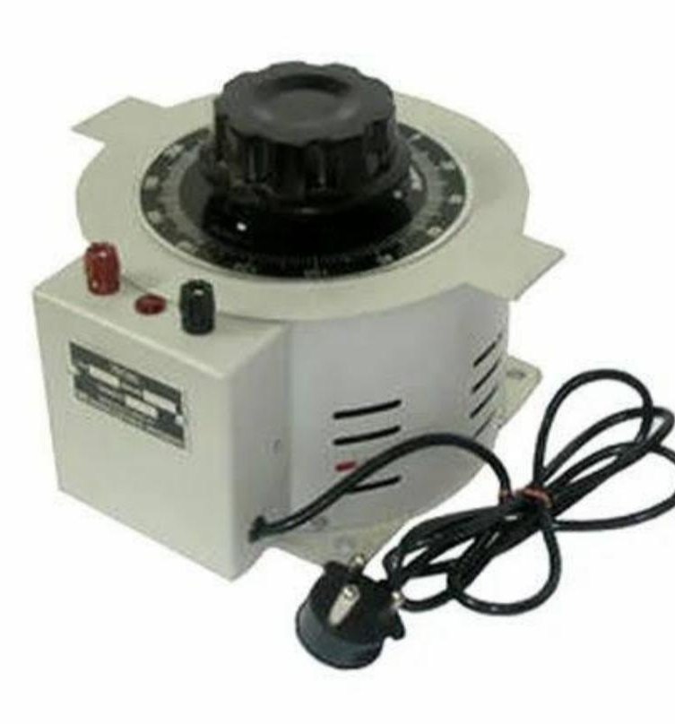
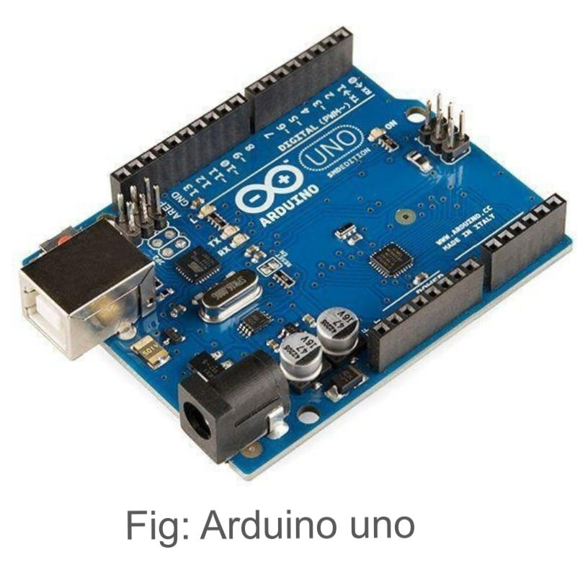
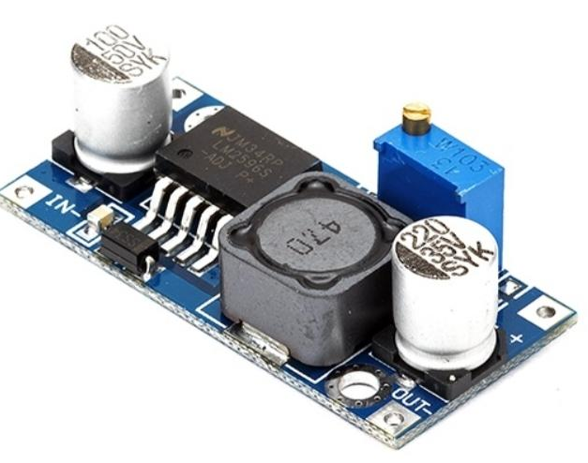
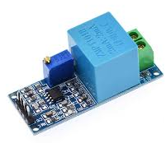
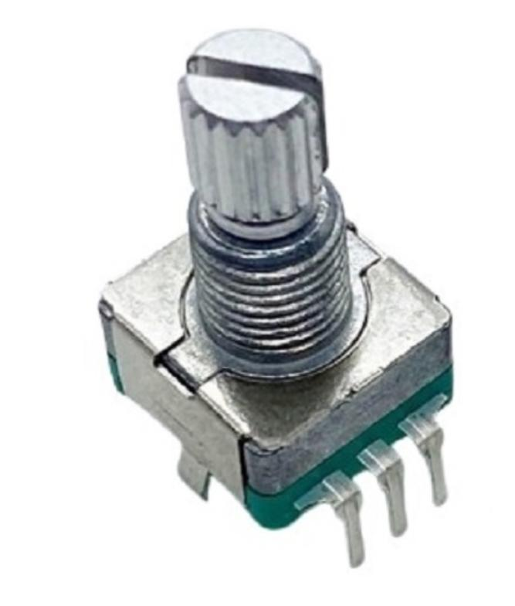
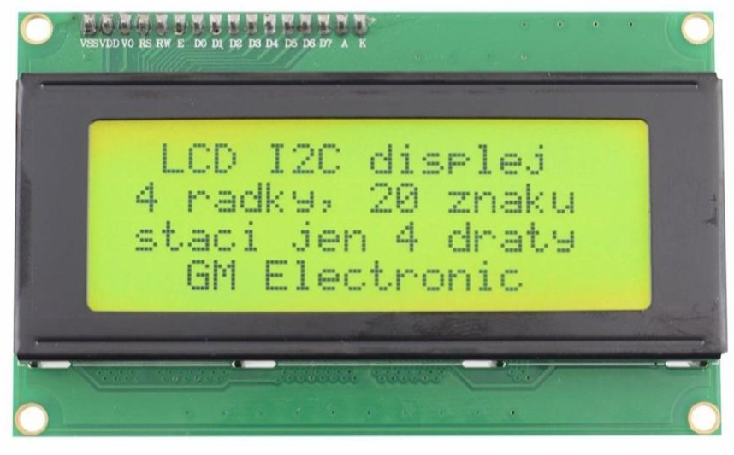
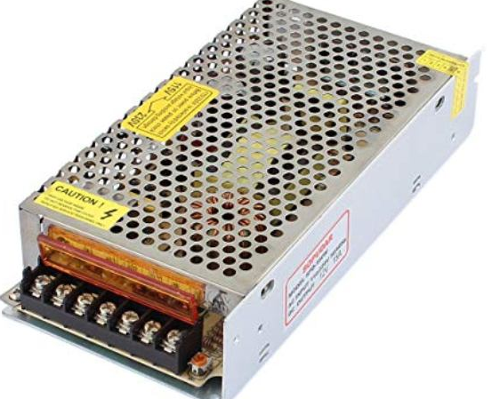
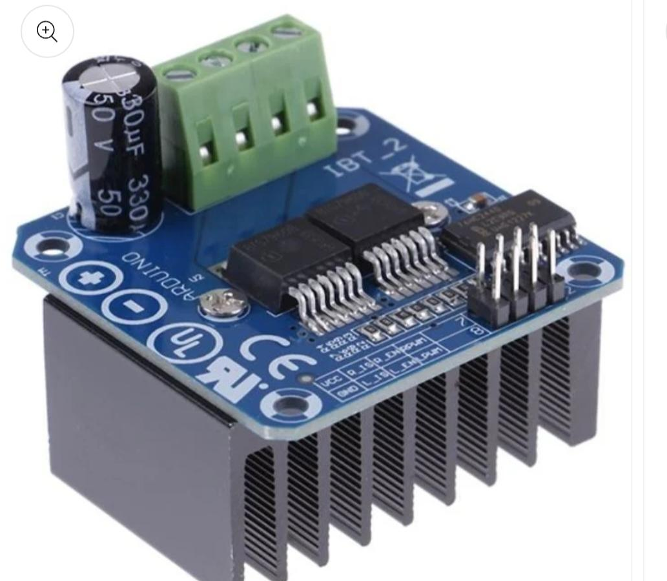
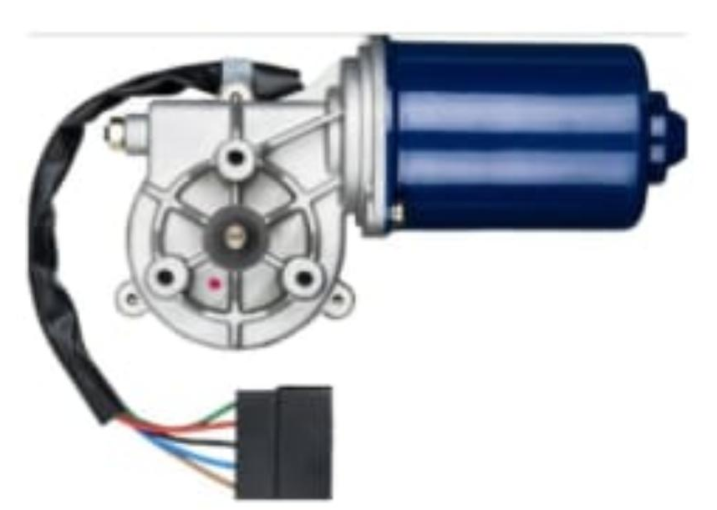

COMPONENTS
Buck Converter
AUTO TRANSFORMER
ZMPT101B (VOLTAGE SENSOR,250v)
ARDUINO UNO
POTENTIOMETER (10K)
ROTARY ENCODER (EC11)
MOTOR DRIVER(BTS7960, 6-27V,43A)
DC MOTOR(12V,10A)
SMPS(SWITCHED MODE POWER SUPPLY)
BUCK CONVERTER(LM2596)
16 X 4 LCD DISPLAY
Auto Transformer
ZMPT101B
SMPS
16 x 4 LCD Display
Rotary Encoder
Motor
Gear
Motor Driver(BTS7960)

Slide 7
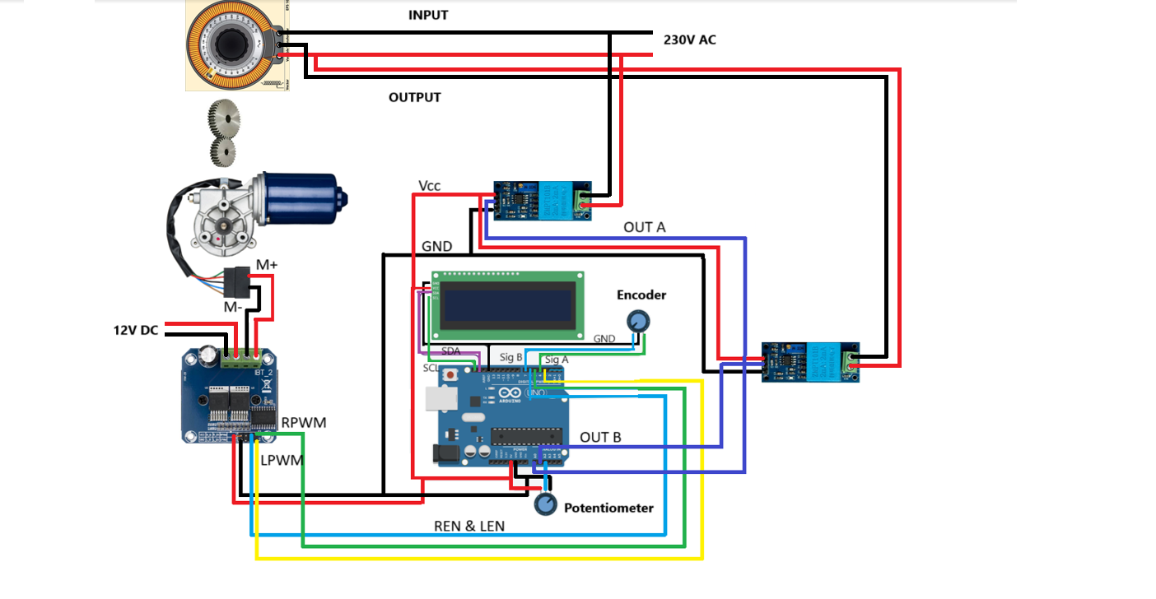
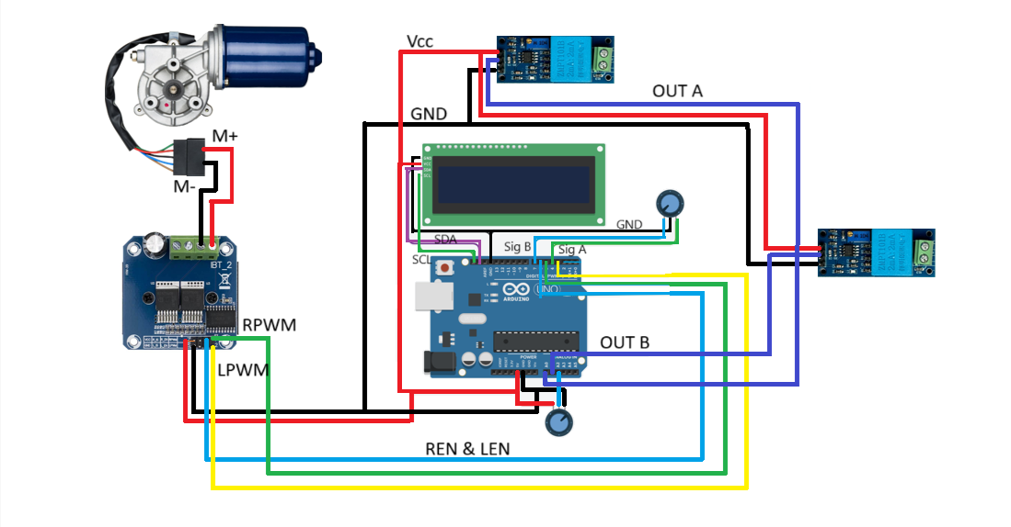
CIRCUIT DIAGRAM
Input voltage
DC motor
Encoder
Output voltage
motor driver
Potentiometer

Slide 8
GEAR DESIGN AND CALCULATION
Gear used ‘SPUR GEAR’, it is a cylindrical gear with straight teeth that are parallel to its axis of rotation.
Module
Pitch Circle Diameter, Face Width
Number of Teeth
Pressure Angle, Clearance
Addendum, Dedendum
Gear Ratio, Material Selection

Slide 9
GEAR DESIGN CONTI….
Module (M) : The ratio of the pitch diameter to the number of teeth. D/T
Pitch Circle Diameter (PCD) : The diameter of the imaginary circle that represents the gear's effective size. M*T
Number of Teeth (T) : The total count of teeth on the gear.
Pressure Angle: The angle between the gear tooth profile and the line tangent.
Addendum :The distance between the pitch circle and the top of the tooth.
Dedendum : The distance between the pitch circle and the bottom of the tooth.
Clearance : The gap between the top of a tooth on one gear and the bottom of the mating gear's tooth
Face Width: The width of the gear tooth measured parallel to the axis

Slide 10
GEAR DESIGN CONTI….
Gear Ratio :The ratio of the number of teeth between the driving gear and the driven gear.(T2/T1)
Material Selection : Gear material (e.g., steel, brass, plastic) is crucial based on load, speed, and durability requirements.

Slide 11
CALCULATION
I/p speed =40 rpm
o/p speed =10 rpm
Gear ratio = 48/12=4 ; (1:4 reduction)
Gear teeth count = T2driven/T1driver
T1 = 12 teeth and T2 = GR*T1 = 48teeth
PCD (for T1) = M*T=2*12 = 24mm; (for T2) = 2*48 = 96mm
Module (D/T)=24/12 = 2mm (for T1) and 96/42=2mm(for T2)
Pressure Angle = 20 degrees (common)
Addendum (1*M) = 2 ; Dedendum = (1.25*M) = 2.5
(T1-driver gear
T2-driven gear)

Slide 12
GEAR SPECIFICATION
Driver Gear (T1)
Driven Gear (T2)
Module: 2mm
No .of teeth: 12
Pressure angle: 20°
Face width: 30mm
Clearance: 0.2mm
Pitch Diameter: 24mm
Addendum : 2mm
Dedendum : 2.5mm
Material: plastic, PLA
Bore diameter/hole for shaft: 8.3mm
Module: 2mm
No .of teeth: 48
Pressure angle: 20°
Face width: 10mm
Clearance: 0.2mm
Pitch Diameter: 96mm
Addendum: 2mm
Dedendum: 2.5mm
Material: Plastic, PLA
Bore diameter/hole for shaft: 10mm

Slide 13
CALIBRATION OF VOLTAGE SENSOR
ZMPT101B module is connected to the Arduino (Vcc, GND, Signal OutputA0) and AC supply is given to its other end.
Use Arduino code to read the analog signal from the ZMPT101B and convert it to voltage.
Use a multimeter to measure the real AC voltage from your source.
On the module, there’s a (potentiometer). Slowly turn it while comparing Arduino reading with the multimeter reading.

Slide 14
CALIBRATION OF POTENTIOMETER
Potentiometer is connected to the Arduino (Vcc, GND, Output-A1)
Use Arduino code to read the analog reading from the potentiometer and convert it to voltage.
Multiply the multiplication factor (46) with raw reading (230/5 ).

Slide 15
METHODOLOGY
Input Voltage Sensing
Control Mechanism
DC Motor Adjustment
Output Voltage Regulation

Slide 16
ALGORITHM
Setup phase
Main loop execution
Update encoder
Update voltage
Control motor
Update display

Slide 17
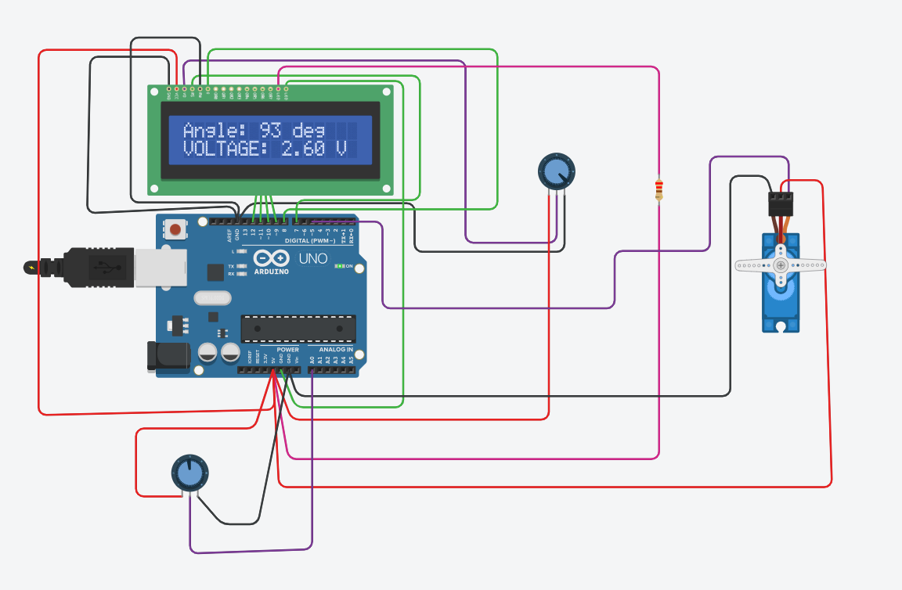
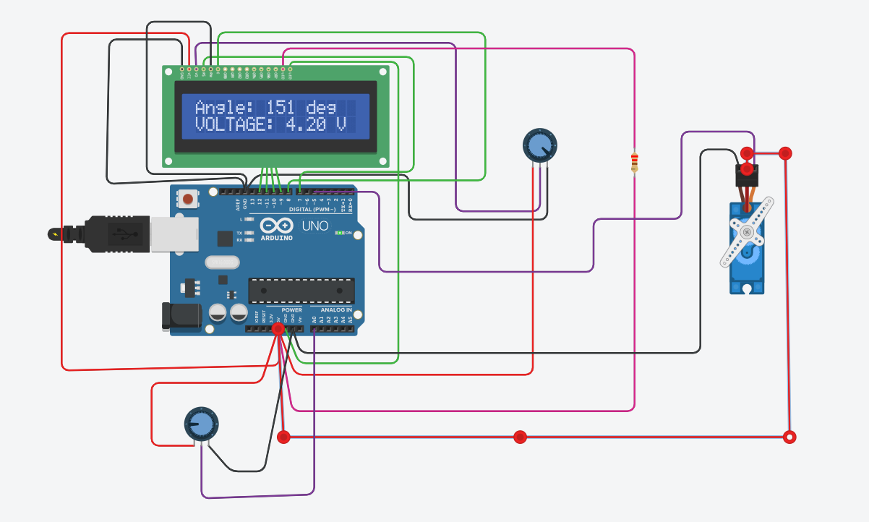
SIMULATION
Fig:1 simulation
Fig:2 simulation

Slide 18
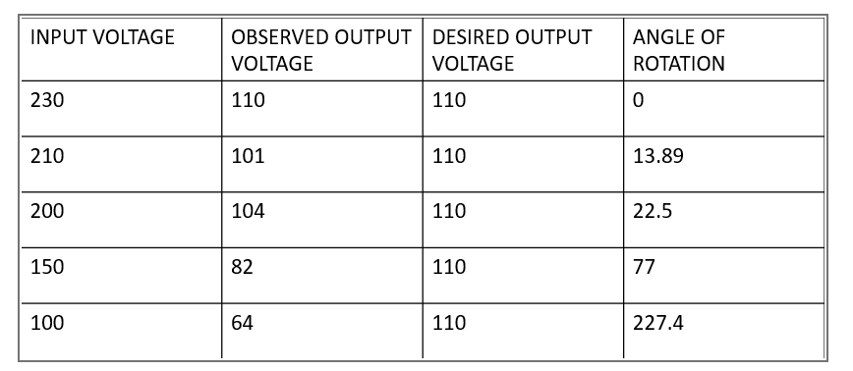
RESULTS
ARC LENGTH=2*Pi*r(theta/360)
Table:1 Observation from hardware setup

Slide 19
Table:2 Readings from stabilizer
OBSERVATION CONTI….
(With ± 5%tolerance)
INPUT VOLTAGE | OBTAINED OUTPUT VOLTAGE | DESIRED VOLTAGE | ANGLE OF ROTATION
230 | 113 | 110 | 90
220 | 111 | 110 | 114
200 | 110 | 110 | 157
150 | 107 | 110 | 207
100 | 106 | 110 | 319

Slide 20
Plottings of significant voltages (Inclusive of respective angles)
OUTPUT VOLTAGE ,DESIRED VOLTAGE ,ANGLE

Slide 21
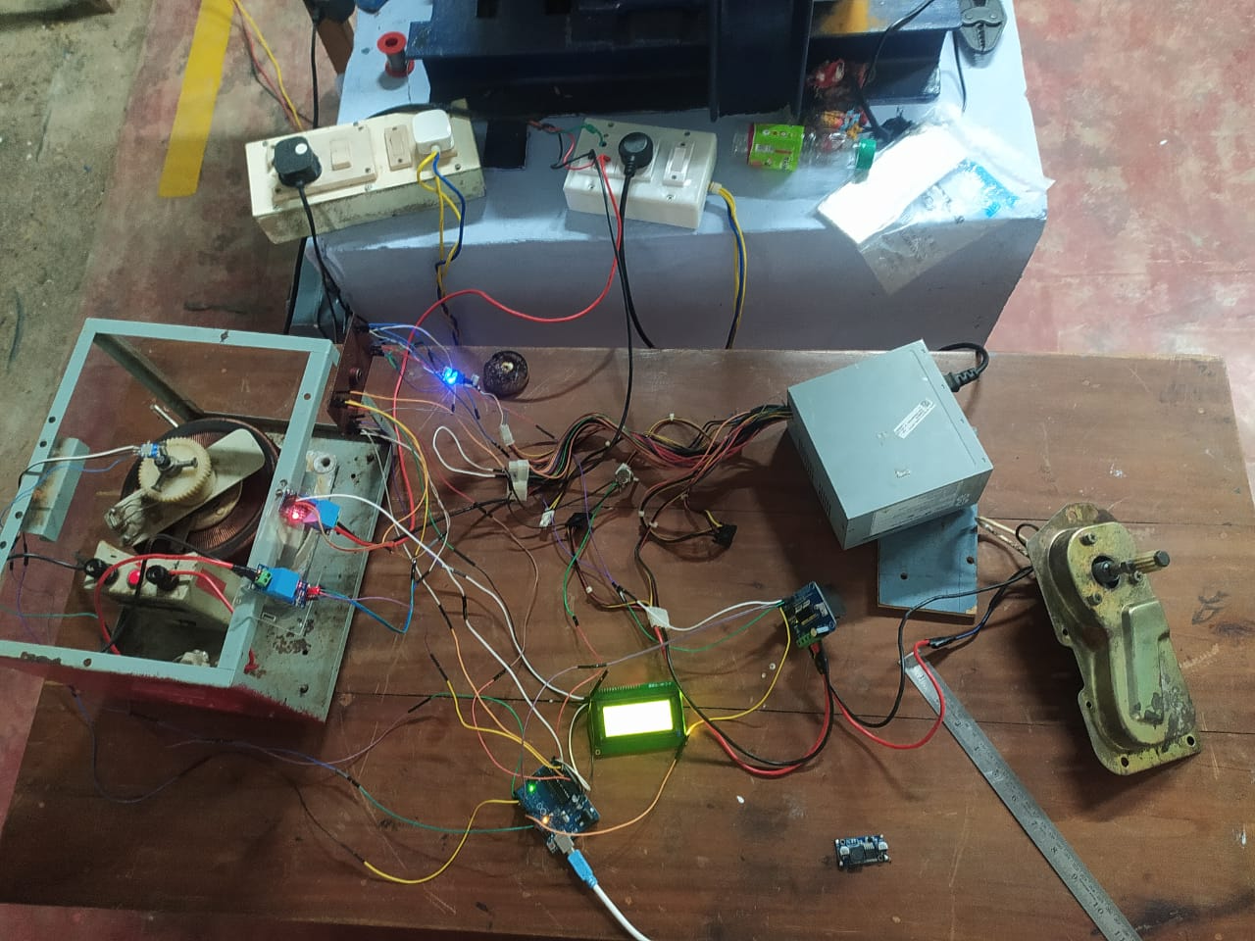
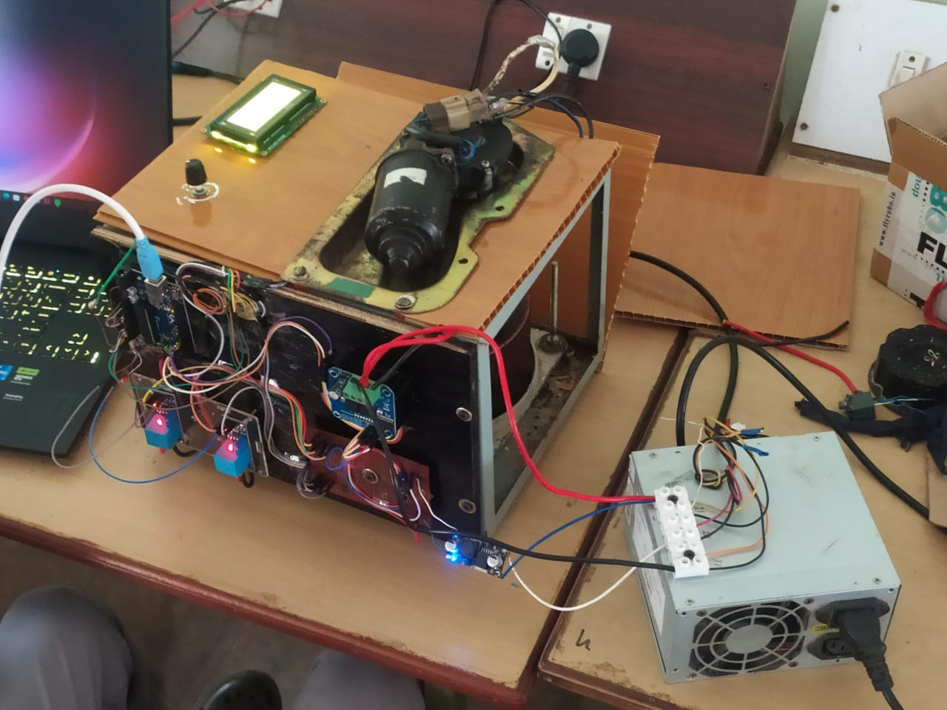
PRODUCT
Fig:1 Side view
Fig:2 Top view(without assembling)

Slide 22
CONCLUSION
The voltage stabilizer effectively regulates output voltage by dynamically compensating for input voltage fluctuations.
It ensures the safe and reliable operation of electrical equipment, protecting them from potential damage.
The system employs a DC motor and an autotransformer to dynamically adjust the output voltage.

Slide 23
THANK YOU

Slide 24
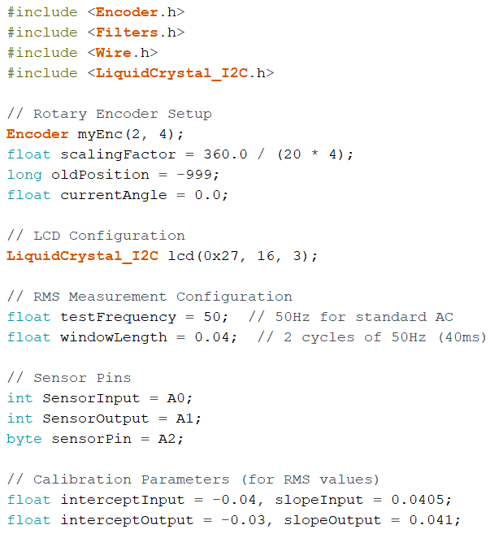
PROGRAM

Slide 25
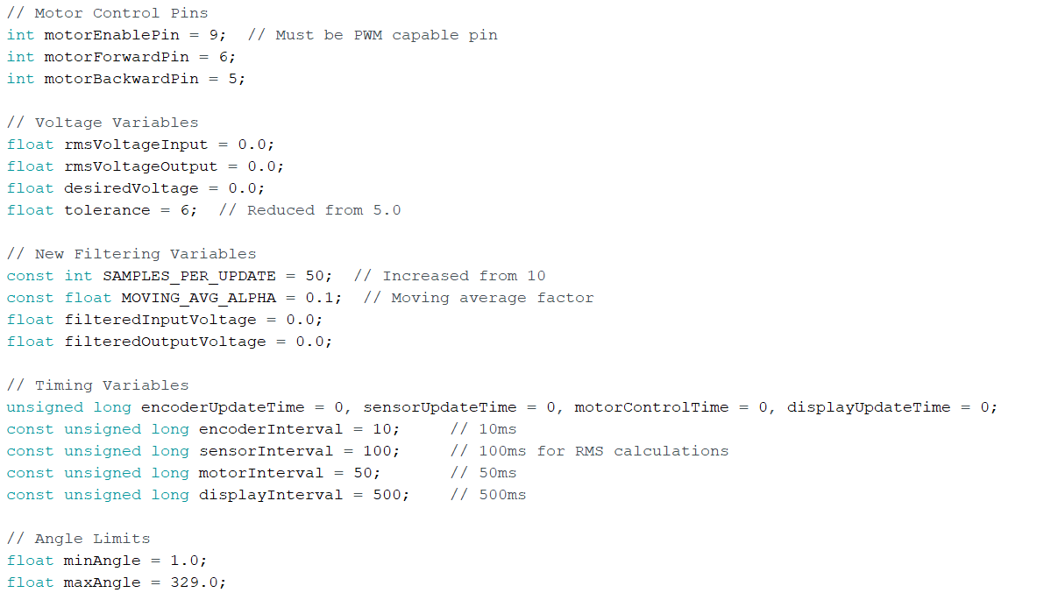
PROGRAM
Conti….

Slide 26
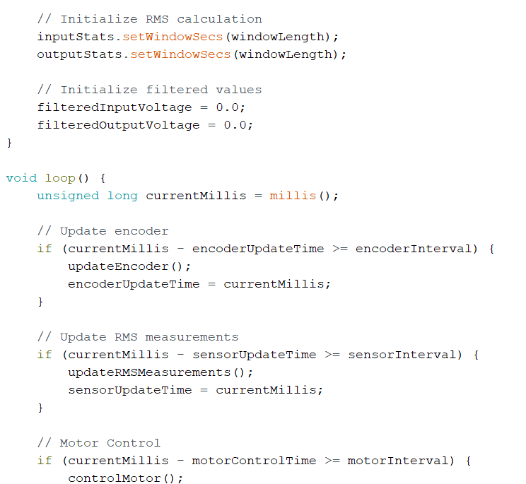
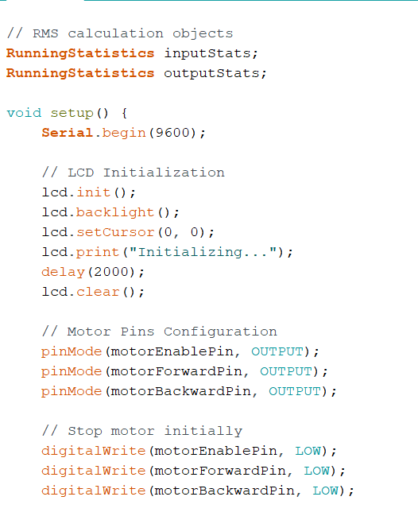
PROGRAM
Conti….

Slide 27

PROGRAM
Conti…..

Slide 28
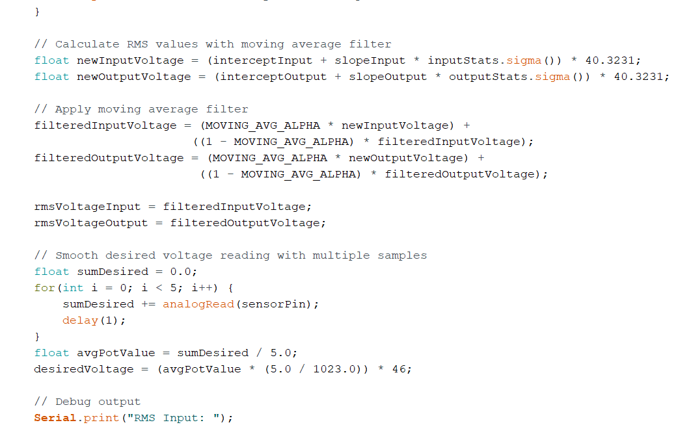
PROGRAM
Conti….

Slide 29
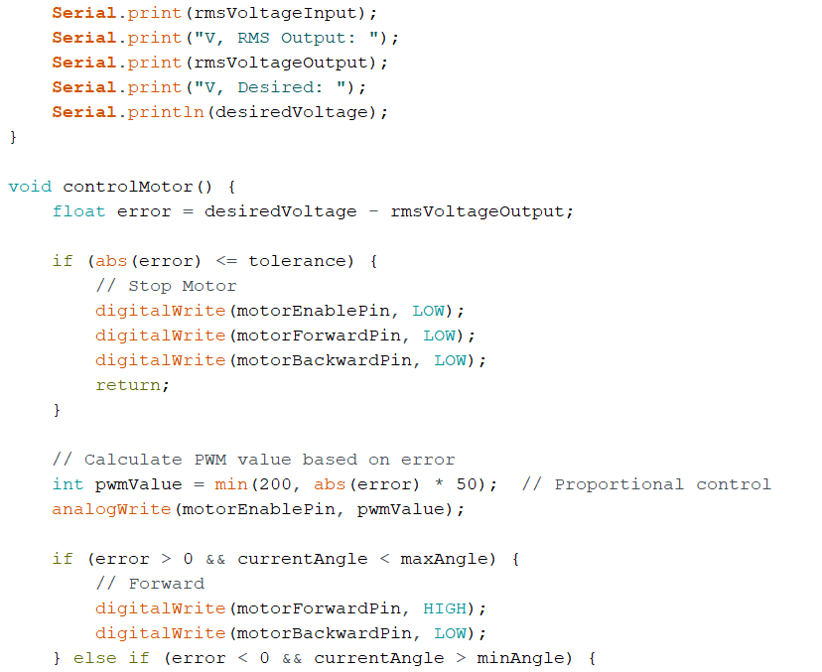
PROGRAM
Conti….

Slide 30
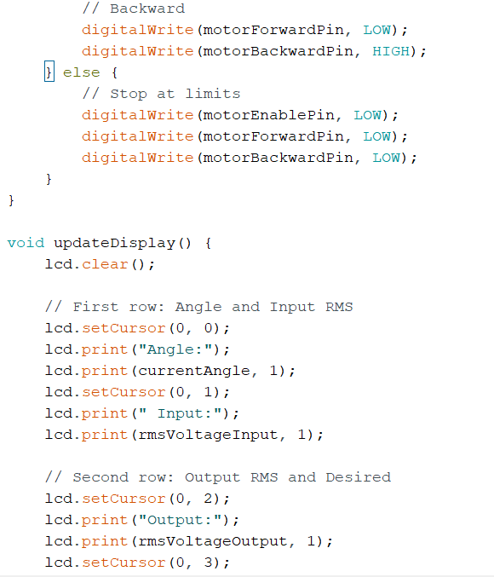

PROGRAM

