Slide 1
Python

Slide 2
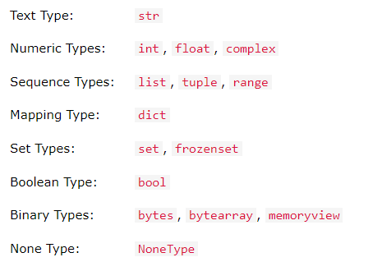
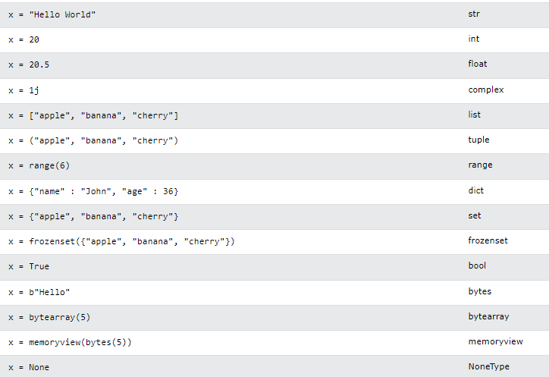
DATA TYPES
type()
Links
Basic Data Types in Python – Real Python

Slide 3
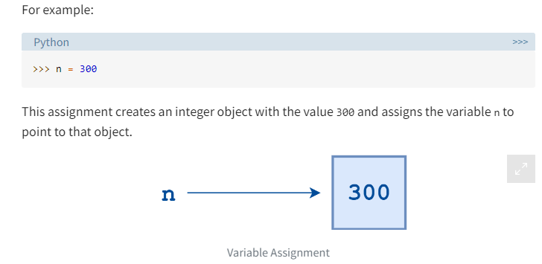
Variables . Container to store values/ name given to a memory location/ name of pointer to an object . dynamically typed/ object life cycle/ garbage collection . id() unique id for object/ object's memory address name = "I am a string" type(name) name = 123 type(name) a = b = c = 300 vs a=300, b=300, c=300 (check diff using id()) a,b,c = 300,300,300 rules of variable declaration . variable name can only contain alpha-numeric characters and underscores (A-z, 0-9, and _ ) . cannot start with digit, can start with letter or _ . cannot be any of the python keywords Links Variables in Python – Real Python

Slide 4
Print()
print(value(s), sep= ‘ ‘, end = ‘\n’, file=file, flush=flush)
name = "Alice", age = 25
print("Hello, my name is", name, '\n I am', age, "years old.")
print("hello python \n")
End - content that is to be printed at the end of the execution of the print() function
print ("Geeks For Geeks is the best platform for DSA content", end= "**")
print("Welcome to GFG")
Sep – to sep positional args
print(10, 20,30,sep='-') vs print(10, 20, sep='-', 30)
NOTE: Positional arguments cannot appear after keyword arguments
File
print('Welcome to GeeksforGeeks Python world.!!', file=open('Testfile.txt', 'w'))
Links
Python | Output using print() function - GeeksforGeeks

Slide 5
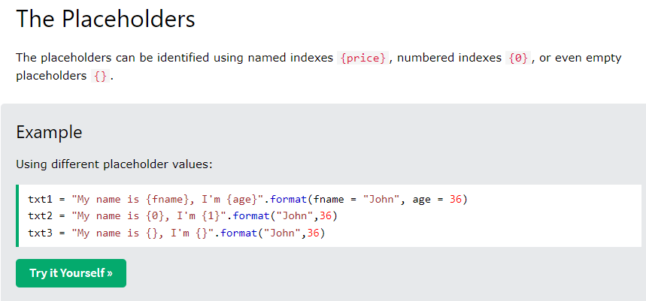
F'string
print(f"add of {a},{b} is {c}")
Format()
formats the specified value(s) and insert them inside the string's placeholder.

Slide 6
OPERATORS
Arithmetic +, -, *, /, //, %, **
Assignment =, +=, -=, *=, /=, %=, //=, **=, &=, |=, ^=, >>=, <<=
Comparison ==, !=, >, <, >=, <=
Logical and, or, not
Identity is, is not
to compare the objects, not if they are equal, but if they are actually the same object, with the same memory location)
Membership in, not in
test if a sequence is presented in an object
Bitwise & ,|, ^, ~, <<, >>
Links:
Python Operators (w3schools.com)

