Slide 1

PROJECT REVIEW – 2
E-Commerce Customer Purchase Behaviour
Analysis Using Data Analytics and Visualization
Submitted by
Anahita Bhalme
2420030708
Karishma Suthar
2420030384
Bejagama Anupama
2420030575
Under the guidance of
Dr. Garimidi Siva Sree
Professor, Dept. of Computer Science & Engineering
Koneru Lakshmaiah Education Foundation (Deemed to be University) • Off-Campus, Bowrampet, Hyderabad, Telangana

Slide 2
IMPLEMENTATION
End-to-End Implementation Workflow
1
2
3
4
5
6
Raw
Dataset
Data
Cleaning
Pre-
processing
Exploratory
Data Analysis
Customer &
Product Analysis
Visualization
& Insights
Stages 1–3 (cleaning & preprocessing) and 4–6 (analysis & visualization) are complete for this review; research-paper drafting begins in the next phase.
Project Review – 2 | E-Commerce Customer Purchase Behaviour Analysis
2

Slide 3
IMPLEMENTATION
Data Cleaning & Preprocessing
1
Missing Value Treatment
Identified and handled missing or null entries across all key fields.
2
Duplicate Removal
Detected and removed duplicate transaction records from the dataset.
3
Data Type Correction
Fixed inconsistent formats such as dates, currency and categorical labels.
4
Outlier Detection
Flagged unusual purchase values for closer review before analysis.
Project Review – 2 | E-Commerce Customer Purchase Behaviour Analysis
3

Slide 4
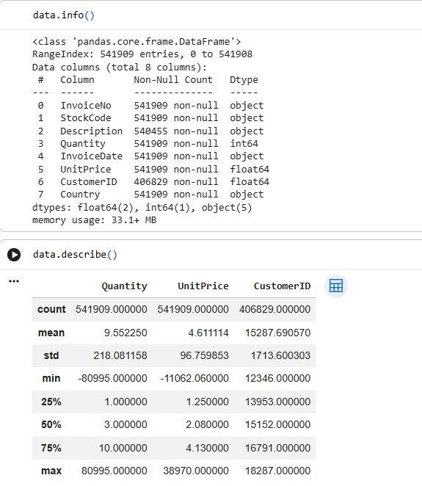
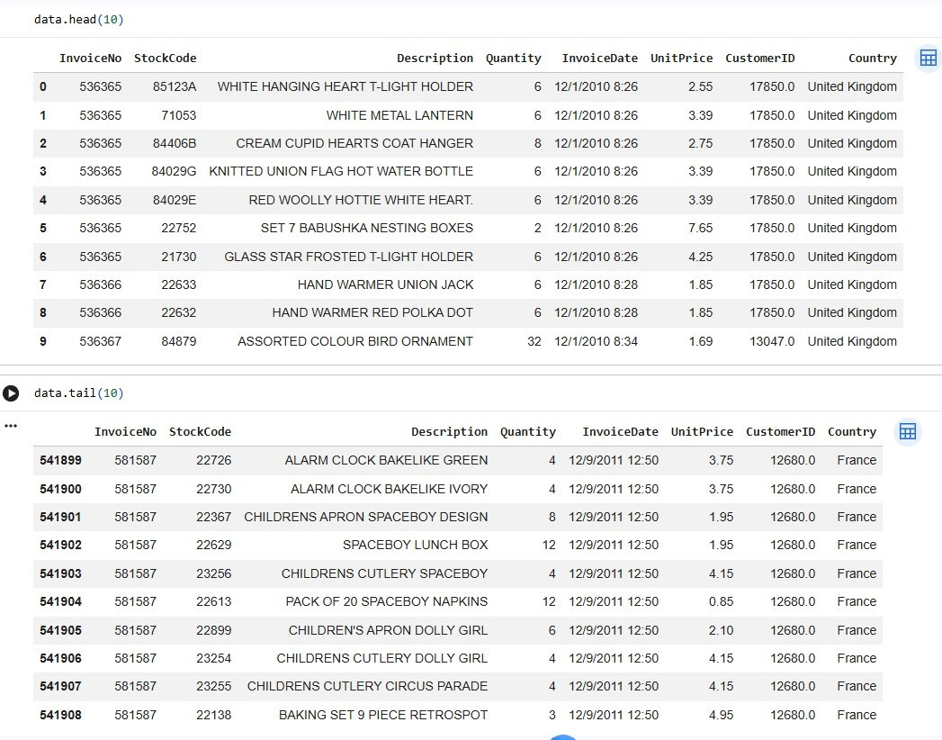

Slide 5
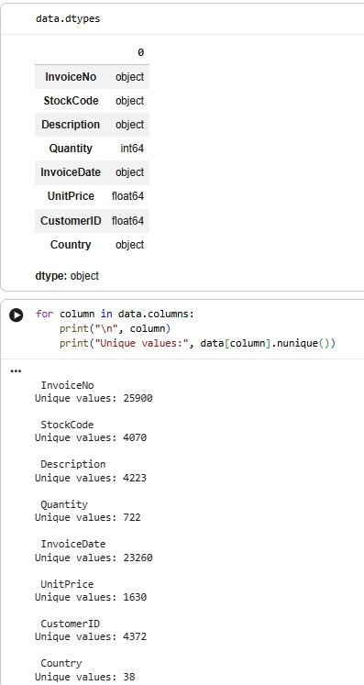
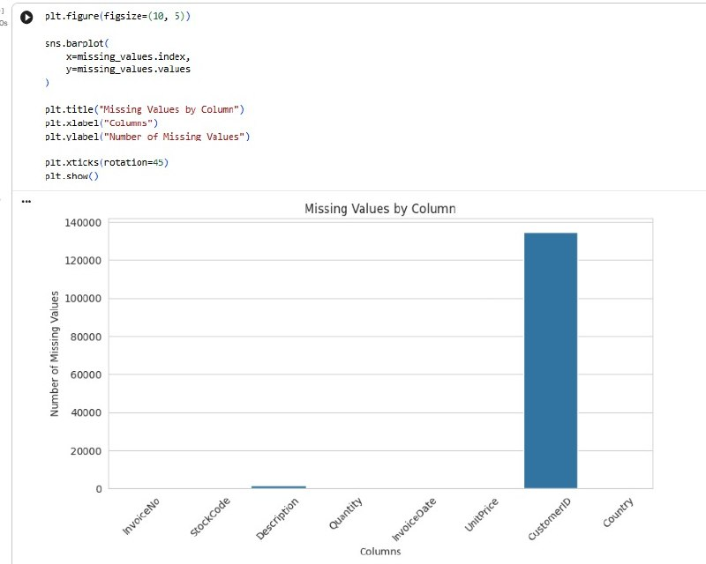

Slide 6
EXECUTION
Exploratory Data Analysis — Techniques Applied
1
2
3
4
Dataset
Overview
Descriptive
Statistics
Missing Value
Analysis
Duplicate
Detection
5
6
7
8
Univariate
Analysis
Bivariate
Analysis
Multivariate
Analysis
Correlation
Analysis
Project Review – 2 | E-Commerce Customer Purchase Behaviour Analysis
4

Slide 7
FUNCTIONALITY
Customer & Product Analysis Delivered
1
Demographic Analysis
2
Product Category Analysis
Buying patterns segmented by age, gender and location.
Identification of most and least purchased product categories.
3
Purchase Pattern Analysis
4
Spending Behaviour
Frequency and timing trends across customer transactions.
Segmentation of high-value versus low-value customers.
Project Review – 2 | E-Commerce Customer Purchase Behaviour Analysis
5

Slide 8
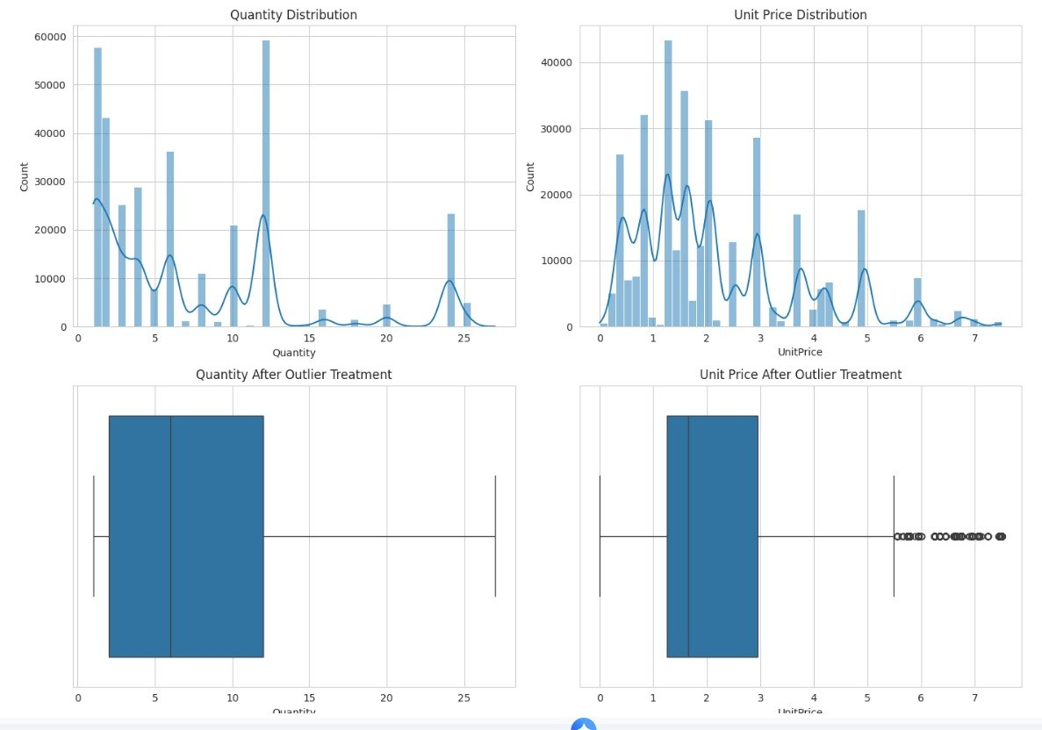

Slide 9
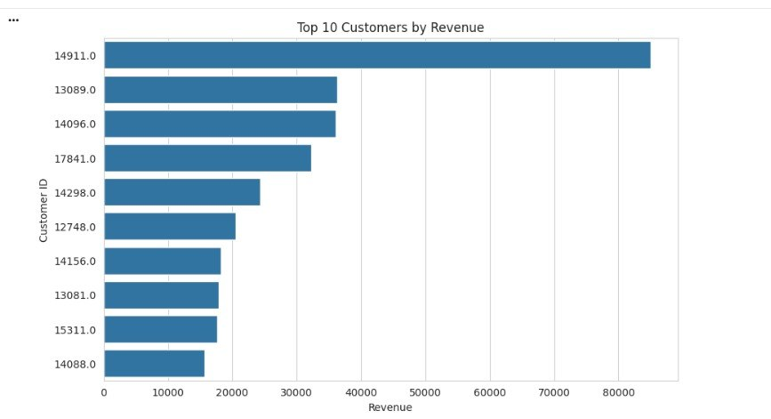

Slide 10
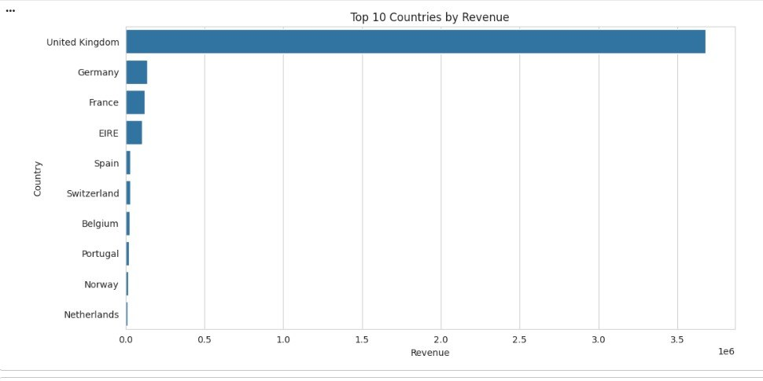

Slide 11
RESULTS & ANALYSIS
Results Obtained So Far
12
EDA techniques applied
4
customer & product
analysis dimensions
6
pipeline stages
completed
Key Insights Identified
Popular and underperforming product categories mapped out
Clear patterns found in customer spending behaviour
High-value customer segments identified for targeting
Links uncovered between demographics and purchase choices
Project Review – 2 | E-Commerce Customer Purchase Behaviour Analysis
6

