Slide 1

Student Performance Analytics Dashboard
Final Project Review | CSE | KLH university
Under the Guidance of
Ms. P. Prathusha
Assistant Professor,
Department of Computer Science and Engineering,
KLH CSE Bowrampet Campus
TEAM MEMBERS
2420030473 – M. Akhila Devi
2420030476 -Sk. Harshitha
2420030186 I. Keerthana
2420030575 B. Anupama
Notes:
Title slide. Replace all bracketed text. Use the full project title, list every team member with registration number, and name your guide. Insert the institution logo in the dashed box.

Slide 2




Introduction & Problem Statement
[
Background
Student performance depends on factors such as study hours, attendance, previous scores and classroom participation. Machine learning helps analyze these factors and predict academic performance.
Problem Statement
Traditional evaluation methods do not effectively predict student performance using multiple factors. This project develops a machine learning system to predict final scores and provide academic insights.
Motivation / Need
Identify students who may need additional academic support.
Understand important factors associated with academic performance.
Provide visual insights through an analytics dashboard.
Notes:
State the domain, the exact problem and why it matters. Keep it to about 2 minutes. Add one real-world statistic if you can, with a citation.

Slide 3


Objectives & Scope
Objectives
1
To develop a machine learning model for predicting students' final academic scores.
2
To analyze academic and learning-related factors affecting model predictions.
3
To classify predicted scores into High, Average and Low Performance.
4
To develop an interactive web-based academic analytics dashboard.
Notes:
Objectives should be measurable and start with action verbs. The scope slide tells the panel what you did and did not attempt.

Slide 4

Literature Survey
S.No | Author(s) & Year | Method / Technique | Key Findings | Limitation / Gap
1 | [Yağcı – Educational Data Mining | Machine learning algorithms | Studies prediction of academic performance | Dataset-specific results
2 | Tomasevic et al. – Student Exam Performance Prediction | Supervised data mining | Compares supervised prediction techniques | Focuses on exam performance
3 | Nachouki et al. – Student Course Grade Prediction | Random Forest | Examines predictor importance | Limited to specific course datasets
4 | Khairy et al. – Student Exam Performance Prediction | Data mining classification | Uses classification to predict exam outcomes | Classification-focused approach
Research Gap
Need for an integrated platform combining student score prediction and academic analytics.
Need to present model-derived feature importance in an understandable dashboard.
Need for a lightweight web-based system that combines prediction and visualization.
Notes:
Summarise four to six relevant papers or existing systems. End with the research gap, because that gap justifies your project.

Slide 5





Proposed System & Methodology
STEP 1
STEP 2
STEP 3
STEP 4
STEP 5
Problem Definition
Dataset Preparation
Model Design
Implement
Test & Evaluate
Identify the need, scope and success criteria.
[Load 800 student records and identify input features and target variable
Apply data preprocessing, one-hot encoding and Random Forest Regression.
Develop the Flask application with prediction and analytics modules
Test prediction, performance classification and dashboard functionality.
Key Novelty / Contribution
The proposed system integrates student performance prediction, performance classification, model-derived feature importance and interactive academic analytics into a single lightweight web application.
Notes:
Walk through the five steps left to right. Rename the steps to match your project (for example, Requirement Analysis, Design, Coding, Testing, Deployment). End with your novelty.

Slide 6
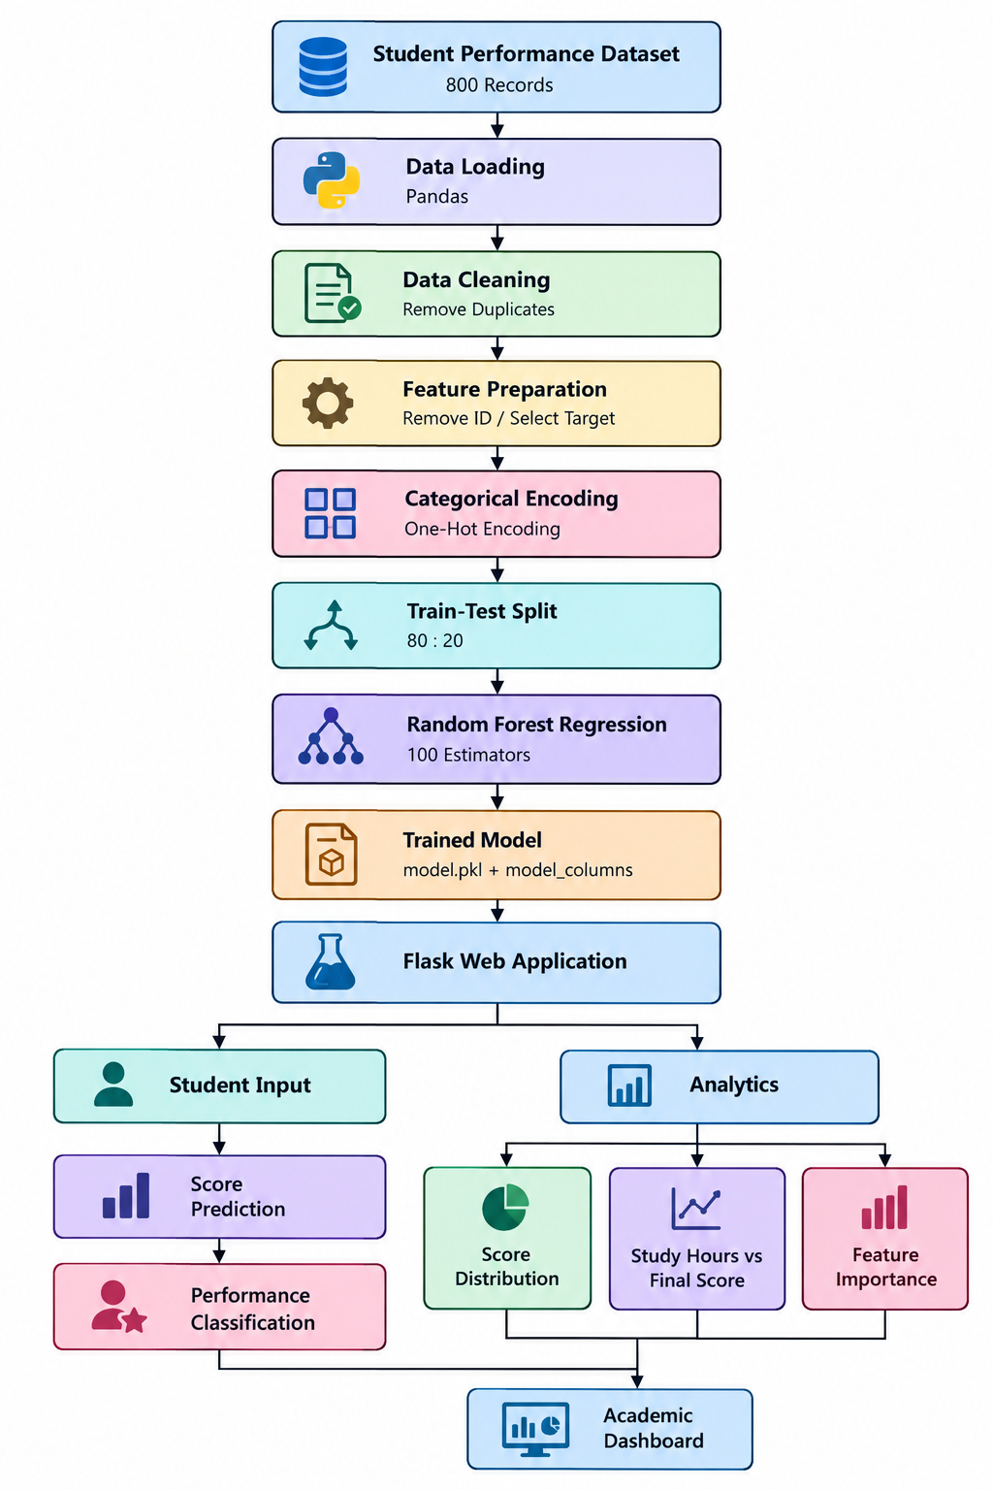
System Architecture
Components
1
Dataset Module – Loads student academic records.
2
Preprocessing Module – Removes duplicates and encodes categorical variables
3
Prediction Module – Predicts final scores using Random Forest Regression.
4
Analytics Module – Displays academic statistics, charts and feature importance.
Notes:
Insert a clear block diagram: input, processing, storage, output. Number each block and explain them on the right. Redraw the figure yourself rather than copying it.

Slide 7


Hardware & Software Requirements
Hardware
Software & Tools
Libraries / Frameworks
Operating System | Windows 11
Programming Language | Python
IDE | Visual Studio Code
Processor | Intel/AMD processor
RAM | 8 GB recommended
Storage | Minimum 1 GB free space
]
L Library | Scikit-learn
Data Processing | Pandas, NumPy
Backend | Flask
Visualization | Chart.js
Model Storage | Joblib
Deployment / Platform: Local machine using Flask development server.
Notes:
List only what you actually used, with versions. For a pure software project, shorten the hardware list and add cloud or deployment resources.

Slide 8
Dataset / Data Understanding
Input Features
Study Hours per Week
Attendance Percentage
Previous Score
Assignment Score
Class Participation
Sleep Hours per Night
Tutoring Sessions
Extracurricular Activities
Internet Access
Motivation Level
Parental Involvement
Target Variable: Final_Score
Quality: Duplicate records are removed during preprocessing. Do not claim there are zero missing values unless you have checked the dataset.
[800]
[13]
Records (rows)
Dataset (columns)
[11]
[2]
Input features
Target classes
Synthetically generated academic dataset for project experimentation.
Notes:
Explain where the data came from and what it contains. Show a screenshot of the first rows or the info summary. For non-data projects, replace this slide with “Requirement Analysis” or “Input Specification”.

Slide 9
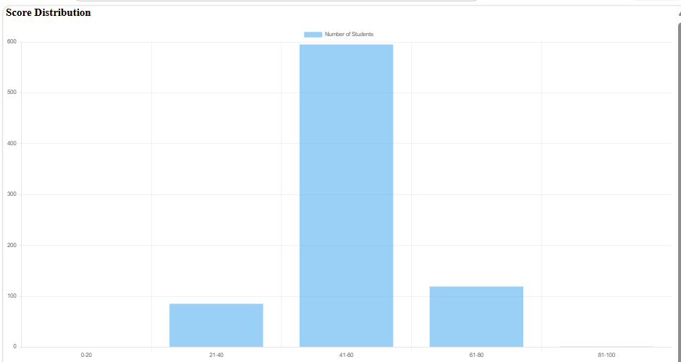
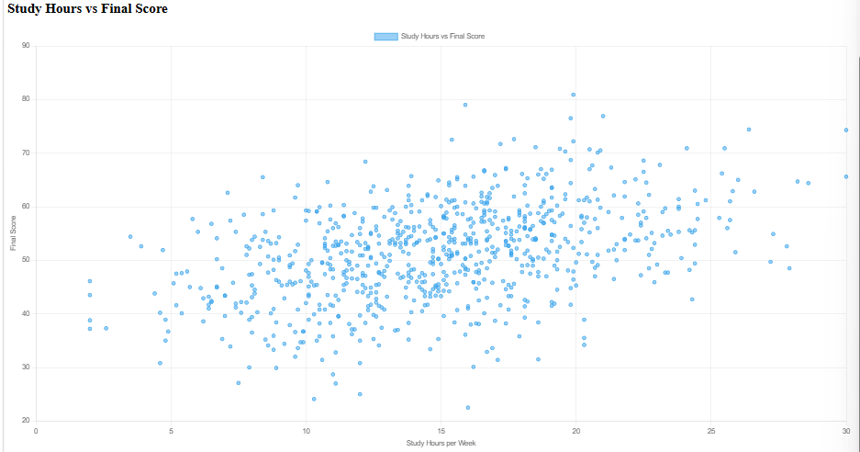



Data Preprocessing & Exploratory Analysis
[Insert feature distribution / histogram]
[Insert correlation heatmap / outlier box-plot]
Cleaning
Transformation
Feature Selection
Load dataset using Pandas.
Remove duplicate records using drop_duplicates().
Remove Student_ID from model input.
Convert categorical variables into numerical values using one-hot encoding.
Separate independent and dependent variables.
Input: 11 student-related features.
Target: Final_Score.
Notes:
Show two or three plots that tell a story: distributions, correlations, outliers. Explain what each plot told you and what you did about it.

Slide 10
Module-wise Description
1
[Dataset Module]
2
[Preprocessing Module]
Purpose: Loads student records
Input → Output: CSV → DataFrame
Developed by: 2420030186
PurposeCleans and encodes data
Input → Output: Raw data → Processed data
Developed by:2420030473
3
[Prediction Module]
4
[Analytics Module]
PurposePredicts final score
Input → Output: Student inputs → Predicted score
Developed by: 2420030476
Purpose: Displays academic insights
Input → Output: Dataset/model → Charts
Developed by: 2420030575
Notes:
Divide the project into three to five modules. For each, state its purpose, inputs, outputs and who built it. Duplicate a card if you have more modules.

Slide 11

Algorithms & Technologies Used
Random Forest Regression
One-Hot Encoding
Flask Framework
Used for predicting numerical final scores.
Combines predictions from multiple decision trees.
Handles multiple input features.
Configuration: n_estimators=100, random_state=42.
Converts categorical variables into numerical columns.
Implemented using pd.get_dummies().
Connects the machine learning model to the web interface.
Handles student input and prediction requests.
Provides home, prediction and analytics routes.
Selection criteria: Simplicity, suitability for numerical prediction and ease of integration with the web application.
Notes:
Name each model, algorithm or technology, say why you chose it, and list the key settings. Then explain how you picked the final one.

Slide 12
Implementation / Model Building
Feature Selection
Code snippet / pseudocode
[Which inputs were used and why]
X = df.drop(
["Student_ID", "Final_Score"],
axis=1
)
y = df["Final_Score"]
X = pd.get_dummies(
X,
drop_first=True)
)
Preprocessing Pipeline
[Steps applied before training or processing]
Data Splitting
[Train / validation / test ratio and sizes]
Configuration
[Hyperparameters, class balance or key settings]
Notes:
Describe the build in the order you did it. Paste only the most important code or pseudocode, not entire files. For hardware projects, show the circuit or wiring summary instead.

Slide 13
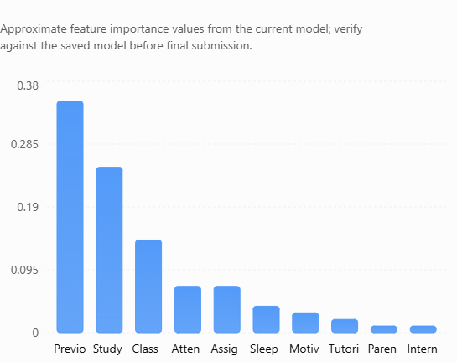
Analysis & Key Findings
Key Findings
Previous Score has the highest model-derived feature importance.
Study Hours per Week is another important feature.
Class Participation also contributes to the model's predictions.
The dashboard provides a visual representation of these factors.
[Insert confusion matrix / feature importance /
ROC curve / output comparison]
Interpretation: Feature importance represents how the trained model uses features. It does not prove that a factor causes higher or lower academic performance.
Notes:
Explain what the numbers mean. Use a confusion matrix, ROC curve, feature-importance chart or output comparison. Be honest about weak results; panels value that.

Slide 14

Testing & Validation
Test ID | Test Description | Expected Result | Actual Result | Status
TC-01 | Open home page | Home page loads | Verify | [Pass / Fail]
TC-02 | Open prediction page | Input form displays | verify | [Pass / Fail]
TC-03 | Submit student details | Predicted score displays | Score 44.7 observed in previous test | [Pass / Fail]
TC-04 | Open analytics page | Charts display | Working in previous test | [Pass / Fail]
Functional Testing
Validation Method
Performance Testing
Flask page navigation.
Student input submission.
Model prediction.
Performance classification.
Dashboard chart rendering.
80:20 train-test split.
80:20 train-test split.
Notes:
List representative test cases with expected and actual outcomes. Name the validation methods you used. Delete rows you do not need.

Slide 15


Challenges & Limitations
Challenges Faced
Limitations
Dataset preparation → Created a structured dataset with academic and behavioral attributes.
Categorical data handling → Applied one-hot encoding.
Model integration → Connected the trained model with Flask.
Visualization → Integrated Chart.js with Flask-generated data.
Dataset is synthetic, not collected from real students.
Model performance on real-world student data is not established.
Only one regression model is currently implemented.
Hyperparameter optimization has not been performed.
Predictions depend on the quality of input data.
Notes:
Be candid. Pair every challenge with how you solved it, and list limitations that the panel would otherwise spot themselves.

Slide 16

Conclusion
Developed a Student Performance Prediction system using Random Forest Regression.
1
Final Outcome
Integrated student score prediction and performance classification.
Dataset: 800 records.
Prediction model: Random Forest Regression.
Web framework: Flask.
Analytics: Interactive charts.
2
Created an interactive academic analytics dashboard using Flask and Chart.js.
3
Notes:
Revisit each objective and say whether you met it. Quote your headline result with numbers. Do not introduce new material here.

Slide 17


Future Scope & Applications
Improve Performance
[Compare Random Forest with other regression algorithms.
Perform hyperparameter tuning.
Calculate MAE, RMSE and R².
Applications
Academic performance monitoring.
Student support and counselling.
Educational data analysis.
Academic planning.
Expand Data / Features
Use real-world student datasets.
Include additional learning-related factors.
Increase dataset size and diversity.
Deploy & Build an Interface
Deploy the application online.
Develop a mobile-friendly interface.
Add student and faculty dashboards.
Notes:
Give concrete next steps, ideally tied to the limitations. Then name two or three real-world uses.

Slide 18
Team Contribution
Reg. No. | Name | Contribution / Modules Handled
2420030186 | Keerthana I | Dataset preparation and preprocessing
2420030473 | Muthangi Akhila Devi | Model development and training
2420030476 | Shaik Harshitha | Flask backend and prediction
2420030575 | Anupama | Dashboard, testing and documentation
Notes:
Show that work was planned and shared. Every member should be able to explain their own module.

Slide 19

References
[1] M. Yağcı, “Educational data mining: Prediction of students’ academic performance using machine learning algorithms,” Smart Learning Environments, vol. 9, art. no. 11, 2022. doi: 10.1186/s40561-022-00192-z.
[2] N. Tomasevic, N. Gvozdenovic, and S. Vranes, “An overview and comparison of supervised data mining techniques for student exam performance prediction,” Computers & Education, vol. 143, art. no. 103676, 2020. doi: 10.1016/j.compedu.2019.103676.
[3] M. Nachouki, E. A. Mohamed, R. Mehdi, and M. Abou Naaj, “Student course grade prediction using the random forest algorithm: Analysis of predictors’ importance,” Trends in Neuroscience and Education, vol. 33, art. no. 100214, 2023. doi: 10.1016/j.tine.2023.100214.
[4] L. Breiman, “Random forests,” Machine Learning, vol. 45, pp. 5–32, 2001. doi: 10.1023/A:1010933404324.
[5] C. Romero and S. Ventura, “Educational data mining: A review of the state of the art,” IEEE Transactions on Systems, Man, and Cybernetics, Part C: Applications and Reviews, vol. 40, no. 6, pp. 601–618, 2010. doi: 10.1109/TSMCC.2010.2053532.
Project Links
GitHub: 2420030473cse-debug/DS-s4-2420030473
Dataset: student_performance_800.csv
Demo video: Recording 2026-11-04 200345.mp4
Notes:
Use IEEE style, numbered in order of first citation in the deck. Include datasets, documentation and code repositories.

Slide 20
THANK YOU
Questions & Discussion
[Team email / contact details]
[Guide name and department]
Notes:
Leave this slide up during questions. Make sure every team member can answer questions about their own module.

