Slide 1
M/S BALTEJ INFRA LLP
COMPANY DOSSIER
Highway construction · Turnkey contracting · Civil engineering
Brief overview · 2026

Slide 2
WHO WE ARE
Engineering excellence from
Jaipur to the Himalayas
Baltej Infra LLP delivers turnkey civil and highway packages across northern and expanding Indian corridors.
• Based in Panchkula (Corporate) with multi-state project delivery
• Focus: highways, hydro-power civil works, structural & general contracting
• Clients include NHAI, SJVN, NHLML, AAI, East Central Railway, and leading EPC firms

Slide 3
WHAT WE DO
Core capabilities
01 TURNKEY CONTRACTS
End-to-end execution from design through delivery.
02 HIGHWAY CONSTRUCTION
Mountain terrain, O&M, restoration, and corridor works.
03 IN-HOUSE ENGINEERING
Geotechnical and structural design support.
04 GENERAL CONTRACTING
Building and industrial infrastructure packages.

Slide 4
SNAPSHOT
Delivery at a glance
27+
5+
1500
100%
Major projects
States active
MW plant infra
supported
Quality focus

Slide 5




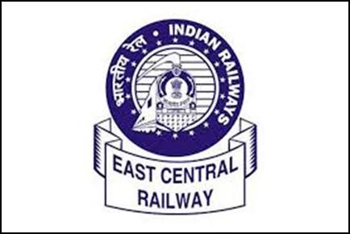




CLIENTS
Trusted by

Slide 6
PORTFOLIO
Where we deliver
• National highway O&M, protection, and black-spot rectification
• Access roads and connectivity for hydro / logistics assets
• Safety furniture, fencing, view cutters, and corridor works
• Civil infrastructure supporting power-plant and industrial projects
Full project list available on the company website → Portfolio

Slide 7
CONTACT
Get in touch
Corporate Office
SCO 297, Second Floor, Above Union Bank of India,
Sector-20, Panchkula — 134117
Phone 01724331410 · +91 98169 61415
Email info@baltejinfra.com
Detailed technical dossier PDF available on request.

