Slide 1
FPGA Implementation of QPSK
• Welcome & Introduction
• Modulation & Demodulation Concepts
• QPSK Fundamentals & Advantages
• FPGA Architecture & Design Flow
• RFSoC Integration & Future Work
Conclusion

Slide 2
Modulation Overview
Modulation:
Modulation is the process of altering certain characteristics of a high-frequency carrier signal — such as its amplitude, frequency, or phase — to embed and transmit the original data signal. This is essential for adapting baseband signals for transmission over various communication channels.
Purpose:
The primary goal of modulation is to enable reliable and efficient transmission of information over long distances. It helps in overcoming physical limitations of antennas and minimizing signal loss, noise, and interference in real-world communication systems.
Types:
Modulation techniques are broadly classified into two categories:
Analog modulation, which includes methods like Amplitude Modulation (AM), Frequency Modulation (FM), and Phase Modulation (PM), is used for continuous signals like audio.
Digital modulation methods such as Amplitude Shift Keying (ASK), Frequency Shift Keying (FSK), Phase Shift Keying (PSK), and Quadrature Amplitude Modulation (QAM) are designed for transmitting discrete digital data efficiently.

Slide 3
Demodulation Overview
Demodulation:
Demodulation is the reverse process of modulation — it involves extracting the original information-bearing signal from a modulated carrier wave at the receiver end. This is essential to recover usable data from the transmitted waveform for further processing or interpretation.
Techniques:
Demodulation techniques are mainly categorized into two types:
Coherent demodulation requires the receiver to be synchronized with the phase and frequency of the carrier signal, providing high accuracy.
Non-coherent demodulation does not require such synchronization, making it simpler but generally less efficient in performance.
Challenges:
Real-world demodulation faces several practical challenges, including:
Noise from the channel which can distort the signal,
Carrier recovery, which involves regenerating the carrier signal at the receiver,
Timing synchronization to correctly sample and interpret the incoming data.

Slide 4
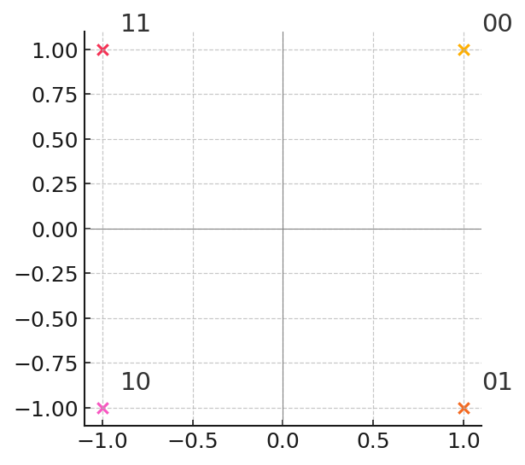
QPSK Fundamentals
Quadrature PSK: 2 bits/symbol via phase shifts.
Constellation: 4 points at 90° for bit pairs 00, 01, 10, 11.
Data rate doubled vs. BPSK in same bandwidth.

Slide 5
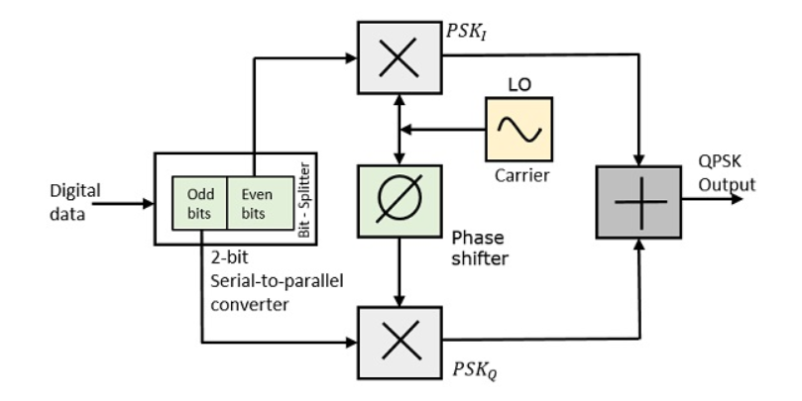
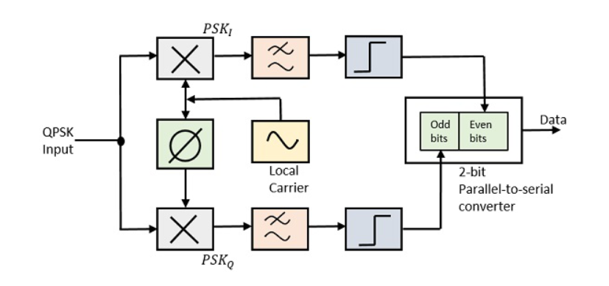
QPSK Advantages
Spectral Efficiency: 2 bits per symbol.
Power Efficiency: Constant envelope signals.
Robust in AWGN; used in satellite & mobile comms.
QPSK MODULATOR QPSK DEMODULATOR

Slide 6
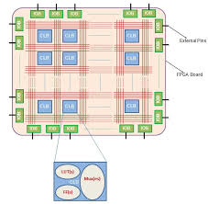
FPGA Architecture
Components: LUTs, Flip-flops, DSP slices, BRAM.
Modulator Block: Mapper, phase accumulator, I/Q LUTs.
Interfaces: AXI4-Stream for high-speed data.

Slide 7
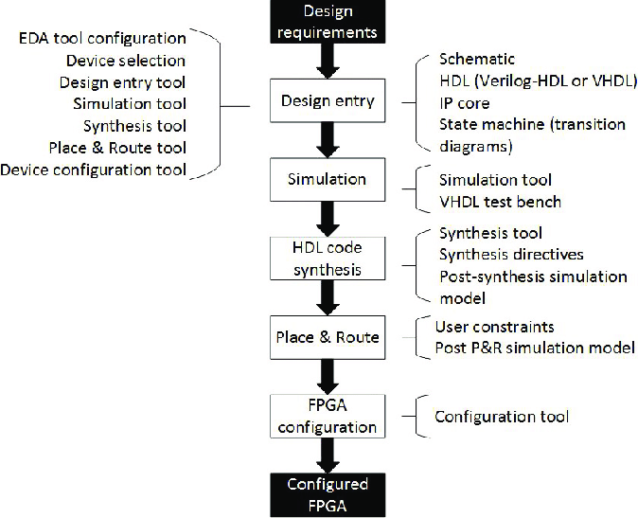
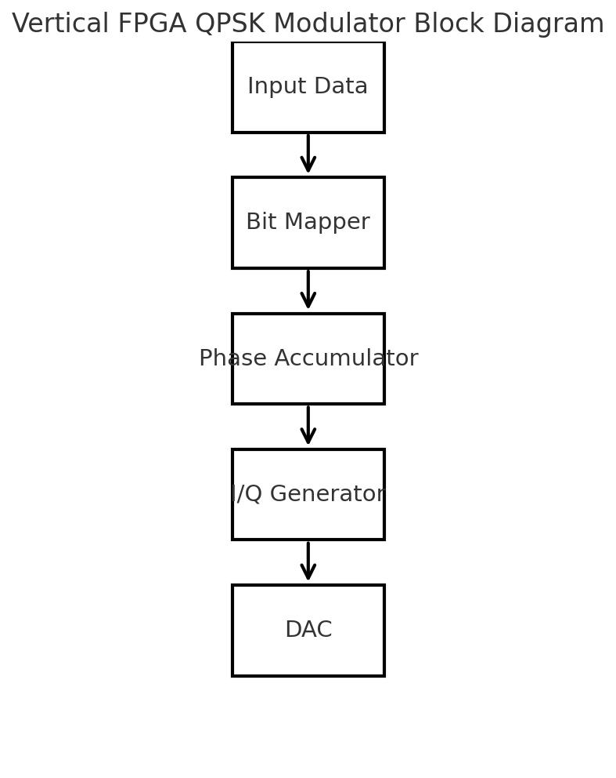
FPGA Architecture Block Diagram

Slide 8
Design Flow
Design Requirements:
Define system specs, performance targets, I/O and timing constraints.
Design Entry :
Create RTL in Verilog/VHDL (or schematic), instantiate IP cores and state machines.
Simulation:
Run functional testbenches to verify logical behavior before synthesis.
HDL Synthesis:
Translate RTL into a gate-level netlist using synthesis directives (area/speed optimizations).
Place & Route:
Map logic onto FPGA resources and route interconnects under timing/I-O constraints.
FPGA Configuration:
Generate the final bitstream and load it into the device using the configuration tool.
Configured FPGA:
Validate functionality on hardware, perform in-system testing and debugging.

Slide 9
RFSoC Overview
1. What Is an RFSoC?
All-in-one silicon: FPGA fabric + high-speed ADCs/DACs + ARM CPUs
Eliminates off-chip mixers, IF stages, and ribbon cables
2. Key Advantages
Ultra-Low Latency
  No off-chip hops—sample, process, re-generate in-chip
  Ideal for real-time beamforming, adaptive filtering, FEC
Minimal Hardware Complexity
  Fewer chips → simpler PCB, lower power, smaller BOM
  Faster time-to-prototype
3. Use Case: Direct RF QPSK Sampling
Clock ADC at RF (e.g. 2–4 GS/s) → sample 2 GHz QPSK directly
FPGA/ARM demodulate:
  Phase‐to‐bit mapping (00→45°, 01→135°, 11→225°, 10→315°)
  Filtering, synchronization, decoding all on-chip
Result: Pure digital QPSK stream—no external mixers or calibration
Use Case: Direct RF sampling of QPSK.

Slide 10
RFSoC Details
Modulator in PL
– Bit-to-phase mapping & filtering on-chip
DAC → RF Output
– Direct RF waveform generation
ADC in PL for Demodulation
– Instant digitization & symbol recovery
Core IP Blocks
– DSP Slices | BRAM | PLLs
– JESD204B SerDes | DMA

Slide 11
Conclusion
FPGA-based QPSK: Efficient, real-time space comms.
RFSoC integration: Compact, low-power solution.
Future: Optimization & satellite telemetry integration.

