Slide 1
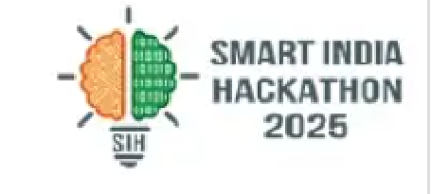
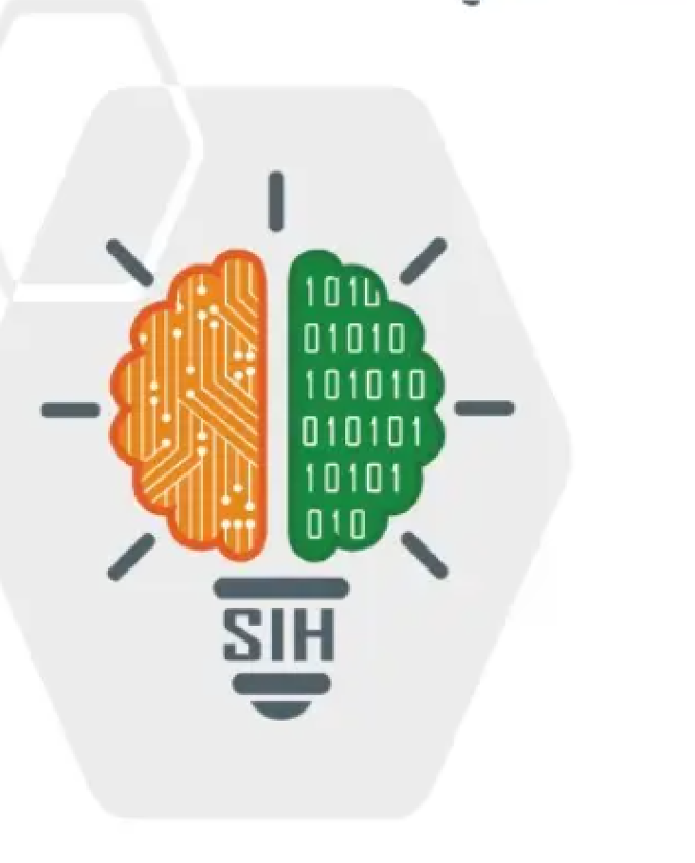
SMART INDIA HACKATHON 2025
• Problem Statement ID – [FILL: SIHXXXX]
• Problem Statement Title - Adaptive Path Planning
• and Collision Avoidance for Autonomous
• Vehicles on Unstructured Indian Roads
• Theme - Transportation & Logistics / Smart Automation
• PS Category - Software
• Team ID -
• Team Name - BharatPath
1

Slide 2
BharatPath
IDEA TITLE
• Proposed Solution :
BharatPath — closed-loop adaptive planner for unstructured Indian roads: YOLOv8n + U-Net → BEV grid → Kalman + DQN prediction → Frenet lattice + safety-bubble filter → bicycle-model control, validated on 5 seeded scenarios.
Solution overview :
Addressing the Problem :
• Early collision-free path in lane-less, mixed traffic (autos, bikes, pedestrians, cattle).
• Helps ego yield, overtake, brake with visible replan (green chosen / red rejected).
PERCEPTION: YOLOv8n + U-Net → BEV 128×128
▼ PREDICTION: Kalman CV + DQN head (8 agents × 5 steps)
▼ PLANNING: Frenet lattice (12 paths) + cost + SAT check
▼ SAFETY: Bubble-1 decel / Bubble-2 e-brake / rear veto
▼ CONTROL: bicycle model + pure-pursuit → metrics HUD
• DQN + lattice + adaptive bubbles for non-lane motion.
• Real IDD perception feeding planner (ONNX, CPU).
• Dashboard + alerts: replan ms, TTC, action tags.
2

Slide 3
BharatPath
TECHNICAL APPROACH
Technologies :
Step I: Scenario + IDD data set
Perceive
BEV grid @10Hz + 12-class boxes
• Frontend/viz: Three.js HUD + pygame sim (60 fps interp).
Step II: Preprocess — detect + segment → BEV
• Backend: Python planner @20Hz, physics @50Hz, WS /state.
Step III: Train/predict — Kalman + DQN trajectory
• AI/ML: YOLOv8n (12 IDD classes), U-Net road-seg, Dueling Double DQN + PER + BC.
BEV +TRACKS
Predict
8 agents × 5 steps @1s horizon
• Fusion: 9-ch geometry → BEV occupancy + Kalman tracker.
Step IV: Lattice plan + bubble safety filter
• Control: kinematic bicycle + pure-pursuit; SAT collision.
Step V: Metrics + HUD (ms, TTC, jerk, completion)
Replan
12 paths, p95 <50ms, 0 collisions
3

Slide 4
BharatPath
FEASIBILITY AND VIABILITY
Feasibility :
5-scenario validation matrix (seeded, repeatable):
• Time-feasible – scenario YAMLs → train → dashboard in 3-week sprint.
Scenario | Trigger | Success
S1 village, no lanes | cow steps in @t=8s, 15m | pass, stop<3s, 0 hits
S2 intersection, no signal | 2 autos + bike @t=5,7s | yield, clear <30s
S3 highway merge | truck merges @t=6s + tailgater | overtake, TTC>2s
S4 market shared space | cart @t=10s + 3 peds | horn + crawl <10kmph
S5 cattle sprint (emergency) | cow sprints @t=7s, 20m | e-brake, gap >2m
• Scalable – density budgets per scenario; ONNX swaps in/out.
• Low cost – open-source (Ultralytics, ONNX, Three.js), CPU-only.
• Modular design – perception / planning / control update independently.
• Challenges: perception latency → last-grid fallback • DQN risk → safe-heuristic flag • Offline stage → vendored three.min.js + backup video • MATLAB ask → semantics-identical Python (report §7).
4

Slide 5
BharatPath
IMPACT AND BENEFITS
Impacts :
Metrics (eval/run_all.py — 5 scenarios × 3 seeds):
• Collision-free runs across 5 scenarios (target 15/15 seeded).
• Visible replanning builds judge/trust + regulator confidence.
• Smooth paths (low jerk) cut fuel use and near-misses.
• CPU-only stack deployable in colleges / fleets.
Metric | Target | How measured | Status
Collisions | 0 | SAT check/log | fill: eval
Replan p95 | <50ms | perf_counter | fill: eval
Min TTC | >2s | BEV rollout | fill: eval
Jerk RMS | low | accel clamp log | fill: eval
Completion | 100% | route dist % | fill: eval
Social
• Saves lives → alerts + e-brake (SMS/Dashboard).
• Trust via real-time monitoring.
Environmental
• Fewer hard brakes → less fuel/tyre wear.
• Diversion over destruction in alerts.
Economic
• Zero-crash demo; reuses open weights + sim.
Demo order: S5 (drama first) → S1 → S3 → S2 → S4. HUD shows speed, action tag (e.g. YIELD_TO_PEDESTRIAN), replan ms, TTC.
5

Slide 6
BharatPath
RESEARCH AND REFERENCES
A. Research
• IDD (idd20kII) shows lane-less mixed traffic needs beyond lane-geometry planners; our 12-class YOLO + road-seg covers autos, bikes, pedestrians, animals.
• Dueling Double DQN + PER with trajectory head fuses learned residuals over Kalman CV baseline (pred = CV + λ·DQN).
• Frenet lattice + SAT safety-bubble veto gives auditable replan vs black-box steering.
• MathWorks mapping: RoadRunner↔YAML scenes, AD Toolbox↔BEV fusion, Nav Toolbox↔lattice, Stateflow↔choose_bot_action, bicycle model, DL Toolbox↔YOLO/U-Net/DQN.
B. References
1. IDD dataset (idd20kII) + devkit; 2. Ultralytics YOLOv8 / MobileSAM; 3. U-Net road segmentation (BCE+Dice);
4. Dueling Double DQN + Prioritized Replay; 5. SIH problem-statement + evaluation rubric (5 scenarios, latency/smoothness/completion);
6. Demo: [FILL video link] Repo: [FILL github link]
6

