Slide 1
CSE7000 - INTERNSHIP A Presentation on Secure Apache SolrCloud with Apache Ranger–Based Authorization and Software Supply Chain Security
Student Details
Name | S Anupriya
Roll No | 20241CSE0682
Section | 5CSE09
Under the Supervision of,
Mr. Mithun H S
Associate Professor
Presidency School of Computer Science and Engineering
Presidency University
Name of the Program: B. Tech (CSE)
Name of the HoD: Dr. Nagaraja S R
Name of the Program Internship Coordinator: Ms. Vidhya Rengasamy
Name of the School Internship Coordinators: Dr. Bhuvaneshwari Patil

Slide 2
Content
About Company or Organization
Working domain or the Technology
Objectives of the work
Methodology Used / Course Description
Results (Optional)
Conclusion

Slide 3

About PointCross Life Sciences
PointCross Life Sciences is a wholly owned subsidiary of PointCross Inc. and provides technology
solutions for the life sciences and BioPharma industry, with a focus on managing, standardizing,
analyzing, visualizing, and automating clinical and nonclinical study data.
Company Overview
Provides Clinical Data Automation and regulatory data solutions for drug development and works across clinical and nonclinical research data.
Focuses on data standardization, harmonization, regulatory readiness, analytics, and visualization.
Has a global presence with offices in the United States, France, and India.
The India engineering office is located in Bengaluru.
Its solutions are used by pharmaceutical, biotechnology, and Contract Research Organization (CRO) customers.
Mission
To increase researchers' access to and utility of data by integrating information generated across discovery, preclinical, and clinical research and helping accelerate the progression from scientific observation to intervention.

Slide 4
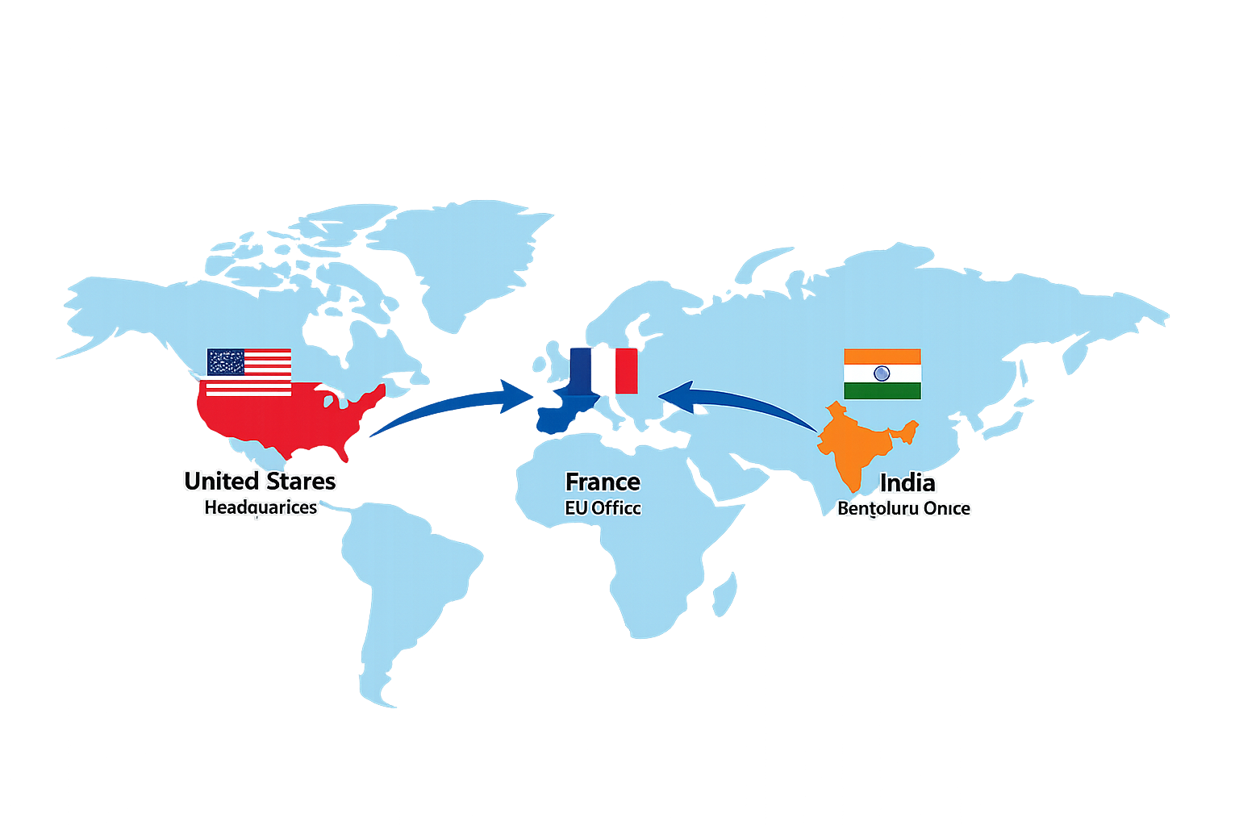
Product and Solutions
Xbiom™ – Clinical Data Automation Platform
PointCross's primary platform for managing and automating clinical and nonclinical study data. Its capabilities include:
Data ingestion, exchange, and curation
Metadata management and transformation
Data standardization and harmonization
Clinical and nonclinical analytics
Regulatory data preparation
Submission-ready SEND, SDTM and Define.xml workflows
eDataValidator™
A validation solution supporting regulatory datasets, including:
SEND
SDTM
It assists with validation and regulatory submission readiness.
Customers / Industry Reach
PointCross serves organizations across the BioPharma ecosystem, including:
Pharmaceutical Companies • Biotechnology Companies • Contract Research Organizations (CROs)

Slide 5
Working domain or the technology
Working Domain: DevSecOps & Enterprise Application Security
Key Technologies:
Apache Solr / SolrCloud – Search and indexing platform
Apache Ranger – Authorization, access-control policies & auditing
Docker – Containerized deployment and testing
REST APIs – Service integration and security testing
Git & GitHub – Version control and project management
Supporting Security Technologies: SBOM • Syft • Grype • OWASP Dependency-Track

Slide 6
Objectives of the work
Secure Apache Solr using authentication and authorization mechanisms.
Integrate Apache Ranger with Solr for centralized policy-based access control.
Configure different access permissions for admin and regular users.
Control query and update operations according to defined Ranger policies.
Implement audit logging to capture allowed and denied access attempts.
Validate authorization by performing positive and negative access tests.
Monitor SolrCloud collections, nodes, shards and replicas.
Develop a web-based security dashboard for centralized monitoring.
Display Ranger policies, users, permissions and audit events through the dashboard.
Verify that security policies are correctly enforced at the Solr resource level.
Gain practical experience with enterprise security and DevSecOps practices.

Slide 7
Methodology Used
System Setup & Configuration
Set up Apache Solr in SolrCloud mode for search and indexing.
Configured the required Solr collection, shard and replica.
Enabled Basic Authentication to secure access to Solr.
Integrated Apache Ranger as the authorization mechanism.
Configured the Ranger Solr service for centralized security management.
Established communication between Solr, Ranger and ZooKeeper.
Verified the environment and service connectivity before security testing.
USER → SOLR → AUTHENTICATION → RANGER AUTHORIZATION → SOLR RESOURCE

Slide 8
Policy & Access Control
Created Ranger authorization policies for Solr resources.
Defined permissions for schema, configuration, administration and collections.
Configured different access privileges for admin and test users.
Granted the administrator query and update permissions.
Restricted the test user to query-only access on collections.
Enabled audit logging for monitoring authorization decisions.
Used Ranger policies to enforce least-privilege access control.
User | Query | Update
Admin | ✅ Allowed | ✅ Allowed
Test User | ✅ Allowed | ❌ Denied

Slide 9
Testing & Monitoring
Tested Solr APIs using authenticated requests.
Performed positive and negative authorization testing.
Verified that the test user could successfully perform a query (HTTP 200).
Verified that an unauthorized update by the test user was blocked (HTTP 403).
Confirmed that the administrator could successfully perform query and update operations (HTTP 200).
Verified the authorization results through Apache Ranger audit logs.
Developed a web-based security dashboard to display:
SolrCloud health and collections
Ranger policies
User permissions
Allowed and denied audit events
Cross-verified frontend information with the underlying Solr and Ranger services.
Final Methodology Flow
CONFIGURE → SECURE → DEFINE POLICIES → TEST ACCESS → AUDIT → MONITOR

Slide 10
SecureSolr
React Dashboard
|
-------------------
| |
Apache Solr Apache Ranger
SolrCloud Ranger Admin
| |
| Ranger Policies
| |
+---- Authorization ----+
|
Audit Logs
|
Ranger Audit Solr
Supporting Services:
ZooKeeper | PostgreSQL | Docker Compose
Security Validation:
Syft → SBOM → Dependency-Track / Grype
The complete environment was deployed as interconnected Docker containers. Apache Ranger provides centralized authorization for Solr resources, while audit events are stored and displayed through the SecureSolr dashboard.

Slide 11
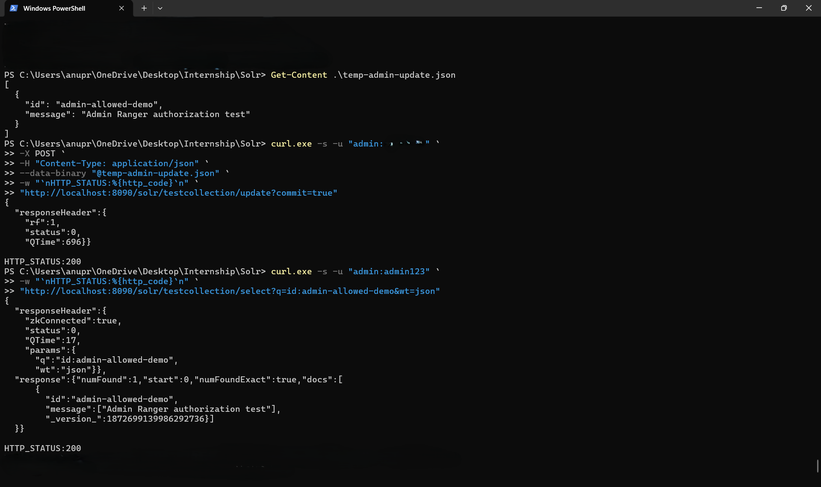
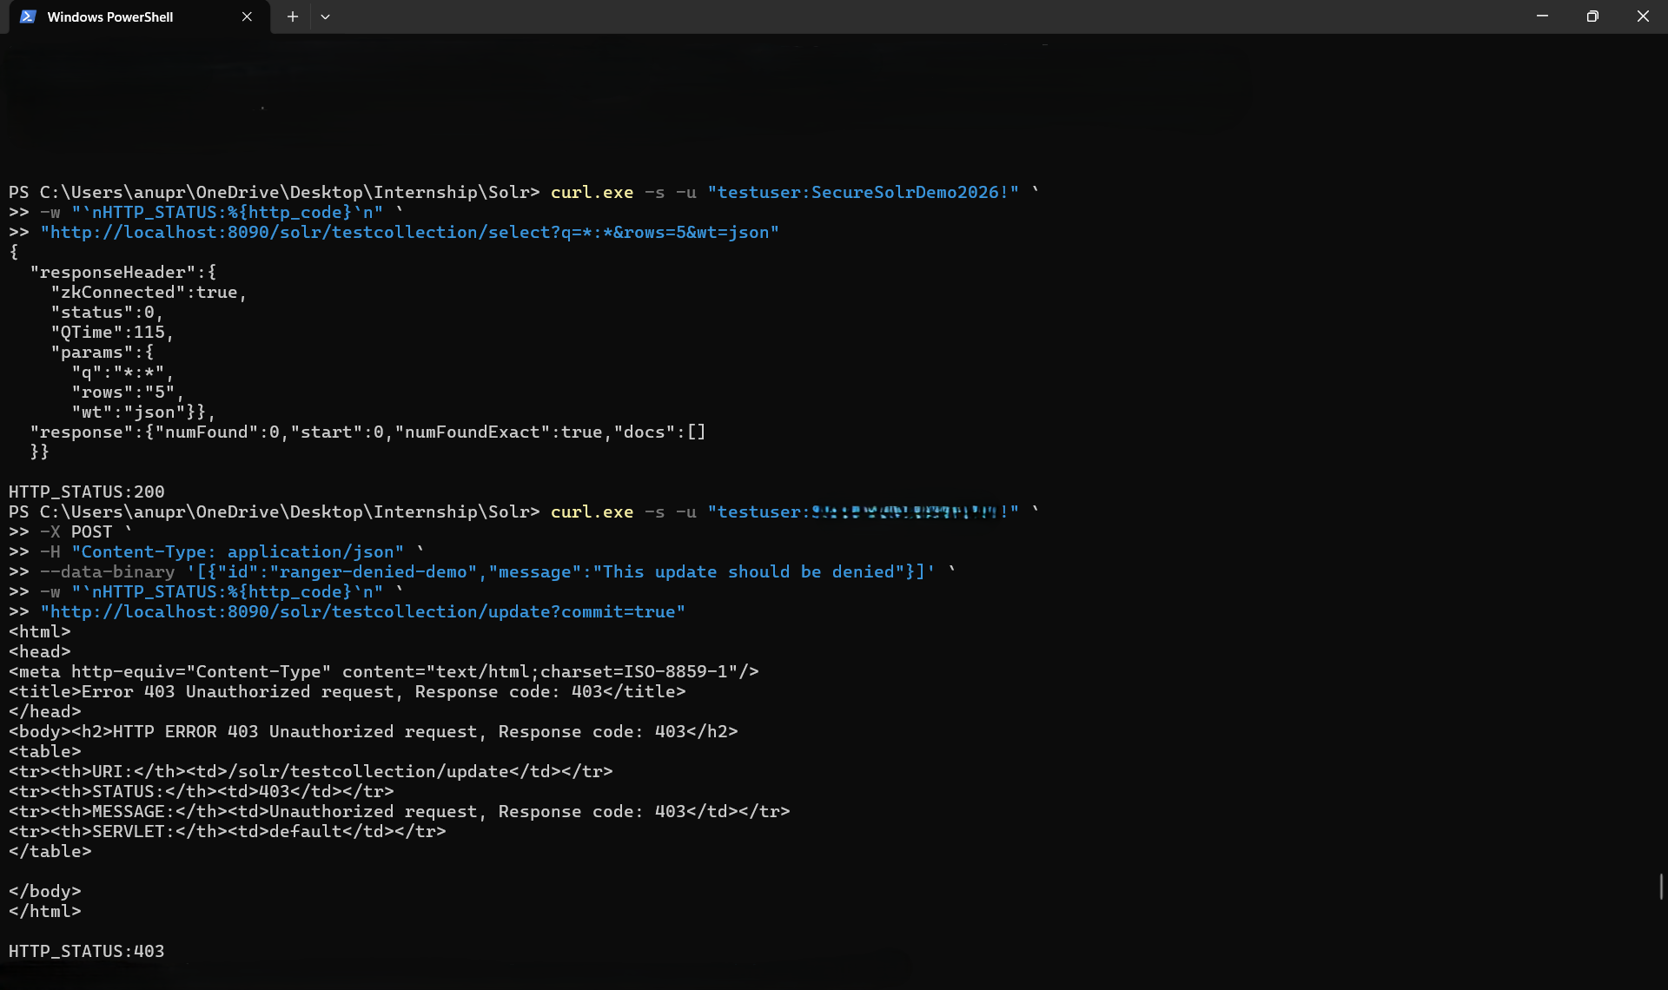
Results
Test User: Query Allowed (HTTP 200) | Update Denied (HTTP 403)
Admin: Query & Update Allowed (HTTP 200)

Slide 12
Security & Audit Validation
Role-Based Authorization
Administrator successfully performed query and update operations.
Test user successfully performed query operations.
Unauthorized test-user updates were denied with HTTP 403.
Audit Logging
Allowed and denied operations were recorded by Apache Ranger.
Audit records captured user, resource, action, result, policy and timestamp.
Software Supply Chain Security
SBOM generated in CycloneDX and SPDX formats.
SBOM analyzed using OWASP Dependency-Track.
Security validation evidence maintained within the project repository.

Slide 13
Conclusion
Successfully implemented a secure and containerized Apache SolrCloud environment.
Integrated Apache Ranger for centralized policy-based authorization and access control.
Successfully validated role-based permissions through allowed and denied operations.
Implemented audit logging to track and monitor security events.
Developed the SecureSolr dashboard for centralized monitoring of Solr and Ranger.
Generated CycloneDX and SPDX SBOMs and performed security analysis using OWASP Dependency-Track.
Applied practical concepts of container security, vulnerability management, access control and software supply chain security.
Gained hands-on experience with enterprise software development and DevSecOps practices.
The internship provided practical experience in building, securing, testing and monitoring an enterprise application using modern DevSecOps and security technologies.

Slide 14
Q&A

Slide 15
Thank you !!

