Slide 1
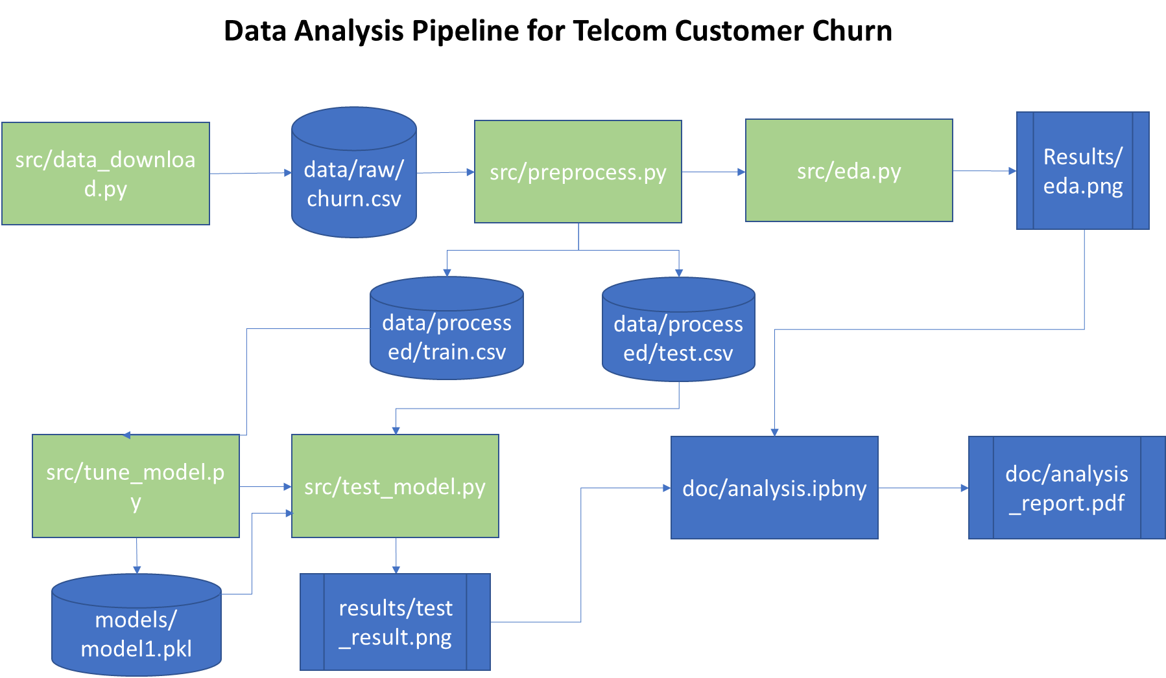

Slide 2
Data Analysis Pipeline for Telcom Customer Churn
data/raw/churn.csv
src/preprocessed.py
src/eda.py
Results/eda.png
src/data_download.py
data/processed/train.csv
data/processed/test.csv
src/tune_model.py
src/test_model.py
doc/analysis.ipbny
doc/analysis_report.pdf
models/
model1.pkl
results/test_result.png

