Slide 1

Project Title - Seasonal Agriculture Performance Analysis
[Student Name : Anupriya
College Name : Vellore Institute of Technology ]
AICTE STU ID : (STU6a0f18aad427b1779374250 )

Slide 2

PROBLEM STATEMENT
(Agricultural activities are influenced by seasonal variations in environmental conditions, farming practices, resource availability and market conditions. As a result, agricultural performance may differ from one season to another. However, raw agricultural data does not clearly explain how agricultural performance changes across seasons or what patterns can be observed in different seasonal conditions. The problem is to analyze the given agricultural dataset and investigate seasonal differences in agricultural performance by identifying meaningful patterns, trends, relationships and variations within the available data.

Slide 3
Project Description
The Seasonal Agriculture Performance Analysis project is a data analytics project developed using Python in Google Collab to understand how agricultural performance varies across different seasons. The project uses an agricultural dataset containing information about farming activities, environmental conditions, crop production, resource utilization, geographical factors, and economic performance. The analysis begins with importing and examining the dataset using Python libraries such as Pandas and NumPy, followed by data cleaning to handle missing values, duplicates, inconsistent data, and unsuitable data types.
Exploratory Data Analysis is then performed using Matplotlib and Seaborn to identify seasonal patterns and compare agricultural performance across different periods. The project analyzes factors such as crop yield, production, rainfall, temperature, irrigation, fertilizer usage, revenue, cost, and profit wherever available. Different visualization techniques, including bar charts, line graphs, box plots, scatter plots, and heatmaps, are used to present meaningful insights.
Correlation analysis and appropriate statistical techniques are applied to investigate relationships between seasonal conditions and agricultural outcomes. Regional and crop-wise comparisons are also performed to identify variations and unusual patterns. Finally, the project summarizes key findings and provides evidence-based recommendations for better seasonal agricultural planning, with the complete analysis documented in a Google Colab notebook.

Slide 4

WHO ARE THE END USERS?
The main end users of the Seasonal Agriculture Performance Analysis project are:
Farmers – to understand seasonal crop performance and improve farming decisions.
Agricultural planners and experts – to identify seasonal trends and plan agricultural activities.
Government departments and policymakers – to support evidence-based agricultural policies and resource planning.
Agricultural researchers – to study relationships between environmental conditions, farming practices, and crop outcomes.
Agribusinesses and organizations – to understand production and economic patterns across seasons.
Agricultural students and analysts – to explore agricultural data and develop data-driven insights.
Primary End Users: Farmers, agricultural planners, researchers, and government agricultural departments.

Slide 5

Technology Used
Google Collab – Development and execution environment.
Python – Programming language used for data analysis.
Pandas – Data cleaning, manipulation, and analysis.
NumPy – Numerical computations and data processing.
Matplotlib – Data visualization and graphical representation.
Seaborn – Statistical visualizations and trend analysis.
SciPy – Statistical analysis and hypothesis testing.

Slide 6
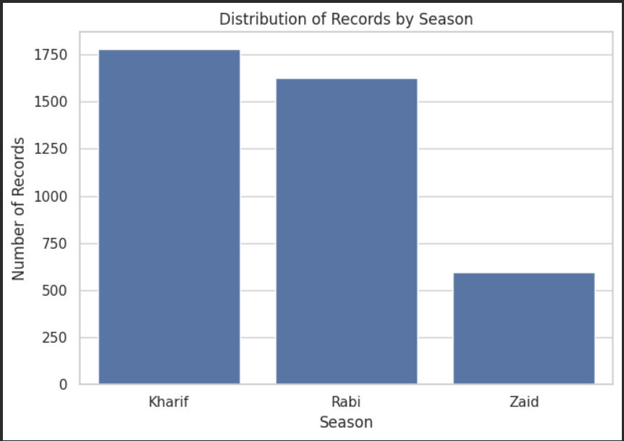
RESULTS
The graph shows the distribution of agricultural records across seasons:
Kharif has the highest number of records, around 1,770.
Rabi has around 1,620 records.
Zaid has the lowest, with around 590 records.
Interpretation: The dataset contains significantly more Kharif and Rabi observations than Zaid observations, so seasonal comparisons involving Zaid should be interpreted carefully due to its smaller sample size.

Slide 7
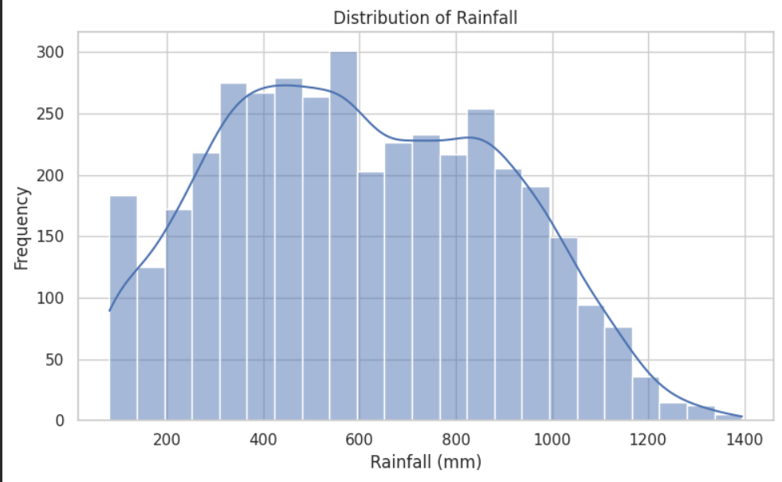
RESULTS
The graph shows the distribution of rainfall in the dataset:
Rainfall values range approximately from 100 mm to 1,400 mm.
Most observations are concentrated between 300 mm and 1,000 mm.
The highest frequency is around 500–600 mm.
Very high rainfall values above 1,200 mm occur less frequently.
Interpretation: Rainfall varies considerably across the agricultural records, with most farms experiencing moderate rainfall levels.

Slide 8
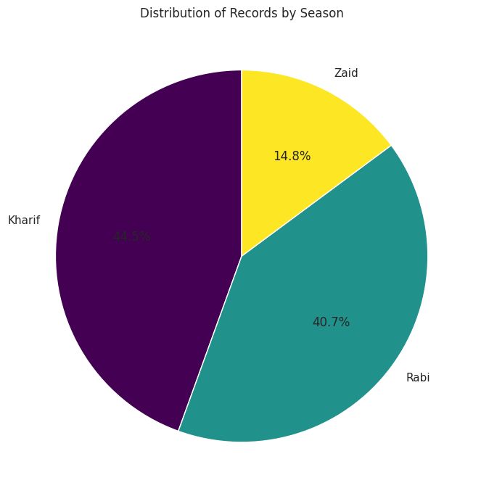
RESULTS
The pie chart shows the percentage distribution of agricultural records by season:
Kharif: 44.5% — highest share of records.
Rabi: 40.7% — second-highest share.
Zaid: 14.8% — lowest share.
Interpretation: Kharif and Rabi together account for the majority of the dataset (85.2%), while Zaid represents a smaller portion. Therefore, seasonal comparisons involving Zaid should be interpreted carefully due to its lower representation.

Slide 9
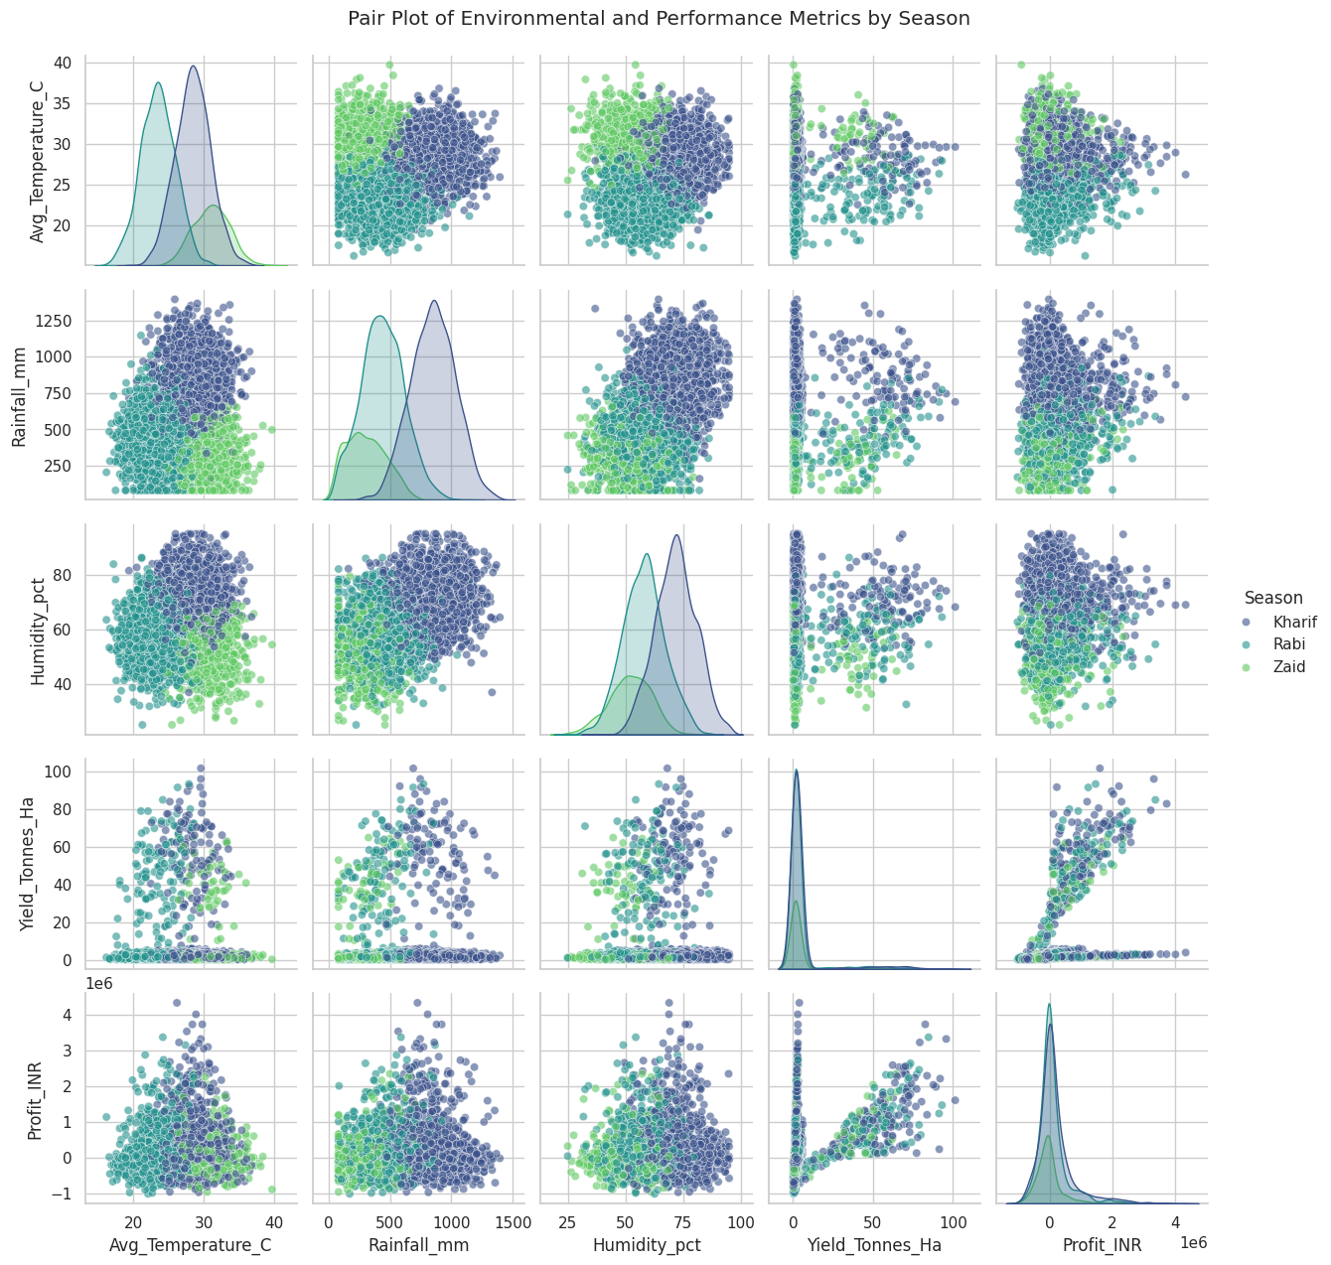
RESULTS
This pair plot shows relationships among temperature, rainfall, humidity, yield, and profit, separated by season.
Temperature: Kharif generally has higher temperatures, while Rabi and Zaid show different temperature distributions.
Rainfall: Kharif has generally higher rainfall, whereas Zaid has comparatively lower rainfall.
Humidity: Kharif tends to show higher humidity compared with the other seasons.
Yield: Most yield values are concentrated at lower levels, with some observations showing much higher yields.
Profit: Profit varies considerably, with most observations concentrated near lower profit values.
Yield vs Profit: There appears to be a - positive relationship—higher yield is generally associated with higher profit.
Seasonal patterns: The colors show that environmental conditions and agricultural performance differ noticeably among Kharif, Rabi, and Zaid.
Overall interpretation: The plot indicates that seasonal environmental conditions are associated with differences in agricultural yield and profitability, but these relationships do not prove causation.

Slide 10
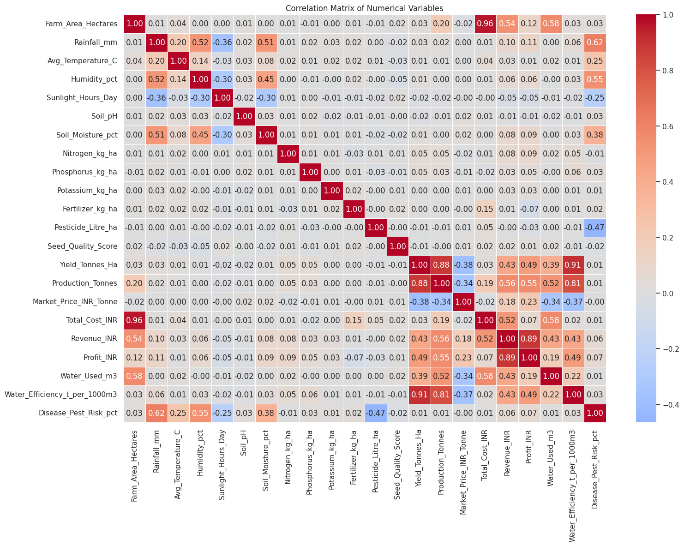
RESULTS
Correlation Matrix – Short Explanation
The correlation matrix shows the relationships between numerical agricultural variables.
Yield and Production: Strong positive correlation (0.88), meaning higher yield is generally associated with higher production.
Yield and Water Efficiency: Very strong positive correlation (0.91), indicating that higher yield is strongly associated with better water efficiency.
Revenue and Profit: Strong positive correlation (0.89), showing that higher revenue is generally associated with higher profit.
Farm Area and Total Cost: Very strong positive correlation (0.96), indicating that larger farms generally have higher total costs.
Production and Water Efficiency: Strong positive correlation (0.81).
Rainfall and Disease/Pest Risk: Moderate positive correlation (0.62).
Pesticide Usage and Disease/Pest Risk: Moderate negative correlation (-0.47).
Sunlight and Rainfall: Moderate negative correlation (-0.36).
Overall Interpretation: The matrix highlights important relationships among agricultural production, yield, resources, environmental conditions, and economic performance. However, these correlations show association, not causation.

Slide 11
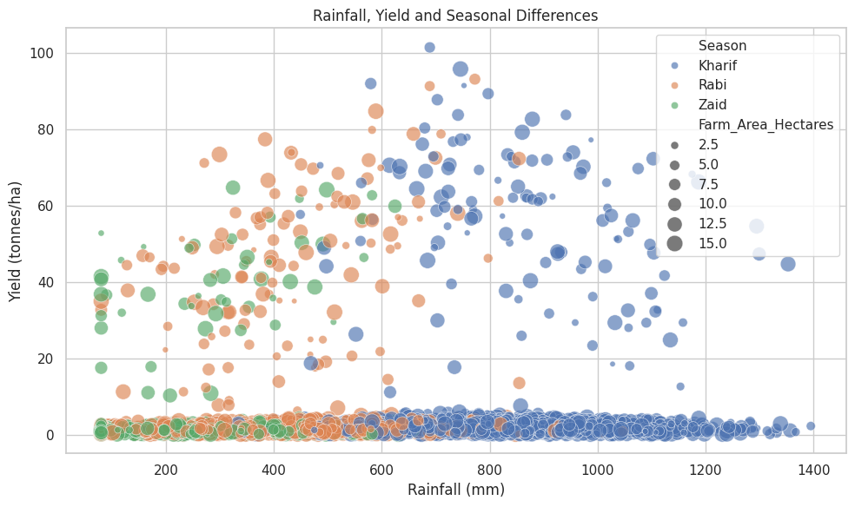
RESULTS
Rainfall, Yield and Seasonal Differences – Short Explanation
The scatter plot shows the relationship between rainfall and crop yield across Kharif, Rabi, and Zaid seasons.
Kharif generally has higher rainfall, with several observations showing higher yields.
Rabi covers a wide range of rainfall and yield values, showing considerable variation.
Zaid generally occurs at lower rainfall levels, with moderate yield values.
The plot suggests that higher rainfall does not always result in higher yield, as many observations have low yields even with substantial rainfall.
Larger bubbles represent farms with larger farm areas.
Overall Interpretation: Seasonal conditions and rainfall are associated with differences in crop yield, but rainfall alone does not determine yield. Other factors such as crop type, soil conditions, irrigation, and farming practices may also influence agricultural performance.

Slide 12
Future scope
The future scope of the Seasonal Agriculture Performance Analysis project includes:
Predictive Analysis: Use machine learning to predict crop yield and agricultural performance for upcoming seasons.
Weather Integration: Incorporate real-time weather data such as rainfall, temperature, and humidity for better seasonal predictions.
Crop Recommendation: Develop a system that recommends suitable crops based on season, soil, and environmental conditions.
Resource Optimization: Predict and optimize the required amount of water, fertilizer, and other resources.
Regional Analysis: Expand the analysis to more geographical regions to identify location-specific agricultural patterns.
Market Prediction: Include market prices to predict potential revenue and profitability.
Interactive Dashboard: Develop a dashboard using tools such as Power BI, Tableau, or Streamlit for real-time visualization.
AI-Based Decision Support: Build an intelligent system that provides data-driven recommendations to farmers and agricultural planners.

Slide 13
GitHub Link
https://github.com/Anupriya39/Seasonal-Agriculture-Performance-Analysis

Slide 14

VOIS Course completion certificate - Course name- Data Visualization

Slide 15
Thank you
.
.

