Slide 1

MediTrack–Transforming Pharmacy Data into Actionable Insights
PROJECT PRESENTATION :
Phase 1 — Python, Data Analysis & SQL
Phase 2 — Power BI Dashboard & Insights
Presented by: Anupriya S

Slide 2
Project Overview & Problem Statement
Problem
Proposed solution
The MediTrack dataset contains records related to prescriptions, medicines, stock levels and payment status. Looking at these records individually makes it difficult to understand patterns and identify useful information
We use Python to explore, clean and analyse the MediTrack dataset. SQL helps us retrieve useful information, while Power BI presents the results in an interactive dashboard.
Project question
How can we analyse the MediTrack dataset to better understand prescription activity, medicine demand, stock levels and payment status?

Slide 3
Objectives & Scope
• Inspect the dataset structure, data types, missing values and duplicates.
• Clean the data using appropriate handling for missing values, duplicates and data types.
• Create 8–10 charts in Python to explore key fields and relationships.
• Use required SQL operations to filter, group, sort and aggregate data.
• Build a Power BI dashboard with KPI cards, visuals and interactive slicers.
• Summarise observations and validate dashboard totals against the cleaned dataset.
Phase 1
Python + Pandas + Matplotlib/Seaborn + SQL
Phase 2
Power BI + DAX measures + slicers

Slide 4
End-to-End Workflow & Data Flow
SYSTEM WORKFLOW
1
2
3
4
5
6
Dataset
Inspect & clean
Explore
Query
Model & visualise
Review
meditrack_dataset.csv
Pandas / Google Colab
10 Python charts
SQL operations
Power BI / DAX
Insights + validation

Slide 5
Technology Stack & Implementation
TOOLS USED ACROSS BOTH PHASES
Python + Pandas
Matplotlib + Seaborn
SQL
Dataset inspection, dataframe operations and cleaning.
10-chart exploratory analysis dashboard.
SELECT, WHERE, ORDER BY, GROUP BY, HAVING, DISTINCT and aggregate functions.
Google Colab / Jupyter
Power BI
DAX
Notebook-based execution of Python analysis.
KPI cards, charts, slicers and report pages.
Measures for quantity, low-stock row count and payment-status percentage.

Slide 6
Phase 1 — Data Exploration & Visualisation
PYTHON ANALYSIS
Preparation workflow
Fields used in the provided chart code
Load the MediTrack dataset from a CSV file using Pandas.
Check the number of rows and columns, column names, data types, missing values and duplicate records.
Clean the data by handling missing values, duplicates and data types where needed.
Use the cleaned dataset for visualisation and further analysis.
PaymentStatus: Compare payment counts and total amounts by payment status.
MedicationName & DoctorName: Identify the top 10 medicines and doctors by record count.
TotalAmount: Understand the distribution of amounts and compare amounts across payment statuses.
StockQuantity: Explore stock levels and identify records with low stock.
Quantity & UnitPrice: Examine the relationship between quantity and amount, and understand the distribution of medicine prices.

Slide 7
Phase 1 — Dataset & Cleaning
Dataset size
Duplicate rows
After notebook cleaning
20,000 rows × 15 columns
0 exact duplicate rows found in the raw CSV
20,000 rows × 15 columns; no nulls remain in the listed fields
• Missing values in PatientName were filled with “Unknown”.
• Phone, DOB and ExpiryDate missing values were filled with “Not Available”.
• Missing StockQuantity values were filled with the median.
• Numeric fields were converted to numeric types; DateIssued was converted to datetime.
• Raw CSV missing values: PatientName 2048; DOB 1999; Phone 1949.
• Other raw missing values: ExpiryDate 1990; StockQuantity 1977.
• No rows were removed by duplicate removal because no exact duplicate rows were found.

Slide 8
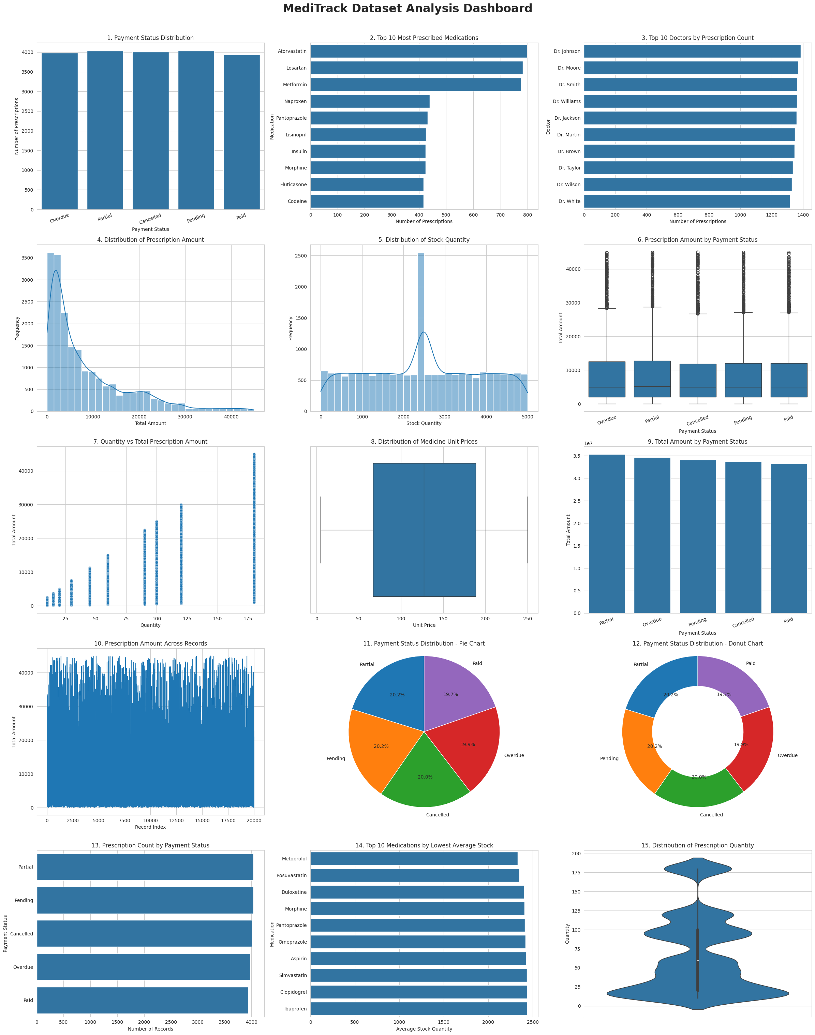
Phase 1 — Actual Python Chart Output

Slide 9
Phase 1 — SQL Analysis
Required operations
Analysis use
Core query operations
• SELECT — choose columns
• WHERE — filter rows
• ORDER BY — sort results
• DISTINCT — return unique values
• GROUP BY — aggregate by category
• HAVING — filter grouped results
Aggregate functions
• COUNT() — count records
• SUM() — calculate totals
• AVG() — calculate averages
• MIN() / MAX() — inspect range
8

Slide 10
Phase 2 — Power BI Dashboard
Total Prescriptions
Total Quantity
Total Amount
Average Prescription Value
Low-Stock Records
20K
1M
171.06M
8.55K
2K
Displayed, rounded
Displayed, rounded
Displayed, rounded
Displayed, rounded
Displayed, rounded
Interactive controls confirmed
Separate report page confirmed
Medication slicer and Payment Status slicer were tested and reported to work.
Payment Analysis page contains a donut chart for Payment Status Distribution with labels enabled.
9

Slide 11
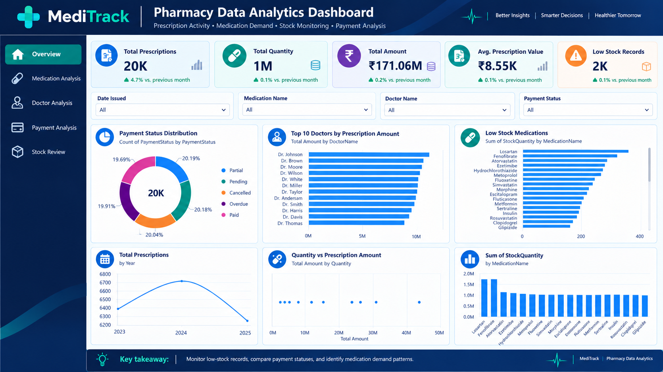

Slide 12
Phase 2 — DAX Measures & Stock Review
Total Quantity
Low Stock Count
Total Quantity = SUM(meditrack_dataset[Quantity])
Counts rows where StockQuantity < 100; it does not count distinct medication names.
Payment Status %
Low-stock visual
Uses row count divided by the row count after removing only the PaymentStatus filter. Other active filters remain in effect.
Medication on X axis and StockQuantity on Y axis, filtered to stock below 100; title: “Low-Stock Medications (Stock Below 100)”.
10

Slide 13
Current Observations & Business Value
• The Power BI KPI cards show approximately 20K prescription records, 1M quantity, 171.06M total amount, 8.55K average prescription value and 2K low-stock records.
• The Payment Analysis donut chart was observed to show Partial as the largest payment-status portion under the current report filters/data.
• The low-stock chart focuses attention on records with StockQuantity below 100.
• Medication and payment-status slicers allow users to inspect subsets of the report.
Business value
A single report makes key activity measures easier to review and compare.
Important limitation
These are descriptive observations, not proof of causation or a forecast.
11

Slide 14
Conlusion
Analyzed the MediTrack pharmacy dataset using Python, SQL, and Power BI.
Studied prescription amounts, payment status, and medicine stock quantities.
Created charts and KPI cards to understand the data easily.
Identified medicines with low stock to help monitor inventory.
This project helped me understand how data analytics can support better pharmacy management and decision-making.

Slide 15
THANK YOU

