Slide 1
MACHINE LEARNING PROJECT
Credit Card Fraud
Detection System
A hybrid approach combining Logistic Regression and Isolation Forest to identify suspicious transactions and strengthen financial security.
Problem Definition
Dataset & EDA
Preprocessing
Modeling

Slide 2
PROBLEM DEFINITION
What We're Solving, and Why It Matters
1
3
What problem are we solving?
Who will use the solution?
Identifying fraudulent credit card transactions in real time, separating them from the overwhelming majority of legitimate purchases.
Banks, payment processors, and fraud-risk teams who need to flag suspicious transactions before funds are lost.
2
4
Why is this problem important?
What is the expected output?
Fraud causes direct monetary losses for banks and cardholders, and undetected fraud erodes trust in digital payment systems.
For each transaction, a classification — legitimate or fraudulent — plus an anomaly score highlighting unusual behavior.

Slide 3
ABSTRACT
Project Overview
Core Techniques
Credit card fraud is a major financial security problem that can cause significant monetary losses for both customers and financial institutions. This project presents a machine learning-based Credit Card Fraud Detection System using Logistic Regression and Isolation Forest anomaly detection techniques. Logistic Regression is used as a supervised classification model to identify transactions as legitimate or fraudulent based on patterns learned from historical transaction data. Isolation Forest is applied as an unsupervised anomaly detection method to identify unusual transactions that significantly differ from normal transaction behavior. The dataset is preprocessed by handling missing values, scaling numerical features, and addressing the highly imbalanced nature of fraud detection data. The performance of the models is evaluated using metrics such as accuracy, precision, recall, F1-score, confusion matrix, and ROC-AUC. By combining supervised classification with anomaly detection, the proposed system aims to improve the identification of suspicious transactions and provide a more reliable approach to detecting credit card fraud. This project demonstrates how machine learning can be effectively applied to enhance financial transaction security and reduce fraudulent losses.
Logistic Regression
Supervised classification of legitimate vs. fraudulent transactions
Isolation Forest
Unsupervised detection of anomalous transaction behavior
Evaluation Metrics
Accuracy
Precision
Recall
F1-Score
Confusion Matrix
ROC-AUC

Slide 4
DATASET COLLECTION
Sourcing and Understanding the Dataset
Source
Kaggle — “Credit Card Fraud Detection” dataset, released by the Machine Learning Group at ULB (Université Libre de Bruxelles). Downloaded as a single CSV file for offline analysis.
Dataset Schema
Time
Seconds since first transaction
Target / Output Column
V1 – V28
Anonymized PCA components
Class — a binary label: 0 for a legitimate transaction, 1 for a fraudulent one. This is the column the models are trained to predict.
Amount
Transaction value ($)
Feature Columns
Class
Target: 0 = legitimate, 1 = fraud
Time and Amount describe the raw transaction, while V1–V28 are anonymized, PCA-transformed features protecting cardholder privacy.
284,807
31
Rows
Columns

Slide 5
DATA UNDERSTANDING
Getting to Know the Dataset
284,807
31
Numeric
Records
Features (incl. target)
Data Types (all float / int)
0
1,081
2
Missing Values
Duplicate Rows
Unique Classes
Statistical Summary & Distributions
df.describe() shows Amount ranging from $0 to $25,691 (right-skewed, mean ≈ $88); Time spans ~48 hours; most V1–V28 features are centered near 0 with unit-scale variance — explored visually in the EDA section.

Slide 6
DATA PREPROCESSING
Cleaning and Preparing the Data
1
Missing Values
2
Duplicate Records
Checked with df.isnull().sum() — none found, so no imputation was required.
1,081 duplicate rows identified and removed with drop_duplicates() to prevent data leakage.
3
Outliers
4
Incorrect Data
Extreme Amount values reviewed via boxplots; retained since large transactions can be genuine fraud signals.
Verified Time and Amount are non-negative and Class contains only {0, 1}, with no invalid entries.
5
Categorical Variables
6
Numerical Variables
None present — all features are numeric, so no encoding step was needed.
Time and Amount were standardized with StandardScaler so their scale matches the already-scaled V1–V28 features.

Slide 7
EXPLORATORY DATA ANALYSIS
Class Imbalance at a Glance
Class Distribution
1
Severe Class Imbalance
Roughly 492 fraud cases out of 284,807 transactions — models need resampling or weighting to avoid bias.
2
PCA-Transformed Features
Features V1–V28 are anonymized principal components, already decorrelated and roughly scaled.
3
Raw-Scale Outliers
'Time' and 'Amount' remain in their original scale and need standardization before modeling.
4
No Significant Missing Data
Fraud cases make up only ~0.17% of all transactions — a textbook class-imbalance problem.
The dataset is largely complete, so preprocessing focuses on scaling and balancing rather than imputation.
284,807
Total Transactions
492
Fraud Cases
30
Features
0.17%
Fraud Rate

Slide 8
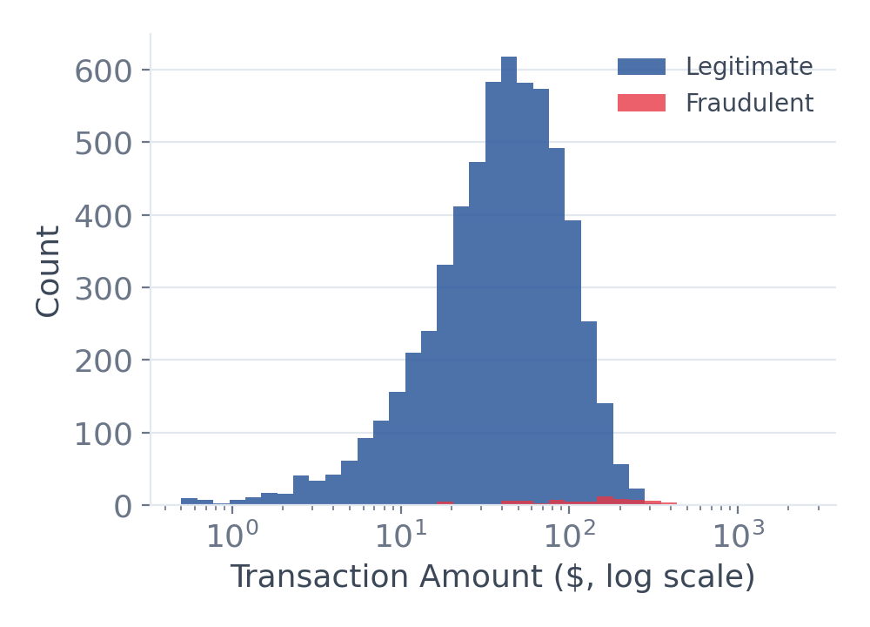
EXPLORATORY DATA ANALYSIS
Visualizing the Transaction Data
Histogram — Amount Distribution
Bar Chart — Avg. Amount by Hour Block
Count Plot — Class Counts
Legitimate amounts cluster low; fraud skews toward a wider, higher range.
Average spend is higher during midday and evening transaction blocks.
Plotted on a linear scale, fraud cases are barely visible next to legitimate volume — reinforcing the imbalance.

Slide 9
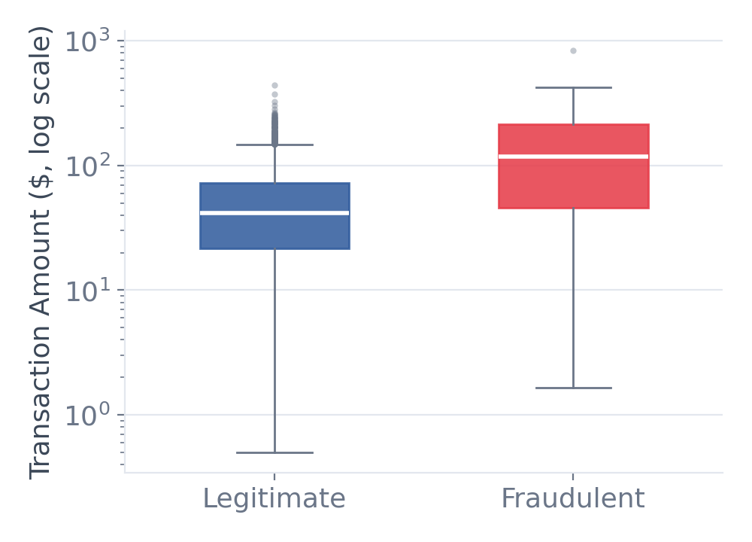
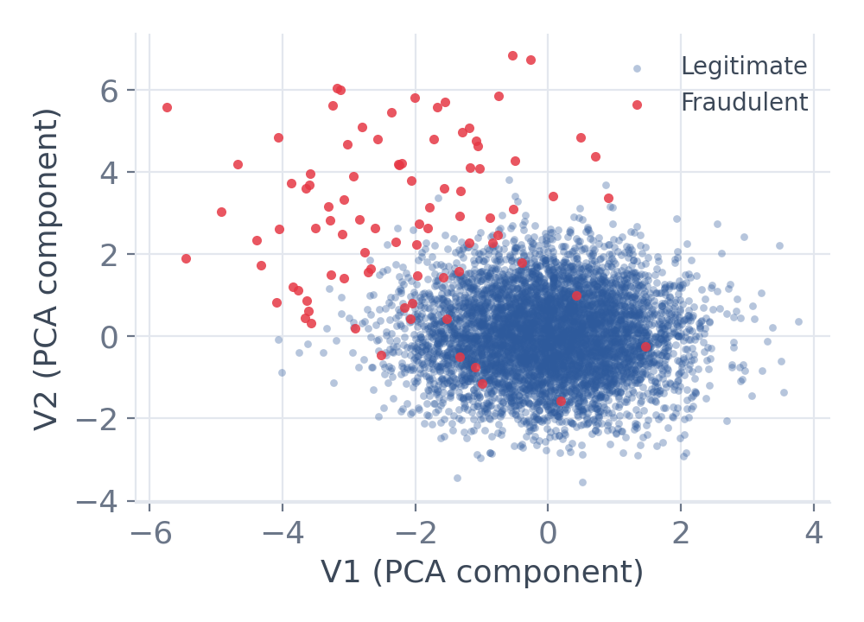
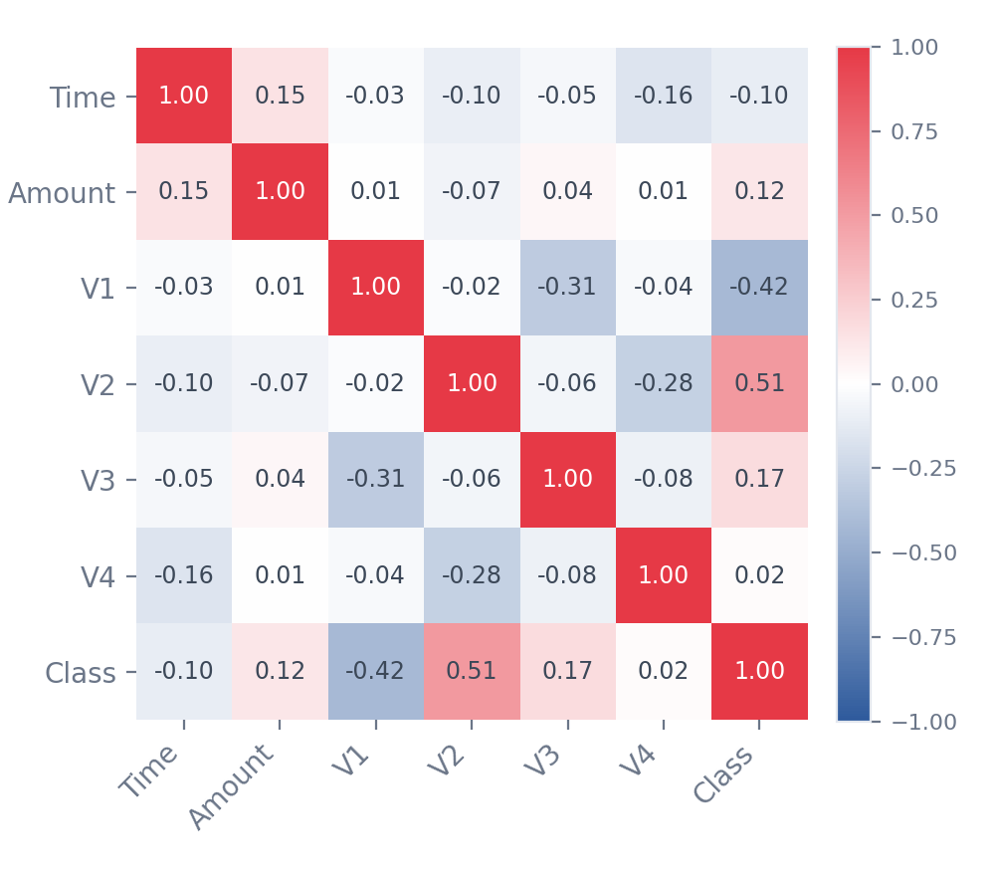
EXPLORATORY DATA ANALYSIS
Spotting Patterns and Relationships
Box Plot — Amount by Class
Scatter Plot — V1 vs V2 by Class
Correlation Heatmap
Fraudulent transactions show a higher median amount and wider spread.
Fraudulent points cluster apart from legitimate ones in PCA feature space.
V2 and V1 show the strongest linear relationship with Class among sampled features.

Slide 10
FEATURE SELECTION / FEATURE ENGINEERING
Choosing and Preparing the Model Inputs
1
Which features are used?
2
Which features are removed?
All 30 input features: V1–V28 (anonymized PCA components) plus scaled Time and scaled Amount. Class is kept aside as the target label.
No V1–V28 component is dropped. The raw Time and Amount columns are replaced by scaled versions, and Class is separated from the inputs as the target (y).
3
Why are they removed?
4
Are new features created?
Raw Time and Amount are on a far larger scale than V1–V28 and would dominate Logistic Regression. Class is the answer itself, so using it as input would leak the label. V1–V28 are already decorrelated by PCA, so none are dropped.
Yes — scaled_time and scaled_amount, created with StandardScaler (mean 0, unit variance). They replace the raw columns so all 30 inputs share a comparable scale.
Final model input: 30 features (V1–V28 + scaled_time + scaled_amount) | Target: Class (0 = legitimate, 1 = fraud)

Slide 11
TRAIN-TEST SPLIT
Dividing the Data into Training and Testing Sets
80% Training data
20% Testing
Training data — 80%
Testing data — 20%
Stratified split
Used to train the model. Logistic Regression learns fraud patterns from these labeled transactions.
Held out and never seen during training. Used only to evaluate how well the model generalizes.
Stratifying on Class keeps the ~0.17% fraud rate the same in both sets. A fixed random state makes results reproducible.
≈ 226,980 transactions
≈ 56,746 transactions
Class weighting: training set only
X_train, X_test, y_train, y_test = train_test_split(X, y, test_size=0.2, stratify=y, random_state=42)

Slide 12
MODEL BUILDING
Machine Learning Models Used
SUPERVISED
UNSUPERVISED
HYBRID
Logistic Regression
Isolation Forest
Combined Decision
Learns from labeled transactions to estimate the probability that a transaction is fraudulent.
Isolates transactions that behave very differently from normal ones, without needing labels.
Merges both views of each transaction to catch fraud that either model alone could miss.
class_weight = 'balanced' to offset the 0.17% fraud rate
max_iter = 1000, lbfgs solver
Output: class label + fraud probability
n_estimators = 100, random_state = 42
contamination ≈ 0.0017 (fraud rate)
Output: anomaly score + outlier flag
Flag a transaction if Logistic Regression predicts fraud or Isolation Forest marks it an anomaly
Each model and the hybrid are scored on the same test set
Both models are fit on the 80% training set and compared on the held-out 20% test set.

Slide 13
MODEL EVALUATION
Measuring How Well the Models Detect Fraud
Accuracy
Precision
Confusion Matrix
(TP + TN) / All
TP / (TP + FP)
Overall share correct — misleading: always saying 'legit' scores ~99.8%.
Of flagged transactions, how many are truly fraud (fewer false alarms).
Predicted: Legit
Predicted: Fraud
Actual: Legit
TN
FP
Recall
F1-Score
Legit passed
False alarm
TP / (TP + FN)
2·P·R / (P + R)
Of all real fraud, how much is caught — missed fraud costs real money.
Single score balancing precision and recall; suits imbalanced data.
Actual: Fraud
FN
TP
Missed fraud
Fraud caught
ROC-AUC
What matters most here
Area under TPR vs FPR
A missed fraud (FN) is the costliest error.
Prioritize recall, precision and F1 — accuracy alone is not reliable on imbalanced data.
Ranks fraud above legitimate across all thresholds (1.0 = perfect).

