Slide 1
CGPA Calculator Using Python Django
Mini Project Presentation
Submitted by: S.Anuradha
Roll Number: 23AK1A0411

Slide 2
Introduction
CGPA Calculator is a web application developed using Python Django. It helps students calculate CGPA quickly by entering subject credits and grades.

Slide 3
Problem Statement
Manual CGPA calculation can be time-consuming and prone to errors. This project automates the process and provides accurate results instantly.

Slide 4
Objectives
• Calculate CGPA automatically
• Reduce calculation errors
• Provide a simple user interface
• Learn Django web development

Slide 5
Technologies Used
Python
Django Framework
HTML
CSS
VS Code

Slide 6
System Architecture
User → Web Form → Django Views → CGPA Calculation → Result Page

Slide 7
Project Modules
1. Home Page
2. Input Form
3. CGPA Calculation Logic
4. Result Display

Slide 8
Implementation
The user enters credits and grades. Django processes the input, calculates CGPA using the formula, and displays the result.

Slide 9
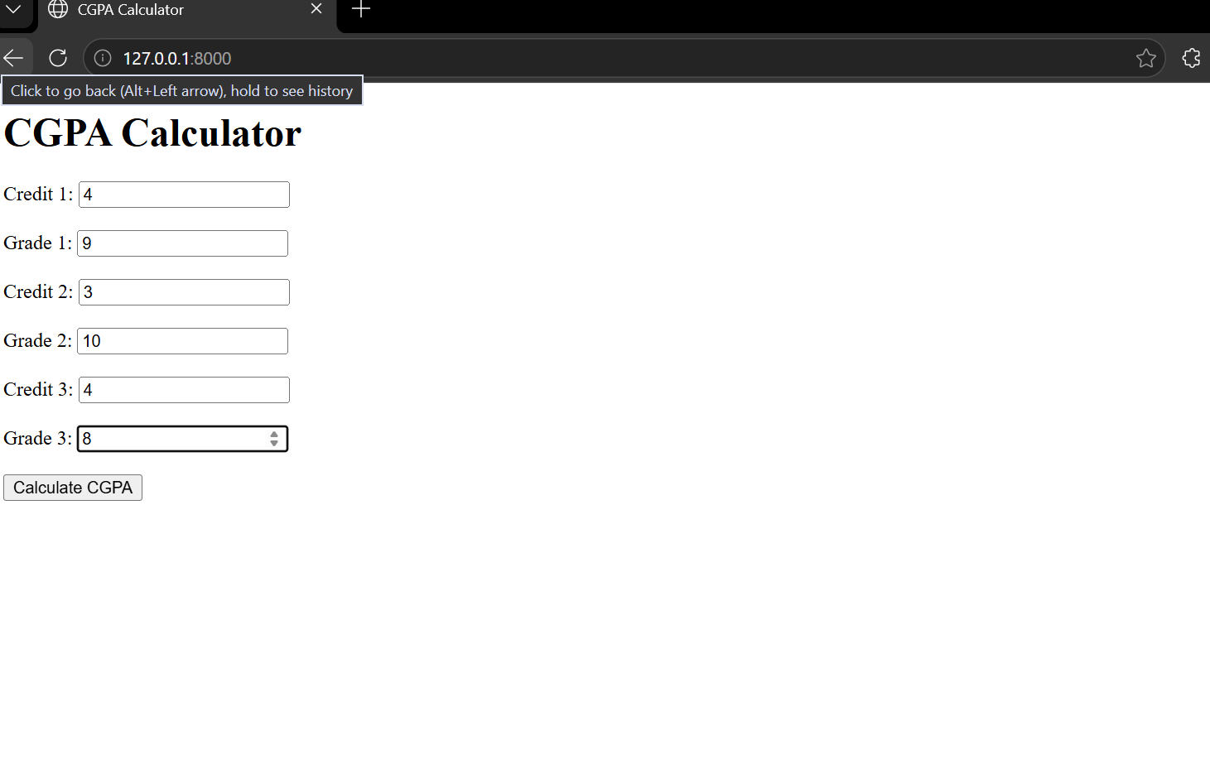
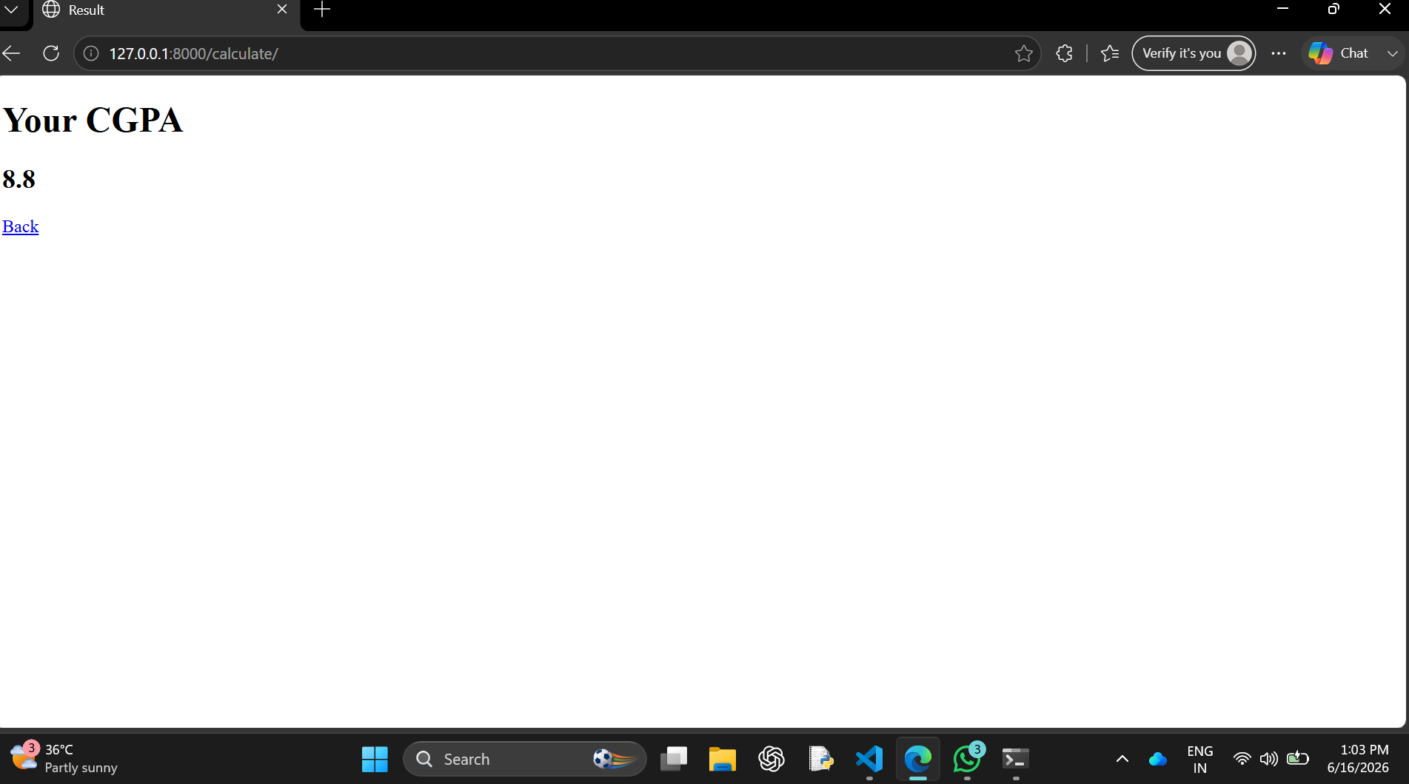
Results and Output

Slide 10
Conclusion
The CGPA Calculator was successfully implemented using Django. The application provides a simple and accurate method for calculating CGPA.

