Slide 1
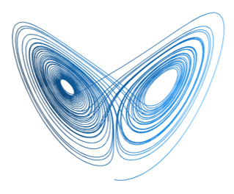


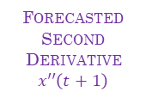

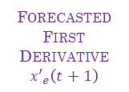

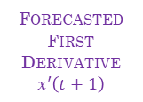

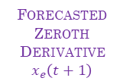

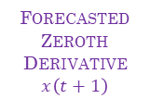





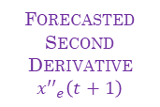
ATTRACTOR DYNAMICS
REAL WORLD EXTREME EVENTS
$$\frac{dx}{dt}=ϕ\left(x, y\right)$$
$$\frac{dy}{dt}=ψ\left(x, y\right)$$
$$x\left(t\right)$$
$$y\left(t\right)$$
$$x_{e}\left(t\right)$$
$$y_{e}\left(t\right)$$
ZEROTH DERIVATIVE
$$x\left(t\right)$$
FIRST DERIVATIVE
$$x′\left(t\right)$$
SECOND DERIVATIVE
$$x′′\left(t\right)$$
ZEROTH DERIVATIVE
$$x_{e}\left(t\right)$$
FIRST DERIVATIVE
$${x′}_{e}\left(t\right)$$
SECOND DERIVATIVE
$${x′′}_{e}\left(t\right)$$
TRANSFER LEARNING
PHYSICS MOTIVATED LOSS FUCTION
$$𝔏_{1}=\sqrt[2]{\frac{\sum_{n}{{\left(𝔛_{predicted}−𝔛_{real}\right)}^{2}}}{n}}$$
PHYSICS MOTIVATED LOSS FUCTION
$$𝔏_{2}=\sqrt[2]{\frac{\sum_{n}{{\left(𝔜_{predicted}−𝔜_{real}\right)}^{2}}}{n}}$$
FORECASTED
ZEROTH DERIVATIVE
$$x\left(t+1\right)$$
FORECASTED
FIRST DERIVATIVE
$$x′\left(t+1\right)$$
FORECASTED
SECOND DERIVATIVE
$$x′′\left(t+1\right)$$
FORECASTED
ZEROTH DERIVATIVE
$$x_{e}\left(t+1\right)$$
FORECASTED
FIRST DERIVATIVE
$${x′}_{e}\left(t+1\right)$$
FORECASTED
SECOND DERIVATIVE
$${x′′}_{e}\left(t+1\right)$$
PRE TRAINING PHASE
TRAINING PHASE

