Slide 1
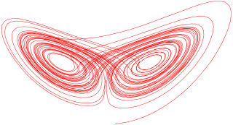

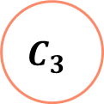
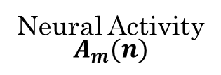
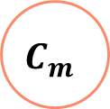
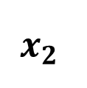
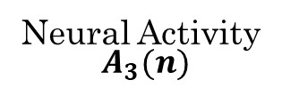

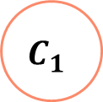

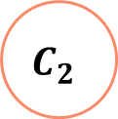
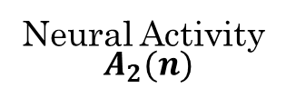
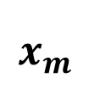

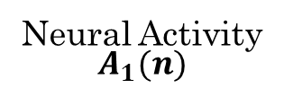
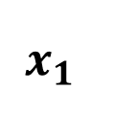
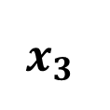

Neurochaos Feature Extractor
ChaosNet Classifier
$$x_{1}$$
$$C_{1}$$
Neural Activity
$$A_{1}(n)$$
Firing Time $N_{1}$
Classification Output
$$x_{2}$$
$$C_{2}$$
Neural Activity
$$A_{2}(n)$$
Firing Time$N_{2}$
$$x_{3}$$
$$C_{3}$$
Neural Activity
$$A_{3}(n)$$
OR
Firing Time$N_{3}$
Supervised Machine Learners
.
.
.
.
.
.
.
.
.
$$x_{m}$$
$$C_{m}$$
Neural Activity
$$A_{m}(n)$$
Firing Time$N_{m}$

