Slide 1
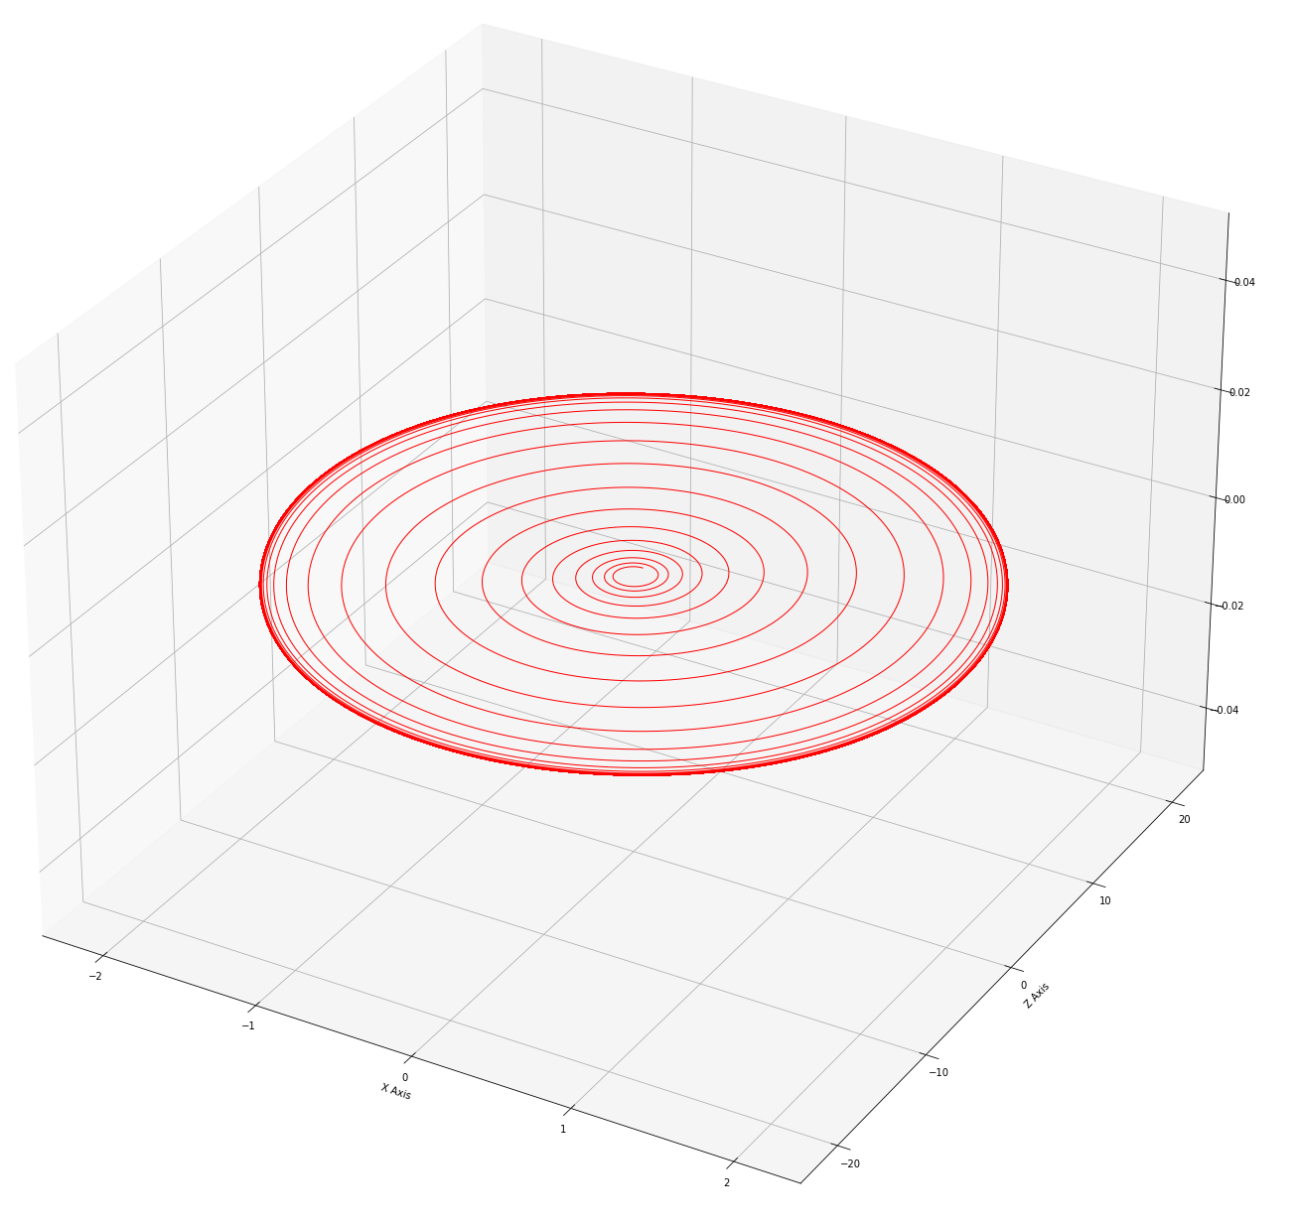
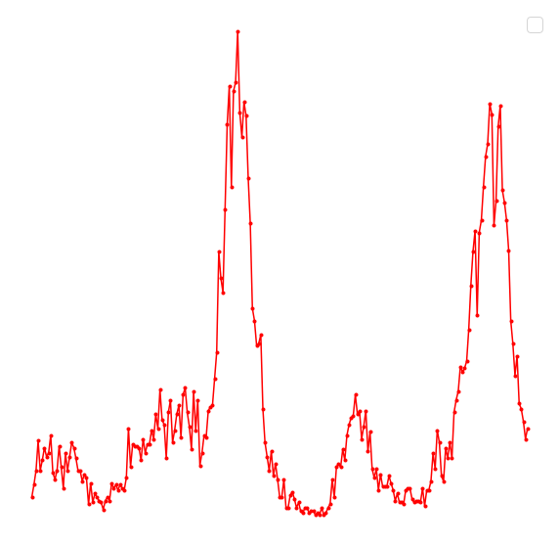




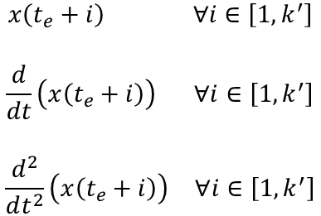
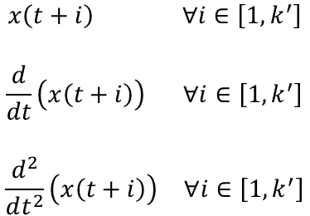
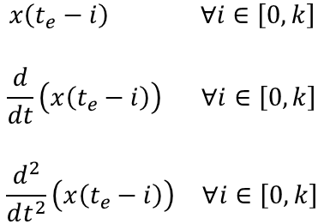
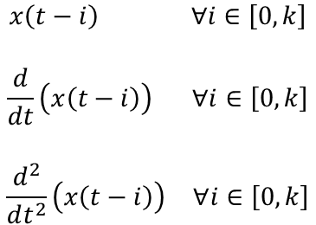




Backpropagation
$$\begin{matrix}\begin{matrix}\begin{matrix}x\left(t−i\right) & ∀i∈\left[0, k\right]\end{matrix} \\ \begin{matrix} \\ \begin{matrix}\frac{d}{dt}\left(x\left(t−i\right)\right) & ∀i∈\left[0, k\right]\end{matrix}\end{matrix}\end{matrix} \\ \begin{matrix} \\ \begin{matrix}\frac{d^{2}}{dt^{2}}\left(x\left(t−i\right)\right) & ∀i∈\left[0, k\right]\end{matrix}\end{matrix}\end{matrix}$$
$$\begin{matrix}\begin{matrix}\begin{matrix}x\left(t+i\right) & ∀i∈\left[1, k^{′}\right]\end{matrix} \\ \begin{matrix} \\ \begin{matrix}\frac{d}{dt}\left(x\left(t+i\right)\right) & ∀i∈\left[1,k^{′}\right]\end{matrix}\end{matrix}\end{matrix} \\ \begin{matrix} \\ \begin{matrix}\frac{d^{2}}{dt^{2}}\left(x\left(t+i\right)\right) & ∀i∈\left[1,k^{′}\right]\end{matrix}\end{matrix}\end{matrix}$$
PHASE 1
$$x(t)$$
$$𝔏_{data}$$
$$t$$
$$𝔏_{{phy}_{1}}$$
Van der Pol Oscillator
Transfer Learning
$$\begin{matrix}\begin{matrix}\begin{matrix}x\left(t_{e}−i\right) & ∀i∈\left[0, k\right]\end{matrix} \\ \begin{matrix} \\ \begin{matrix}\frac{d}{dt}\left(x\left(t_{e}−i\right)\right) & ∀i∈\left[0, k\right]\end{matrix}\end{matrix}\end{matrix} \\ \begin{matrix} \\ \begin{matrix}\frac{d^{2}}{dt^{2}}\left(x\left(t_{e}−i\right)\right) & ∀i∈\left[0, k\right]\end{matrix}\end{matrix}\end{matrix}$$
$$\begin{matrix}\begin{matrix}\begin{matrix}x\left(t_{e}+i\right) & ∀i∈\left[1, k^{′}\right]\end{matrix} \\ \begin{matrix} \\ \begin{matrix}\frac{d}{dt}\left(x\left(t_{e}+i\right)\right) & ∀i∈\left[1,k^{′}\right]\end{matrix}\end{matrix}\end{matrix} \\ \begin{matrix} \\ \begin{matrix}\frac{d^{2}}{dt^{2}}\left(x\left(t_{e}+i\right)\right) & ∀i∈\left[1,k^{′}\right]\end{matrix}\end{matrix}\end{matrix}$$
$$x(t_{e})$$
$$𝔏_{data}$$
PHASE 2
$$t_{e}$$
$$𝔏_{{phy}_{2}}$$
Extreme Events
Backpropagation

