Slide 1


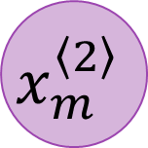


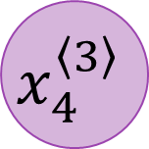

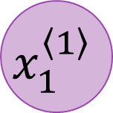
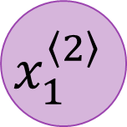


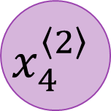
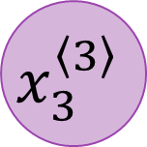


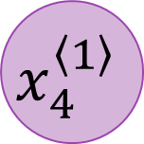



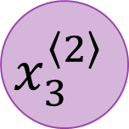
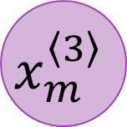

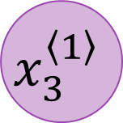
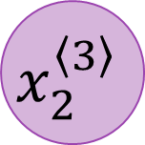

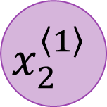

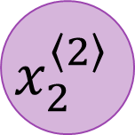
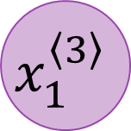


$$x_{1}^{\left\langle 1\right\rangle }$$
$$x_{1}^{\left\langle 2\right\rangle }$$
$$x_{1}^{\left\langle 3\right\rangle }$$
$$x_{1}$$
$$x_{2}^{\left\langle 1\right\rangle }$$
$$x_{2}^{\left\langle 2\right\rangle }$$
$$x_{2}^{\left\langle 3\right\rangle }$$
$$y_{1}$$
$$x_{2}$$
$$x_{3}^{\left\langle 1\right\rangle }$$
$$x_{3}^{\left\langle 2\right\rangle }$$
$$x_{3}^{\left\langle 3\right\rangle }$$
$$y_{2}$$
$$x_{3}$$
$$x_{4}^{\left\langle 1\right\rangle }$$
$$x_{4}^{\left\langle 2\right\rangle }$$
$$x_{4}^{\left\langle 3\right\rangle }$$
$$y_{3}$$
$$⋮$$
$$⋮$$
$$⋮$$
$$⋮$$
$$⋮$$
$$x_{n}$$
$$⋮$$
$$⋮$$
$$⋮$$
$$y_{k}$$
$$x_{m}^{\left\langle 1\right\rangle }$$
$$x_{m}^{\left\langle 2\right\rangle }$$
$$x_{m}^{\left\langle 3\right\rangle }$$

Slide 2


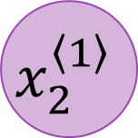

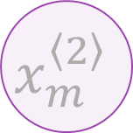
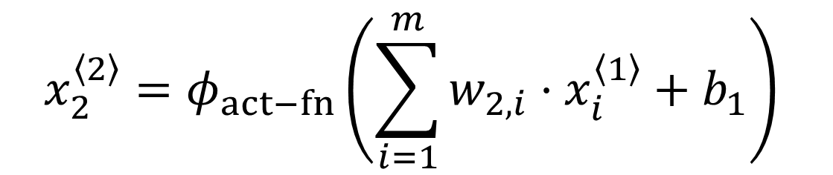

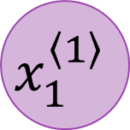
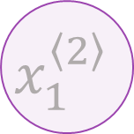


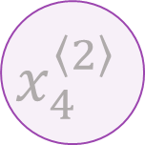

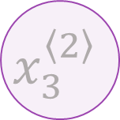

$$x_{1}^{\left\langle 1\right\rangle }$$
$$x_{1}^{\left\langle 2\right\rangle }$$
$$x_{2}^{\left\langle 2\right\rangle }=φ_{act−fn}\left(\sum_{i=1}^{m}{w_{2, i}⋅x_{i}^{\left\langle 1\right\rangle }}+b_{1}\right)$$
$$x_{2}^{\left\langle 1\right\rangle }$$
$$x_{2}^{\left\langle 2\right\rangle }$$
$$x_{3}^{\left\langle 1\right\rangle }$$
$$x_{3}^{\left\langle 2\right\rangle }$$
$$x_{4}^{\left\langle 1\right\rangle }$$
$$x_{4}^{\left\langle 2\right\rangle }$$
$$⋮$$
$$⋮$$
$$⋮$$
$$⋮$$
$$x_{m}^{\left\langle 1\right\rangle }$$
$$x_{m}^{\left\langle 2\right\rangle }$$

