Slide 1

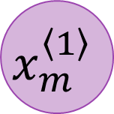
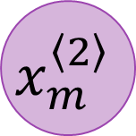


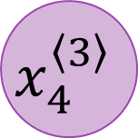
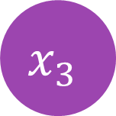
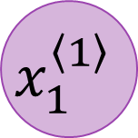
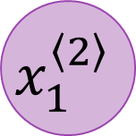


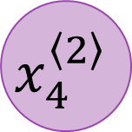
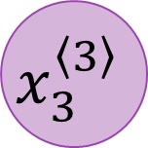

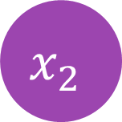
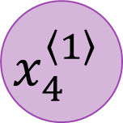



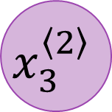
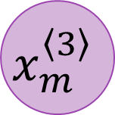

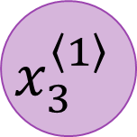
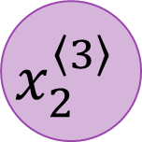

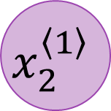

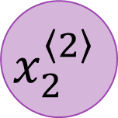
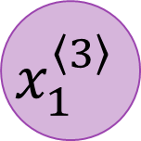


$$x_{1}^{\left\langle 1\right\rangle }$$
$$x_{1}^{\left\langle 2\right\rangle }$$
$$x_{1}^{\left\langle 3\right\rangle }$$
$$x_{1}$$
$$x_{2}^{\left\langle 1\right\rangle }$$
$$x_{2}^{\left\langle 2\right\rangle }$$
$$x_{2}^{\left\langle 3\right\rangle }$$
$$y_{1}$$
$$x_{2}$$
$$x_{3}^{\left\langle 1\right\rangle }$$
$$x_{3}^{\left\langle 2\right\rangle }$$
$$x_{3}^{\left\langle 3\right\rangle }$$
$$y_{2}$$
$$x_{3}$$
$$x_{4}^{\left\langle 1\right\rangle }$$
$$x_{4}^{\left\langle 2\right\rangle }$$
$$x_{4}^{\left\langle 3\right\rangle }$$
$$y_{3}$$
$$⋮$$
$$⋮$$
$$⋮$$
$$⋮$$
$$⋮$$
$$x_{n}$$
$$⋮$$
$$⋮$$
$$⋮$$
$$y_{k}$$
Input Layer
$$x_{m}^{\left\langle 1\right\rangle }$$
$$x_{m}^{\left\langle 2\right\rangle }$$
$$x_{m}^{\left\langle 3\right\rangle }$$
Output Layer
Hidden Layers

Slide 2

















$$C_{t−1}$$
$$⨂$$
$$⨁$$
$$C_{t}$$
Forgetting from Long Term Memory
Saving to Long Term Memory
Long Term Memory Retrieval
Long Term Memory
$$tanh$$
Long Term Memory
$$F_{t}$$
$$I_{t}$$
$$⨂$$
$$O_{t}$$
$$⨂$$
Short Term Memory
$$σ$$
$$σ$$
$$tanh$$
$$σ$$
Short Term Memory
$$H_{t−1}$$
$$H_{t}$$
Input
$$X_{t}$$

Slide 3
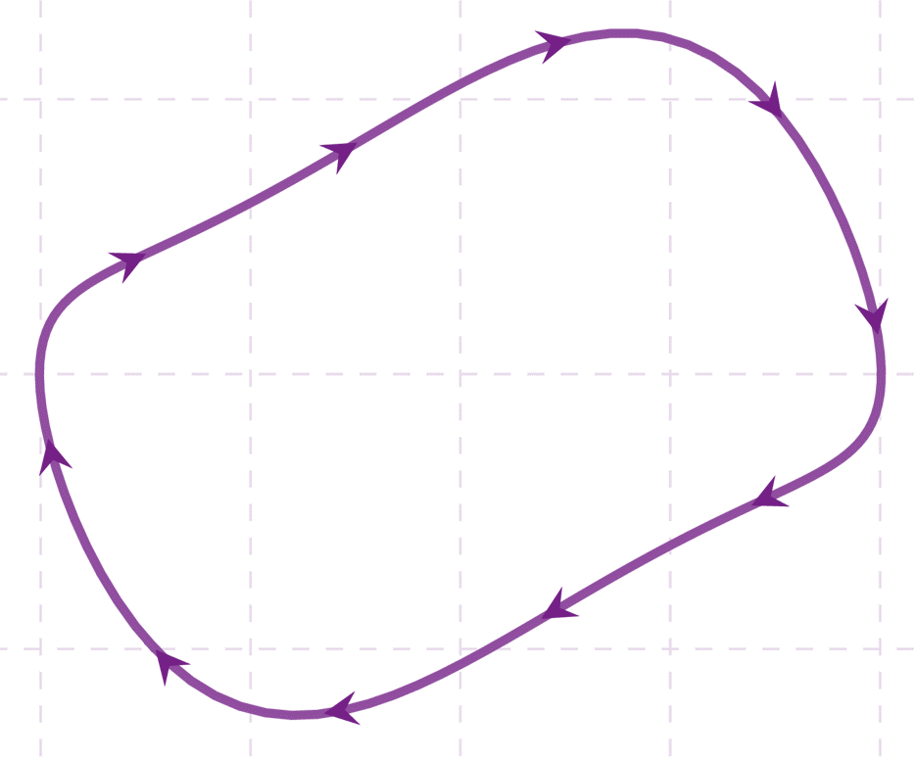
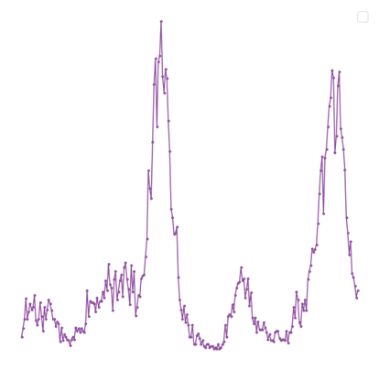
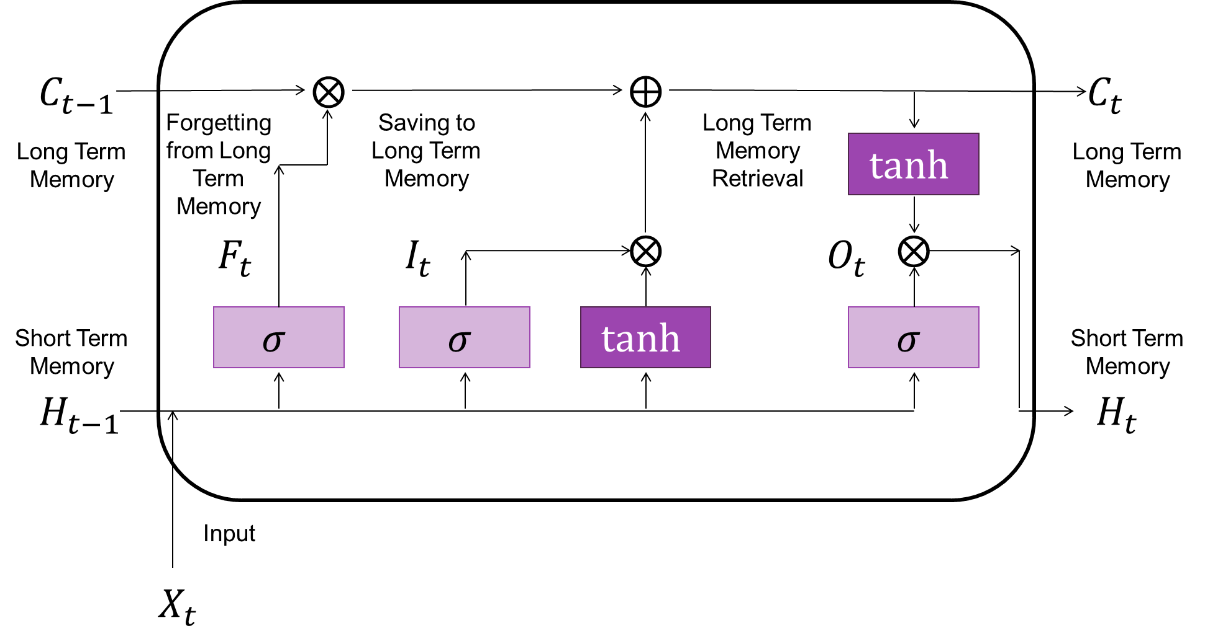
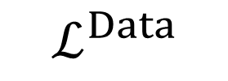
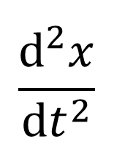
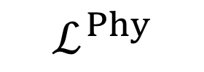
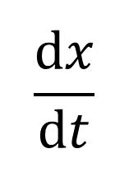
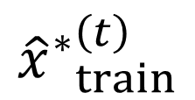
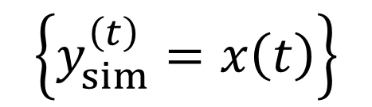
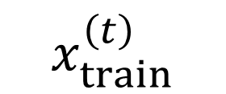


$$ℒ^{Total}=𝒞_{1}⋅ℒ^{Data}+𝒞_{2}⋅ℒ^{Phy}$$
$$\left\{y_{sim}^{\left(t\right)}=x\left(t\right)\right\}$$
Simulated
Data
Repeated for both the Pre-training and Training Phases
Backpropagation
$$ℒ^{Phy}$$
$$ℒ^{Data}$$
$$\frac{dx}{dt}$$
$$\frac{d^{2}x}{{dt}^{2}}$$
Physics Guided Differentials
$$x_{train}^{\left(t\right)}$$
$$⨁$$
$${{\hat{x}}^{∗}}_{train}^{\left(t\right)}$$
Input
Output
50
Real Time
Extreme Events
LSTM Units

