Slide 1
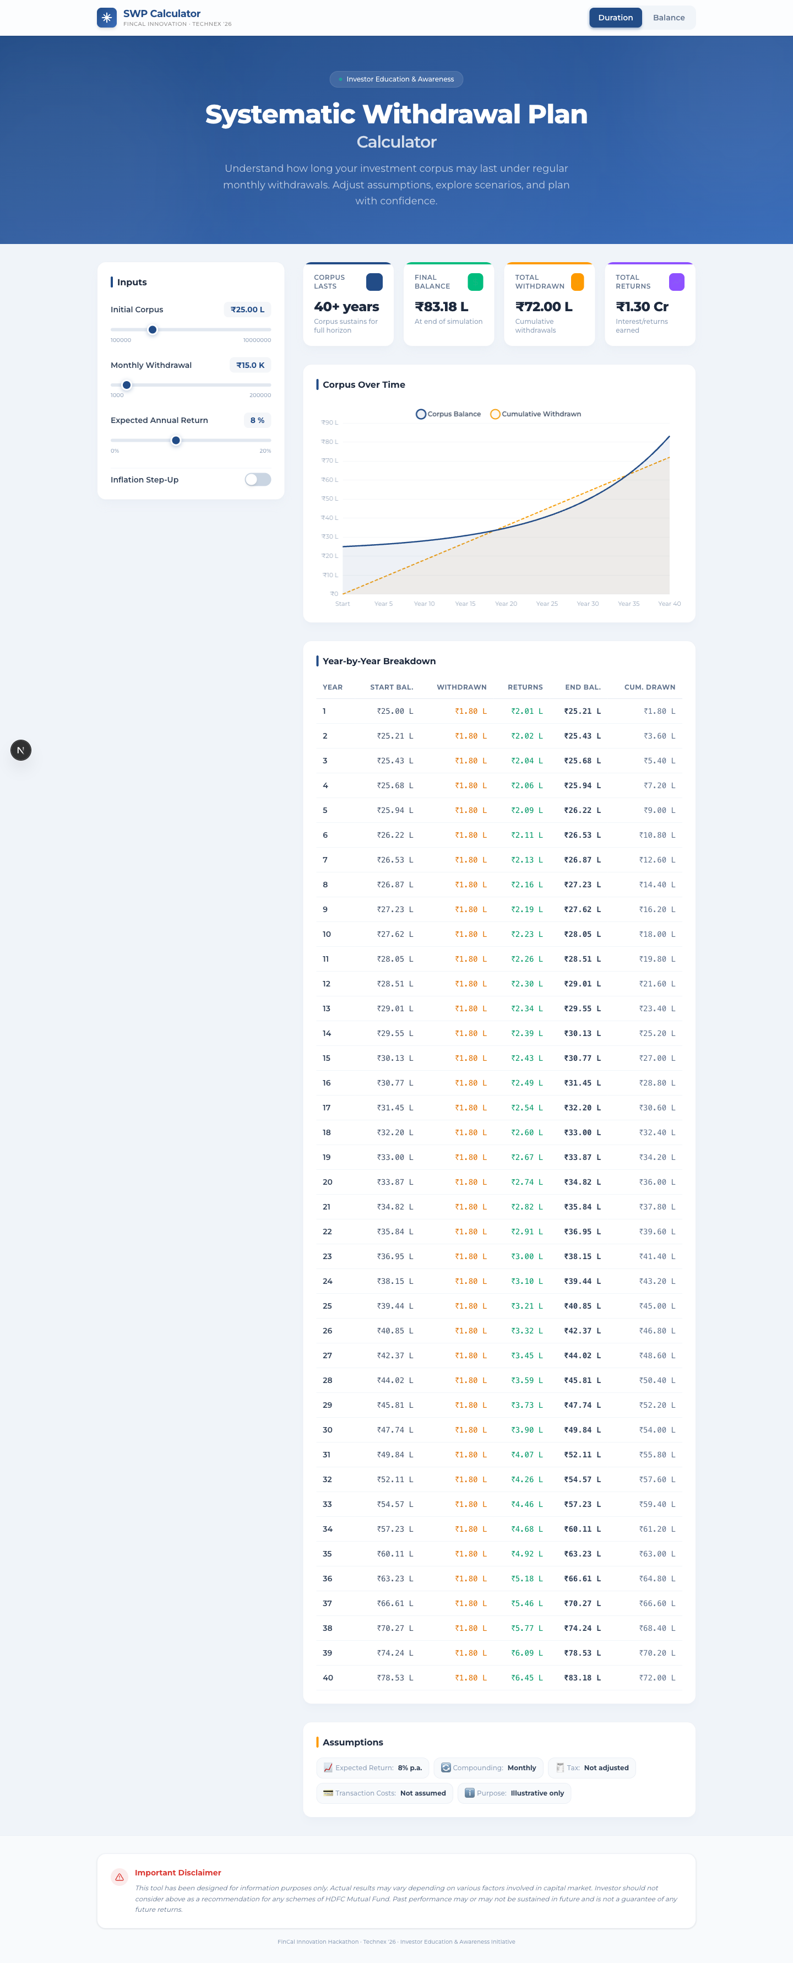
FinCal Innovation Hackathon · Technex '26
SWP Calculator
Interactive Systematic Withdrawal Plan planning tool with real-time UI, charting, and year-wise breakdown.
Next.js 16
React 19
TypeScript
Actual calculator UI captured from the running project
SWP Calculator

Slide 2
Desktop UI Overview
The presentation now uses the real application interface
What users see
A branded hero section, input controls, live KPI cards, a corpus chart, detailed yearly table, assumptions, and disclaimer.
Live behavior
As sliders change, the stats, chart, and table update immediately using the TypeScript calculation engine.
Why it matters
This makes the project feel like a real product demo instead of a static calculation form.
Slide 2
Default desktop experience

Slide 3
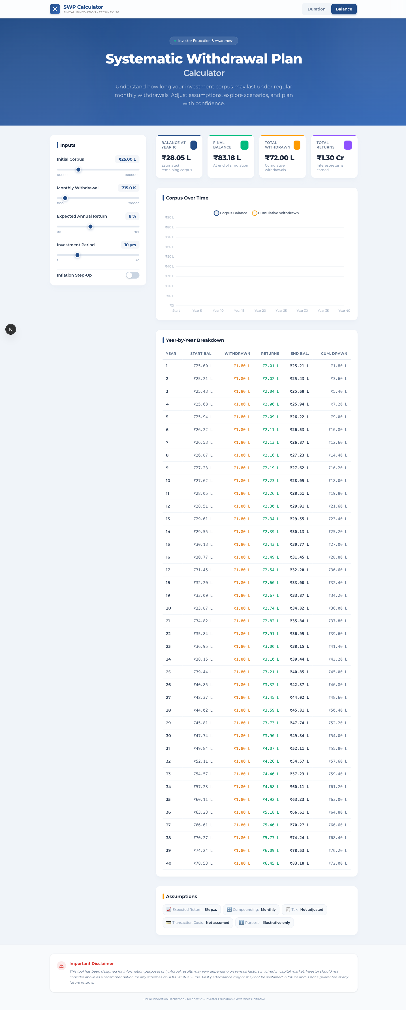
Balance Mode UI
Shows remaining corpus after a chosen investment period
Users can switch between Duration and Balance modes from the header toggle.
Balance mode reveals the investment-period slider and highlights corpus value at the chosen year.
The same screen keeps the chart, table, and assumptions visible for context.
Target balance at Year 10
Unified workflow
Slide 3
Balance mode with the target-year slider visible

Slide 4
Responsive Mobile View
The interface also adapts to smaller screens
Mobile structure
Consistent styling
Inputs, KPI cards, chart, table, assumptions, and disclaimer stack vertically for easier scrolling.
The same blue visual identity, rounded cards, and financial widgets carry across breakpoints.
Useful for demos on laptop and phone screens.
Supports hackathon judging scenarios where portability matters.
Keeps the investor-education message clear even in a compact layout.
Mobile layout captured from the app
Slide 4

Slide 5
Calculation Logic
Month-wise simulation powers the live UI
Monthly Rate
Two modes are supported: corpus duration and target-year balance.
The engine stores month-wise rows and yearly aggregate rows.
Depletion is detected exactly and surfaced back into the UI.
Indian-number formatting improves readability for local users.
r = annualReturn / 100 / 12
Core Flow
Each month the corpus earns return, then the configured withdrawal is applied.
Inflation Step-Up
When enabled, withdrawals increase once every 12 months.
lib/swpCalc.ts
hooks/useSWP.ts
components/*
Slide 5

Slide 6
Testing And Quality
The project is not just UI; the financial logic is verified
Jest tests cover monthly rate conversion, depletion logic, balance mode, inflation step-up, totals, yearly aggregation, and edge cases.
The calculator logic is implemented outside React, which makes it easier to test and maintain.
Build verification confirms the Next.js app compiles successfully.
Tests
Build
106 passing tests
Production build successful
Project Strength
Polished UI plus reliable calculation logic makes the project presentation stronger.
Future Scope
Scenario comparison, tax-aware calculations, exportable reports, and advanced simulations.
Slide 6

Slide 7
Conclusion
A project presentation aligned with the real product UI
The deck now reflects the actual application screens instead of generic placeholder content.
It highlights the core product flow: desktop usage, balance mode, mobile responsiveness, logic, and testing.
This makes the PPT much more suitable for project submission and demo walkthroughs.
Thank you
Investor education tool
Real app screenshot used in the final slide as well
Slide 7

