Slide 1
Problem Statement :
“Commodity Price Forecasting using AI/ML.”
Problem Statement Number: 02 Team Name : The Titans Team Number: HS109_PS2
College Name: PES Modern College of Engineering, Pune-05.

Slide 2
Idea / Approach details
Problem Statement:
“Our idea is to build a model using kalman filter/LSTM to forecast the future prices of a commodity.”
Technology stack used:
Python
Keras,Numpy, pandas, matplotlib, sklearn, pykalman,seaborn.
Jupyter Notebook

Slide 3
Application
We will be building Two models based on Kalman Filter and LSTM.
The Idea is to predict Commodity Price (such as Coffee, stainless steel.etc) with advanced deep learning algorithms with accuracy and precision.
Let us understand what are Kalman Filter and LSTM.
Long Short-Term Memory (LSTM) networks are a type of recurrent neural network capable of learning order dependence in sequence prediction problems.This is a behavior required in complex problem domains like machine translation, speech recognition, and more.
The Kalman filter is an optimized algorithm that uses noisy observations of a system over time to estimate the parameters of the system and predict future observations. Note that some of systems are unobservable. At each time step, it makes a prediction, takes in a measurement, and updates itself based on how the prediction and measurement compare.

Slide 4
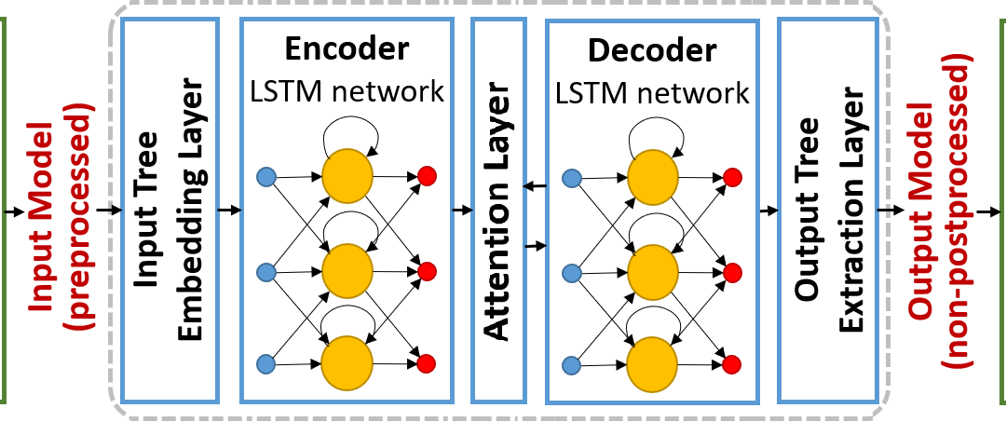

Slide 5
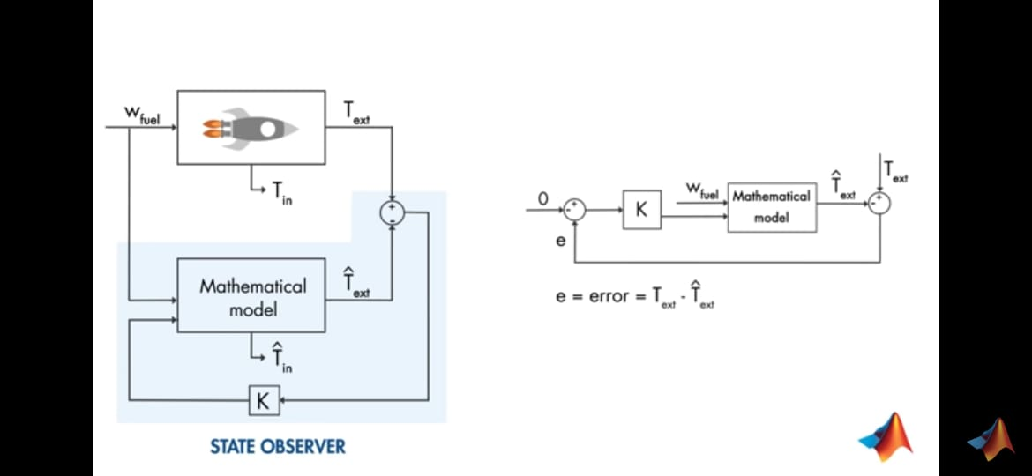

Slide 6
Day 2 additions
Suggestions given by the mentor :
Mentor suggested to Checkout different Tensorflow Add-ons and also recommendted to deploy the Build Model using Streamlit Library

Slide 7
Day 3 additions
To be Honest we have learnt more about respected domain (ML) more in depth than have learnt in College during past two days.
Enjoyed those Late Night Coding with Coffee to keep us Awake and Energetic.
Faced Many Hudles while Building Model, many syntax error,parsing error,token errors but Stackoverflow and Our Mentors helps us overcome those .
Special thanks to our Mentors and the core team for conducting such an amazing event.

