Slide 1

Industry Project
Part II
Name: Anubhav Lahoti, Kiran and Anurag

Slide 2
Assignment Instructions
DELIVERABLES
Part-1 - Product Analytics
Part-2 - Growth Strategies
Part-3 - Product Roadmap
Part-4 - Product Backlog and Sprint Backlog
Part-5 - Product Requirements Document
Part-6 - Go-to-Market Strategy
SUBMISSION GUIDELINES
Part-1, 2 and 6 should be submitted in this PPT document.
Part-3 and 4 should be submitted in the excel document given on the platform.
Part- 5 should be submitted in the word document given on the platform.

Slide 3
Part 1
Product Analytics

Slide 4
Recap - AARRR Framework
Acquisition
Retention
Referral
A
A
R
R
R
Find the core
Concept
Activation
Revenue

Slide 5
Acquisition Metrics
# | METRICS | EXPLANATION
1 | Customer Acquisition Rate | The most basic and important metric to be tracked in the initial stage of any online product is the rate at which the number of customers is increasing.
2 | Customer Acquisition Cost (CAC) | CAC is the cost incurred to acquire a single customer. This value calculated for various acquisition channels helps in filtering the better performing channels eventually reducing the CAC value
3 | Bounce Rate | Bounce rate tells us how many users are leaving the app/website without any purchase. Reducing the bounce rate should be the highest priority as it is easy to convert a user to customer than to bring the user to visit the site for the first time. A low bounce rate helps in generating more revenue.

Slide 6
Activation Metrics
# | METRICS | EXPLANATION
1 | Number of users who ordered for the first time | This metrics helps us to identify of all the users who visited our website/app, how many users took our service for the first time. A low rate indicates that more and more people are not taking our service.
2 | Number of users who searched for a restaurant or dish for the first time | This metric is similar to the one above but this metric helps us identify how many users are actually willing to take our service.
3 | Rate at which number of users who ordered for the first time is increasing for a specific period of time | This metric helps in identifying whether our efforts to improve conversions are fruitful or not. If the rate at which number of users who ordered for the first time is increasing then it means we are moving in the right direction.

Slide 7
Retention Metrics
# | METRICS | EXPLANATION
1 | Daily/Weekly/Monthly active users | An increasing active user base is a good sign for a growing company.
2 | Churn Rate of existing customers | This metric tells us how many existing customers are not opting our service again.
3 | Repeat purchase ratio | Repeat purchase ratio is how many existing customers are opting our service again and again.

Slide 8
Revenue Metrics
# | METRICS | EXPLANATION
1 | Average revenue per user | This metric is the measure of revenue generated per user. It will allow us to refine our analysis of our company’s revenue generation capability and growth at the per-customer level.
2 | Monthly recurring revenue | This metric will help us understand our earning potential and growth on a monthly basis.
3 | Customer lifetime value | CLV is a measurement of how valuable a customer is to our company with an unlimited time span as opposed to just the first purchase. This metric will help us understand a reasonable cost per acquisition.

Slide 9
Referral Metrics
# | METRICS | EXPLANATION
1 | Net Promoter Score | This metric tells us how likely our customers are going to refer our service to others
2 | CSAT | This metrics tell about how much customer is satisfied with our services
3 | Number of referral invites sent (a variant of viral coefficient) | This is a metric that helps us analyze how many customers are willingly promoting our business. This is an indication of service standard.

Slide 10

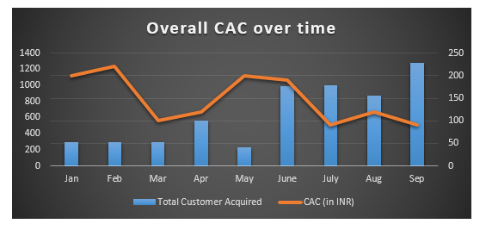
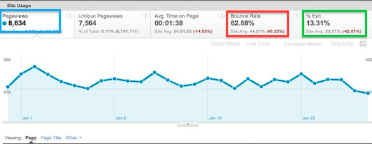
Wireframe - Analytics Dashboard
Acquisition Dashboard
Overall CAC report shows monthly new user acquisition and cost of acquiring.
Channel wise bounce rate, which gives information about which channel is performing well and which not.

Slide 11
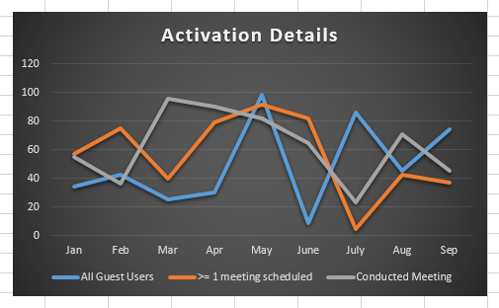
Wireframe - Analytics Dashboard
Activation Dashboard
Shows following information:
Ordering first time users
Just searched for dish or restaurant
Rate at which first time ordering over month is happening
Ordered First time
Searched for dish first time
Rate of ordering

Slide 12
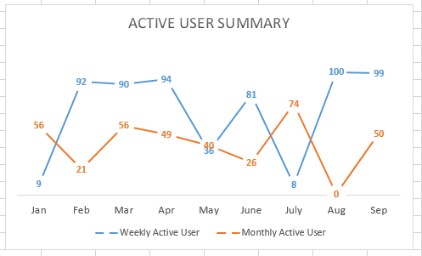
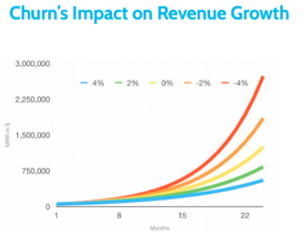
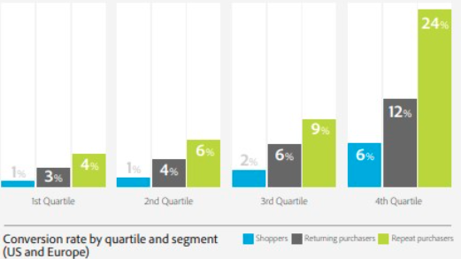
Wireframe - Analytics Dashboard
Retention Dashboard
Shows Active user summary weekly and monthly. Active users are one are ordering
Churn rate, and its impact on the revenue to keep track.
Repeat purchase/return purchase and 1st time Shoppers ratio.

Slide 13
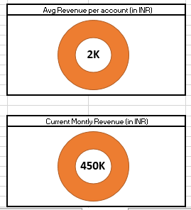
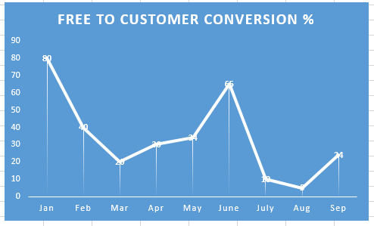

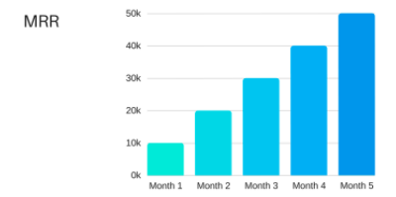
Wireframe - Analytics Dashboard
Revenue Dashboard
Average revenue per user
MRR or Monthly Recurring Revenue talks about how each month are coming from monthly/yearly plans.
Free to Customer conversion %, gives me understanding about how much are converting to premium member by taking monthly/yearly membership

Slide 14
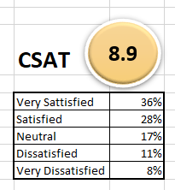
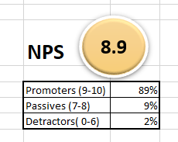
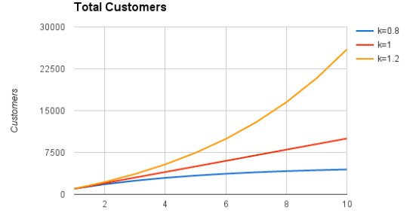
Wireframe - Analytics Dashboard
Referral Dashboard
Shows NPS and CSAT Survey results.
Number of referral invites shared.

Slide 15
Part 2
Growth Strategies

Slide 16
Acquisition Strategy
Food tech companies need a strong brand recall for the customers to visit their website/download their app to make a purchase.
People generally type the website URL and make a purchase than search online to find relevant service.
Keeping the above things in mind, we believe the major acquisition channels for the food-tech startup would be:
Acquisition Channels:
Display Ads: YouTube video ads, display Ads, Social Media Ads
Social Media Engagement: Social Media is the best way for start-ups, especially those that are low on budget
SEO: Even though people do not search for a food tech company (for other than obvious reasons). Many people still search for restaurants near by or a restaurant with specific cuisine. Improving SEO for these keywords would build the brand awareness and possibility of conversion for free.
Email Marketing: Email is again one of the cheapest ways to promote a business and build brand awareness.

Slide 17
Acquisition Strategy
Acquisition Strategies:
Restaurant ranking system based on multiple paramaters – food quality, packaging quality, taste, etc. Collecting user feedback helps gaining customer confidence and hence NPS.
Referral Program: Referral is the best way to promote a service. It is free and has high conversion ratio.
To improve the acquisition rate, one also needs to optimize their app on the App Store and improve the SEO.

Slide 18
Activation Strategy
Helping a new customer to make his/her first purchase is the primary goal of our activation strategy. The below-mentioned activation strategies would help achieve the same.
Add some credit to the customer’s account: Doing this would motivate him/her to make their first purchase as this makes them believe that they are getting the food for free or for low cost.
Multivariate testing Restaurant search page, add to cart page, & booking page: This helps to check which variant has highest conversions.
Customizing for the user: Ask the user about his food preferences, automatically identify his location, etc. to showcase the listings accordingly. This significantly improves the UX and helps in increasing the bookings.

Slide 19
Retention Strategy
Retention is the only way to scale & sustain a business. The main aim of the retention strategy is to reduce churn rate and improve engagement/frequency-of-engagement metrics.
Remarketing: Personalised notifications about recently searched items, etc. would help remind the customer about his last visit or give extra motivation to complete the transaction.
Special Offers: Just like Flipkart & Amazon celebrates Big Billion Days & The Great Indian Festival respectively, constantly surprising the customers with different offers will keep them enthused about the offer & the app
Identify users specific to a cohort or with a particular behaviour who are dropping off rapidly and use analytics to understand why they are dropping. Knowing the reason of the churn will help fix the issue.

Slide 20
Referral Strategy
Referral users are the easiest to convert in any kind of business and it is the cheapest way to increase sales. All it takes is a good product or service.
Below are the tactics we will use as a part of our Referral growth hacking strategy.
Double sided referral bonus: When a user sends a referral to another person and the other person accepts/activates for the first time then a bonus amount is credited into both the sender’s & recipient’s account.
Social Share: Our aim is to make it easy for the customers to share through social media channels like Facebook, Instagram, etc. about what food they are enjoying.

Slide 21
Revenue Strategy
Our revenue strategy focuses mainly on increasing conversions at each stage of the customer journey or increase ARPU. One way of increasing conversions is through improving the customer engagement. To this end, we have identified three tactics to drive our revenue strategy.
A customer who reaches the final page is most likely to buy and is further inclined if nudged a bit. So, we would like to include the promotions/discounts/coupons feature such that it is very easy for the customer to see what additional value he is getting from our product.
Send customized push notifications regularly to improve engagement
Upsell/cross-sell “Also bought” items or provide a subscription service.

Slide 22
Part 3
Product Roadmap

Slide 23
Product Roadmap
Note:
Use the template provided on the platform to create a product roadmap
You are free to edit / add columns as needed to the template provided

Slide 24
Part 4
Product Backlog and Sprint Backlog

Slide 25
Part 5
Product Requirements Document

Slide 26
Submission Template
Note:
Use the template provided on the platform to create a well-structured, exhaustive and comprehensive PRD.
You are free to edit / add columns as needed to the template provided

Slide 27
Part 6
GTM Strategy

Slide 28
Achieving Product-Market Fit
Note:
Provide your input here.
You can add more slides if required

Slide 29
Product Positioning
Note:
Provide your input here.
You can add more slides if required

Slide 30
Pricing Strategy
There are multiple pricing options for our food delivery business. Let us understand one by one.
Charging Restaurants:
Online delivery of food enables restaurants to reach wider range of audience outside their possible reach. It also helps them to collect payments or manage orders seamlessly. We also help them promote their restaurant through ads or suggesting the restaurant based on data. This creates a lot of value for the restaurants and helps improve the top-line. We are eventually charging them for the value we created – Value based charging.
10% – 15% of the booking value for providing business
20% - 30% of the booking value for providing business and providing delivery services
Promoting restaurant ads

Slide 31
Pricing Strategy
Charging Customers:
We are enabling customers to choose from a wide range of customers at a time and and order from reasonably far away places. We also deliver them food at their doorstep in any part of tier 1,2,3 cities giving them a lot of flexibility. We need to employ a demand based pricing because we need to balance between the demand and supply. We do not want to receive more orders when delivery boys are already buy. Similarly we do not want less bookings when delivery guys are idle.
Charging for delivery of orders below a certain value
Charging for late night deliveries
Paying Delivery Men:
Our aim is to improve the efficiency of delivery persons by employing competitive pricing strategy. Paying them for each delivery encourages them to deliver as many as possible.

Slide 32
Sales & Marketing Strategy
Marketing Channels:
Since people are highly unlikely to search for food tech companies online we are not going to concentrate very much on PPC campaigns. Having said that we would still use PPC and organic SEO based on Restaurant, Cuisine & Specific Dish keywords. But our major marketing channels would be
Word of the mouth
Social Media Marketing
Social Media Management
TV?Media Ads
Word of the Mouth:
Word of the mouth is the most economical and effective marketing channel. Also it defines the quality of our service. Hence word of the mouth is an obvious choice
TV/Media Ads & Social Media Marketing/Management:
Our business heavily relies on branding and these channels helps in improving the brand awareness.

Slide 33
Sales & Marketing Strategy
Sales Channels:
To bring restaurants and customers on a single platform we need a website/app and there is no need of physical stores. So our obvious sales channels would be
Website: A responsive website enables customers to book through mobile, laptop, & desktop without having to install an app.
Mobile App: Both Android & iOS App is essential for customers who frequently book our service.

Slide 34
Product Launch Plan
Planning a product launch involves three main phases – Pre-launch, Launch-day, & Post-launch. Product launch plans requires & ensures seamless co-ordination between cross-functional teams. Understanding key activities involved in each stage helps in identifying opportunities or bottlenecks early-on.
Pre-Launch Phase:
The main objective now is to ensure our product, marketing, & sales channels are ready, to ensure our promotions are at the maximum, orchestrating a rolling launch, & to prepare all the stake holders for the launch day.

Slide 35
Product Launch Plan
How to ensure | Description
Product Readiness | Finalize launch date Ensure engineering deliverables and feature completion are on time Ensure the quality of the product Test the product for performance
Marketing & Sales Channel Readiness | Define launch goals based on SMART (Specific, Measurable, Assignable, Relevant, & Time Bound) framework Prepare marketing content Conduct competitive research to refine messaging
Maximizing Promotions | Release for testing and get user feedback Identify social media influencers and offer them early access to use our service We would like to promote our product mainly on Social Media such as Facebook, & Instagram.
Orchestrating Rolling Launch | Tweet about the product is going to help customers order food sitting at home/office Tweet about how influencers are enjoying the service Engage with social media users and offer them free credit

Slide 36
Product Launch Plan
Launch Day:
A successful launch is essential to make our product a success. Below are the activities that are needed to be done to ensure the same
How to ensure | Description
Preparing Team | Ensure consistency of messaging across teams Train the trainers about product usage and other policies Define KPIs such as Number of app downloads, number of orders, bounce rate, etc on the first day to measure the launch go.
What to do | Description
Track Influencer Endorsements | Check with influencers for scheduled endorsements.

Slide 37
Product Launch Plan
What to do | Description
Engage with audience | Engage with audiences and take feedback Track engagement metrics Track KPIs
Media Interactions | Share information about our service to the media

Slide 38
Product Launch Plan
Post Launch Phase:
This is a very important phase as it helps us validate our hypothesis in real time and how customers are perceiving our product when compared with the competitors (both direct & indirect).
Things to do | Description
Define & Measure KPIs | Track KPIs such as acquisition rate, adoption rate, conversion rate Use telemetry date to understand customer behavior pattern
Ensure Strong Customer Support System | Stream line customer support through phone/chat/email Train customer support team to handle complaints and inquiries
Listen to customers | Understand what customer pain points are in using our website/app Understand what our customer are expecting

Slide 39
Disclaimer
All content and material on the upGrad website is copyrighted material, either belonging to upGrad or its bonafide contributors and is purely for the dissemination of education. You are permitted to access print and download extracts from this site purely for your own education only and on the following basis:-
● You can download this document from the website for self use only.
● Any copies of this document, in part or full, saved to disc or to any other storage medium may only be used for subsequent, self viewing purposes or to print an individual extract or copy for non commercial personal use only.
● Any further dissemination, distribution, reproduction, copying of the content of the document herein or the uploading thereof on other websites or use of content for any other commercial/unauthorized purposes in any way which could infringe the intellectual property rights of upGrad or its contributors, is strictly prohibited.
● No graphics, images or photographs from any accompanying text in this document will be used separately for unauthorised purposes.
● No material in this document will be modified, adapted or altered in any way.
● No part of this document or upGrad content may be reproduced or stored in any other web site or included in any public or private electronic retrieval system or service without upGrad’s prior written permission.
● Any rights not expressly granted in these terms are reserved.

