Slide 1

PathSetu
Behind the Startup, Grand Finale
From flagged scan to finished follow-up
A vendor-neutral layer that makes sure every patient an AI reader flags actually comes back for their CT, consult and treatment.
Team TimeSpace
Anurag Sharma (team leader), Samyak Kumar Singh, Purav Sihag
Notes:
Open with the patient, not the product: "Every day, AI flags thousands of chest X-rays in India in under a minute. What happens after the flag is nobody's job. We built PathSetu to own that job." Photo is the same image we used in our Round 2 submission.

Slide 2

A flagged scan is not a treated patient
The problem
Ramesh, 56, from Karimnagar, gets a chest X-ray for a cough. The AI reader flags a 9 mm lung nodule in under a minute.
He leaves with a PDF that says “CT advised”. Nobody calls. He never comes back.
Ramesh is an illustrative patient.
1 in 6
Indians diagnosed with TB were historically lost before starting treatment (16%, meta-analysis of Indian studies).
4 of 10 finish the follow-up their scan asked for
6 of 10 never do
In a US study of incidental lung nodules, 58% got no recommended follow-up. We found no published Indian figure for this gap, which is part of the problem.
Sources: JACR study via Radiology Business; Eon (2025); Subbaraman et al. 2016, cited in Thomas et al., PMC5872574
PathSetu · 02
Notes:
Tell Ramesh's story slowly. Then: "This isn't rare. In the US, where hospitals do track it, only 3 or 4 in 10 patients complete the follow-up for an incidental lung nodule. We couldn't find a published Indian number at all. For TB, an Indian meta-analysis found 1 in 6 diagnosed patients never started treatment." The 4-in-10 pictogram rounds the ~30–42% US range; say "roughly" if asked.

Slide 3
AI solved the reading. Nobody owns the return visit.
Why now
~1 : 1 lakh
5,500+
₹1.3 Cr
53 crore
radiologists to people in India
sites run just one AI reader, Qure.ai
Qure.ai's India revenue in FY25
WhatsApp users in India
The channel to reach the patient is already in their pocket, in their language.
About 20–22K radiologists for 1.4 billion people. That's why AI readers are spreading fast.
Every new reader creates more flagged patients who need a follow-up.
Against ₹174 Cr abroad. Indian hospitals won't pay much for reads. They do value patients who come back.
Our Round 1 teardown of Qure.ai showed it: in India the money is not in reading scans. It is in the follow-up after the scan.
Sources: RIAI via 5C Network (2026); qure.ai (2026); Entrackr (Oct 2025); MeitY figures, Feb 2021
PathSetu · 03
Notes:
Link back to Round 1: "When we tore down Qure.ai, the most surprising number was this: ₹174 crore of revenue abroad, ₹1.3 crore in India. Indian hospitals pay under a dollar per AI read. So we asked: what would an Indian hospital actually pay for? Answer: patients who come back for the CT and the consult." The WhatsApp figure is the government's Feb 2021 count; it has only grown since.

Slide 4

PathSetu closes the loop after the flag
Our solution
PathSetu
Patient back at the hospital
Any AI reader or radiologist
1 Prioritise
2 Nudge
3 Book
4 Close
Qure.ai, 5C Network, in-house reports
Our Q-Triage engine decides how hard and how fast to chase each patient
WhatsApp and voice calls in 10+ Indian languages; ASHA hand-off in villages
One tap books the CT or specialist slot at the same hospital
Doctor notified, ABDM health record updated, ROI report for the hospital
CT done, consult done, treatment started
We don't read scans. We take the flag any reader produces and own everything that happens after it.
We don't diagnose. We schedule and track the follow-up the doctor has already ordered.
ABDM: Ayushman Bharat Digital Mission. ASHA: community health workers.
PathSetu · 04
Notes:
Walk the four steps left to right using Ramesh: "His flag arrives from the AI reader. PathSetu marks him urgent because the nodule is 9 mm and the reader is 94% sure. He gets a Telugu WhatsApp within the hour, taps to book Thursday 10:30, and when the CT is done his doctor is notified and the hospital sees the recovered revenue." The two lines at the bottom answer the first boardroom question before it is asked.

Slide 5
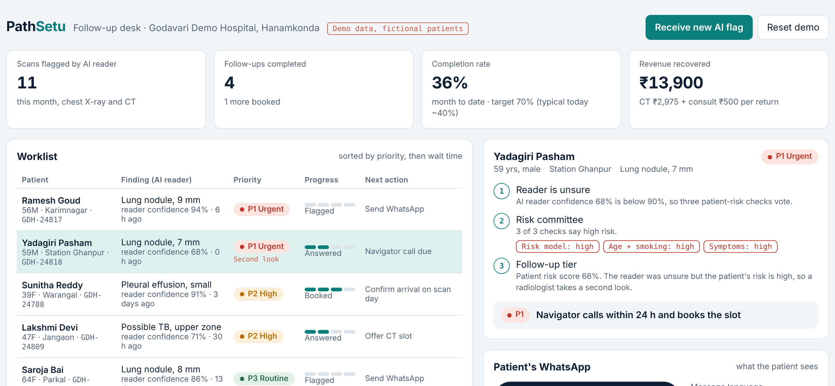
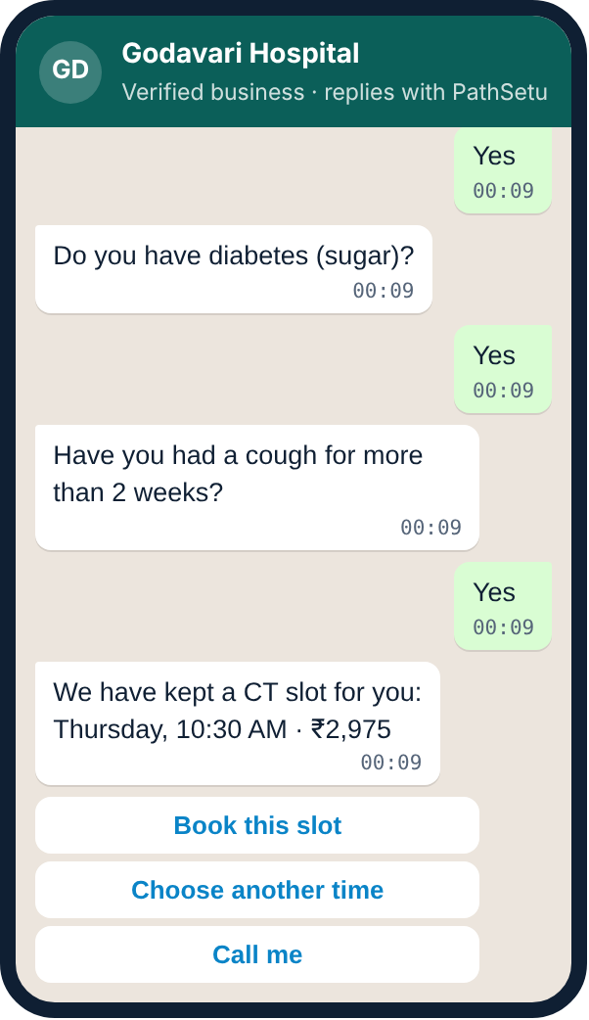
The follow-up desk and the patient’s phone
Working prototype
Front desk view: every flagged patient, sorted by urgency, with the next action and money recovered
Patient view: 3 questions, then one tap to book
Demo data, fictional patients. Messages also run in Telugu and Hindi.
PathSetu · 05
Notes:
Switch to the live prototype here (60–90 seconds). Script: click Ramesh, send the Telugu WhatsApp, answer the three questions, book, mark the scan done, and point at completion rate and revenue recovered going up. Then click "Receive new AI flag", answer Yes three times, and show the tier jump P3 to P1 with a "Second look" tag. If Wi-Fi fails, stay on this slide and narrate the screenshots.

Slide 6
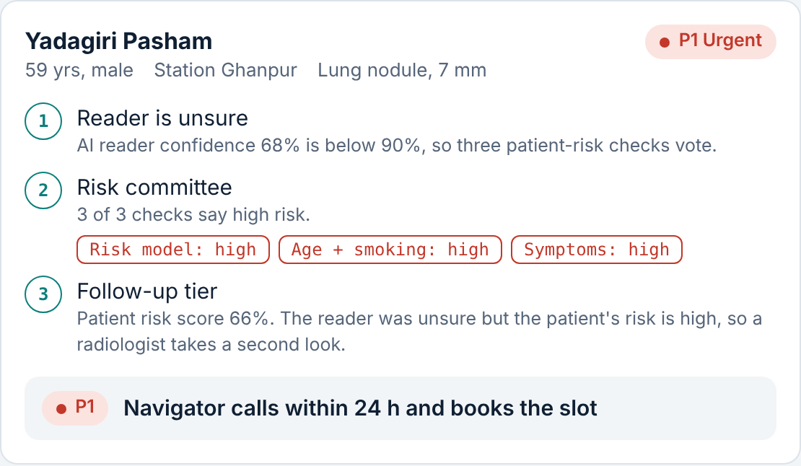


A priority engine built on Q-Triage
Our technology
1. Is the AI reader at least 90% sure?
Yes: urgency comes from the finding itself
↓ No
2. Three patient-risk checks vote
Risk model, age + smoking, symptoms, all from the patient's WhatsApp answers
↓
3. Reader unsure, but patient high-risk?
Second look by a radiologist
P1 Urgent
Navigator calls within 24 hours
This is the confidence cascade from Q-Triage, our Smart India Hackathon 2026 project. Its classical models run inside PathSetu; its quantum committee stays a research track until we can validate it on real follow-up data.
P2 High
WhatsApp + call, booked within 7 days
P3 Routine
Reminders, booked within 30 days
Q-Triage: Team Ninth Quadrant, SIH 2026 (SIH26139). Risk weights in the prototype are illustrative.
PathSetu · 06
Notes:
Keep this to 40 seconds. "Not every flagged patient needs the same effort. Our engine reuses the cascade we built for Q-Triage at SIH: if the AI reader is confident, the finding decides urgency. If it isn't, three risk checks vote using the patient's own WhatsApp answers. And when the reader is unsure but the patient looks high-risk, we ask a radiologist for a second look." If asked about quantum: "The quantum committee is research. We'd only use it in production after it beats the classical model on real follow-up data."

Slide 7

A ₹1,620 Cr market; we start with ₹246 Cr
Market opportunity
TAM
TAM: every Indian hospital with 50+ beds
~45,000 hospitals × ₹3.6 L a year (smaller sites, ~80 scans a day)
₹1,620 Cr
SAM: NABH-certified hospitals with 50+ beds
4,094 hospitals × ₹6 L a year. Organised buyers who already track quality metrics.
SAM
₹246 Cr
SOM: 120 hospitals by Year 3
~3% of SAM, Tier-2/3 South India first, × ₹7.6 L = ₹9.1 Cr a year. Pharma programmes are extra.
SOM
Tailwind: India's radiology-AI market grows from ~$32M (2025) to ~$107M (2030), 27% a year. More AI reads mean more flags to follow up.
₹9 Cr
Sources: ThePrint (Oct 2024) on NABH data and hospital counts; MarketsandMarkets (2025). Revenue per hospital: TimeSpace model.
PathSetu · 07
Notes:
Bottom-up, not top-down. TAM: around 45,000 Indian hospitals have 50 or more beds (industry estimate quoted by ThePrint), priced at a smaller-site ₹3.6 lakh a year. SAM: the 4,094 hospitals of that size with NABH full or entry-level certification; they already measure quality, so a follow-up rate is a metric they care about. SOM: 120 hospitals by Year 3 at our standard ₹7.6 lakh. If asked "why so small?": "We'd rather show a number we can defend. Pharma and state programmes are upside we haven't counted."

Slide 8




We bring the patient back
Competition and differentiation
Tracks the patient to treatment
Vendor-neutral
Hospitals use several readers and teleradiology firms. We work with all of them.
Qure.ai qTrack
PathSetu
Eon, US only
Built for Indian patients
Hospital call centres
WhatsApp and voice in 10+ languages, ASHA hand-offs, ABDM records.
Tied to one AI vendor
Works with any
Paid when the patient returns
Today: a PDF report
Most of our fee is per completed follow-up, so our incentive matches the hospital’s.
Teleradiology (e.g. 5C Network)
Stops at the report
Proof it works: Eon does this in the US at 1,000+ sites and reports 73% follow-up against a ~30% national average.
Positions are our reading of each player’s stated focus
Sources: Eon press release (Feb 2025); qure.ai; 5cnetwork.com
PathSetu · 08
Notes:
Name competitors confidently. Qure.ai's qTrack does follow-up, but only for Qure's own reads. Teleradiology firms like 5C Network read scans and stop at the report. Hospital call centres can phone patients, but they don't know who is urgent and don't measure outcomes. Eon proves the model in the US (1,000+ sites, 73% vs ~30% follow-up) but isn't in India and isn't built for WhatsApp, Indian languages or ASHA workers. Our moat grows with use: every hospital adds flag-to-completion data that sharpens the priority engine.

Slide 9
Three ways we get paid
Business model
Hospital platform fee
Outcome fee
Pharma programme fee
₹25,000
₹300
~₹500
per hospital, per month
per completed follow-up
per patient navigated (target)
Integrations with the AI reader and hospital system, the follow-up desk, navigator tools
About 10% of a ₹2,975 CT. The hospital pays only when the patient actually comes back.
Lung-cancer and TB programmes pay for navigation in hospitals that can’t, as AstraZeneca does with Qure.ai
What one hospital pays us in a year (200 chest scans a day)
Platform ₹3.0 L
Outcome fees ₹4.6 L (1,533 completed follow-ups)
Total ≈ ₹7.6 L a year. 61% of it depends on patients actually returning.
CT price: ManipalCigna indicative Tier-2 cost. Fees and volumes: TimeSpace model (see backup slides).
PathSetu · 09
Notes:
Key message: we earn mostly when the patient comes back. Example hospital: 200 chest X-rays and CTs a day, 3% need a follow-up, so 2,190 flagged patients a year. We get 70% of them back, which is 1,533 completed follow-ups at ₹300 each, plus ₹25,000 a month. Pharma fee is a target; we have not signed one, so say "target". Qure.ai's lung programme with AstraZeneca is our proof pharma pays for this kind of work.

Slide 10
Hospital pays ₹7.6 L, gets back ₹22.8 L
Unit economics, per hospital per year
For the hospital
For PathSetu
Pays PathSetu
Metric | Per hospital
Revenue | ₹7.6 L / yr
Cost to serve (navigators, cloud, WhatsApp, success manager) | ₹1.15 L / yr
Gross margin | 85%
Cost to win a hospital (sales, integration, free pilot) | ₹4 L
Payback | 7.4 months
Lifetime value ÷ cost to win (5 years) | 8×
₹7.6 L
Earns back from 657 extra patients who return (CT ₹2,975 + consult ₹500)
₹22.8 L
3×
return in year one. Follow-up goes from ~40% to 70% of 2,190 flagged patients.
WhatsApp utility message ₹0.11 (Meta, Jul 2025). 70% target benchmarked on Eon’s 73%. All other inputs: TimeSpace model.
PathSetu · 10
Notes:
Two sides of the same hospital. The hospital: 2,190 flagged patients a year; today ~40% come back, with us 70%, so 657 more patients each bringing a ₹2,975 CT and a ₹500 consult: ₹22.8 lakh. It pays us ₹7.6 lakh: about 3x. Us: cost to serve is ₹1.15 lakh, mostly a share of a success manager and cloud; WhatsApp messages cost about ₹1,500 a year per hospital. Winning a hospital costs ~₹4 lakh, paid back in about 7 months. If a judge pushes: at only 55% follow-up the hospital's return falls to 1.7x; still positive (backup slide).

Slide 11
Land in Telangana, grow through partners
Go-to-market
Months 0–6
Months 6–18
Months 18–36
1. Land
2. Expand
3. Scale
8 hospitals
35 hospitals
120 hospitals
3 design-partner hospitals in Warangal, Karimnagar and Khammam
Free 90-day audit: we measure how many of their flagged patients never return
Sell to the radiology head and the CFO with that number
Bundle with AI readers and teleradiology firms: they flag, we follow up
Mid-size hospital chains in Andhra Pradesh, Karnataka and Maharashtra
Publish our first outcome study with a partner hospital
Pharma lung-cancer and TB patient programmes
State TB and NCD programmes through ASHA networks
Sales team per state; partners bring most new hospitals
Why Telangana first: we’re based in Warangal, so we can sit with hospital teams in person, and patients speak Telugu, which our messages already handle.
Hospital targets match the 5-year plan in the backup slides.
PathSetu · 11
Notes:
The free 90-day audit is the hook: we plug into their AI reader or report system and show the hospital its own number of flagged patients who never came back, and the rupees that walked out with them. No hospital has that number today. Partners matter most in Phase 2: an AI reader sells reads; we sell what happens after. Bundling makes both products more valuable. Be ready for "why would Qure partner with you?": because they earn little in India today, and better follow-up makes their flags worth more to the hospital.

Slide 12
Profitable in Year 3, ₹50 Cr by Year 5
Scalability and growth
Revenue, ₹ Cr
Hospitals
Pharma programmes
Why it scales
50.8
Light to run
We move text, not images. Cloud is ~6% of cost to serve.
More findings, same engine
26.3
Lung nodules and TB first; then heart, breast and fractures.
More payers
11.1
Pharma, state TB and NCD programmes, insurers.
3.2
More countries
0.4
South-East Asia and Africa, riding AI readers already deployed there.
Year 1
8 hosp.
Year 2
35 hosp.
Year 3
120 hosp.
Year 4
280 hosp.
Year 5
550 hosp.
−0.95 loss
−0.52 loss
+1.8 profit
+8.7 profit
+20.7 profit
TimeSpace 5-year model. Profit shown as EBITDA, ₹ Cr. Full table in backup.
PathSetu · 12
Notes:
The shape matters more than the exact numbers: two years of small losses while we prove the model in Telangana, then each new hospital adds about ₹6.4 lakh of gross profit a year. Year 1 revenue is low because hospitals go live mid-year after a free pilot. Pharma revenue starts in Year 2 and is the most uncertain line; without it we still turn profitable in Year 3 (₹9.1 Cr hospital revenue vs ₹9.3 Cr total cost is roughly break-even, so be honest: pharma tips it positive).

Slide 13
What could go wrong, and our plan
Risks
Risk | Our answer
Patient data and consent | Consent is asked in the first WhatsApp message. Data stays in India. Built to the DPDP Act 2023 from day one.
Clinical liability | We never diagnose. We schedule the follow-up the doctor already ordered, and a radiologist makes every “second look” call.
Hospitals won’t change how they work | The free 90-day audit shows them their own lost patients and lost rupees first. The desk needs no new hardware.
An AI vendor builds this itself | Hospitals use several readers. A neutral layer works with all of them, and our outcome data grows with every hospital.
Patients without smartphones | Voice calls in their language, SMS, and hand-off to the local ASHA worker.
DPDP Act: Digital Personal Data Protection Act, 2023.
PathSetu · 13
Notes:
Showing risks before the judges raise them builds trust. Spend 30 seconds; don't read every row. Pick the two the panel looks most interested in. On regulation: because PathSetu only schedules a doctor-ordered follow-up and does not make a diagnosis, we expect it to sit outside medical-device software rules in version one; the priority engine stays a workflow tool, and the radiologist decides every second look. Say "we expect", not "we are certain": we haven't had legal advice yet.

Slide 14
₹1.5 Cr for 10%
The ask
₹15 Cr post-money. Covers our first two years until the business turns profitable in Year 3.
Where the money goes
What you get in 24 months
Product and hospital integrations
₹60 L
35
hospitals live across 4 states
Pilots and sales
₹45 L
₹3 Cr
yearly revenue run-rate
Patient navigators and operations
₹30 L
70%
Data privacy compliance and an outcome study
₹15 L
follow-up completion, proven in a published study
1+
pharma programme signed
Burn in Years 1–2 in our model: ₹1.47 Cr.
PathSetu · 14
Notes:
Say the ask once, clearly, then stop and let it land: "We're asking for 1.5 crore for 10%." If a shark counters on valuation, our floor is the plan: the money must cover the ₹1.47 crore two-year burn. Acceptable trade: lower valuation in exchange for an introduction to a hospital chain or a pharma programme. Pre-agree among the three of you what you will and won't accept before the finale.

Slide 15
Ramesh came back.
PathSetu
His CT was on Thursday. His treatment started the next week. The hospital earned ₹3,475 it would have lost.
We want that for every flagged patient in India.
Thank you. Team TimeSpace
Anurag Sharma, Samyak Kumar Singh, Purav Sihag
Notes:
Return to Ramesh to close the loop on the story. Pause after "Ramesh came back." Then hand to Q&A: "We're happy to take your questions." Backup slides follow for the boardroom: assumptions, sensitivity, the 5-year plan and Q-Triage details.

Slide 16
Every number, and where it comes from
Backup A
Input | Value | Source
CT scan price, Tier-2 city | ₹2,975 | ManipalCigna indicative cost
Follow-up completion today | ~40% | US studies (JACR; Eon cites ~30%)
Follow-up completion with PathSetu | 70% | Target; Eon reports 73% in the US
WhatsApp utility message, India | ₹0.11 | Meta pricing, July 2025
Hospitals with 50+ beds / NABH-certified | 45,000 / 4,094 | ThePrint, Oct 2024
Chest X-rays and CTs per target hospital | 200 a day | Our assumption (Round 2 customer profile)
Scans needing a follow-up | 3% | Our assumption; tested 2–5% in Backup B
Consult captured on return | ₹500 | Our assumption
Platform fee / outcome fee | ₹25k / ₹300 | Our pricing
Cost to win a hospital / hospital lifetime | ₹4 L / 5 yrs | Our assumption
The first five rows are sourced; the last five are our assumptions.
PathSetu · A
Notes:
Use this when a judge asks "where did that number come from?" Be clear about which numbers are ours. The biggest unknown is the share of scans that need a follow-up; that is exactly what the free 90-day audit measures at each hospital.

Slide 17
What if our assumptions are wrong?
Backup B
Scenario | We earn per hospital | Hospital’s return | Our gross margin | Payback
Only 2% of scans need follow-up | ₹6.1 L | 2.5× | 82% | 9.6 months
Base case: 3% | ₹7.6 L | 3.0× | 85% | 7.4 months
5% of scans need follow-up | ₹10.7 L | 3.6× | 88% | 5.1 months
We only reach 55% follow-up, not 70% | ₹6.6 L | 1.7× | 83% | 8.8 months
Smaller hospital: 100 scans a day | ₹5.3 L | 2.2× | 81% | 11.2 months
In every case the hospital earns back more than it pays us, and we earn back the cost of winning it within a year.
TimeSpace model; each row changes one input from the base case.
PathSetu · B
Notes:
Open this when someone says "3% is made up" or "70% is optimistic". The worst single case is a 55% follow-up rate: the hospital still gets 1.7 times what it pays.

Slide 18
Five-year plan, ₹ crore
Backup C
 | Year 1 | Year 2 | Year 3 | Year 4 | Year 5
Hospitals live | 8 | 35 | 120 | 280 | 550
Hospital revenue | 0.36 | 2.66 | 9.12 | 21.28 | 41.79
Pharma programmes | 0 | 0.50 | 2.00 | 5.00 | 9.00
Total revenue | 0.36 | 3.16 | 11.12 | 26.28 | 50.79
Total costs (team, serving, sales) | 1.31 | 3.68 | 9.28 | 17.63 | 30.15
EBITDA | −0.95 | −0.52 | +1.83 | +8.65 | +20.65
Team cost grows from ₹0.9 Cr to ₹13 Cr. New hospitals cost ₹4 L each to win. Year-1 hospitals go live mid-year, so they bring 60% of a full year’s revenue.
TimeSpace model. Pharma revenue is the least certain line.
PathSetu · C
Notes:
Without pharma, Year 3 is roughly break-even (₹9.1 Cr revenue against ₹9.3 Cr cost); pharma programmes make it clearly profitable. Say that openly if asked.

Slide 19
Q-Triage under the hood
Backup D
Q-Triage part | What it is | Use in PathSetu
Classical gatekeeper | Random forest (heart, ROC-AUC 0.87) and XGBoost (diabetes, 0.81) | Next: health check at the return visit
Confidence cascade | Trust the model when it is ≥90% sure, otherwise ask a committee | Live: priority tiers P1–P3
Quantum committee | 3 quantum-kernel classifiers (angle, amplitude, IQP) that vote | Research only, run offline
Disagreement tier | Flags cases where the models disagree | Live: radiologist “second look”
Why the quantum part stays research
It was trained on small public datasets (300 samples) and runs on a simulator. We will only use it with patients after it beats the classical model on real follow-up data from partner hospitals.
What carries over today is the logic: be careful when the model is unsure, and escalate when two views disagree.
Q-Triage, SIH 2026 (SIH26139), Team Ninth Quadrant. Public data: UCI heart, CDC BRFSS 2015.
PathSetu · D
Notes:
If a judge asks "isn't quantum just hype?": "For this use, today, yes, which is why it isn't in our product. What we kept from Q-Triage is the decision logic, which works with classical models. The quantum committee is a research track we can run offline as partner hospitals give us data." Anurag led Q-Triage at SIH, so he should take this question.

