Slide 1
Bluestock Mutual Fund Analytics Capstone Project I
Prepared By: Anurag Kaushik B.Tech CSE (AI & ML) June 2026

Slide 2
Problem Statement: Analyze mutual fund industry data to derive investment insights.
Objectives: • ETL Pipeline • Data Cleaning • EDA • Fund Performance Analysis • Dashboard Development • Risk Analytics • Investor Analytics

Slide 3
Data Sources:
• Fund Master Data • NAV History • Investor Transactions • SIP Inflows • Category Inflows • Scheme Performance • Benchmark Indices

Slide 4
Project Architecture
Raw Data
↓
ETL Pipeline
↓
SQLite Database
↓
EDA & Analytics
↓
Power BI Dashboard
↓
Insights & Recommendations

Slide 5
EDA Highlights:
• Industry AUM increased over time. • SIP inflows showed consistent growth. • Equity funds dominated folio counts.
• Large-cap funds had stable returns. • Mid-cap funds showed higher volatility. • Investor participation increased yearly.

Slide 6
Metrics Used:
• Alpha • Beta • Sharpe Ratio • Sortino Ratio • Maximum Drawdown Top funds achieved superior Sharpe ratios.

Slide 7
Advanced Analytics:
• Historical VaR • CVaR • Rolling Sharpe Ratio • Cohort Analysis • SIP Continuity Analysis • Fund Recommendation System

Slide 8
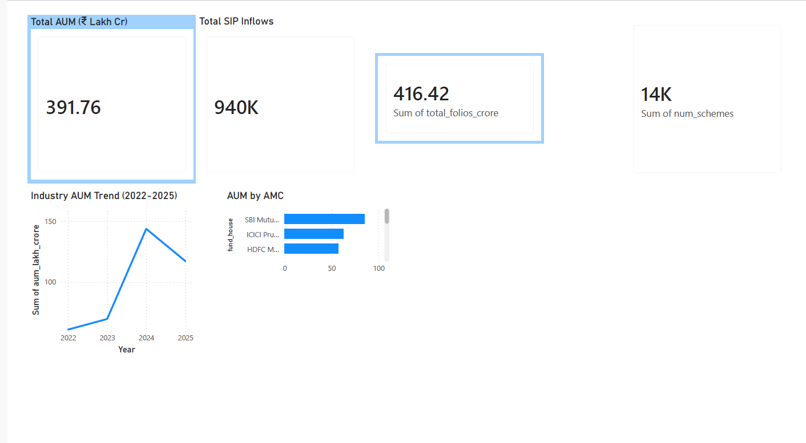
Dashboard Overview

Slide 9
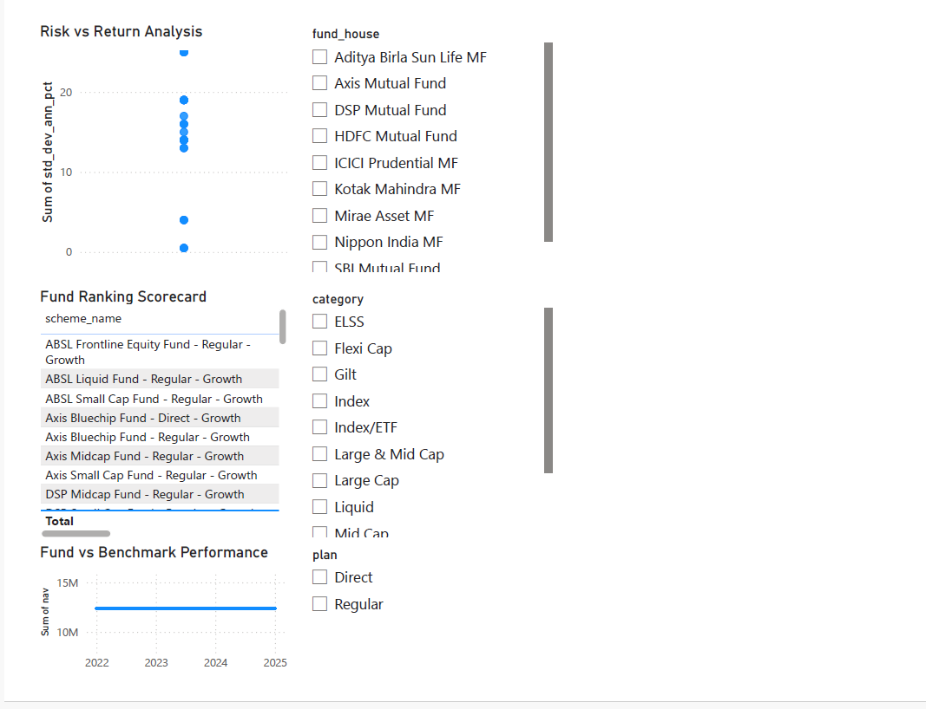

Slide 10
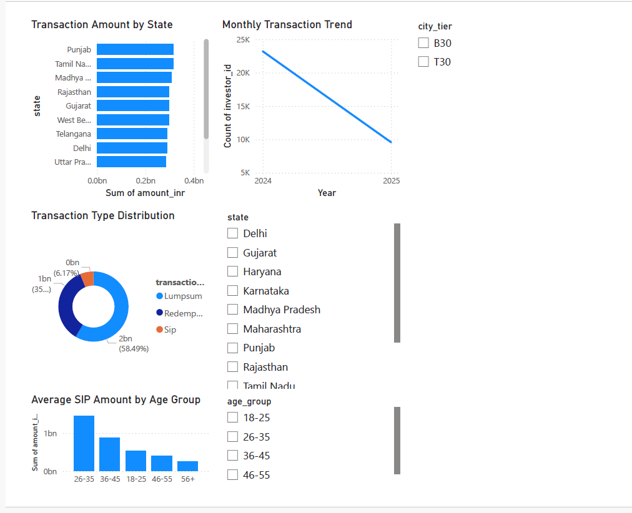

Slide 11
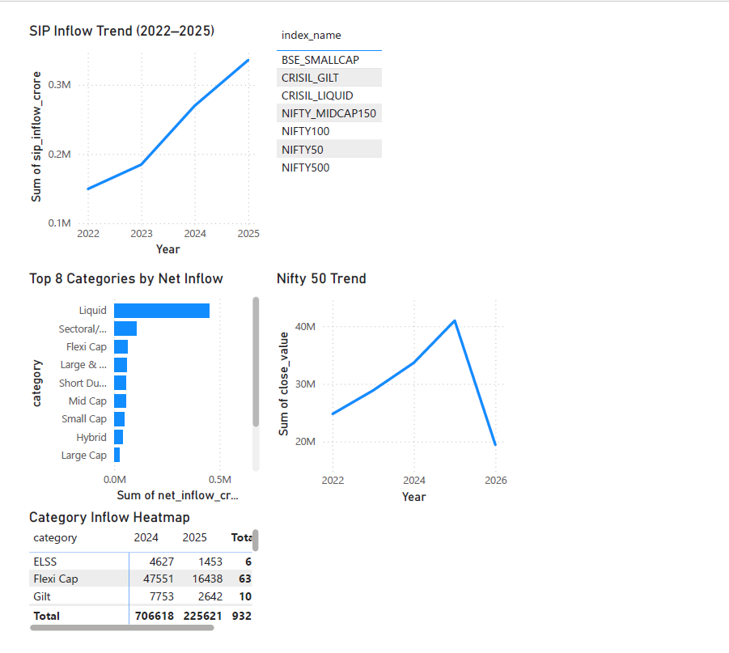

Slide 12
Key Findings:
• SIP inflows steadily increased. • High-risk funds delivered higher returns. • Certain cohorts invested more aggressively.

Slide 13
Recommendations:
• Diversify investments. • Monitor SIP continuity. • Focus on risk-adjusted returns.

Slide 14
Thank You
Questions? Anurag Kaushik B.Tech CSE (AI & ML)

