Slide 1


PROP’21 on “Attendance and Sanitization Management”
Students:
Anurag V S (1RN16CS012)
Smaran S (1RN16CS105)
Shreyas M (1RN17CS419)
Guide:
Dr. Kiran P
Professor and Head of Department,
Dept. of CSE, RNSIT
Department of Computer Science and Engineering
RNS Institute of Technology
2020-21

Slide 2
CONTENTS
INTRODUCTION
REQUIREMENTS
FLOW CHART
IMPLEMENTATIONS
RESULTS
CONCLUSION
REFERENCES

Slide 3
INTRODUCTION
COVID-19 has had drastic effects on the working environment of various organizations.
It has made working in an office space a risk factor.
A person who hasn’t sanitized himself, poses danger to himself and his colleagues.
There are various ways of recording attendance today such as biometric scanner, signing on a paper, RFID etc.,
In all of the mentioned attendance systems people come in contact with each other.

Slide 4
INTRODUCTION
Problem Statement –
Sanitization monitoring and no-contact attendance must be introduced in the working environment in a cost-effective manner.
Proposed Solution –
To enforce a safe working environment we have developed a system of autonomous attendance and sanitization monitoring using computer vision concepts.

Slide 5
HARDWARE AND SOFTWARE REQUIREMENTS
Hardware Requirements
720P Camera
Intel i5 or equivalent Processor
8GB RAM
2GB or mode dedicated graphics
Software Requirements
IDE(Atom, VisualStudio, etc.,)
Python 3+/Anaconda
OpenCV Library
Dlib Library
Five or more images of each employee

Slide 6
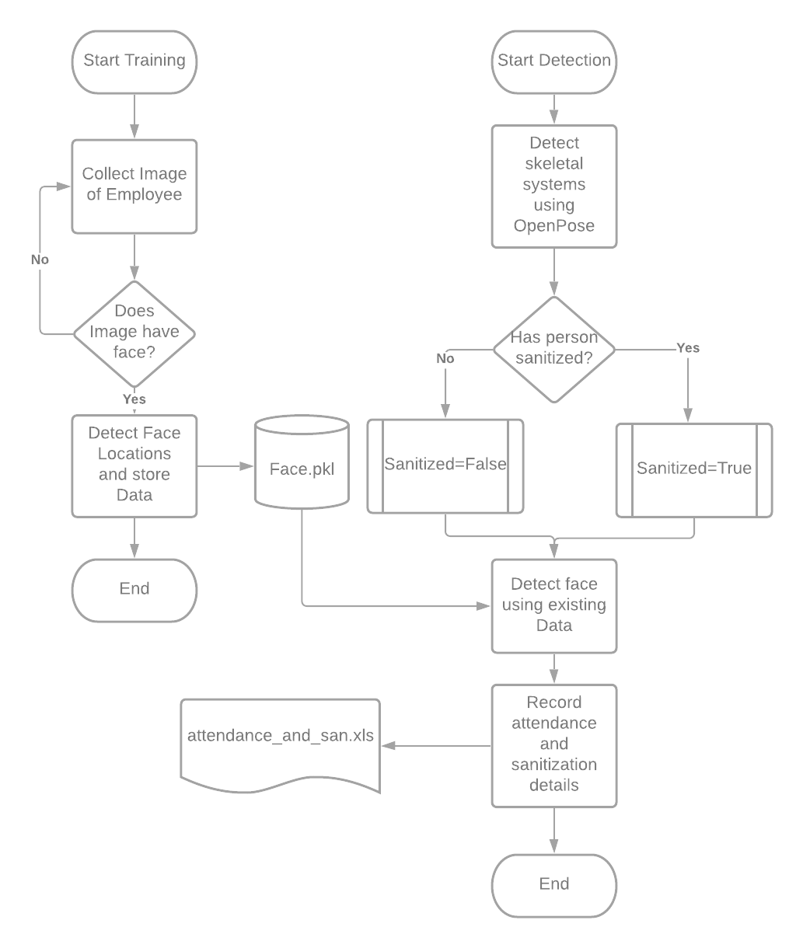
FLOW CHART

Slide 7
IMPLEMENTATION
The process begins with capturing five images of the employee.
It detects the faces from the image and stores it in the data base.
Detecting facial landmarks involves localizing the face and detecting key-facial structure in face ROI.
A training set of labeled facial landmarks on an image is required. These images are manually labeled, specifying specific (x, y)-coordinates of regions surrounding each facial structure.
Given this training data, an ensemble of regression trees are trained to estimate the facial landmark positions directly from the pixel intensities themselves.
The end result is a facial landmark detector that can be used to detect facial landmarks in real-time with high quality predictions.

Slide 8
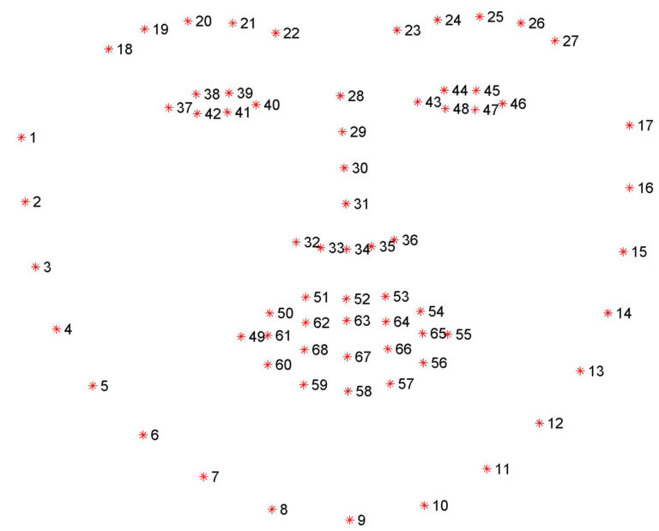
IMPLEMENTATION

Slide 9
IMPLEMENTATION
Open Pose is the first real-time multi-person system to jointly detect human body, hand, facial, and foot key points.
We have used this to detect the skeletal system of a person and estimate his pose.
We get the locations of all the body parts of the human.
Then we assume that if the person’s hands are touching and his wrists and elbows lie on the same x-axis plane the person has sanitized.
OpenPose for human pose estimation has been implemented using TensorFlow.
OpenPose uses 10 layers of VGG-19 Neural net to extract skeletal system of a person.

Slide 10
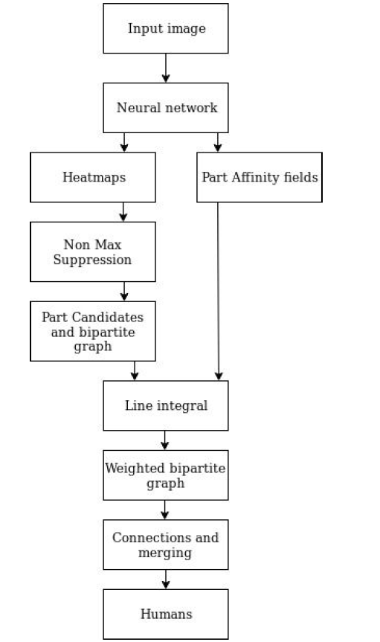
IMPLEMENTATION
Confidence Maps - A Confidence Map is a 2D representation of the belief that a particular body part can be located in any given pixel.
Part Affinity Fields - Part Affinity is a set of 2D vector fields that encodes location and orientation of limbs of different people in the image. It encodes thee data in the form of pairwise connections between body parts.

Slide 11
RESULTS

Slide 12
CONCLUSION
Our system proposes a contactless attendance and sanitization monitoring system in a office space.
This system will help in stopping the spreading of virus while carrying on in our day to day life.
It uses new technologies which are constantly supported and updated.

Slide 13
REFERENCES
[1] Xudong Sun, Pengcheng Wu, Steven C.H. Hoi “Face Detection using Deep Learning: An Improved Faster RCNN Approach” , eprint arXiv:1701.08289v1 [cs.CV] 28 Jan 2017
[2] Sharma S, Karthikeyan Shanmugasundaram, Sathees Kumar Ramasamy, “FAREC-CNN Based Efficient Face Recognition Technique Using Dlib”, 2016 International Conference on Advanced Communication Control and Computing Technologies (ICACCCT)
[3] Zhe Cao, Student Member, IEEE, Gines Hidalgo, Student Member, IEEE, Tomas Simon, Shih-En Wei, and Yaser Sheikh, “OpenPose: Realtime Multi-Person 2D Pose Estimation using Part Affinity Fields ”, eprint arXiv:1812.08008v2 [cs.CV] 30 May 2019
[4] Tomas Simon, Hanbyul Joo, Iain Matthews and Yaser Sheikh, “ Hand Keypoint Detection in Single Images using Multiview Bootstrapping”, CVPR, 2017
[5] Tejashree Dhawle, Urvashi Ukey, Rakshandha Choudante, “Face Detection and Recognition using OpenCV and Python”

Slide 14
SUGGESTIONS….!

Slide 15
THANK YOU!!!

