Slide 1

DataWarriors
PRESENTS
Price Setter & Follower Detection Algorithm

Slide 2

MEET THE TEAM
Nikhil Agarwal
Anurag Vaibhav
IIT KHARAGPUR
nikhil204@iitkgp.ac.in
IIT KHARAGPUR
anuragvaibhav7@gmail.com

Slide 3
Description
TASK- Construction of a data-based method or algorithm that can reveal the market dynamics, which usually occurs in the price-setting game for a bus. This method should broadly classify which bus operator changes price based on supply and demand independently and who is a follower of other price setters. We must also produce a confidence score in favor of what we predict.
DATASET –Our dataset consists of 5 columns out which ‘Seat Fare Type 1’ and ‘Seat Fare Type 2’ column contains 4 comma separated price values for different categories like front/back/upper/lower. Some of the entries in these columns only have one price, some have two, three, and four. Depending upon available seat categories. Some entries of the ‘Seat Fare Type 2’ column are zero which is an anomaly. The column ‘recorded contains the time at which the prices are recorded, we also have the ‘service date column which specifies the date on which bus will run, and ‘Bus’ column which contains different bus ids.

Slide 4
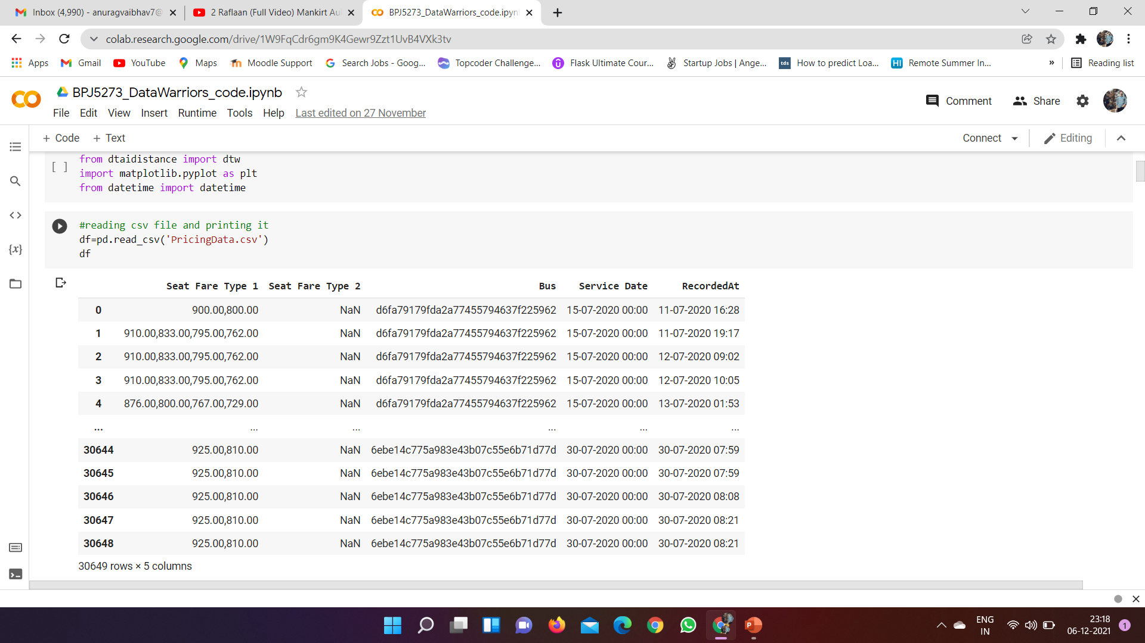
Picture of Dataset

Slide 5
Approach
Step1 : First, we used pandas for reading the csv dataset file then we performed a data cleaning operation to remove rows having ‘Seat Fare Type 2’ value zero.
Step2 : In the next step, we made the ‘Seat Fare Type1’ and ‘Seat Fare Type 2’ split into 4 categories each depending on subcategories(front/back/upper/lower) in this process we created 8 new columns like Category11 for Seat Fare Type 1 front seat, Category12 and so on.
Step3 :This step is a bit complicated to understand but to summarise it. We first used a unique method to find several unique buses in the dataset. Later we iterated over the dataset and we started storing all the prices of Category11 for a bus in a list and the time also in a list. Then we created a new data frame in which we stored unique buses and in front of it we stored a list of prices along with the time in the list.

Slide 6
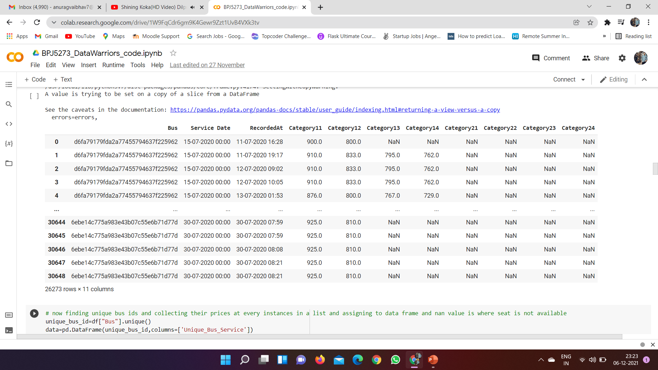
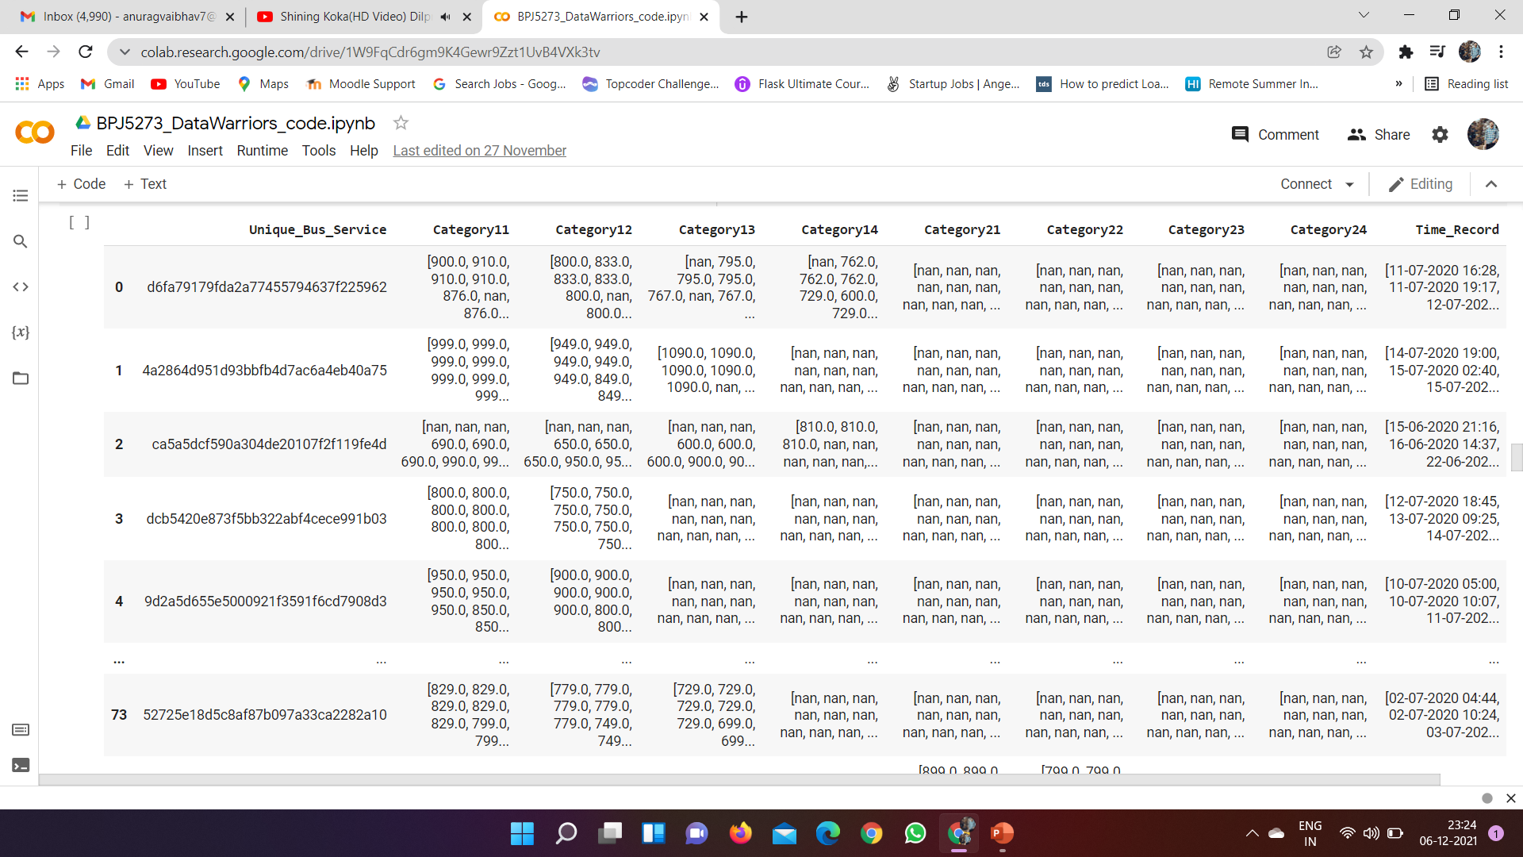
Pictorial Representati -on of Three Steps

Slide 7
Step4 : In this step, we sorted the time list for each bus and according we sorted the price list and converted the date in Date Time format then we started plotting time-series graphs for each category column.
Step5: Then we found that the time series graph of Category21, Category22 ,Category23 have only 1 or 2 bus data so we decide to drop it off.
Step6 : In this step, we used a dynamic time wrapping algorithm to compare time series. We calculated the dtw distance between buses for each category and stored it in a list and if unfortunately, we got dtw distance as infinity then we stored -1 in place of it and then later replaced it with the max of that list +1000 to prevent our analysis to produce poor results.
Step7 : Now we added dtw distance of each category together and obtained a compared distance list for each bus. Then we used minimum distance in the list which corresponds to the closest comparison. Using this we're able to find who follows whom then we normalized the distance using (M-S(x,y))/M and then passed it to the sigmoid function to get a confidence score.

Slide 8
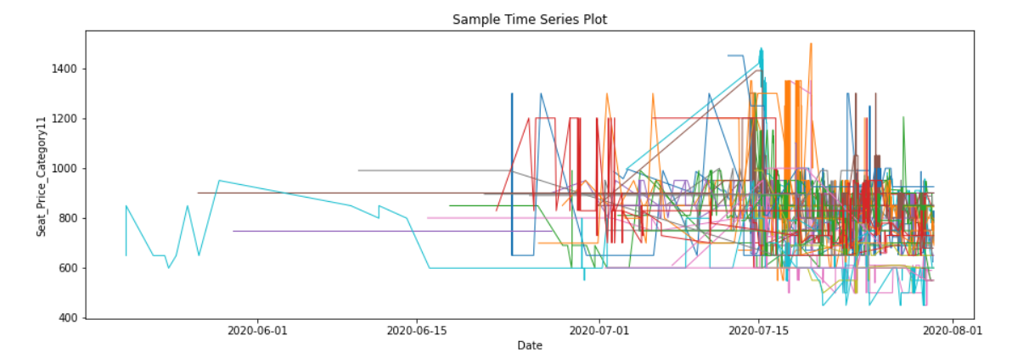
TimeSeries

Slide 9
Intuition
First, we thought that since the price is changing over time then we can use time series analysis later further we thought that dividing the Seat Fare Type 1 and Seat Fare Type 2 and analyzing each category and merging the result will produce better results. We also assumed the intuition that we will replace infinity dtw distance with a maximum of compared value, so that it must not hamper analysis much when we merge results of each category analysis.

Slide 10
Generalization
Our model is generalized that even if a bus doesn’t follow another bus completely then also our algorithm will find some generalization because we are first comparing category wise then we are merging results. So our model is generalized to handle this case and also we have generalized infinite dtw distance with a maximum of the list so that if we combine results then it should not distort results for other categories because it can happen a bus doesn’t follow in one category so got infinity distance but it follows in other categories.

Slide 11
Experimental Details
A few experiments that we tried with data were that first, we tried to average prices of Seat Fare Type 1 and Seat Fare Type 2 but the results were not so convincing which can be thought logically. Since we don’t have multiple category prices then averaging will not be a good option plus we will lose a good point that after averaging we cannot see the pattern in each category individually. Secondly, if we don’t remove infinity as a dtw distance list of a category then merging results of all categories will produce a poor result. As we know infinity will upon summation make overall distance infinity.

Slide 12

THANKS!
Any Question for us?

