Slide 1
Unified Threat Management Cloud Dashboard
Design and Implementation of an Edge-Fog-Cloud Architecture
Presented by: Anurag Khanapurkar
Lecturer: Prof. Giovani Estrada
MSc Cloud Computing, National College of Ireland

Slide 2
The Limitations of Cloud-Direct IoT
Modern perimeter security relies on high-bandwidth multi-sensor arrays.
Transmitting raw telemetry directly to the cloud introduces critical flaws:
• High Ingestion Latency: Unacceptable for mission-critical physical security.
• Bandwidth Consumption: Continuous streaming incurs prohibitive egress costs.
• Single Point of Failure: WAN outages completely blind the security apparatus.
• Database Bloat: Storing harmless environmental noise degrades analytical performance.

Slide 3
Edge-Fog-Cloud Paradigm
A decoupled, three-tier architecture to process threats locally and visualize them globally.
1. Edge Tier (Sensors): Generates raw UDP telemetry (RF, Acoustic, Seismic, Thermal).
2. Fog Tier (Local Brain): Executes mathematical threshold filtering at the network edge.
3. Cloud Tier (AWS IoT & Django): Handles secure ingestion, routing, and persistent storage.
Objective: Transmit only actionable threats to the Dashboard.

Slide 4
Fog Node: Multi-Sensor Threat Classification
Evaluates incoming sensor data by calculating a localized Threat Score.
Assesses multiple variables simultaneously to prevent false positives. example:
• Drone Breach: High RF (> -60 dBm), High Pitch (> 2000 Hz), Low Mass (< 10 kg).
• Vehicle Approach: High Seismic (> 1.5 g), Massive Thermal (> 1000 kg).
Threshold Logic: If the Threat Score exceeds the limit, a cloud payload is generated.
If below the limit, the data is classified as background noise and raw telemetry is discarded.

Slide 5
The Aggregated Metric Heartbeat
Challenge: How does the cloud know edge filtering is working if the data is discarded?
Solution: The Aggregated Metric Heartbeat pattern.
• The Fog Node increments a local tally counter for every discarded false alarm.
• Every 60 seconds, it transmits a single, lightweight 'heartbeat' JSON payload.
• The Django backend logs this metric to a dedicated database table.
Result: Preserves exact system observability without suffering bandwidth penalties or database bloat.

Slide 6
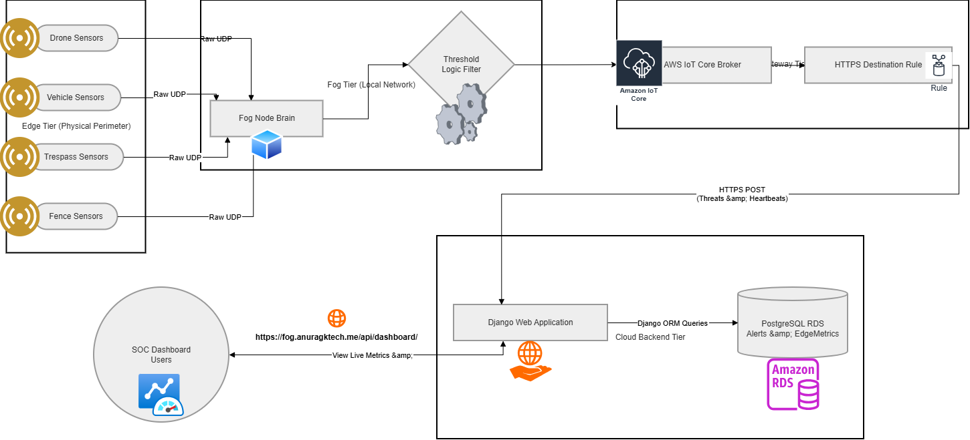
Architecture

Slide 7
Cloud Dashboard & Automation
Backend: Django web application hosted on an AWS Elastic Beanstalk Auto Scaling Group.
Database: Amazon RDS (PostgreSQL) optimized for relational telemetry data.
Security: Protected by Cloudflare's Strict SSL reverse proxy to mitigate DDoS and manage DNS.
CI/CD: Fully automated deployment pipeline utilizing GitHub Actions.

Slide 8
Reflections & Future Implementations
Successfully validated the Edge-Fog-Cloud architecture for physical security environments.
Achieved substantial bandwidth reduction while maintaining UI responsiveness and data integrity.
Future Work: Transitioning from static mathematical thresholds to Edge ML.
• Deploying a lightweight Random Forest classifier directly onto the Fog Node.
• Dynamic anomaly detection based on localized, site-specific calibration data.

