Slide 1


Shrimad Bhagavad: A Project Report
This presentation explores the project report submitted for the Bachelor's Degree in Computer Science and Engineering at KIIT Deemed to be University, focusing on the application of technology to explore the ancient teachings of the Bhagavad Gita.
by Anurag Panda
Ankit Hati
Prajukta Sahoo
Saumya

Slide 2
Project Scope
Objective
Implementation
The project aims to create a user-friendly platform to make the teachings of the Bhagavad Gita more accessible to the modern generation.
The project utilizes a combination of Machine Learning, sentiment analysis, and a chatbot to deliver a personalized experience.

Slide 3
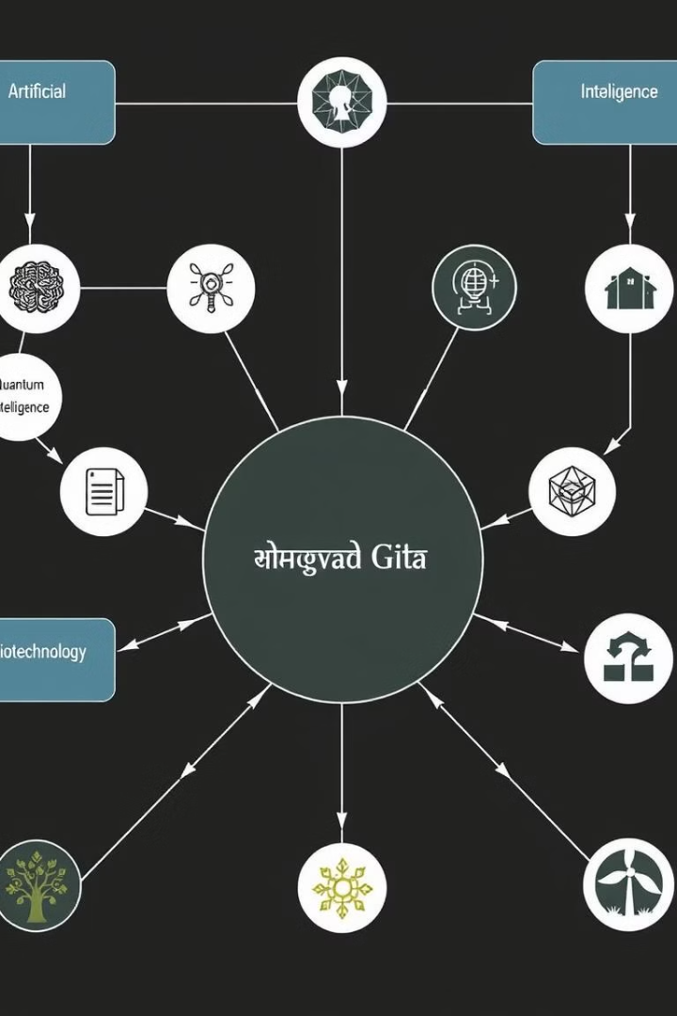
Technical Foundations
HTML
CSS
The standard markup language for web documents.
Style sheets for controlling the presentation of web pages.
Bootstrap
JavaScript
A library to simplify web page development.
Programming language used for interactive web behaviors.

Slide 4



Machine Learning & Sentiment Analysis
Dataset Processing
1
Pre-processing the Bhagavad Gita text for model training.
Natural Language Processing
2
Enabling the model to understand user queries.
Sentiment Analysis
3
Identifying the emotional tone of user inputs.

Slide 5
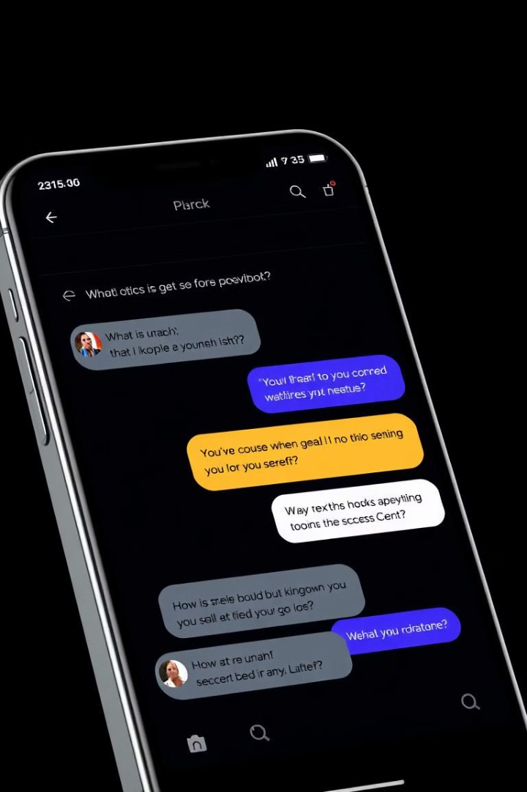



Implementation Details
Mobile Optimization
Responsive design ensures accessibility across devices.
Color Palette
A clean and simple color scheme enhances user experience.
Font Selection
A modern yet uncluttered font enhances readability.

Slide 6
Project Contributors
Anurag Panda (2105181)
Ankit Hati (21052897)
Frontend & Backend Integration
Dataset Integration with ML Model
Flask Backend Development
ML Model Creation & Training
GitHub Repository Management
Sentiment Analysis Implementation
Website Deployment
Model Bug Fixing

Slide 7
Project Contributors (cont.)
Prajukta Sahoo (21051231)
Saumya (2129100)
Chatbot API Development
Chatbot Layout Design
Frontend Integration with APIs
HTML & CSS Implementation
Dataset Research for ML Model
Chatbot Responsiveness for all Devices

Slide 8

Conclusion
The Shrimad Bhagavad project successfully leverages technology to create a user-friendly platform, making the teachings of the Bhagavad Gita accessible to the modern generation. The project's implementation of Machine Learning, sentiment analysis, and a chatbot offers a personalized experience, promoting a deeper understanding of our spiritual heritage and inspiring courage, self-awareness, and conviction in the face of adversity.

