Slide 1


Sketchpad.pro
BY ANURAG
To Los Altos Hackathon

Slide 2
What’s Sketchpad.pro
Sketchpad.pro is a simple graphic editor written for the web. This drawing library uses HTML5 Canvas supported by all modern browsers (Chrome, Firefox, Opera, Internet Explorer...). You can use any device to draw on "sketchpad". Drawn sketches you can export to jpeg/png or save as .json history file.

Slide 3



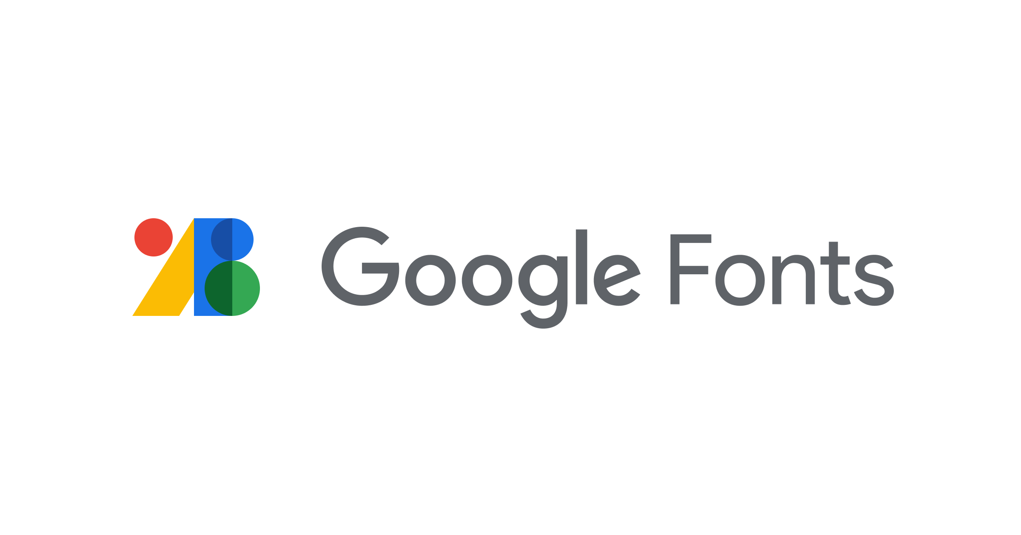
Sketchpad.pro is made with
Frontend-HTML ,CSS , JavaScript
Backend-NodeJS
API’s- Google Font api, Bootstrap

Slide 4
Uses
Used by Graphic designers
Used by teacher to share white board with students.
Used by developers to design websites.
And Many more……………

Slide 5
Key Features
Has white board.
Has online white board sharing feature.
Has variety of tools like fill tool , shape tool , text add tool and many more.
You can make your own tool with your coding skills.

Slide 6

Lets head to
part

