Slide 1
Banking Analytics Solution for Czechoslovakia Bank
Name: Anurag
Date: 01-07-26

Slide 2
BUSINESS CONTEXT
● Banking Industry Challenge: Managing 1M+ transaction records across 8 interconnected data sources
● Data Quality Imperative: Ensuring data integrity is foundational for decision-making and analytics
● Analytics-Driven Strategy: Shift from reactive reporting to proactive insight generation
● Technology Stack: Leverage SQL Server for data management, Power BI for visualisation, Python for predictive analytics
● Risk Mitigation: Comprehensive data audit reduces reporting errors, regulatory exposure, and operational risk

Slide 3
BUSINESS OBJECTIVES
✓ Assess data quality and identify inconsistencies across all 8 tables.
✓ Validate referential integrity and enforce data governance standards.
✓ Consolidate transaction data into a unified fact table (1M+ records).
✓ Build clean, reliable foundation for analytics and reporting.
✓ Design Power BI dashboards for executive-level insights.
✓ Enable predictive modelling for loan default prediction and customer risk scoring.

Slide 4
PROJECT SCOPE & METHODOLOGY
Data Audit
Data Validation
Data Processing
EDA Planning
Analytics Planning

Slide 5
DATASET OVERVIEW
Table | Record Count | Type
fact_table | 1048575 | Transactions
order | 6,471 | Master
client | 5,369 | Master
disp | 5,369 | Master
account | 4,500 | Master
card | 892 | Master
loan | 682 | Master
district | 77 | Master
TOTAL | 1,071,935

Slide 6
TECHNOLOGY STACK
📊 SQL Server
→ Data ingestion, validation, transformation, and KPI calculation
📈 Power BI Desktop
→ Interactive dashboards, DAX modelling, cloud deployment
🐍 Python (Pandas, NumPy, Scikit-Learn)
→ Data cleaning, EDA, predictive modelling, visualisation
📋 Excel & PowerPoint
→ Documentation, reporting, presentation

Slide 7
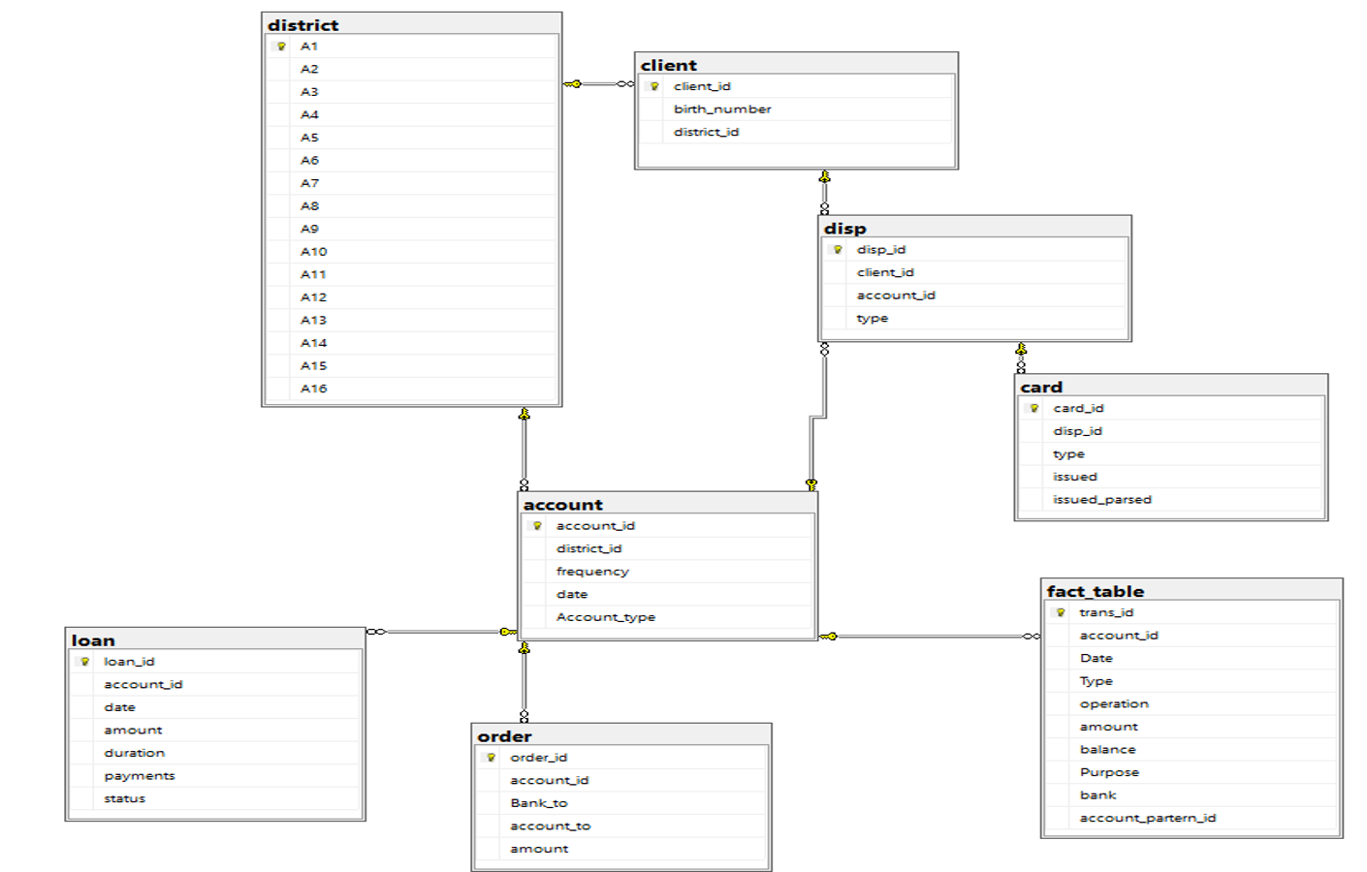
ER DIAGRAM

Slide 8
DATA AUDIT FRAMEWORK
1. Primary Key Validation — Detect duplicate and NULL primary keys
2. Foreign Key & Referential Integrity — Identify orphan records and broken relationships
3. Date Format & Range Validation — Ensure date columns are properly formatted
4. Null Value Analysis — Identify unexpected NULLs in critical columns
5. Domain & Enumeration Validation — Verify categorical values match allowed domain
6. Business Rule Validation — Enforce data consistency rules (negative amounts, balances, etc.)

Slide 9
PRIMARY KEY VALIDATION RESULTS
0
Duplicate PKs
0
NULL PKs
✓ PASS: All 8 tables have valid, unique primary keys with no duplicates or NULL values

Slide 10
REFERENTIAL INTEGRITY VALIDATION
Relationship | Orphan Rows | Status
account → district | 0 | ✓ PASS
client → district | 0 | ✓ PASS
disp → account | 0 | ✓ PASS
disp → client | 0 | ✓ PASS
card → disp | 0 | ✓ PASS
loan → account | 0 | ✓ PASS
order → account | 0 | ✓ PASS
fact_table → account | 0 | ✓ PASS
✓ 100% REFERENTIAL INTEGRITY — All foreign key relationships validated

Slide 11
DATA QUALITY SCORE CARD
32+
SQL Checks
28
Executed
23
Passed
5
Issues Found
99.2%
DATA QUALITY SCORE

Slide 12
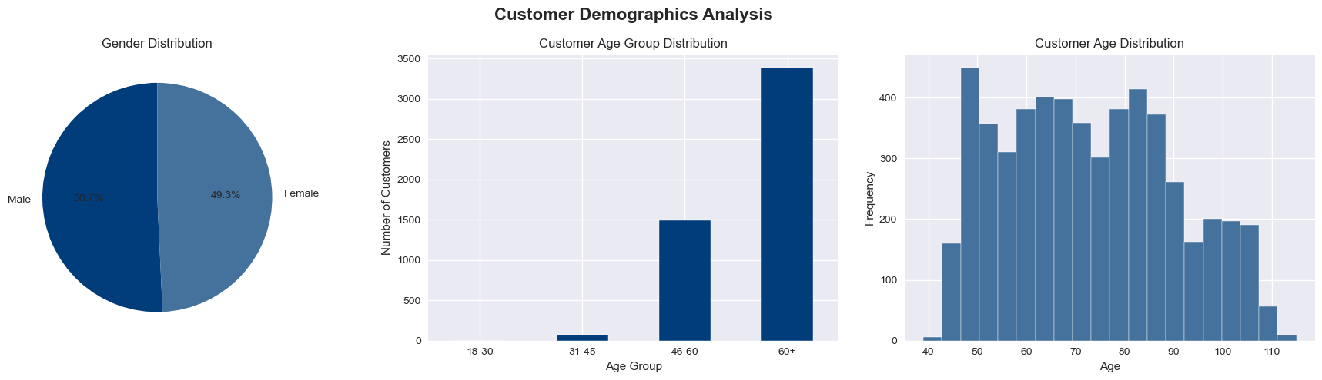
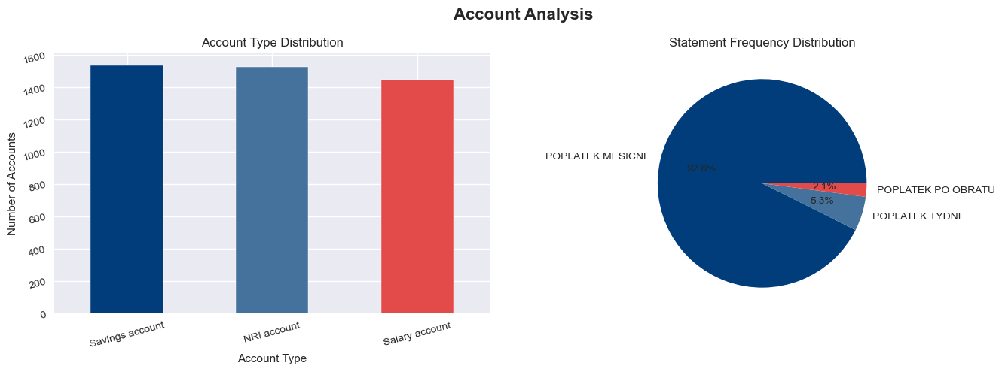
PYTHON EDA — CUSTOMER & ACCOUNT ANALYTICS
50.7% / 49.3%
Gender Split (M / F)
73
Avg. Customer Age (yrs)
16.6%
Card Adoption Rate
4,500
Total Accounts (3 Types)
Customer base skews older (68% aged 46+) with balanced adoption across Savings, NRI, and Salary accounts.

Slide 13
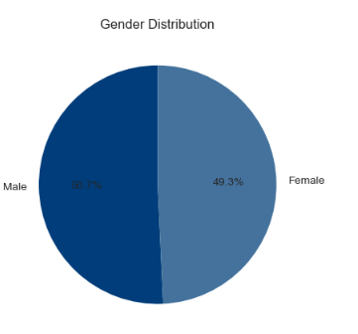
Gender Distribution
Insights
Male customers account for 50.7% of the customer base.
Female customers account for 49.3%.
The customer base is almost evenly distributed between males and females.
Business Interpretation
The bank has a balanced customer portfolio with no significant gender bias.
Marketing campaigns and financial products can be designed for both genders without major demographic imbalance.
Any future segmentation should focus more on customer behaviour than gender.

Slide 14
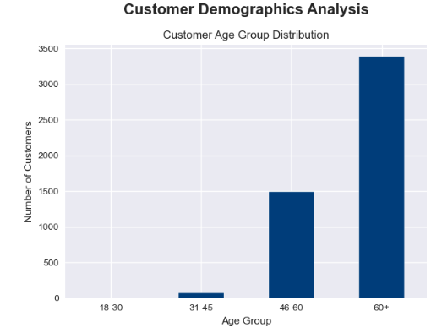
Customer Age Group Distribution
Insights
The 60+ age group represents the largest proportion of customers.
Customers aged 46–60 form the second-largest segment.
Very few customers fall into the 18–30 and 31–45 age groups.
Business Interpretation
The bank primarily serves middle-aged and senior customers.
Older customers are likely to have higher account balances, pensions, or long-term banking relationships.
Younger customers represent a growth opportunity.
Recommendation
Develop digital banking products and targeted marketing campaigns to attract younger customers.
Continue offering retirement, investment, and wealth management services for senior customers.

Slide 15
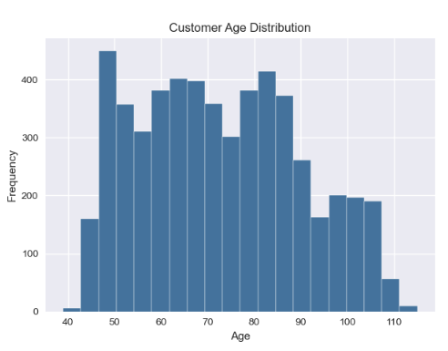
Customer Age Distribution
Insights
The customer age range is approximately from 40 to 110 years.
Most customers appear to be concentrated between 50 and 90 years.
Very few customers are below 45 years of age.
Business Interpretation
The customer base is relatively mature.
Banking products should emphasise savings, fixed deposits, insurance, and retirement planning.

Slide 16
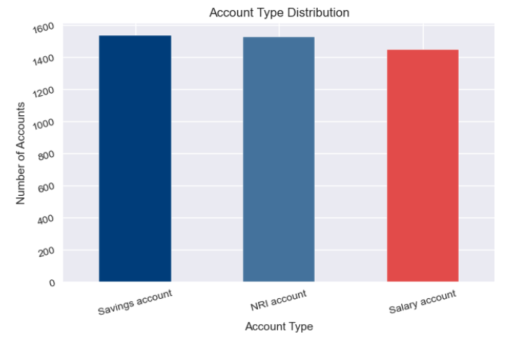
Account Type Distribution
Key Insights
Savings Accounts are the most common account type, accounting for approximately 1,550 accounts.
NRI Accounts are almost equal in number to Savings Accounts (around 1,540).
Salary Accounts are slightly lower at approximately 1,450 accounts.
The distribution is relatively balanced across all three account types.
Business Interpretation
The bank has a well-diversified customer portfolio, reducing dependence on a single account type.
Strong adoption of Savings and NRI accounts indicates healthy customer trust and deposit growth.
Salary accounts represent an opportunity for expansion through employer partnerships.
Recommendation
Introduce cross-selling opportunities such as loans, insurance, and investment products across all account holders.
Collaborate with corporate organizations to increase Salary Account acquisitions.
Offer premium banking services to NRI customers to improve customer retention.

Slide 17
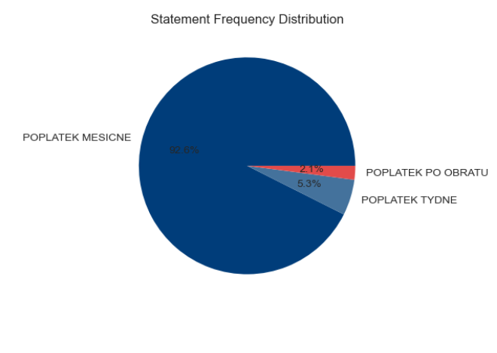
Statement Frequency Distribution
Key Insights
Monthly statements (POPLATEK MESICNE) account for 92.6% of all customers.
Weekly statements (POPLATEK TYDNE) represent 5.3%.
Statements after each transaction (POPLATEK PO OBRATU) account for only 2.1%.
Business Interpretation
Most customers prefer receiving monthly account statements, suggesting this is the standard communication frequency.
Very few customers require frequent updates, indicating lower demand for detailed statement services.
Monthly statements help reduce operational and communication costs compared with daily or transaction-based notifications.
Recommendation
Continue offering monthly statements as the default option.
Encourage customers to adopt digital statements and mobile notifications instead of printed statements.
Offer customizable notification preferences through internet and mobile banking.

Slide 18
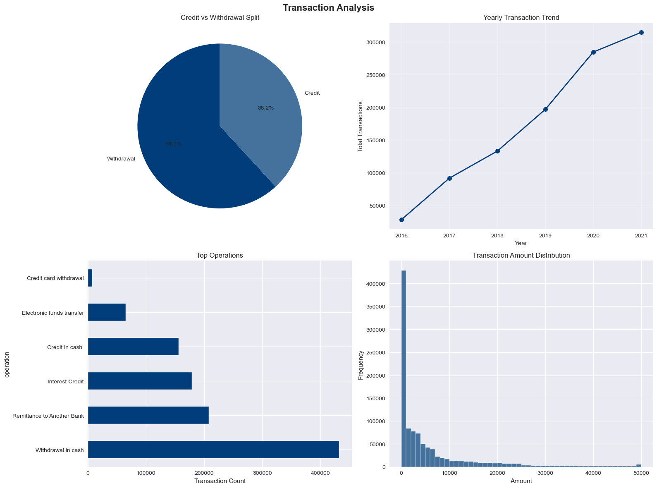
PYTHON EDA — TRANSACTION ANALYTICS
Withdrawals make up 62% of all activity; transaction volume has grown more than 10x since 2016, led by cash withdrawals and bank transfers.

Slide 19
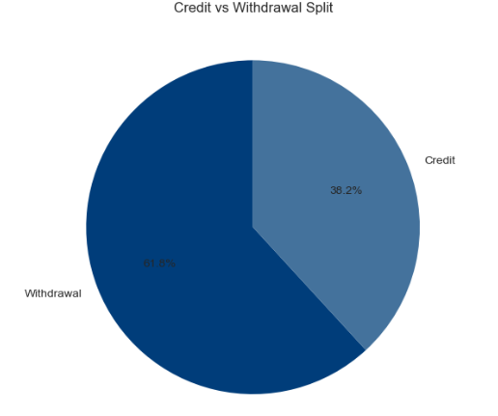
Credit vs Withdrawal Split
Insights
Withdrawals account for 61.8% of all transactions.
Credits account for 38.2% of total transactions.
Business Interpretation
Customers perform withdrawals more frequently than deposits.
The bank experiences a higher volume of outgoing transactions, indicating active account usage.
A larger withdrawal share may reflect customers using accounts primarily for spending and cash withdrawals.
Recommendation
Promote savings and investment products to encourage customers to retain higher account balances.
Introduce cashback or rewards for maintaining balances and increasing deposits.

Slide 20
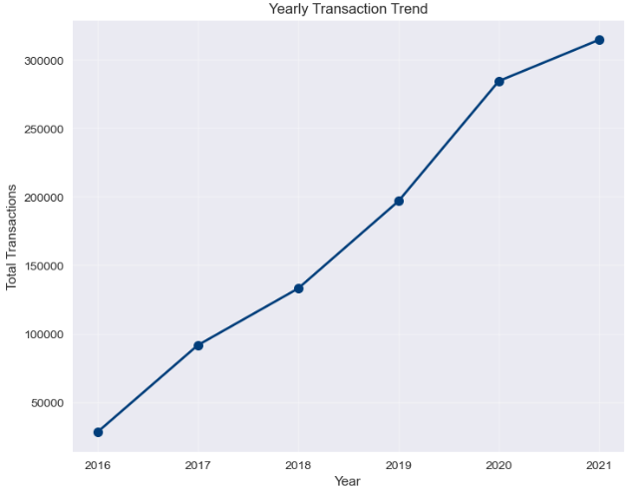
Yearly Transaction Trend
Insights
Total transaction volume increases consistently from 2016 to 2021.
The sharpest growth occurs between 2019 and 2020.
2021 records the highest transaction volume.
Business Interpretation
Customer engagement has steadily increased over time.
The growth indicates expanding banking activity and greater adoption of banking services.
The upward trend suggests improved customer retention and transaction frequency.
Recommendation
Ensure infrastructure can scale with increasing transaction volumes.
Use transaction trends for forecasting future system capacity and staffing requirements.

Slide 21
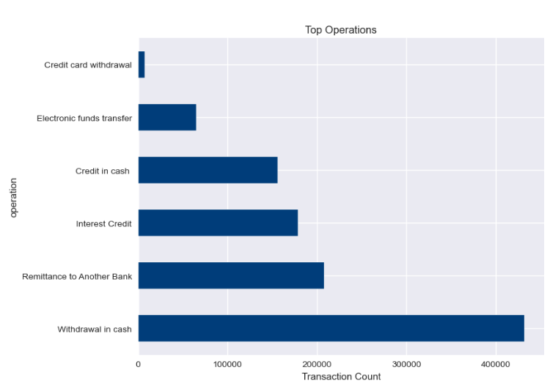
Top Banking Operations
Insights
Withdrawal in cash is the most frequently performed banking operation.
Remittance to another bank is the second most common transaction type.
Interest credit and cash deposits are moderately frequent.
Electronic funds transfer occurs less frequently.
Credit card withdrawals represent the smallest proportion of transactions.
Business Interpretation
Customers continue to rely heavily on cash-based transactions.
Inter-bank transfers are an important service for customers.
Digital payment adoption appears relatively low compared with cash transactions.
Recommendation
Encourage digital payments and online fund transfers through incentives.
Reduce dependence on cash transactions by promoting mobile and internet banking.

Slide 22
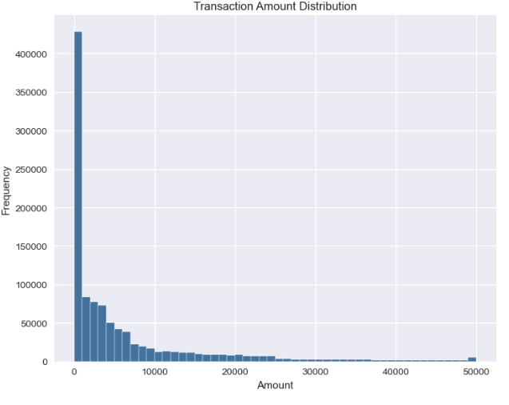
Transaction Amount Distribution
Insights
Most transactions involve small monetary amounts.
Transaction frequency decreases as transaction value increases.
Large-value transactions are relatively rare.
Business Interpretation
Customers primarily perform routine day-to-day banking transactions.
High-value transactions constitute only a small portion of overall banking activity.
The distribution is right-skewed, with many low-value transactions and few high-value transactions.
Recommendation
Develop products and offers targeted at frequent low-value transaction users.
Monitor unusually large transactions as part of fraud detection and risk management.

Slide 23
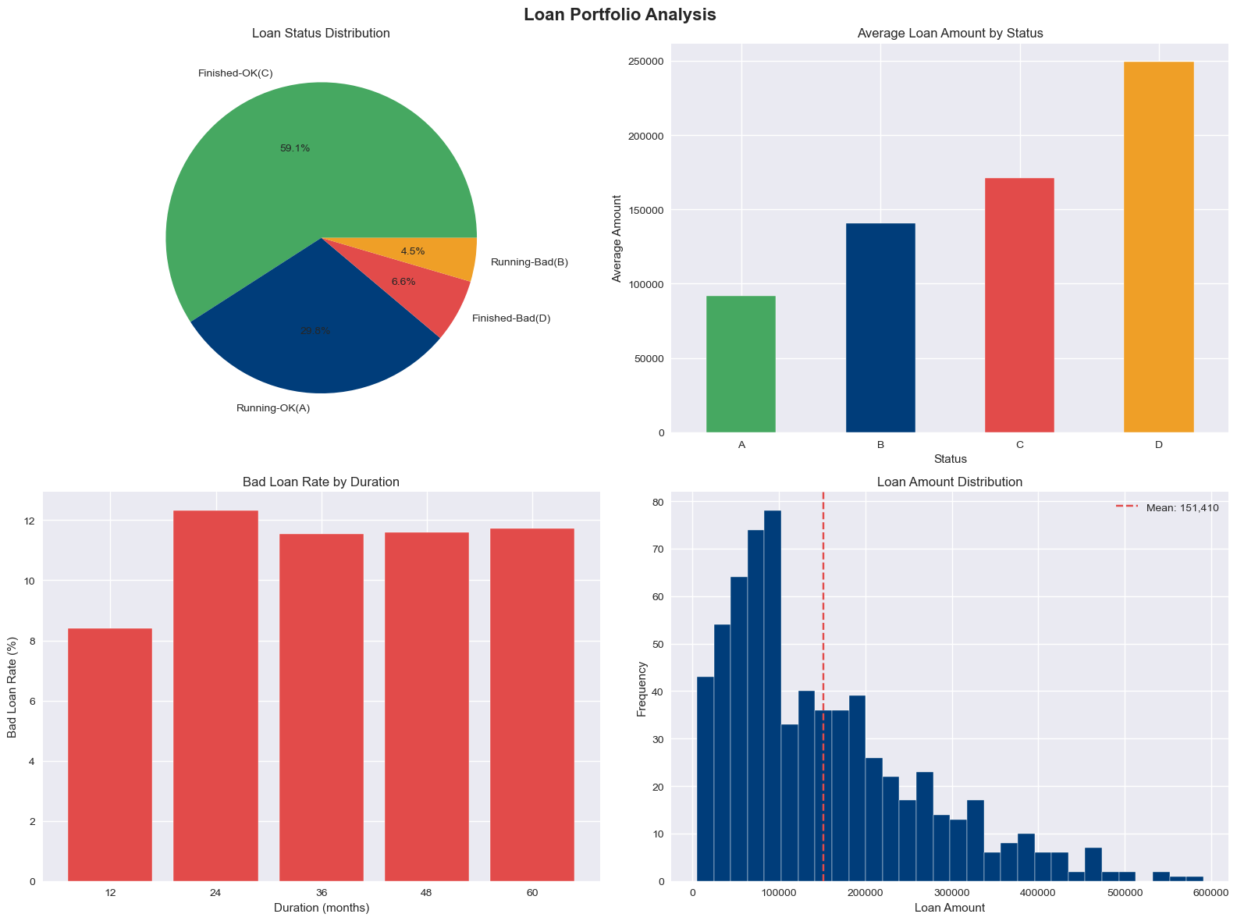
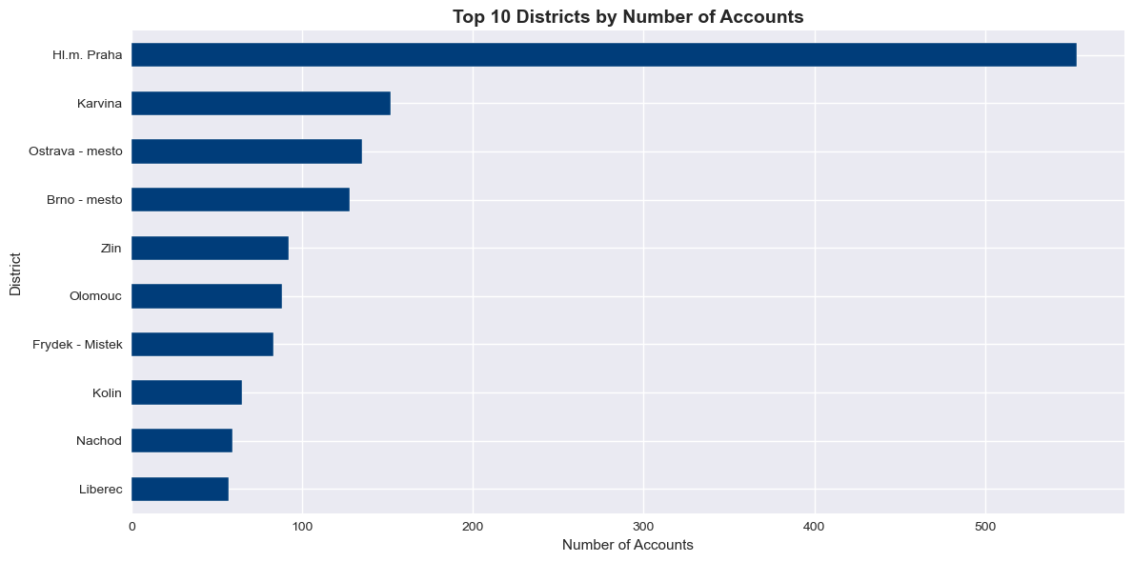
PYTHON EDA — LOAN & DISTRICT ANALYSIS
59% of loans finish in good standing; 11.1% overall default rate. Hl.m. Praha leads all districts by account volume, nearly 4x the next-largest district.

Slide 24
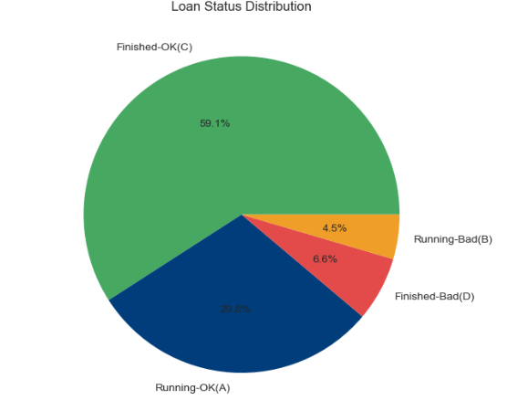
Loan Status Distribution
Insights
59.1% of loans are Finished-OK (Status C), indicating successful loan repayment.
29.8% are Running-OK (Status A), representing active loans that are being
repaid on schedule.
6.6% are Finished-Bad (Status D), where loans ended with repayment issues.
4.5% are Running-Bad (Status B), indicating active loans with repayment concerns.
Business Interpretation
Nearly 89% of loans are performing well, reflecting a healthy loan portfolio.
Only 11.1% of loans fall into bad loan categories (Statuses B and D), suggesting that credit risk is relatively well managed.
The bank maintains a strong repayment performance while keeping loan defaults under control.
Recommendation
Continue monitoring customers in the Running-Bad category through early warning systems and proactive customer engagement.
Use predictive analytics to identify borrowers at higher risk of default before repayment issues escalate.

Slide 25
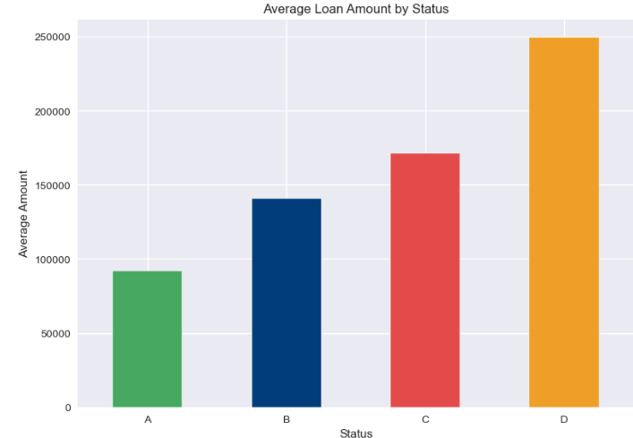
Average Loan Amount by Status
Insights
Average loan amount increases from Status A to Status D.
Finished-Bad (Status D) loans have the highest average loan amount
(approximately 250,000).
Running-OK (Status A) loans have the lowest average loan amount
(approximately 90,000).
Business Interpretation
Larger loans appear to be associated with a higher likelihood of repayment issues.
Customers borrowing higher amounts may require more detailed credit assessment and monitoring.
Recommendation
Apply stricter credit evaluation and risk assessment for higher-value loans.
Introduce enhanced monitoring for customers with large outstanding loan balances.

Slide 26
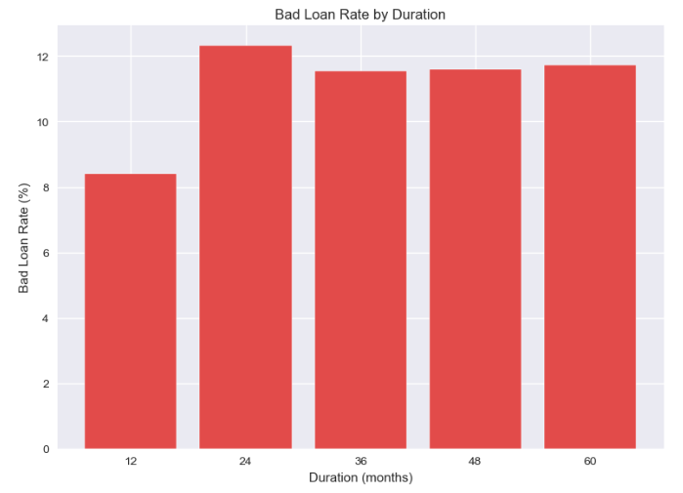
Bad Loan Rate by Loan Duration
Insights
12-month loans have the lowest bad loan rate (approximately 8.4%).
Loan durations of 24, 36, 48, and 60 months show similar bad loan rates
(around 11–12%).
Business Interpretation
Short-term loans appear to have better repayment performance.
Extending loan duration beyond one year does not significantly change the bad loan rate, but longer repayment periods may increase exposure to credit risk.
Recommendation
Encourage customers who qualify to choose shorter repayment periods.
Monitor long-duration loans more closely through periodic credit reviews.

Slide 27
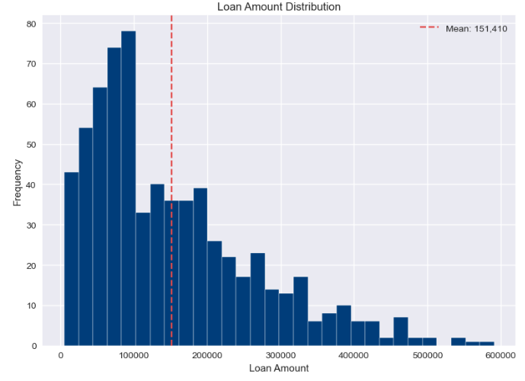
Loan Amount Distribution
Insights
The average loan amount is approximately 151,410.
Most loans are concentrated below 200,000.
The distribution is positively skewed, with relatively few high-value
loans exceeding 400,000.
Business Interpretation
The bank primarily issues small to medium-sized loans.
High-value loans represent a smaller share of the portfolio but may contribute disproportionately to credit risk.
Recommendation
Maintain diversified lending across different loan sizes.
Implement additional approval and monitoring procedures for high-value loans.

Slide 28
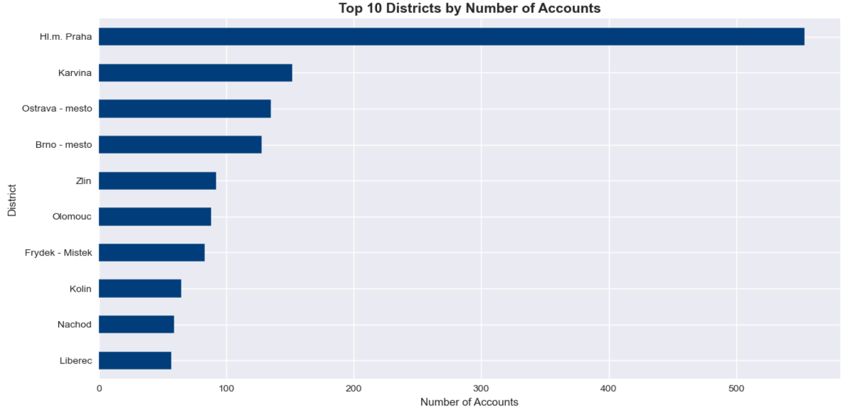
District-wise Account Distribution
Insights
Customer accounts are highly concentrated in Hl.m. Praha.
There is a noticeable gap between Praha and all other districts.
Most districts have relatively similar account volumes after the top four.
Business Interpretation
Hl.m. Praha is the bank's strongest market and contributes the largest share of customers.
Districts such as Karvina, Ostrava-mesto, and Brno-mesto represent important secondary markets with potential for further growth.
Lower-ranked districts may indicate untapped opportunities or lower banking penetration.
Business Recommendations
Continue strengthening customer retention and premium banking services in Hl.m. Praha to maintain market leadership.
Expand marketing campaigns and branch outreach in medium-performing districts such as Karvina, Ostrava-mesto, and Brno-mesto.
Introduce targeted acquisition programs in lower-performing districts to increase customer penetration.
Allocate resources and promotional budgets according to regional customer concentration to maximise return on investment.

Slide 29
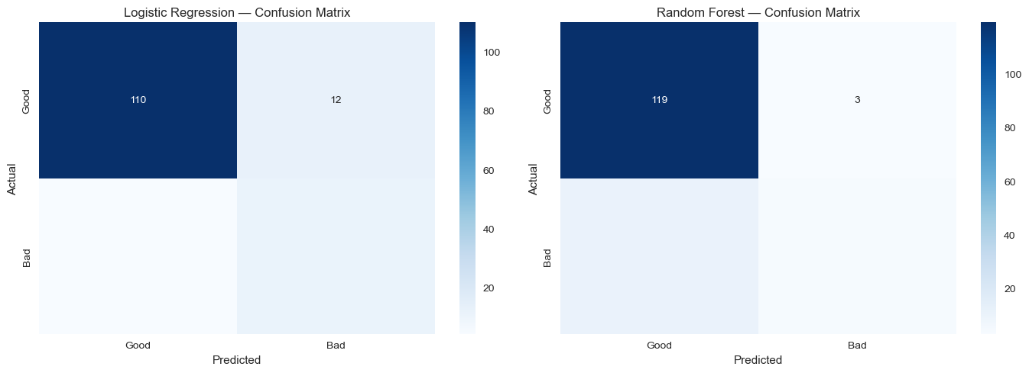
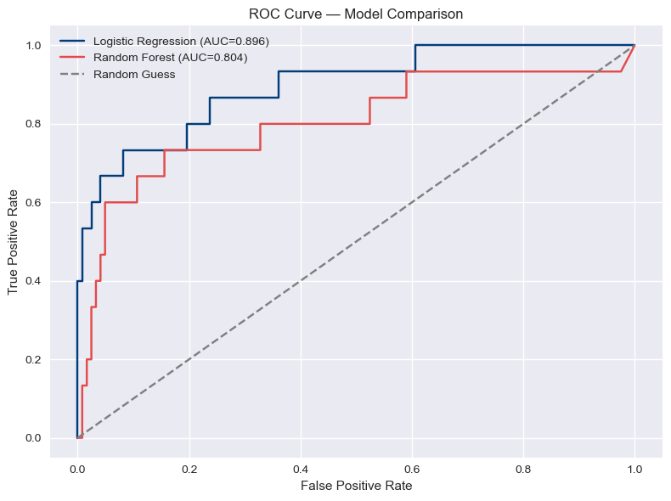
PREDICTIVE MODEL — LOAN DEFAULT PERFORMANCE
88.3%
Accuracy (Logistic Regression)
73.3%
Recall on Defaults (catches 11/15)
0.896
ROC-AUC Score
Logistic Regression was selected for deployment: lower accuracy than Random Forest, but far better at catching actual defaults — the metric that matters most for risk management.

Slide 30
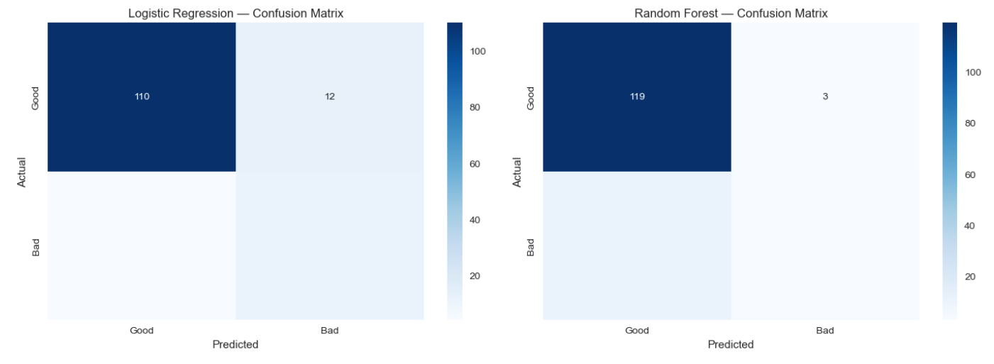
Logistic Regression
Insights
Correctly classified 110 good loans.
Misclassified 12 good loans as bad.
The model demonstrates good overall classification performance but produces more false predictions than Random Forest.
Business Interpretation
Logistic Regression provides reliable predictions and is suitable as a baseline classification model.
Some good customers may be incorrectly flagged as risky, potentially leading to unnecessary loan reviews.
Random Forest
Insights
Correctly classified 119 good loans.
Misclassified only 3 good loans.
Produced fewer classification errors than Logistic Regression.
Business Interpretation
Random Forest achieves higher classification accuracy on the test data.
Fewer misclassifications reduce unnecessary interventions for customers classified as high risk.

Slide 31
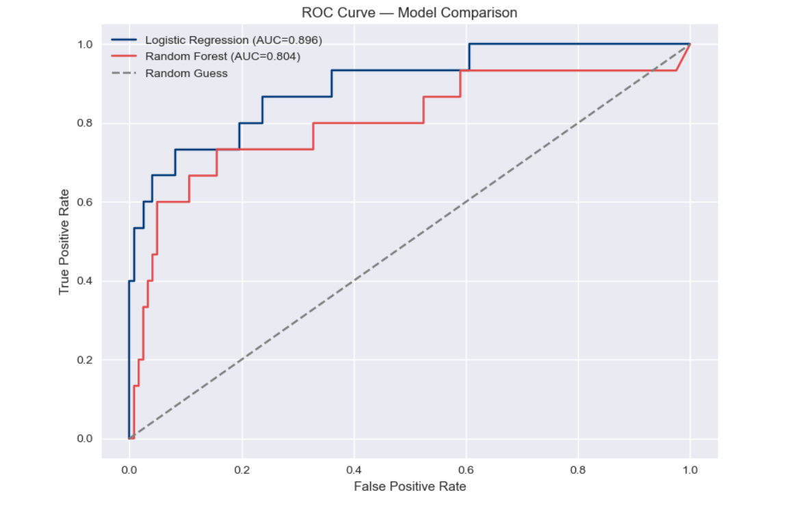
ROC Curve Comparison
Insights
Logistic Regression AUC = 0.896
Random Forest AUC = 0.804
The ROC curve shows how well each model distinguishes between good and bad loans across different classification thresholds.
Business Interpretation
Logistic Regression has the higher AUC, indicating better discrimination between loan classes overall.
Both models perform substantially better than random guessing.
A higher AUC suggests Logistic Regression ranks risky customers more effectively across varying decision thresholds.

Slide 32
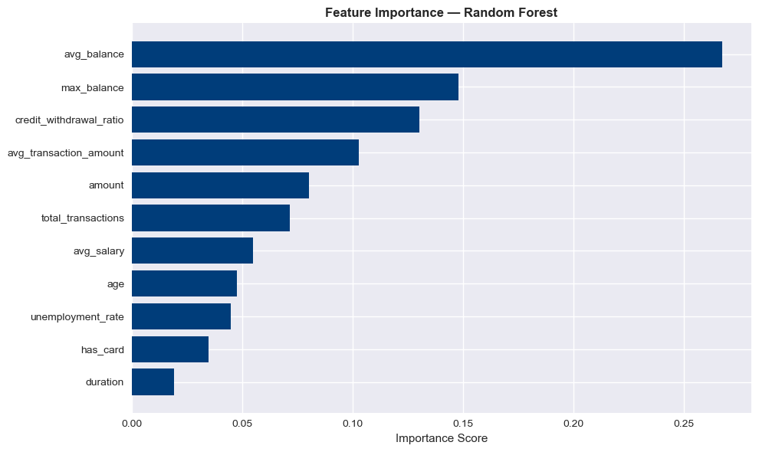
KEY MODEL DRIVERS & TAKEAWAYS
Balance behavior drives risk: avg_balance and max_balance are the top two predictors of default.
Spending pattern matters: the credit-to-withdrawal ratio ranks 3rd, ahead of loan amount itself.
Model choice favors recall: Logistic Regression (73.3% recall) was deployed over Random Forest (26.7% recall) to catch more true defaults.
Deployment: model and scaler saved as .pkl files and served through a Streamlit web application.
Feature Importance — Random Forest

Slide 33
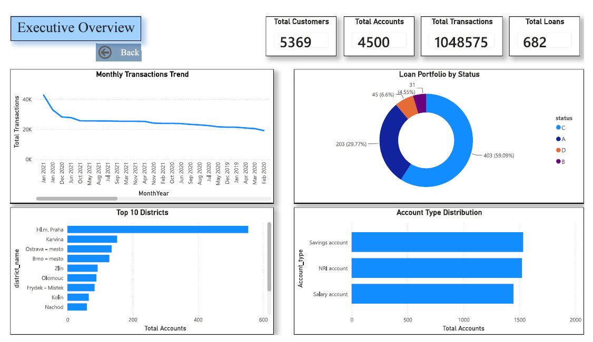
POWER BI DASHBOARD — EXECUTIVE OVERVIEW
Hl.m. Praha anchors the customer base with nearly 4x the accounts of any other district, while 89% of loans remain in good standing (Running-OK or Finished-OK status).

Slide 34
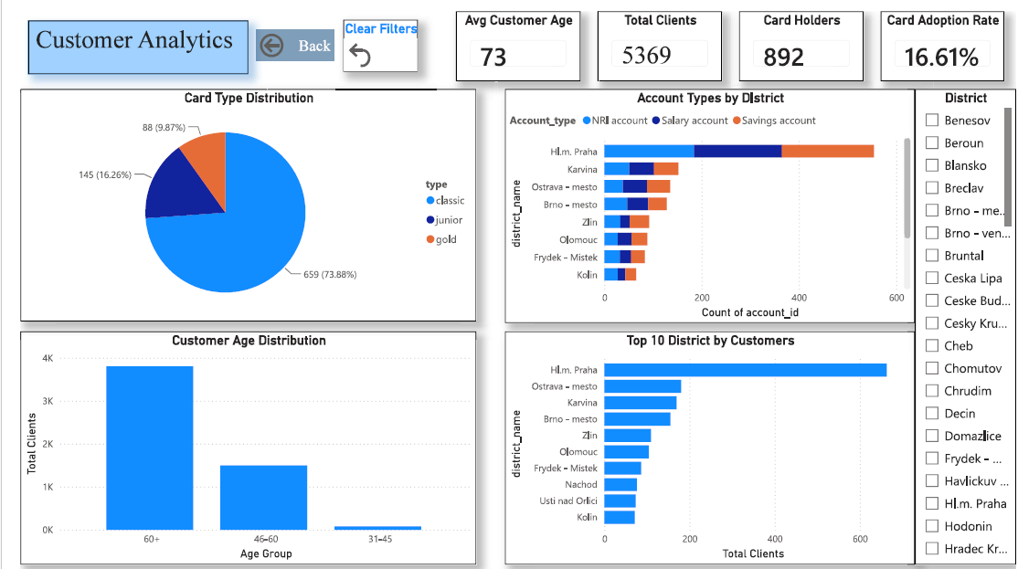
POWER BI DASHBOARD — CUSTOMER ANALYTICS
Customers skew notably older (avg. age 73, dominated by the 60+ segment), and card adoption remains modest at 16.6%, led almost entirely by classic cards (74%).

Slide 35
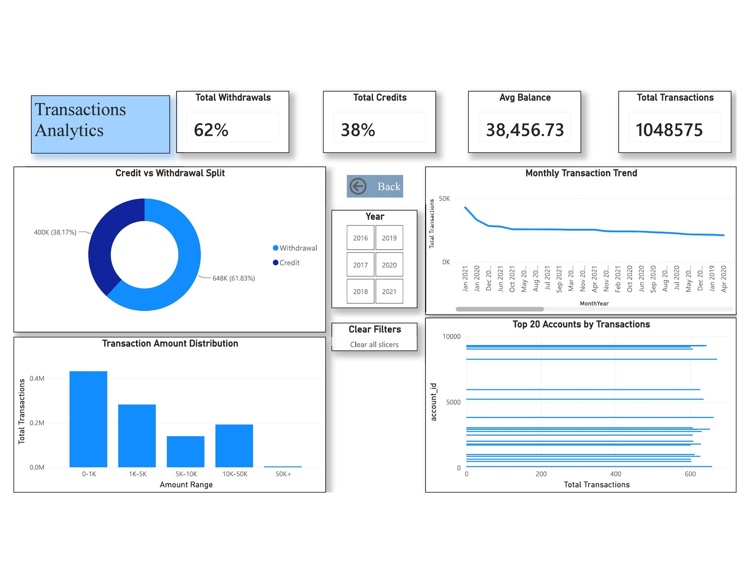
POWER BI DASHBOARD — TRANSACTION ANALYTICS
Withdrawals dominate at 62% of volume, and transaction activity has grown steadily each year, concentrated among a small set of high-activity accounts.

Slide 36
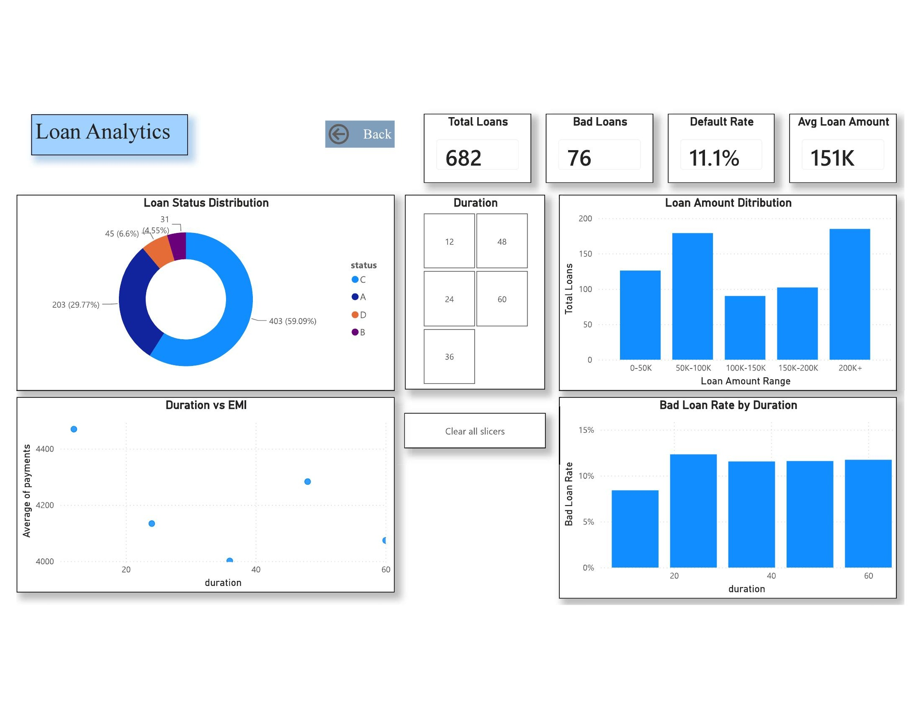
POWER BI DASHBOARD — LOAN ANALYTICS
Bad loan rate holds steady around 11–12% regardless of duration, while loans of 200K+ represent the largest share of the portfolio by amount.

Slide 37
Business Recommendations
1. Strengthen Loan Risk Monitoring
Use the predictive model to identify customers with a higher probability of loan default.
Prioritize these customers for early intervention and repayment reminders.
2. Increase Savings Account Adoption
Launch targeted marketing campaigns in districts with lower savings account penetration.
Offer promotional interest rates or bundled banking products.
3. Improve Customer Segmentation
Use customer demographics, transaction frequency, and account activity to create personalized financial products.
4. Optimize Branch Performance
Allocate more resources and marketing efforts to underperforming districts while maintaining service quality in high-performing regions.
5. Enhance Digital Banking Adoption
Encourage online banking and digital transactions to reduce operational costs and improve customer convenience.
6. Continuous Data Quality Monitoring
Implement automated SQL validation checks to maintain high data quality and ensure reliable business reporting.

Slide 38
Project Outcomes
Successfully integrated data from 8 banking tables into a unified analytical dataset containing over 1 million transaction records.
Performed comprehensive SQL-based data validation, including:
Primary key validation
Foreign key validation
Null value analysis
Business rule validation
Referential integrity checks resulting in a 99.2% data quality score.
Developed interactive Power BI dashboards for:
Executive Overview
Customer Analytics
Transaction Analytics
Loan Analytics
Conducted Exploratory Data Analysis (EDA) in Python to identify customer behaviour, transaction trends, and loan characteristics.
Built machine learning models for loan default prediction and customer risk assessment, supporting proactive risk management.
Delivered actionable business insights to support strategic decision-making, customer segmentation, and loan portfolio optimization.

Slide 39
THANKS

