Slide 1
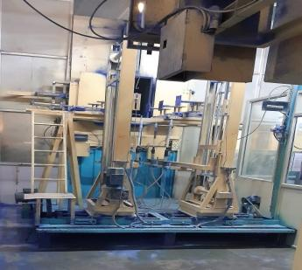
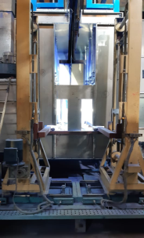
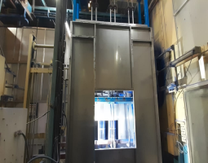
Improvements
Paint Shop:
No booth arrangement Powder spreading over the floor Dangerous for manpower and environment | Booth install in coating Powder collected in hopper and approx. 3~4 kg saving Safe to use
BEFORE
AFTER
Front View
Front View
Side View

Slide 2
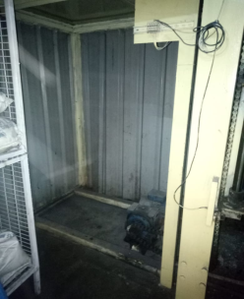
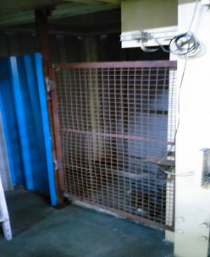
Improvements
Paint Shop:
- No door due to accidental chances | Door install to avoid accidental chances
BEFORE
AFTER

Slide 3
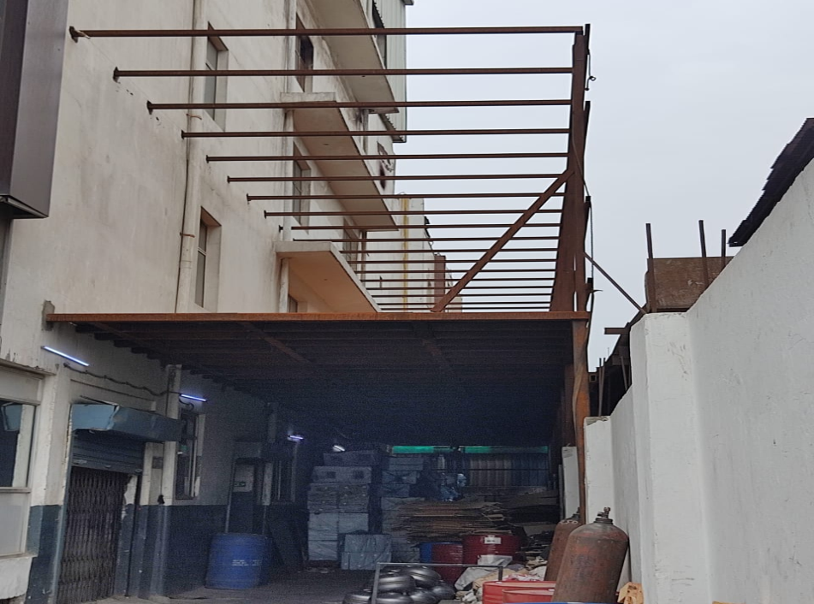
Improvements
No Such Arrangement
- No additional storage structure | 17550 sq. feet structure add for storage
BEFORE
AFTER

