Slide 1
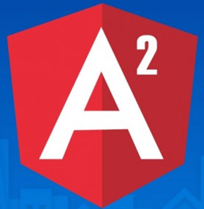
Day 1
Satyanarayana T
About 17 yrs Experience in
7 years in Java Enterprise Application Development
10 years in Training
Technical Trainer and Consultant
+91 9440220062 satyamtd@gmail.com

Slide 2
About Your
Object Oriented Programming Experience
Web Application Development Experience
  Front-End (UI) Technologies
  Server Side Technologies
Design Patterns Used / Implemented

Slide 3
Day1 Content
Pre Assessment (HTML, CSS, JavaScript, OO Concepts)
Angular2 Introduction
Working with Development Environment
Front End Project Setup with NPM
Quick Review to ES6 & TypeScript
Understanding Webpack
Understanding Angular CLI
Creating First Angular Application
Angular Application Project Setup

Slide 4
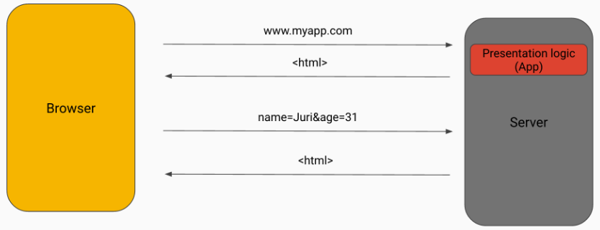
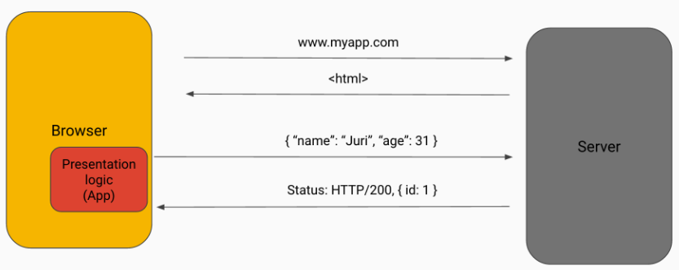
Web Application Development
Server-side Applications
Client-side Applications (Modern Development)

Slide 5
Java Script MVC Frameworks
AJAX-based Applications
Single Page Applications
Client-Side MVC Frameworks
  A Framework gives you an architecture and you will need to follow the rules.
  JavaScript MVC frameworks provide developers an API to develop an Client-Side Enterprise Application using MVC.
Java Script Frameworks.
  AngularJS, KnockoutJS, BackboneJS, EmberJS
  Angular, React, Aurelia

Slide 6
What is Angular2
Angular is an open-source Client-Side framework developed by Google has been designed with modern web standards.
Implement many Design Patterns e.g.:
  MVC Pattern, Singleton, Dependency Injection etc..,
Angular 2 was written in TypeScript, a superset of JavaScript that implements many new ES6 features.
It helps to develop Single Page Applications.
Visit official website: angular.io
Angular2 is a framework for all types of apps
  Web Apps, Mobile Apps (Hybrid), Desktop Apps

Slide 7
Development Environment
Development environment:
  Node JS (6.9 OR above)
  Visual Studio Code
Browser
  Chrome
Text Editor
  System Text Editor (Notepad)
IDE
  Netbeans / SublimeText / Eclipse / WebStorm / VisualStudio2015
Browser
  Firefox / Safari / Opera / Microsoft Edge

Slide 8
Front End App Getting Started – Hands On
Browser: Chrome
Code Editor : Visual Studio Code
Create a Workspace (Folder): AngularTraining
In Workspace, create a new project (Folder) day1project
  Open the Project in Visual Studio Code
Create a Home Page index.html
Open web page in browser

Slide 9
Cascading Style Sheet
CSS can add style to your pages, enhancing and improving the presentation of your content.
Implementing CSS
  1 – Add in the head section (Style Tag)
  2 – In the Style (Style Attribute)
  3 – Link to external file
Selectors
  Tag Selector, Class Selector, ID Selector
CSS Properties: Color, font, text . . .
Bootstrap is a HTML, CSS and JS framework aims to ease web development.
It is a collection of CSS classes and tools for Web Sites.

Slide 10
FrontEnd Project Setup with NPM
NPM (node package manager) is a command line utility
  To install libraries, packages, and applications along with their dependencies for a Front End Application Project.
  NPM is also used to update, uninstall the required project dependencies.
  npm can install packages in local or global mode.
NPM is available as part of Nodejs, command prompt: npm –v
The most commonly used npm commands are:
  install OR i, uninstall, update
  To install a specific version, use @ sign and append a version number.
  Options are: --save OR –S, --dev-save OR –D
  list, init, run, build, start

Slide 11
NPM Project Configuration
Package.json is a project configuration file used by npm.
  With a package.json file in the project dir, you can re-use it.
To generate package.json file, in Command Prompt npm init
  Normally npm init asks several questions while creating the file.
To generate package.json without queries npm init -y
npm install bootstrap --save OR -S
  A new directory called node_modules was created.
  It contains the project libraries and its dependencies.
Refer the bootstrap CSS file in our project home page
<link rel="stylesheet" href="node_modules/bootstrap/dist/css/bootstrap.css">

Slide 12
JavaScript
JavaScript is a scripting language designed primarily for adding interactivity to Web pages and creating Web applications.
<head>
<script>
JavaScript statement(s)
</script>
<script src="mycode.js">
</script>
</head>
<body>
<script>
JavaScript statement(s)
</script>
<body>
internal script - put in <head> section
external JavaScript file
inline script - put in <body> section

Slide 13
Hands On Example
In Current Project, create js folder
In JS folder create a file demo1.js
Print first 5 numbers in Java Script Console using FOR loop
for(var i=1;i<=5;i++) {
console.log(i)
}
Refer demo1.js file in index.html and Verify the output of index.html
Print value of i after FOR loop
Use ES6 Variable declaration – let, and const
Use ES6 FAT Arrow Function

Slide 14
What is TypeScript?
JavaScript is not strongly typed.
  Since JavaScript is Loosely Typed Language, it allows any type of value in a variable.
TypeScript is a open source language that is a superset of JavaScript, developed by Microsoft.
  with ES6 support.
  Strongly Typed
  Class-based and Object-Oriented
  Transpiles to Java Script
Available as CLI (Command Line Interface) tools or with Visual Studio 2015.
We write our code in TypeScript in a file with the ‘ts’ extension.

Slide 15
Strong Typing – Type Annotations
TypeScript let’s you add data type to your variable and function declarations.
  Once you have declared a variable to be of type string, you can only assign string values to it.
  This helps to ensure that code that we write will behave as expected.
  Types have proven ability to enhance code quality and under standability.
  This makes JS a TypeSafe language and a strongly typed language.
Types are annotated using :TypeAnnotation syntax.
let a:string = “TS”;
a = 40; // Error
a = ‘TEMP';

Slide 16
Hands On Example
In Current Project, create TS folder
Create a file test.ts in TS folder
let v1:string = “My Test";
console.log(v1);
Verify the Output in Browser Console.
Browser throws an error.
Transpile: TypeScript code (saved with extension .ts) is compiled to regular Java Script (.js) file and supposed to work on any browser
Using in HTML Document: HTML document includes a script element that refers a file with the 'js' extension.

Slide 17
TS Development Environment
  Now, our project is dependent on a transpiler typescript for development environment only.
    That’s why it is dev dependencies.
We use npm to install the typescript with the following command: npm install -D typescript
To verify installation: AngularTraining\day1project>node_modules\.bin\tsc -v
After the TypeScript is installed we can use the
tsc (TypeScript Compiler) to compile any file with the ts extension to a js file.
To Compile: node_modules\.bin\tsc scripts\test.ts
To Compile with source code changes detection:
tsc –w filename.ts

Slide 18
TypeScript Configuration
To generate transpiled files of a project / folder, we need Typescript Configuration file (tsconfig.json) to apply compiler settings.
To Create tsconfig.json file, in project folder tsc --init
When TypeScript Compiler (tsc) is executed the tsconfig.json file is read and the js files are created.
Open tsconfig.json file and observe the properties therein.
Understanding Configuration Properties
  target: sets up the ECMAScript version being used.
  noEmitOnError: Do not emit outputs if any errors were reported.
  rootDir: Specifies the root directory of input files.
  outDir: Redirect output structure to the directory.

Slide 19
NPM as Task Runner
A task is something you need to do.
  Common web development tasks include running test suites, compiling TypeScript, and starting a web server etc.,
  If you want to perform that task over and over again.
  npm has a way for you to run tasks for you!
There are two types of tasks with npm,
  built-in tasks and / or
  your own tasks.
npm’s tasks are called “scripts”, and they’re added to the “scripts” property of a project’s package.json file.
By default, npm init creates the test task, which can be run like this: npm test

Slide 20
NPM Custom Task
When you want to create your own task, you can name these tasks whatever you want, but you must use the run command to set them going.
Use Transpiler using NPM:
We could add a new entry called mytask to use the transpiler
"scripts": {“mytask": “tsc -w“}
To execute the custom task, at command prompt use
npm run mytask

Slide 21
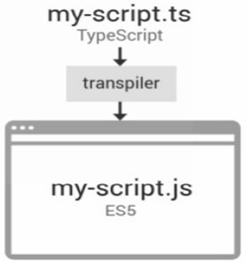
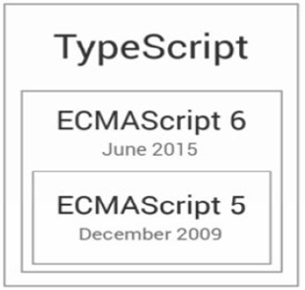
What is Type Script? - Review
TypeScript = JavaScript + Types

Slide 22
Automatic Type Inferring
When declaring a variable without specifying an explicit type, the variable's type is inferred from the value on the right hand side.
var s = "Satya"
Here, s is defined as String type
Changing the value of s with number s = 10; means its type is affected.
TypeScript identifies type changes automatically at compile time.

Slide 23
Data Types in TypeScript
Primitive Types
  string
  number
  boolean
Special Types
  any, void
Array Types
  [ ]
  Array
Function Types
  Function
Object Types
  { }

Slide 24
Functions in TypeScript
When we define a function we can specify the types of each one of the parameters as well as the type of the returned value.
function sum(a:number,b:number):number
{
return a+b;
}
var result:number = sum(7,18);
console.log("result="+result);

Slide 25
Decorators
Decorators in typescript are used to describe more information about a class or method or property or a data member.
Decorator is a function that adds meta data to a
  Class
  Its members or
  Its method arguments
Prefixed with an @

Slide 26
Using Modules
Modules allows you to organize your code, breaking up complex systems into small, self contained pieces that can be managed easily.
  Modules are executed within their own scope, not in the global scope; this means that variables, functions, classes, etc. declared in a module are not visible outside the module.
The relationships between modules are specified in terms of imports and exports at the file level.
  export keyword: In order to avail an Interface or Class or a function to a different TypeScript module you need to expose it using the export keyword.
  import keyword: In order to access Class or an Interface of different module we need import it.
  Each file is a module OR a module is in a file

Slide 27
Module System Styles
In js folder, create app.js, child1.js, child2.js files
There are multiple standards for how to define dependencies and export values:
  CommonJS, AMD, UMD, RequireJS
Modules should be executed on the client, so they must be transferred from the server to the browser.
There are two extremes when transferring modules:
  1 request per module
  All modules in one request

Slide 28
Hands On Example – CommonJS Style
Applying dependencies in app.js file, use require() function to refer dependencies.
The app.js is dependent on child1.js and child2.js, In app.js
const c1 = require("./child1.js")
const c2 = require("./child2.js")
console.log("This is APP Message")
In web page, refer app.js
<script src="scripts/app.js"></script> throws an error

Slide 29
Web Pack
Web pack takes care of loading modules and it also bundles all our code into a single file, so that browser can load it in a single http request.
  Module bundling is the process of combining a group of modules along with their dependencies together into a single file (or a bunch of files).
Install webpack to the project
npm i webpack –D

Slide 30
Hands On Example
Module Dependencies and Bundling
Bundle JS files
node_modules\.bin\webpack js\app.js js\mybundle.js
Refer mybundle.js file in webpage and verify the output.
Create and Run web pack as NPM Task Runner with watch option.
"webpk": "webpack --watch"

Slide 31
Angular2 Framework API
Angular is an open-source Client-side framework developed by Google has been designed with modern web standards.
It’s a complete client side solution i.e. it all happens within browser, making it an ideal partner with any server technology.
Visit: angular.io
Angular2 is a framework for all types of apps
  Web Apps, Mobile Apps (Hybrid), Desktop Apps
Angular API is organized in the form of modules.
A module is a collection of related classes, interfaces, decorators, services, pipes, templates etc..,

Slide 32
Angular2 Project Setup
There are various options to create Angular2 Project Setup:
Manual Setup
Use Quick Start files – Download from angular.io
Angular Command Line Interface (CLI) Tool – Generates boilerplate code.
Using Angular CLI:
One of the easiest ways start a new Angular 2 application is to use the Angular command-line interface (CLI) that allows you to:
  generate boilerplate code for new Angular 2 applications
  add features (components, directives, services, pipes, etc) to Angular 2 applications

Slide 33
Working with Angular CLI
To install Angular CLI: npm install -g @angular/cli
  which will install the ng command globally on your system.
  To verify whether your installation completed successfully:
ng version display the version you have installed.
Angular CLI commands:
  new is used to create a new angular project with ready-to code.
  serve is used to execute angular application in live-reload server
  test is used to unit test and end-to-end test an angular application
  build is used to make angular application deployable app in a hosting server.

Slide 34
Creating Angular Application
Create a New Project in your workspace.
we use CLI to create an Angular application:
In Workspace: ng new ngproject1
This will create a new directory for us with everything we need to get started
Change to ngproject1 folder and start the development server ng serve
  which will start a local development server that you can navigate to in your browser on http://localhost:4200/.
To change default port: ng serve --port 9090

