Slide 1

Day 2
Understanding Angular Core Concepts
  Working with Multiple-Modules
  Working with Multiple Components
Binding
  Property Binding, Event Binding, Data Binding (One-way Data Binding, Two-data binding)
Understanding Dependency Injection using Services

Slide 2
What is Angular2 - Review
Angular is an open-source Front-end framework developed by Google and it was written in TypeScript, a superset of JavaScript that implements many new ES6 features.
Angular API is organized in the form of modules.
A module is a collection of various members of an Angular application.
  These are: Components, Directives, Pipes, Services, Templates, Models, Decorators etc.
Angular Project should have at least ONE module.
Members of module must register in it.
Angular2 application is a set of components.

Slide 3
Creating Angular Application
Create a New Project in your workspace.
we use CLI to create an Angular application:
In Workspace: ng new ngproject1
This will create a new directory for us with everything we need to get started
Change to ngproject1 folder and start the development server ng serve
  which will start a local development server that you can navigate to in your browser on http://localhost:4200/.
To change default port: ng serve --port 9090

Slide 4
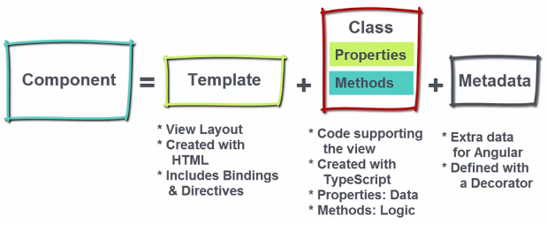
Structure of Angular2 Application
Angular2 application is a set of components.
We design and build each component individually and then stack them nicely to create our application.
We design each component to work with the others ultimately provide user experience.
Each component is a part of Angular Module.

Slide 5
CLI Project File Name Conventions
Open the Project in VS Code
Observe the CLI project folder structure
  Important folder is src
  Files in app folder
app.module.ts → Application Module
app.component.ts → Application Component Class
app.component.html → Application Template
app.component.css → Application Component Styles
app.component.spec.ts → Application Component Unit Testing File

Slide 6
Angular Application Flow - Review
Bootstrapping the Module: Initializing Angular App in Browser.
Root Module: Each root component lives within a module, and it is defined using @NgModule Decorator.
  declarations: Registers particular components within this module
  bootstrap: Tells the module which component to bootstrap
  imports: Imports other modules into this module
Root Component: To bootstrap an Angular app, we need a root component and it is defined using @Component Decorator.
  selector: defines the tag to be used for the instance of the component on the html page.
  template: defines the html content that will be displayed for the component.

Slide 7
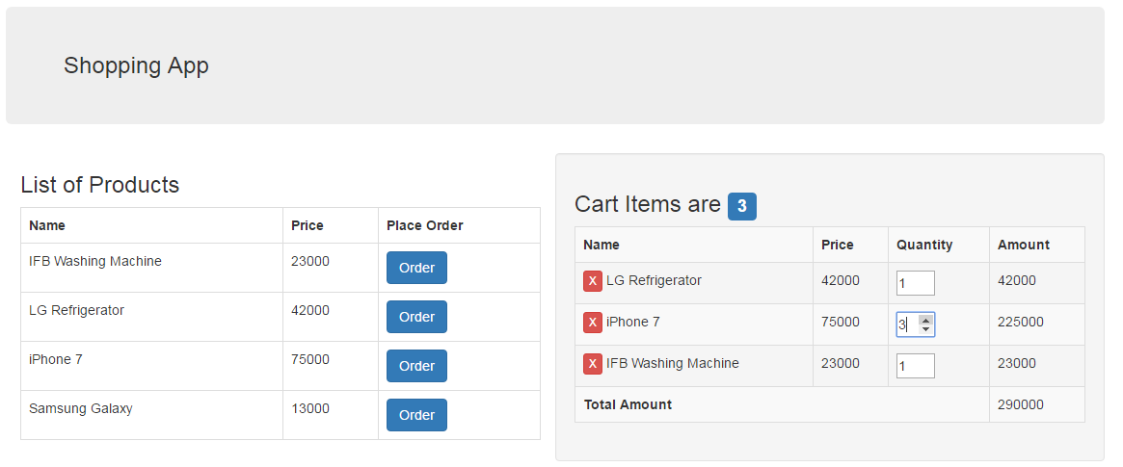
What are we building?
We are going to build a basic Shopping Cart Application, to understand the features of Angular.

Slide 8
Application Style
Bootstrap is a HTML, CSS and JS framework aims to ease web development.
  It is a collection of CSS classes, add style to your pages, enhancing and improving the presentation of your content.
Using Bootstrap Framework in Angular CLI project
Install bootstrap in project: npm i –S bootstrap
Open .angular-cli.json file and modify the following:
"styles": [
"../node_modules/bootstrap/dist/css/bootstrap.min.css"],
Execute the Project with ng serve and verify the Output

Slide 9
Creating a Component
In App Component Template, we need to use a web component as :
<app-header></app-header>
As per convention, each component will have .component.ts file header.component.ts for the tag <app-header>
Define a class HeaderComponent
export class HeaderComponent {
}
Import the Built-In Decorator Component from Angular 2 Core
import {Component} from "@angular/core";
Use the @Component decorator
@Component({ })

Slide 10
Hands On Example - Component
Provide meta data with two parameters:
  selector and
  template.
The selector parameter defines the tag to be used for the instance of the component on the html page.
And template defines the html content that will be displayed for the component.
@Component({
selector: “app-header",
template: "<nav class='navbar navbar-default'></nav> “
})

Slide 11
Registering and Using Component
As per Angular specification, the component should register in a module.
In AppModule, register component in declarations meta data property.
Register in App Module
declarations: [AppComponent, HeaderComponent]
After registration in a module, we are ready to use web component in template.
In app.component.html, use the
<app-header></app-header>

Slide 12
Multi Line Template
Add a header class .navbar-header to the <div> element.
Include an <a> element with class navbar-brand. This will give the text a slightly larger size.
Multi Line Template: Typescript uses BackTick to work with multi line strings.
template: `<nav class='navbar navbar-default'>
<div class="navbar-header">
<a href="#" class="navbar-brand"> Shopping App</a>
</div>
</nav>`

Slide 13
Passing Data to Template
Define a data member in Component Class
export class HeaderComponent {
cmpHeading:string = “My Shopping Cart App"
}
Interpolation: Use double-curly braces of interpolation,
{{ and }} to bind data into the text between HTML element tags and within attribute assignments.
Bind the data member to View (Template) using {{ }}
<a href="#" class="navbar-brand"> {{cmpHeading}}</a>
Angular replaces that name with the string value of the corresponding component data member.

Slide 14
Angular Modules
Angular Modules help organize the source code of an application.
An Angular Module is a class decorated with @NgModule decorator function.
Every Angular app has at least one module class, the root module.
We bootstrap that module to launch the application.
As the app grows, we can add feature modules that represent collections of related functionality.

Slide 15
Hands On Example
Create a new folder shopping in app folder
Create a new module in shopping.module.ts file
import {NgModule} from "@angular/core“
@NgModule({
declarations: []
})
export class ShoppingModule {
}

Slide 16
Hands On Exercise - Component
Create a web Component “<product-list>”
  Create a file product-list.component.ts in shopping folder
  Define a class ProductListComponent
  Create an external template
  Register in Shopping Module
  Use <product-list> in App Component Template

Slide 17
Module Dependencies
In order to use Product List, AppModule is depends on Shopping Module members.
Specify the Shopping Module as a dependency in AppModule.
imports: [
BrowserModule, . . . , ShoppingModule
],
We need to access product-list from one Module to another Module, so export the productlist component from ShoppingModule
exports: [ProductListComponent]

Slide 18
Hands On Exercise
Create a web component <cart-items> component with external template in Shopping Module.
Use the Web Component within AppComponent Template.

Slide 19
Bootstrap Grid System
Bootstrap 3 includes predefined grid classes for quickly making grid layouts.
Creating Two Column Layout:
Bootstrap grid system is based on 12 columns, so to keep the columns in a one line (i.e. side by side), the sum of the grid column numbers in each row should be equal to 12.
<app-header></app-header>
<div class="col-sm-6“>
<product-list></product-list>
</div>
<div class="col-sm-6 well“>
<cart-items></cart-items>
</div>

Slide 20
Hands On - Bootstrap
  Presenting list of products in tabular format
<table>
<tr><th>Name</th><th>Price</th><th>Action</tr>
</table>
  The table class improve the appearance of table in a simple way.
  <table class=“table">
  The table-bordered class add borders to the all table cells.
  <table class=“table table-bordered">
  The table-striped class used for alternate background like zebra-stripes.
  <table class=“table table-bordered
  table-striped">

Slide 21
Hands On Exercise
Display Cart Items with Name, Price, Quantity, Amount and Total Amount in tabular format.

Slide 22
Model Class
Model represents data of our application.
  Each Model instance maps to a Row in the data source.
Create a folder models in app folder and create a file product.model.ts
export class Product {
id: number;
name: string;
price: number;
description: string;
constructor(id:number, name:string, price:number, description: string) {
. . . . }
}

Slide 23
Using Model in Component
Define data member products of type Product Array in ProductList Component.
products: Product[] = [];
Populate sample data in ProductList Component constructor
constructor(){
this.products = [new Product(1, "IFB Washing Machine", 23000, "Automatic Washing Machine"),
new Product(2, "LG Refrigerator", 42000, "Double Door Refrigerator"),
new Product(3, "iPhone 7", 75000, "Next Gen Smart Phone"),
new Product(4, "Samsung Galaxy", 13000, "Android Smart Phone")]
}

Slide 24
Directives
Directive is an custom element, attribute, or a class that allows we to attach behavior to DOM elements.
There are three kinds of directives:
Components – using @Component():
Directives with templates known as Components.
Structural Directives – using @Directive:
Directives that creates and destroys DOM elements known as Structural Directives such as NgFor, NgIf.
Attribute Directives – using @Directive:
doesn’t change the DOM but can change the appearance or behavior of an element such as hidden.

Slide 25
Built In Structural Directives
Structural directives allow us to add, remove, or replace a part of the DOM depending on the expression given as parameter.
*ngFor directive
This directive is used to repeat collection of data items.
  This is an attribute directive
  * represents structural directive
  Structural directives update the content of a page
Syntax: <HTMLTag *ngFor=“elem of collection”>

Slide 26
Hands On Example
Bind the data in template using *ngFor structural directive
<h3>List of Products</h3>
<table class="table table-bordered">
<tr>
<th>Name</th><th>Price</th><th>Action</th>
</tr>
<tr *ngFor="let product of products">
<td>{{product.name}}</td>
<td>{{product.price}}</td>
</tr>
</table>
Throws an error regarding ngFor. This directive is available in CommonModule, so import in ShoppingModule
imports: [CommonModule]

Slide 27
*ngIf Directive
If the expression is evaluated to a true the NgIf shows the elements else it removes this element from DOM.
Modify ProductList Component constructor, comment this.products statement.
<tr *ngIf=“products.length == 0">
<td colspan="4">No Data Found...</td>
</tr>

Slide 28
Hands On Exercise
Develop a model class for cartitems with public members.
Use in Component
Present the data in Template

Slide 29
Angular2 Services
The Best Practice to organize our source code is to divide our application source code into different layers.
  Presentation Layer
  Business Layer
  Data Layer
Components are responsible for displaying stuff.
Need of Service:
  If the logic or data isn’t view specific OR
  Needs to be used globally across number of different components
Service is basically just a class

Slide 30
Hands On Example
Create services folder in app folder. And Create ProductService in product.service.ts file
  Move the data from Component to Service
export class ProductService {
private productsData:Product[];
constructor(){
this.productsData = [new Product(1, "IFB Washing Machine", 23000, "Automatic Washing Machine"),
new Product(2, "LG Refrigerator", 42000, "Double Door Refrigerator"),
}
getProducts(){
return this.productsData;
}
}

Slide 31
Using Service
Create an object of Service
Invoke the method of a service.
export class ProductListComponent {
products: Product[] = [];
constructor(){
let ps:ProductService = new ProductService();
this.products = ps.getProducts();
}
}

Slide 32
Hands On Exercise
Create CartService to handle
  Cart Items Data
Define Data Operation logic in Cart Service
  Retrieve Cart Items
  Add New Item in Cart
  Delete an existing Item in Cart

Slide 33
Dependency Injection
Features of Services:
  Are independent from any particular component
  Provide shared data or logic across components
Dependency Injection is a pattern in which a class receives the instances of objects it needs (called dependencies) from an external source rather than creating them itself.
Angular is designed to manage all these dependencies between components and services for us.
Alternatively, we can register our service with Angular2 and Angular creates single instance of that class called Singleton
Angular2 provides an built-in Injector, which maintains a container of the created service instances.

Slide 34
Working with Service
1) A class with @Injectable to tell angular 2 that its to be injected – DataService
2) A class with a constructor that accepts a type to be injected
import {Component, Injectable} from “@angular/core“
@Injectable()
export class CartService {
}

Slide 35
Using and Registering a Service
Inject the dependency object in any component as argument.
Modify Component Constructor
constructor(private asvc: CartService){
}
Register the Service in our application module by using providers metadata attribute.
providers: [CartService],

Slide 36
Event Binding
To bind a click event for button, use the parentheses syntax, (click)
<button (click)=“addToCart(product)">Add To Cart </button>
Define a method addToCart() in ProductListComponent
addToCart(selectedProduct:Product){
let cartItem:CartItem = new CartItem(selectedProduct.getName(), selectedProduct.getPrice(), 1);
this.cartSvc.addCartItem(cartItem);
}

Slide 37
Hands On Exercise
Implement cancelItem()
Implement Total Amount

