Slide 1

Infrastructure Automation with Terraform: VPC and Networking Setup

Slide 2

Objective: Build and manage a cloud infrastructure (VPC, Subnets, Route Tables, S3 Endpoints).
Automate tasks with Infrastructure as Code (IaC).
Securely route traffic within a private and public network.
Tools Used: Terraform, AWS (VPC, EC2, S3, Route Tables).

Slide 3
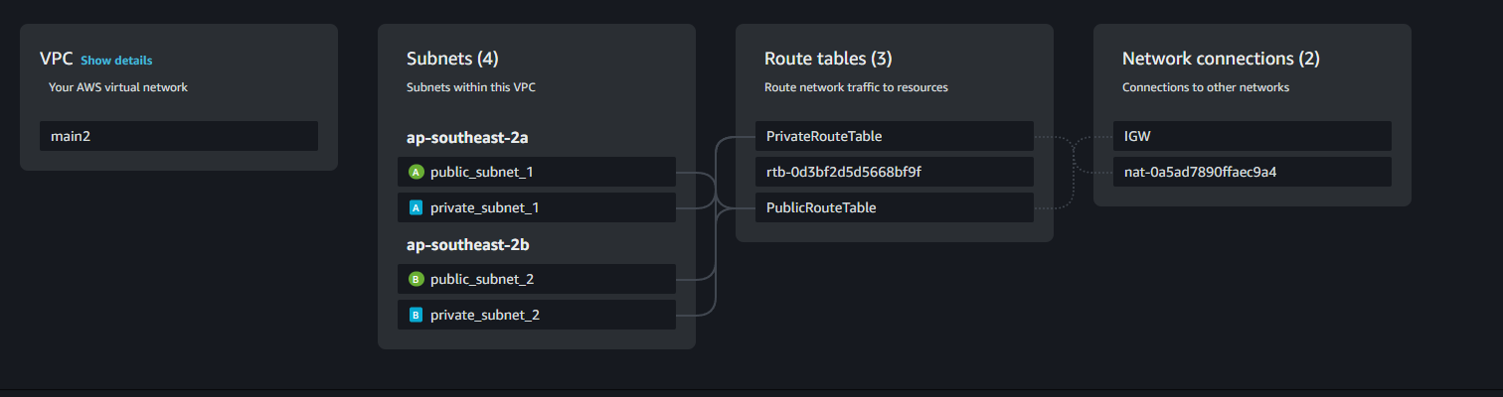
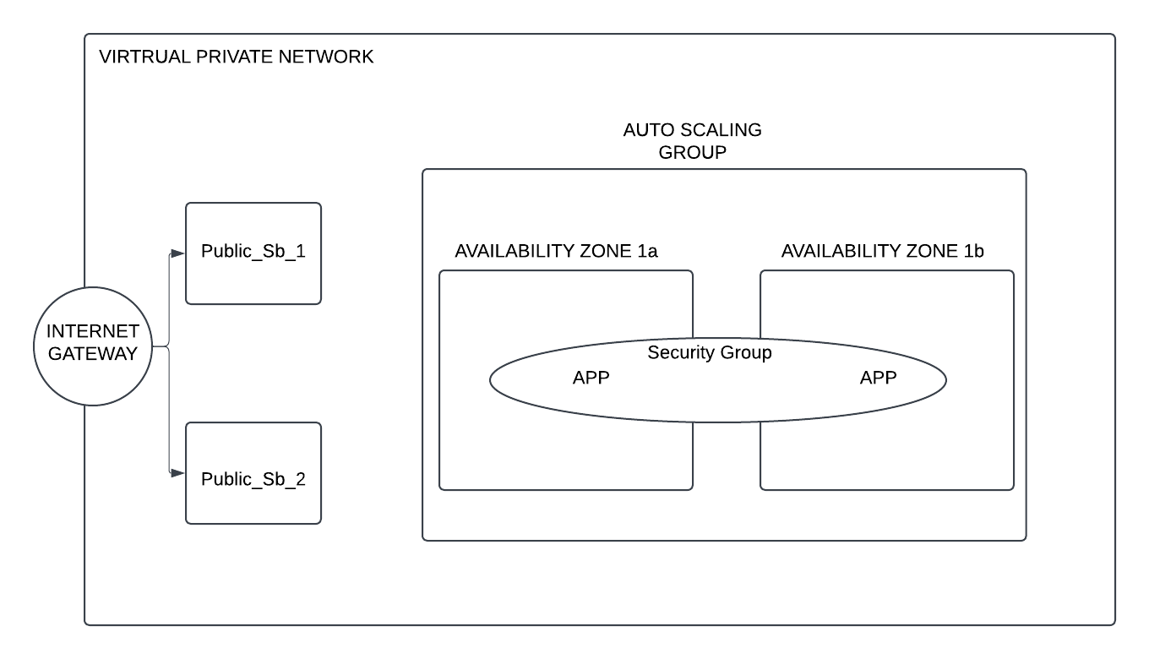


Architecture Diagram

Slide 4

Terraform Workflow
1. Plan
The terraform plan command is a critical step in the workflow, ensuring accuracy and avoiding unintended changes to infrastructure.
Purpose:
To preview the changes Terraform will make to your infrastructure based on the current state and configuration files.
Identify any misconfigurations or missing dependencies before applying the changes.
Usage in My Project:
I ran terraform plan after each modification to the .tf files. Plan: 10 to add, 0 to change, 0 to destroy.
This confirmed that new resources, such as the VPC, Subnets, and Route Tables, would be added without altering existing resources.
It helped catch errors like conflicting arguments or resource dependencies early.

Slide 5
2. Apply
The terraform apply command is used to execute the plan and provision the specified resources in your cloud environment.
Purpose:
To implement the changes previewed in terraform plan and create or update resources as defined in the configuration.
Usage in My Project:
Once satisfied with the terraform plan output, I used terraform apply to deploy the infrastructure.
Example Workflow:
Ran terraform apply and reviewed the execution plan.
Confirmed the action (typed "yes").
OUTPUT::aws_vpc.main: Creation complete after 2s [id=vpc-0abc123456789def] aws_subnet.public: Creation complete after 1s [id=subnet-0xyz789456123abc
Verified the resources in the AWS Management Console to ensure everything was set up as intended.

Slide 6
State Management
Terraform uses state files (terraform.tfstate) to keep track of the current state of infrastructure.
Purpose:
To map your configuration to the real-world infrastructure.
Enable Terraform to identify which resources to add, modify, or destroy.
Usage in My Project:
The state file was automatically created and updated during terraform apply.
I used terraform show to inspect the state and ensure it reflected the actual setup.
To avoid issues:
Backed up the state file periodically.
Used remote state storage (e.g., AWS S3) for collaboration and versioning in team environments.

Slide 7
Implementation Challenges
Errors Encountered
1. "Unclosed Configuration Block"
Issue:
This error occurred due to a missing closing brace (}) in one of the resource definitions, which caused Terraform to misinterpret the configuration block structure.
Resolution:
Carefully reviewed the error message and pinpointed the line causing the issue.
Added the missing brace, ensuring proper indentation for clarity

Slide 8
Misconfigured aws_route
Issue:
Initially, the aws_route resource used a combination of vpc_endpoint_id and destination_cidr_block, which are mutually exclusive.

