Slide 1
Pre-Project Presentation Title: Graph Signal Processing to classify multidimensional data Programme: B. Tech in AI & ML
Mentor : Dr. C Narendra Babu
Group No. : 38
Team Leader : Pratistha Gaur
Department : Computer Science and Engineering

Slide 2
Project Team
Sl no. | Registration no. | Students
1 2 3 | 20ETAI410002 20ETAI410035 20ETAI410036 | Aishwary Anurag Pratistha Gaur Prrathyush Kedeelaya

Slide 3
Outline
Title and Aim
Objectives
Methods and Methodology
Results
Expected Outcomes
Cost Estimation
Gantt Chart
References

Slide 4
Title
Classification of multidimensional complex data using graph signal processing
Aim
To design and develop Graph Signal Processing based classification model for classifying multidimensional complex data

Slide 5
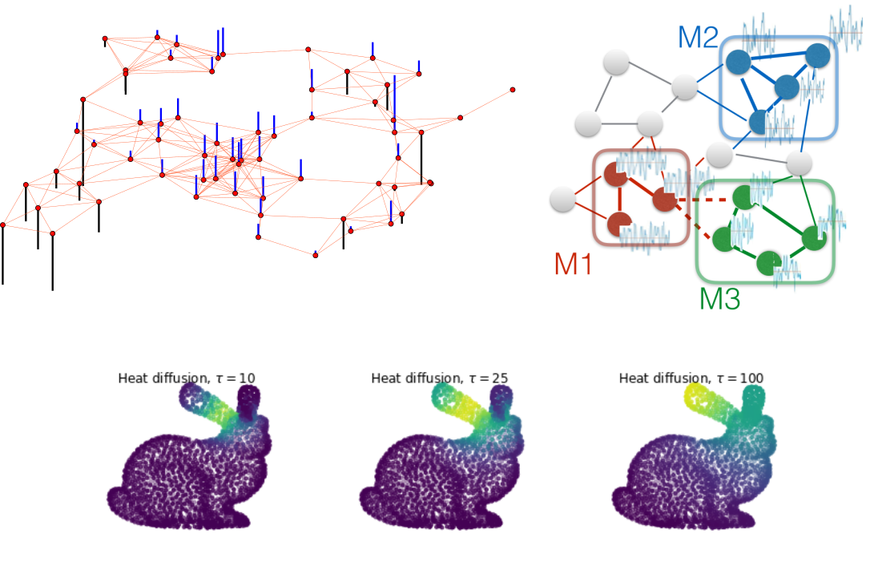
Explaining Graph Signal Processing with help of an example- Heat Diffusion in a Rabbit

Slide 6
Objectives
Graph Signal Processing has strong connections to several theoretical and practical research domains. It potential lies in the ability to develop new tools and approach existing problems from different perspectives.
To carry out a literature survey on Signal processing techniques on graphs and Machine learning techniques
01
To identify and extract the appropriate features and arrive at design specifications for multidimensional data
02
03
To design and develop a classification model using graph signal processing techniques on image data
04
To test, validate and evaluate the proposed classification model
05
To apply the proposed classification model to different scenarios

Slide 7
Methods and methodologies
Understanding existing research on graph signal processing and machine learning.
01
Literature Survey
02
Data collection & preprocessing
It involves several key steps to clean and transform the data
Construct graphs from the multidimensional image data, with images represented as nodes and edges established based on spatial relationships or similarity measures.
03
Graph construction
04
Graph signal processing
Graph signal processing techniques are applied to analyze and process signals on the constructed graphs
GSP
We plan to explore graph signal processing techniques such as graph Fourier transforms and graph filters for feature extraction.
05
Feature extraction & selection
06
Model development, training & evaluation
Use of ML algorithms and the integration of selected features into the model.
The proposed classification model is implemented and applied to real-world scenarios
07
Real-time application

Slide 8
Expected Outcomes Upon the completion of this project, we expect to achieve the following outcomes:
Research Publication
Spectral Analysis of Graphs
Discretization
Multidimensional image Data Classification model for real-time applications

Slide 9
Cost Estimation
S.No. | Particulars/Components/Devices | Estimated Cost
1
2
 | Total: | Rs 0
Man hours:
Man hours per week (students): 25*3 students =75
Man hours per week (faculty): 2-4 hours

Slide 10
Gantt Chart
Project Work (UG) 16 weeks
Week | 1 | 2 | 3 | 4 | 5 | 6 | 7 | 8 | 9 | 10 | 11 | 12 | 13 | 14 | 15 | 16
Major Activities
1.1
1.2
2.1
2.2
2.3
2.4
3.1
3.2
4.1
4.2
5.1
5.2

Slide 11
References
• Sandryhaila, Aliaksei, and Jose MF Moura. "Big data analysis with signal
processing on graphs: Representation and processing of massive data sets with
irregular structure." IEEE Signal Processing Magazine 31, no. 5 (2014): 80-90.
• Sandryhaila, Aliaksei, and Jose MF Moura. "Discrete Signal Processing on Graphs:
Frequency Analysis." IEEE Trans. Signal Processing 62, no. 12 (2014): 3042-3054.
• Sandryhaila, Aliaksei, and José MF Moura. "Discrete signal processing on graphs."
IEEE Transactions on signal processing 61, no. 7 (2013): 1644-1656.
• Narendra Babu and Pallaviram Sure, "Low-Dimensional Models for Traffic Data
Processing Using Graph Fourier Transform," in IEEE Computing in Science &
Engineering Magazine, vol. 20, no. 2, pp. 24-37, Mar./Apr. 2018.
doi: 10.1109/MCSE.2018.110111913

Slide 12


Slide 13


