Slide 1
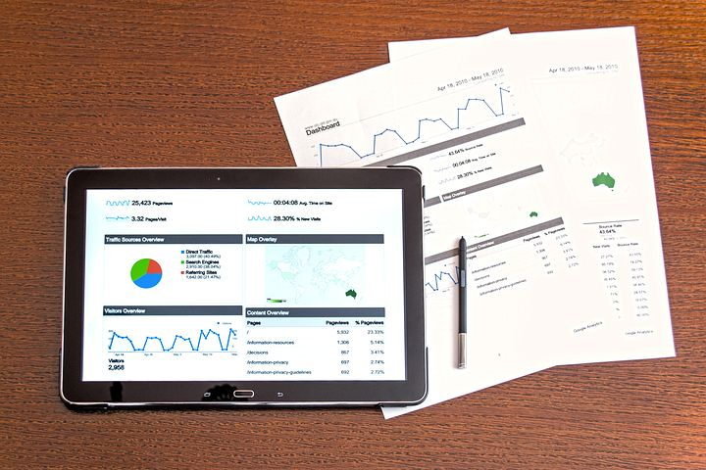


Welcome to Data Visualization with Python
Dave Dalsveen

Slide 2
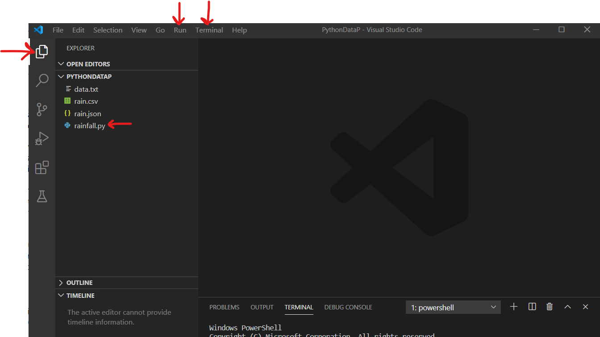
Visual Studio Code
The main Visual Studio Icons we are using are:
Explorer
Run->run without debugging
Code editor Window

Slide 3
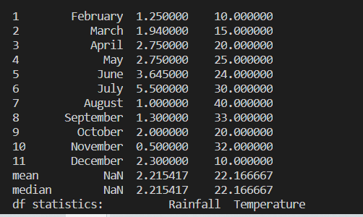
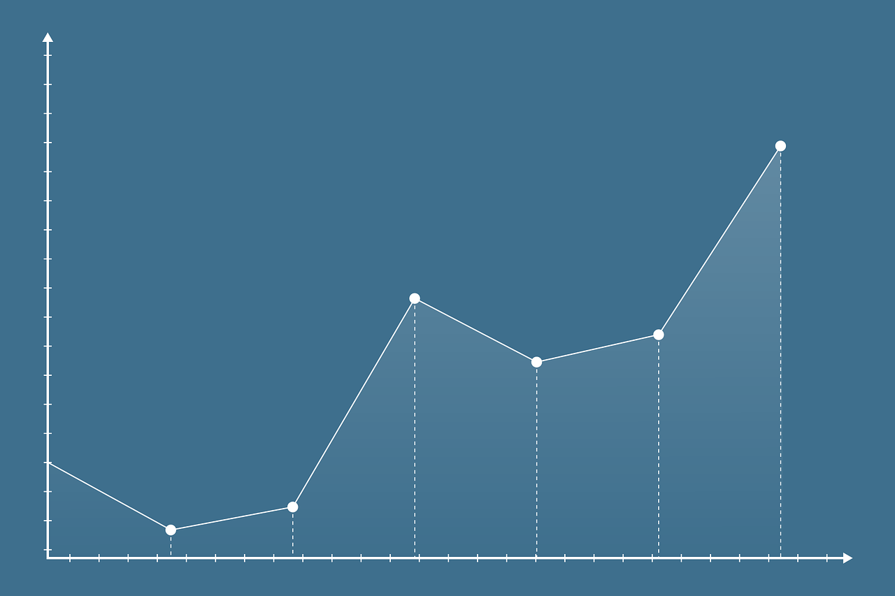
Task1: Create a Pandas DataFrame Table
Create:
A Table using Pandas dataframe and print.
Statistics based on the table values.
A Line graph with an X axis and Y axis using Pandas
A window showing the graph using Matplotlib’s pyplot.

Slide 4
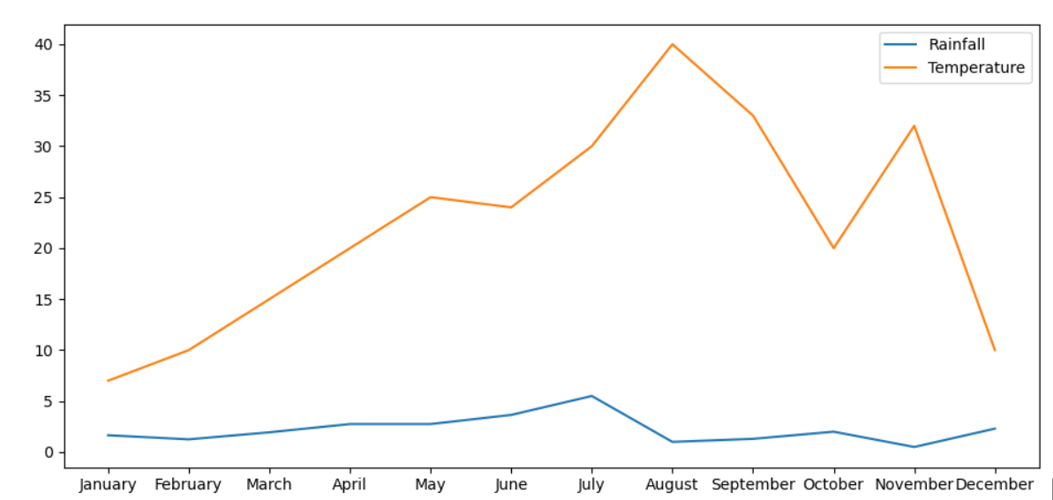
Task2: MatPlotLib PyPlot
Create:
A Pyplot plot using Temperature and Month.
A Pyplot using Month and Temperature.
A Pyplot plot using Month on the X axis, Temperature and Rainfall together on the Y.
Create a Legend for the graph.

Slide 5
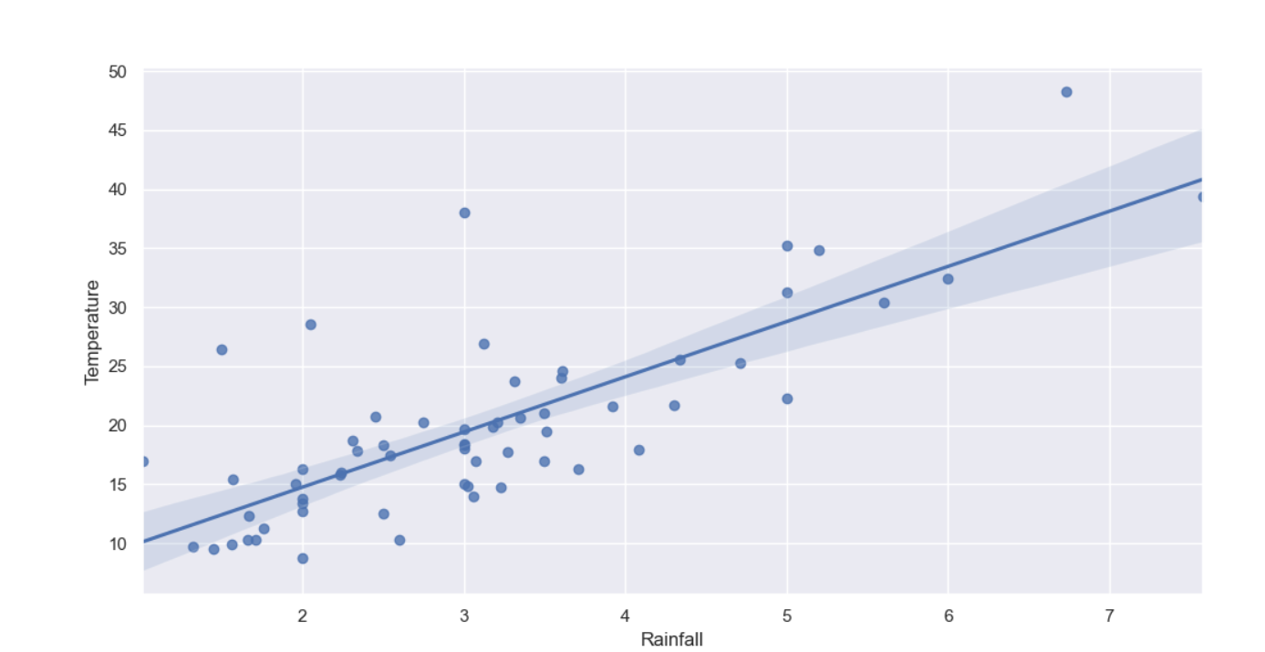
Task3: Scatterplot Graph
Introducing the Seaborn library
Built atop MatplotLib.
Create a plot with individual data points scattered
Create a regression to show possible correlation

Slide 6
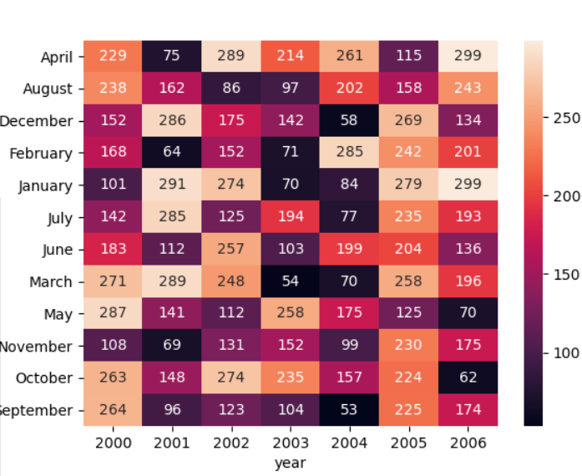
Task4: Seaborn Heatmap
Popular type of graph--Good for spotting large and small values quickly.
Sometimes requires data to be reorganized into a Matrix using pivots.
Has a color key on the side.
Create using a new births data set: (month, year, number of births

Slide 7
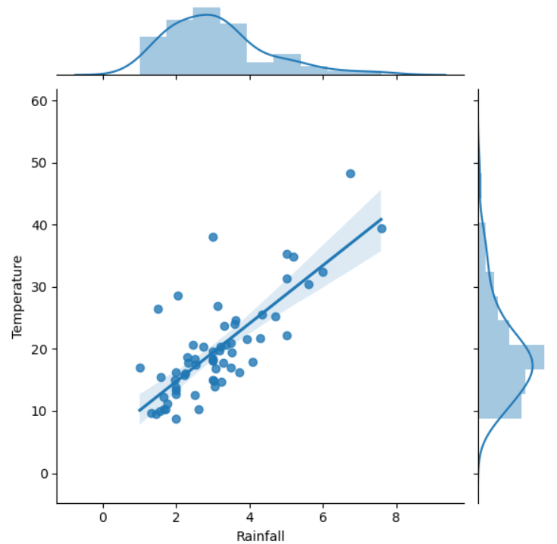
Task5: Seaborn JointPlot
Popular type of graph--Good for looking at distribution and data points at the same time.
Has option to display different kind of graph- the parameter called kind.
Here, we will see scatter with regression line, as well as distribution.

