Slide 1


Add User Directory Tree Linux File System
Dave Dalsveen

Slide 2
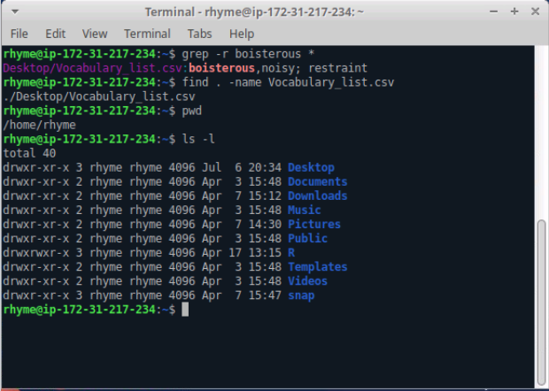
The Terminal Window

Slide 3
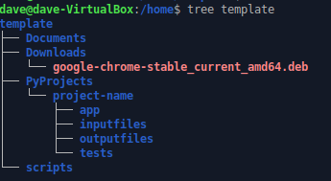
Task1: Display the directory tree from a terminal
Open a terminal on Ubuntu Linux.
Display working directory.
Use the tree command to display the user’s home directory tree
Display the home directory tree (users) using a relative path.

Slide 4
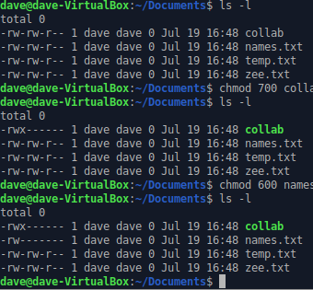
Task2: Describe permissions in files and directories using ls -l
Get details of files and directories using –l option..
Describe the three permission categories. User, Group, and Other
Use chmod with digits to change permission.
Use chmod with characters to change permissions.

Slide 5

Task3: Use the mkdir -p command to recursively add directories
Use the mkdir –p command to set up project directories
Use the mkdir –p command to set up project directories
Add a requirements.txt file to the project-name directory.
Use app.py to the app directory..

Slide 6
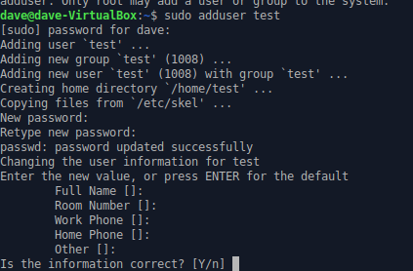
Task4:Use adduser to create a new user account and give the user directories and files.
Use adduser to create a template user.
Login as the new user.
Copy the directories recursively to the new user
Remove any files in the new directories.
Copy the Project directory into the new user directory.

Slide 7
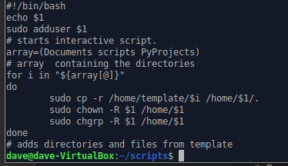
Task5: Create a script to add a user and copy directories and files into the new user’s directory
Make a new directory called scripts.
Use vi to open a new script file.
Begin the file with a script invocation. #!/bin/bash
Use the previous task commands to generate the user and copy files and directories.

