Slide 1
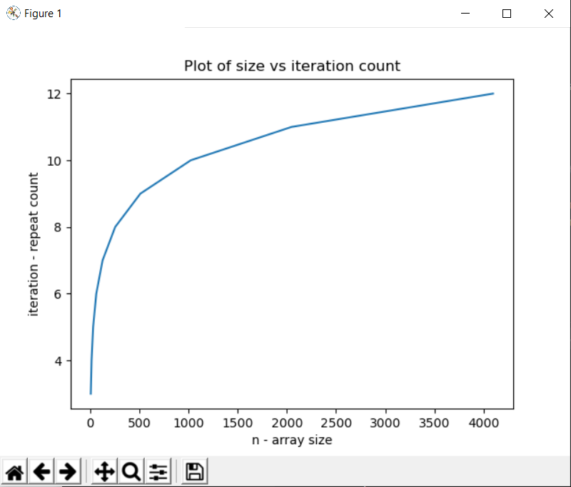

Welcome to Determining Big-O Time Complexity in Python Code
Dave Dalsveen

Slide 2
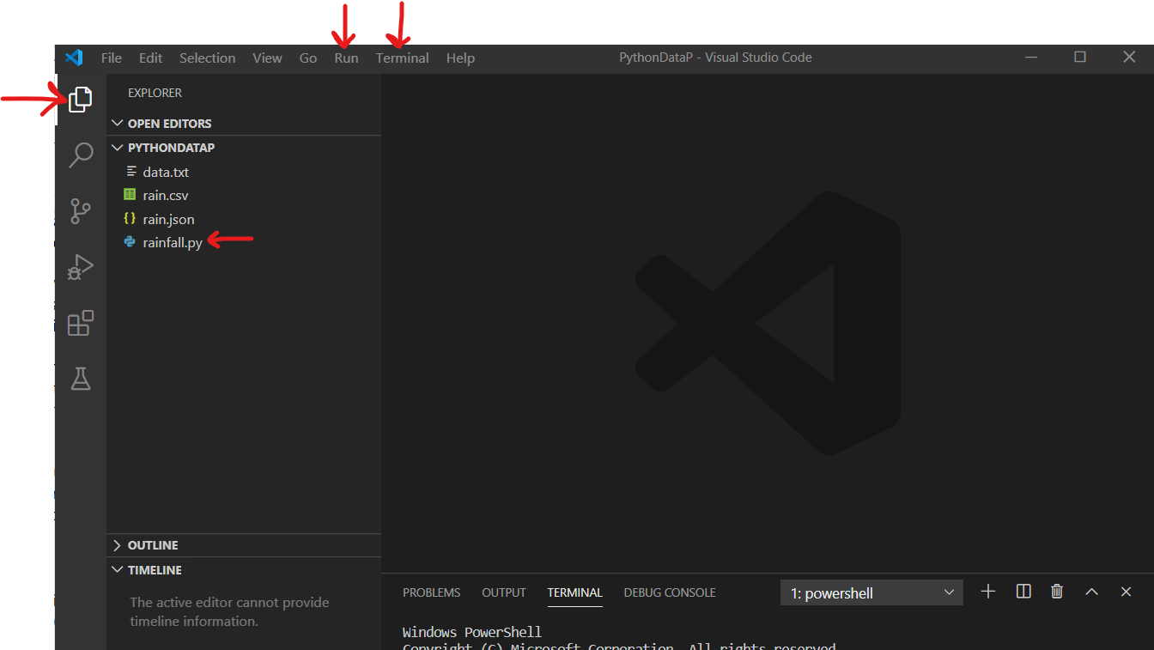
Visual Studio Code
The main Visual Studio Icons we are using are:
Explorer
Run->run without debugging
Run->start debugging
Code editor Window

Slide 3
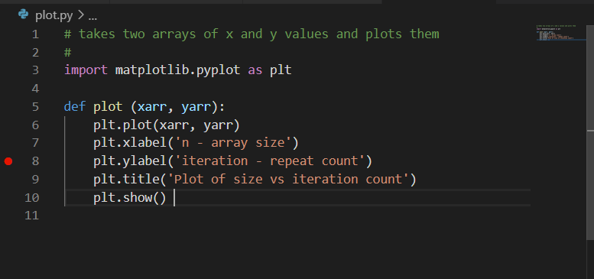
Task1: Use matplotlib Pyplot to produce a graph to visualize Big-O performance data.
Implement the plot function that will be used for future tasks.
Takes an array for X-coordinates and an array for Y coordinates.
Used in future tasks to plot input Size N on the X axis and iteration count on the Y axis.
Create a window showing the graph using Matplotlib’s pyplot.
Determine how this will be used to Visualize Big-O

Slide 4
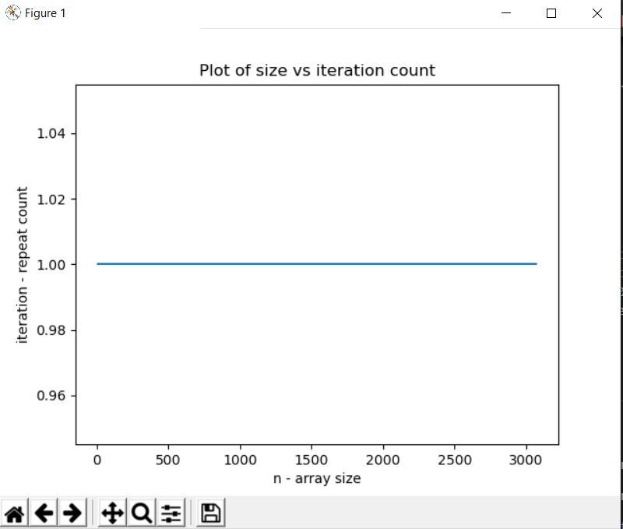
Task2: Write a function that returns one element and analyze the Big-O time complexity
Analyze the code used to test the function return_element.
Implement the return_element function.
Use the plot to determine the Big-O of the function.
Describe what O(1) means.

Slide 5
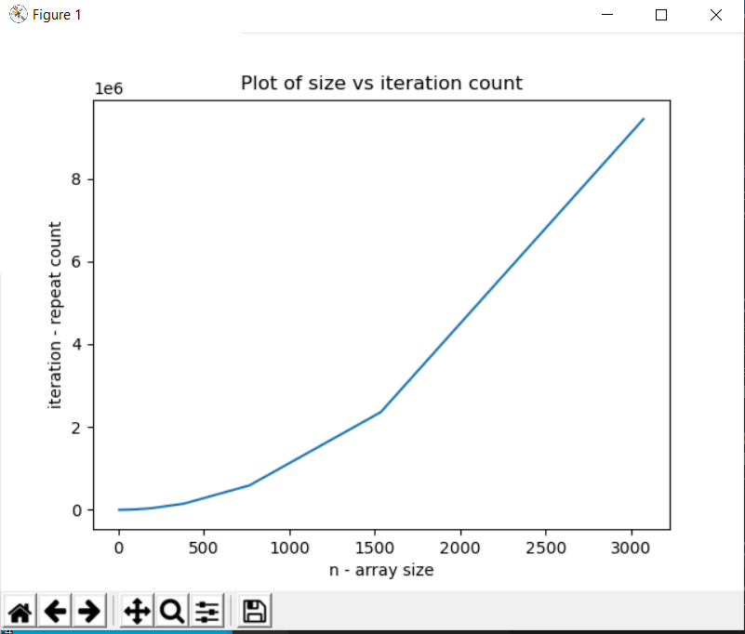
Task3: Write a Bubble sort function and analyze its performance
Describe the test used for the bubble sort
Implement the bubble sort function.
Step through the sort code using the debugger.
Run task3.py to generate the plot of N vs Iteration Count.

Slide 6
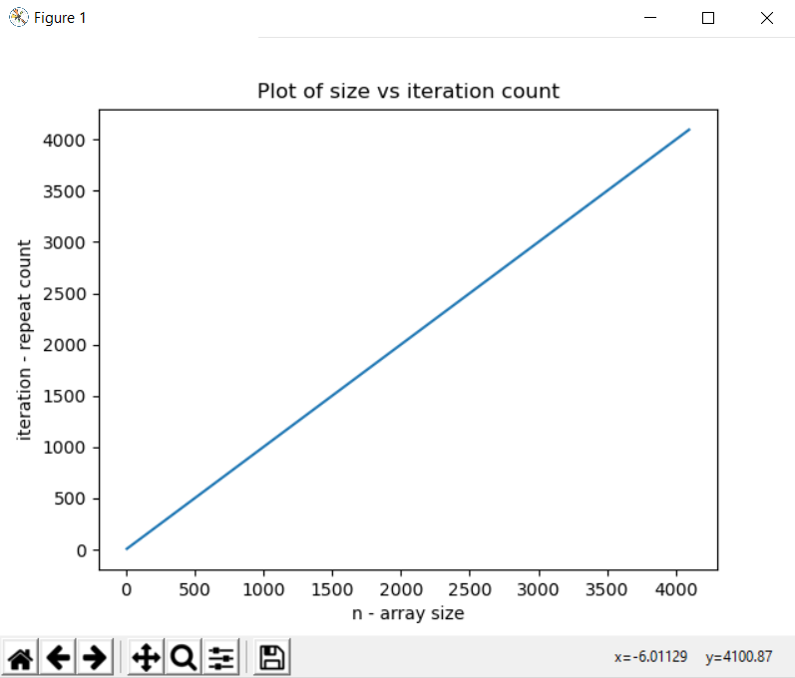
Task4: Implement a Linear Search of an Array and determine its performance.
Observe the worst-case search scenario used to determine Big-O.
Describe how the linear search works.
Run task 4 to plot the array size vs iteration count.
Determine Big-O for linear search.

Slide 7
Task5: Create a Binary Search function and perform Big-O analysis.
Implement the binary search function that keeps a count of the call stack.
Describe the steps taken in a binary search divide-and-conquer approach.
Step through the binary search with the debugger.
Run task 5 and determine Big-O for a binary search function.

