Slide 1
Car Washing Management System

Slide 2

SHRI JAYKUMAR RAVAL INSTITUTE OF TECHNOLOGY, DONDAICHA.
Department of Computer Science and Engineering [2022-2023]
by:-
: ANAN DADAJI PATIL.
: ANURAG BHIMRAO BAGUL.
Under the guidance of: Prof. S.N.RAUL Mam

Slide 3
INDEX
ABSTRACT
OBJECTIVE
FUNCTIONALITY
FEATURES
EXISTING SYSTEM
PROPOSED SYTEM
USE-CASE DIAGRAM
DATA FLOW DIAGRAM
SOFTWARE REQUIREMENT
HARDWARE REQUIREMENT
ADVANTAGES & DISADVANTAGES
REFRENCES

Slide 4
Abstract
We aim to become a pioneer in the car washing industry by completely focusing on customers, our employees, growth, innovation and efficiency. All of these elements will drive us towards success and show us as one company that can perform and give value for money.
Car Washing Management System is fully automated with different stages of foaming, washing, drying and brushing. In Car Washing System, we performed all the operations needed to clean the car successfully by using highly expert and experience worker, also developed mimic of the whole system and works and checked the overall process step by step by visualization. Authorised person maintains the car washing details in papers, which is a tedious task if any updating or changes need to be done.
Details are stored in Papers.
Maintenance is a huge problem.
Updation, changes in details is a tedious task.
Performance is not achieved up to the requirements.

Slide 5
Objective
We aim to become a pioneer in the car washing industry by completely focusing on customers, our employees, growth, innovation and efficiency. All of these elements will drive us towards success and show us as one company that can perform and give value for money. This Service will make A manager to think of whether the transportation is expensive and maintaining quality or not.
In Car Washing Management System, we performed all the operations needed to clean the car successfully by using highly expert and experience worker, also developed mimic of the whole system, works and checked the overall process step by step by visualization.
. In this project, we use PHP and MySQL database. It has two modules.
Admin
User

Slide 6
Functionality
Secure admin login system
Dashboard: In this section, admin can see two wheeler and four wheeler vehicle detail in brief.
Washing Points: In this section, admin can manage washing location (Add/Update).
Add Car Washing Booking: In this section, admin add car washing booking on his/her end.
Car Washing Booking: In this section, admin can view booking details of car washing which is booked by users.
Manage Enquiries: In this section, admin can read the enquiries of users.
Pages: In this section, the admin can manage about us and contact us pages.
Admin can also change the password of his/her account.

Slide 7
Features
Users
Home Page: Users can see the listed vehicles on the home page.
About Us: Users can view about us page.
Washing plans: User can view car washing plans and book that plans.
Washing points: User can view car washing location.
Contact us: Users can view the contact us page and do enquiry.

Slide 8
Existing System
Car Washing Management System is fully automated with different stages of foaming, washing, drying and brushing. In Car Washing System, we performed all the operations needed to clean the car successfully by using highly expert and experience worker, also developed mimic of the whole system and works and checked the overall process step by step by visualization. Authorized person maintains the car washing details in papers, which is a tedious task if any updating or changes need to be done.
Details are stored in Papers.
Maintenance is a huge problem.
Updation, changes in details is a tedious task.
Performance is not achieved up to the requirements.

Slide 9
Proposed System
In the Previous System, Details are Stored Manually in papers, to share the details between employees was a financial drawback. Updating in the details is a tedious task.
But a new system was proposed to overcome the above drawbacks.
Functionalities and advantages of proposed system are:
Data is Centralized which has overcome the Sharing problem in previous system.
As data is Maintained electronically, it’s easy for a person to update the details, which has overcome the tedious updation in previous system.
Maintenance is easy and performance is good.
Mainly the system has automated the Transportation Process.

Slide 10
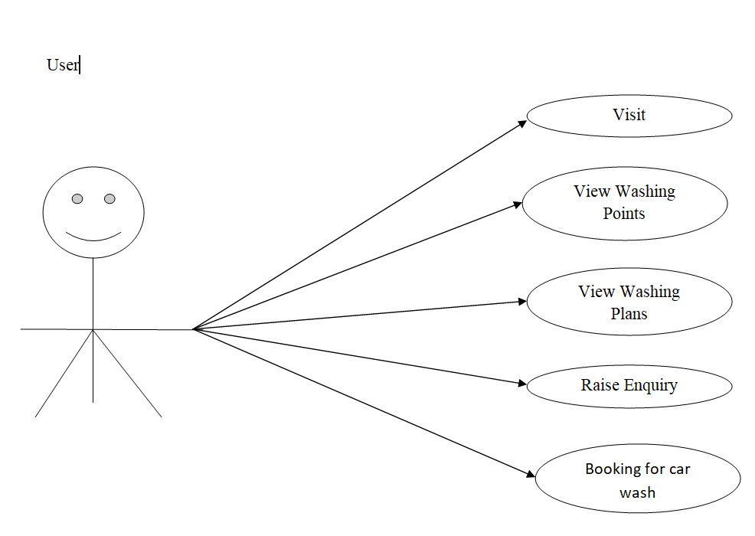
Use Case Diagram
Notes:
USECASE DIAGRAM: A Use case is a description of set of sequence of actions. Graphically it is rendered as an ellipse with solid line including only its name. Use case diagram is a behavioral diagram that shows a set of use cases and actors and their relationship. It is an association between the use cases and actors. An actor represents a real-world object. Primary Actor – Sender, Secondary Actor Receiver.

Slide 11
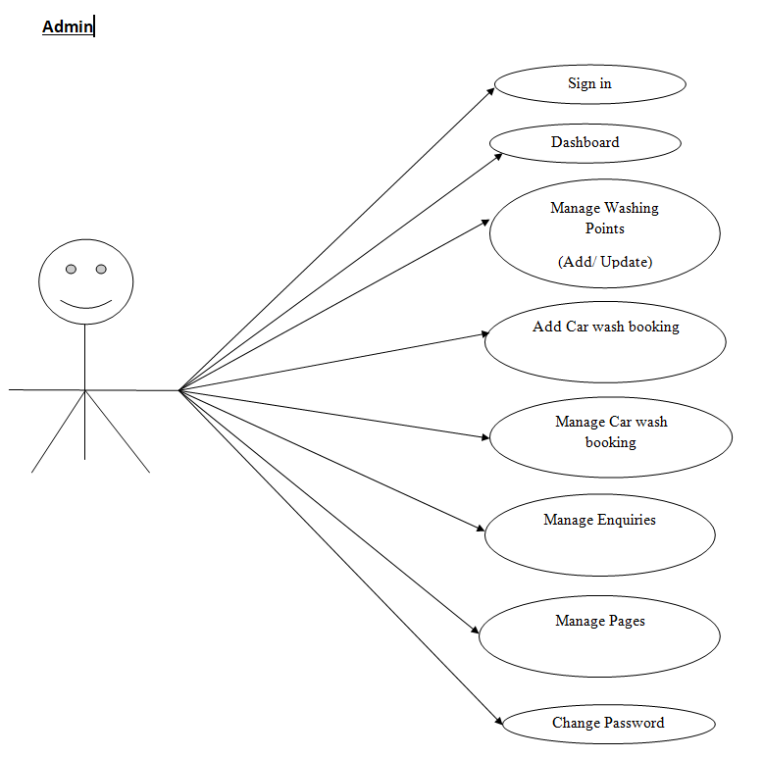
Continue.......

Slide 12
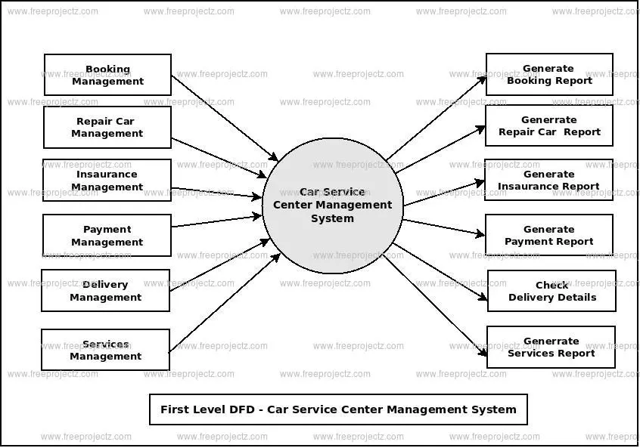
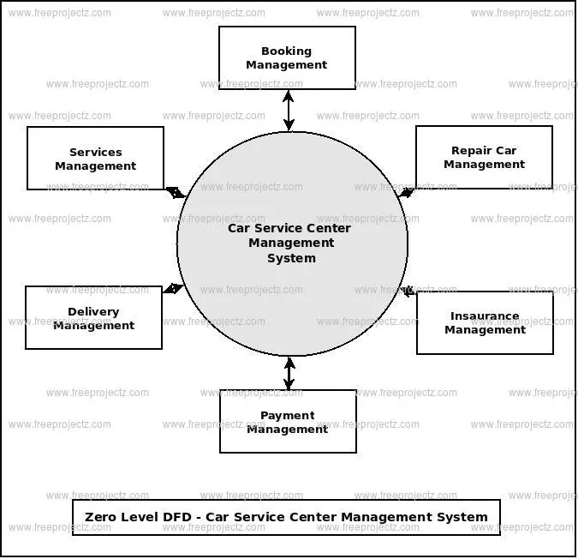
Data Flow Diagram

Slide 13
Requirement Specification
Hardware Configuration:
RAM | 512 MB
Hard Disk | 10GB
Processor | 1.0 GHz
RAM | 1 GB
Hard Disk | 20GB
Processor | 2.0GHz

Slide 14
Continue.....
Software Requirement:
Web Browser | Google Chrome or any compatible browser
Operating System | Windows or any equivalent OS
Web Server | APACHE
Server side Language | PHP5.6 or above version
Database Server | MySQL
Web Browser | Google Chrome or any compatible browser
Operating System | Windows or any equivalent OS

Slide 15
Advantages & Disadvantages
Advantages
Create Membership discounts and Packages to attract prime customers.
Car Wash Management system is efficient to operate multiple orders at once and responsive to use on Desktops, Tablets, and POS.
Car wash POS offers multiple calculations on the dashboard.
Users can create multiple layouts for a dashboard.
Disadvantages
One of the greatest disadvantages to owning a car wash is the complexity of this type of business and how expensive it can be to repair specialized car wash equipment when pieces break.

Slide 16
References
For PHP
https://www.w3schools.com/php/default.asp
https://www.sitepoint.com/php/
https://www.php.net/
For MySQL
https://www.mysql.com/
http://www.mysqltutorial.org
For XAMPP
https://www.apachefriends.org/download.html

Slide 17
Thank You

