Slide 1

Smart Finance Tracker
Your personal AI-powered financial assistant.
Project Presentation
Anurag Baibhav
RegNo 12304517
GitHub: https://github.com/AnuragBaibhav/Personal_Finanace_Tracker

Slide 2

Platform Overview
Smart Finance Tracker is a full-stack, AI-integrated web application designed to help users take total control of their financial health.
By bridging traditional income and expense tracking with cutting-edge Large Language Models (LLMs), the app goes beyond just showing numbers.
It actively assists users with intelligent budgeting insights, dynamic charting, and automated, professional financial reports.

Slide 3






The Tech Stack: Frontend Architecture
React 19 & Vite
Dynamic UI & Visuals
Seamless Navigation
Built on the latest React 19 framework and bundled with Vite, ensuring rapid rendering, optimized performance, and instant hot-module reloading during development.
Leveraging Recharts for rendering interactive, scalable SVG pie and bar charts. The UI is governed by a custom CSS design system for a highly responsive experience.
Integrated with React Router DOM (v7) for fluid Single-Page Application (SPA) navigation. Enriched with Lucide React icons and React-Markdown for text rendering.

Slide 4


The Tech Stack: Backend & AI Engine
Server-Side Infrastructure
AI & Machine Learning
▹
Framework: Django 4.2 with Django REST Framework (DRF) for structured, scalable, and secure API endpoints.
▹
Google Gemini API: Cloud-based LLM integration serving as the core engine for conversational, natural language financial assistance.
▹
Database: MySQL via pymysql and Django ORM, ensuring strict relational data integrity and robust querying.
▹
Auto-Categorization: Custom ML utilities built directly into the pipeline to intelligently categorize incoming transactions based on text context.
▹
Auth & Reports: Token-based authentication for data security. Integration with ReportLab for on-the-fly PDF generation.
▹
Smart Insights: Context-aware logic that analyzes user spending patterns to provide actionable financial advice.

Slide 5
Core Feature: Intelligent Tracking
▹
Multi-Account Management: Users can effortlessly create and manage various accounts (Checking, Savings, Credit Cards) in one unified space.
▹
Real-Time Sync: Account balances update instantaneously as new income or expenses are logged into the system.
▹
Precision Logging: Log transactions with exact categorization. Includes native multi-currency support with dynamic exchange rates.
▹
Receipt & Audit Support: Users can upload images of receipts and attach detailed notes to transactions, streamlining tax season preparations.

Slide 6
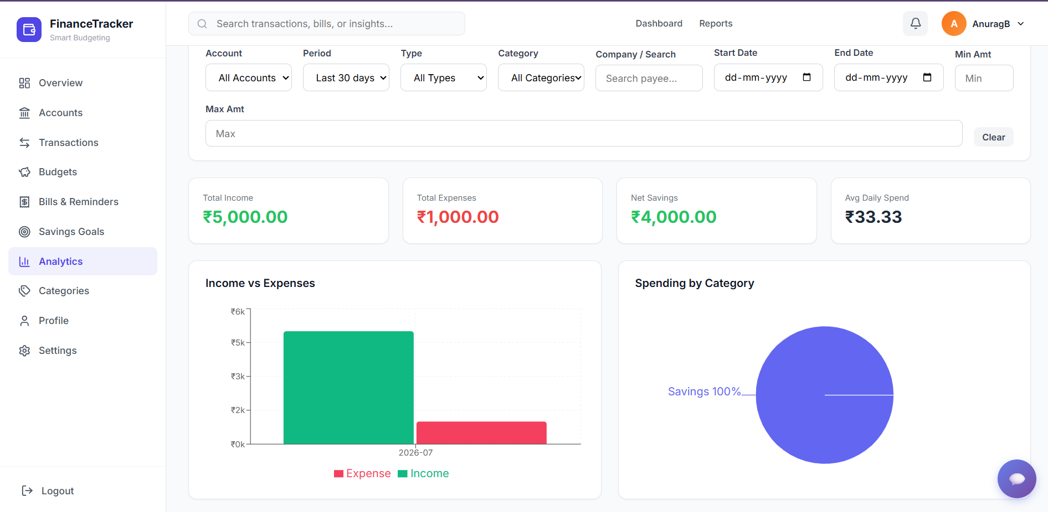
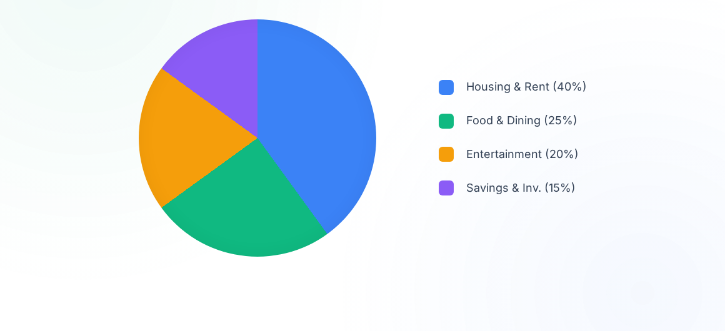
Dynamic Analytics Dashboard
Visual Insights instantly calculate KPIs such as Net Savings, Total Income, and Average Daily Spend, providing a complete breakdown of where your money is going.

Slide 7
AI Assistant & Financial Reporting
Context-Aware AI Chatbot A built-in assistant that understands your exact financial situation. Ask questions like: "How much did I spend on dining this month compared to last?" and receive natural, accurate answers.
Exportable Professional PDF Reports Generate formatted, professional financial statements with a single click. Advanced filters allow users to isolate specific date ranges, transaction types, or categories for clean archiving.
Proactive Bill Reminders A dedicated notification system continuously tracks upcoming bills and subscription due dates, ensuring users never miss a payment and avoid unnecessary late fees.

Slide 8
Usage Flow: How It Works
2. Data Entry
4. Insights
User logs transactions. ML categorizer automatically tags data (e.g., "Starbucks" to Food).
User chats with the AI for budgeting advice based on recent high expense categories.
1. Onboarding
3. Review
5. Reporting
User signs up and creates their first base account (e.g., "Main Checking").
User visits the Analytics tab for a real-time visual representation of their cash flow.
User exports a filtered PDF statement at month-end for personal auditing and archiving.

Slide 9


Future Scope: Scaling Up
Predictive & Automated Finance
The Smart Finance Tracker has massive potential for horizontal and vertical scaling in upcoming versions.
▹
Paid API Integration: Connect directly to real-world banks to auto-sync transactions, removing the need for any manual data entry.
▹
Predictive Forecasting: Utilize Machine Learning to predict future balances (e.g., "Warning: At this spending rate, you will overdraft in 12 days.").

Slide 10





Future Scope: Next-Gen Features
Family & Shared Accounts
Goals & Gamification
Mobile Application
Allow couples or families to seamlessly collaborate on a single household budget with secure, role-based permissions.
Set specific financial targets (e.g., "Save $5,000") and visualize progress bars complete with rewarding achievement badges.
Port the React frontend into React Native to provide a unified, seamless native application experience for iOS and Android.

