Slide 1
Project Title : Expense tracker

Slide 2
Introduction
The Expense Tracker is a web-based application designed to help users monitor and manage daily income and expenses efficiently. The system provides transaction recording, expense categorization, balance calculation, and financial insights through charts and reports. It helps users improve budgeting habits and financial planning.

Slide 3
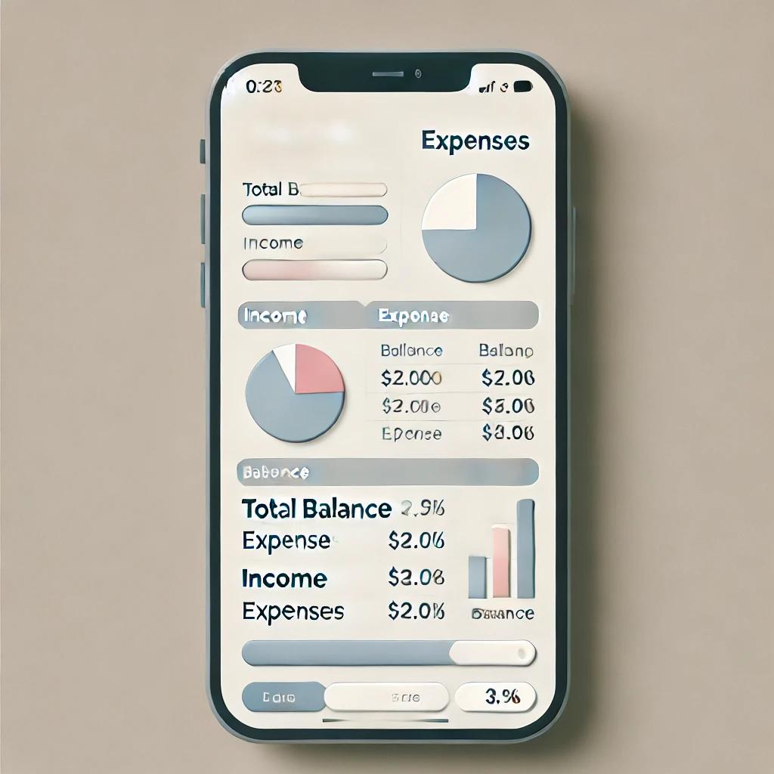
Problem Statement
To develop a web-based application that allows users to track and manage their daily expenses in a simple, organized, and user-friendly way.

Slide 4
Objectives
To develop a user-friendly expense tracking system
To record daily income and expenses
To categorize financial transactions
To generate summaries and reports
To help users make better financial decisions

Slide 5
LITERATURE SURVEY
Paper | Authors Name | Year of Publication | Approach | Dataset Description | Performance Parameter | Limitation | Gaps Identified
TrackEZ Expense Tracker | Priyanka Bhatele, Divya Mahajan, Bhushan Mahajan | 2023 | The frontend is designed with HTML, CSS, and JavaScript. It supports features such as adding, viewing, and analyzing income and expenses. The data is visualized in real-time through charts and graphs | The application works with user-inputted income and expense entries, making it suitable for personal financial tracking | The primary metrics include real-time data updates and positive user feedback | The app is limited to individual users and does not cater to shared or group expense tracking needs. | There is no provision for managing shared expenses, making it less suitable for collaborative financial management
Expense A Smart Approach to Track Everyday Expense | Shahed Anzarus Sabab, Sadman Saumik Islam | 2018 | This paper describes a mobile application that uses OCR and SMS parsing for automated expense tracking. | The app processes receipts and SMS as input data | It is measured by task completion time and success rate | OCR accuracy decreases under poor lighting or noisy images, | The system lacks automatic detection of regions of interest on receipts

Slide 6
Expense Management System | Era Johri, Parth Desai, et al. | 2023 | Mobile app for tracking expenses via SMS and AI insights | SMS-based expense data | Financial insights | Limited to SMS, privacy concerns | Lacks integration with other data sources
Smart BAT - Smart Budget Analyzer and Tracker | Shelke, Shaikh, Shingre, Lebisha | 2023 | OCR and ML for expense categorization and analyse expenses | Uses scanned bills,banknotes for OCR validation | 90%+ OCR accuracy I teext extraction | Limited with low-quality images | Lacks advanced budget forecasting
Development of an Application for Expense Accounting | Denis E. Yurochkin, Anton A. Horoshiy, Saveliy A. Karpukhin | 2021 | This research implements a mobile app that uses Tesseract OCR combined with OpenCV for pre-processing receipts | Focuses on receipts from select stores | good recognition accuracy under ideal lighting conditions. | Lower performance in varied lighting | Limited generalization to receipts from untested stores and lack of optimization for diverse lighting conditions

Slide 7
Software Requirements
Frontend: React.js (For a responsive, fast, single-page user interface).
Backend: Node.js & Express.js (For building robust RESTful APIs).
Database: MongoDB (For flexible, document-based data storage).
Development Tools: GitHub (Version Control), Postman (API Testing)

Slide 8
Methodology

Slide 9
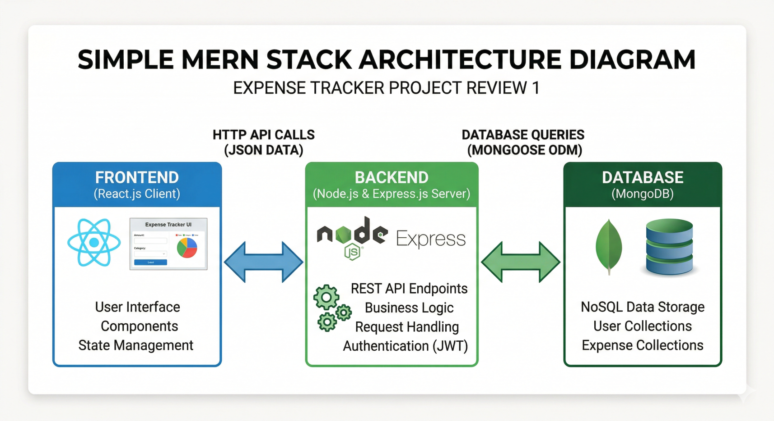
System Architecture

Slide 10
Functional requirements
1.Add Income and Expenses
2.Display Current Balance
3.View Transaction History
4.Edit and Delete Transactions
5.Category-based Filtering

Slide 11
FUNCTIONAL REQUIREMENTS
1)Add Income and Expenses
Users should be able to add entries for both income and expenses by entering an amount, category, date, and optional description.
2)Display Current Balance
The application should calculate and display the current balance based on the total income and total expenses entered by the user.
3)View Transaction History
Users should be able to view a list of all income and expense entries, with details like date, category, and amount.
4)Edit and Delete Transactions
Users should have the option to edit or delete individual entries to ensure accuracy in tracking.
5)Category-based Filtering
The application should allow users to filter transactions by category (e.g., Food, Rent, Entertainment) to analyze spending in specific areas.

Slide 12
Non- Functional requirements
1.Usability
2.Performance
3.Scalability
4.Data Security
5.Compatibility

Slide 13
NON-FUNCTIONAL REQUIREMENTS
1)Usability
It should have an intuitive and user-friendly interface, with clear navigation and labels, so that users of all experience levels can easily track their expenses.
2)Performance
It should load quickly, with minimal delays when adding or editing transactions, ensuring smooth interaction even with a large number of entries.
3)Scalability
It should be design to handle an increasing number of transactions without significant performance degradation, allowing users to add and review a high volume of entries over time.
4)Data Security
While it stores data locally, it should still prevent unauthorized access by ensuring that stored data remains private and secure, especially if deployed online or synced across devices in future updates.
5)Compatibility
It should work smoothly across different web browsers (e.g., Chrome, Firefox, Safari) and devices (e.g., desktops, tablets, smartphones) to ensure accessibility for users regardless of their device.

Slide 14
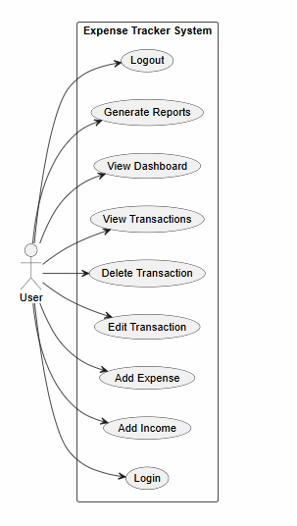
USE CASE DIAGRAM

Slide 15
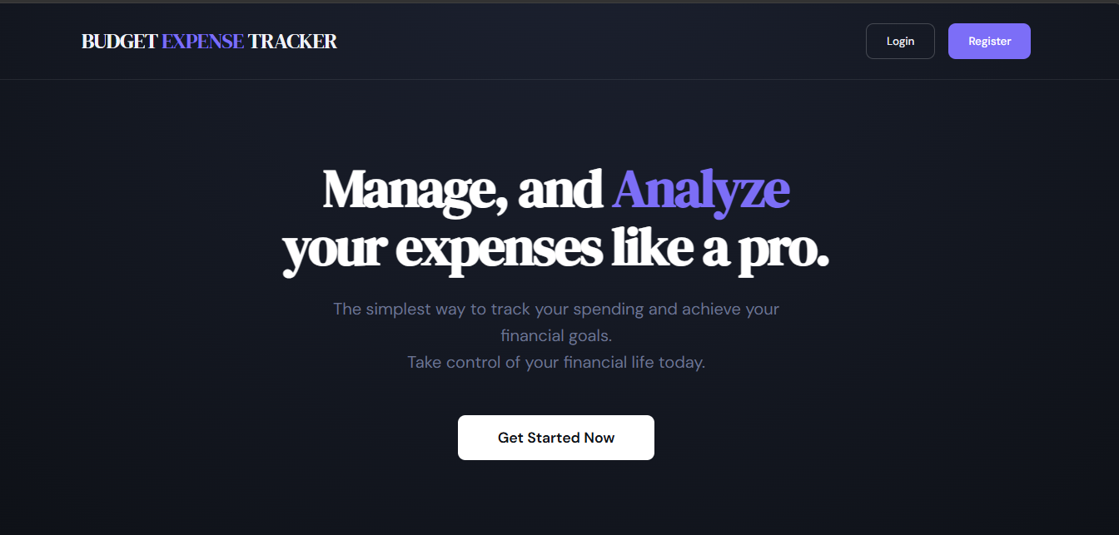
Results and Output

Slide 16
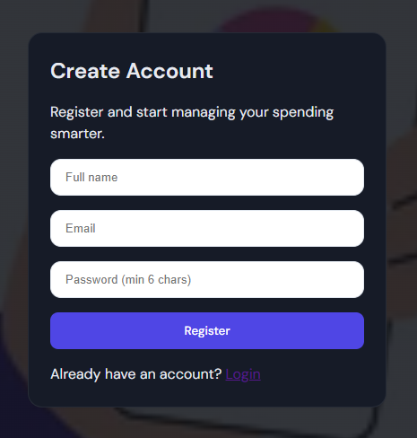
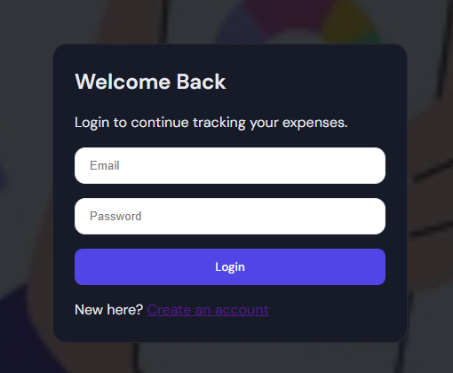

Slide 17
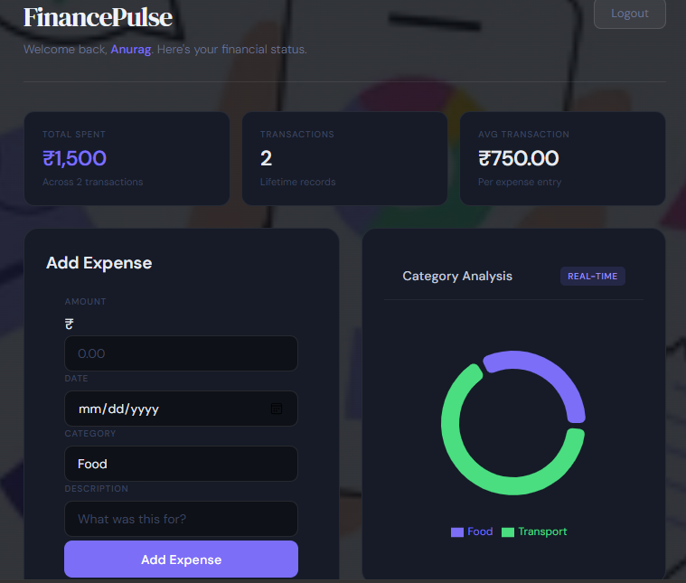
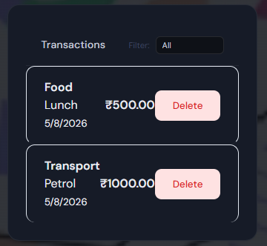

Slide 18
Results and Discussion
The Expense Tracker system's user interface is designed for simplicity and efficiency, with key features including:
Dashboard Overview:
Provides a quick summary of financial status.
Displays current balance, recent transactions, and categorized expense breakdowns in an intuitive layout.
Add Income and Expenses:
Easy-to-use screen with labeled fields for date, amount, and category.
Focuses on effortless transaction entry.
Transaction History:
Detailed tabular view of all transactions with date, category, amount, and type.
Includes search and filter options for quick navigation.
Edit and Delete Options:
Users can manage transactions with clear icons or buttons directly from the history page.
Category-based Filtering:
Dropdowns or menus allow viewing expenses by category (e.g., food, travel).
Includes visual cues like charts or highlights to analyze spending patterns.
Visual Insights:
Interactive charts (pie, bar graphs) offer a clear visual representation of income and expenses.
Ensures data exploration is engaging and informative.

Slide 19
CONCLUSION & FUTURE SCOPE
CONCLUSION
The Budget Expense is an efficient and user-friendly web application designed to simplify personal financial management. By enabling users to track their income and expenses, it promotes better financial awareness and decision-making. The integration of modern web technologies ensures a seamless user experience, making it a valuable tool for anyone seeking to maintain financial discipline and achieve budgeting goals.
FUTURE SCOPE:
Advanced Data Visualization:
Include dynamic charts and graphs for deeper insights into spending trends over time, allowing users to make more informed financial decisions.
Integration with External Financial Platforms :
Enable integration with banking apps, credit card systems, or e-wallets for automatic expense tracking and reconciliation.
Collaborative Budgeting :
Add shared budget options for families or teams, where multiple users can contribute and monitor a common financial goal.

Slide 20

THANK YOU

