Slide 1
Design Pattern

Slide 2
Adapter Pattern
Incompatible interfaces between a client and service provider
Bridge Design pattern
Decouple Abstraction from implementation, so that the two can vary independently

Slide 3
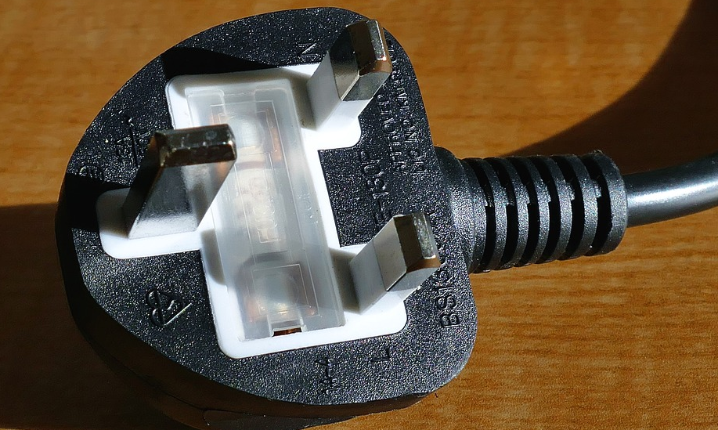
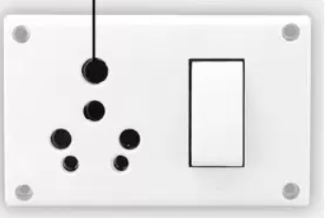
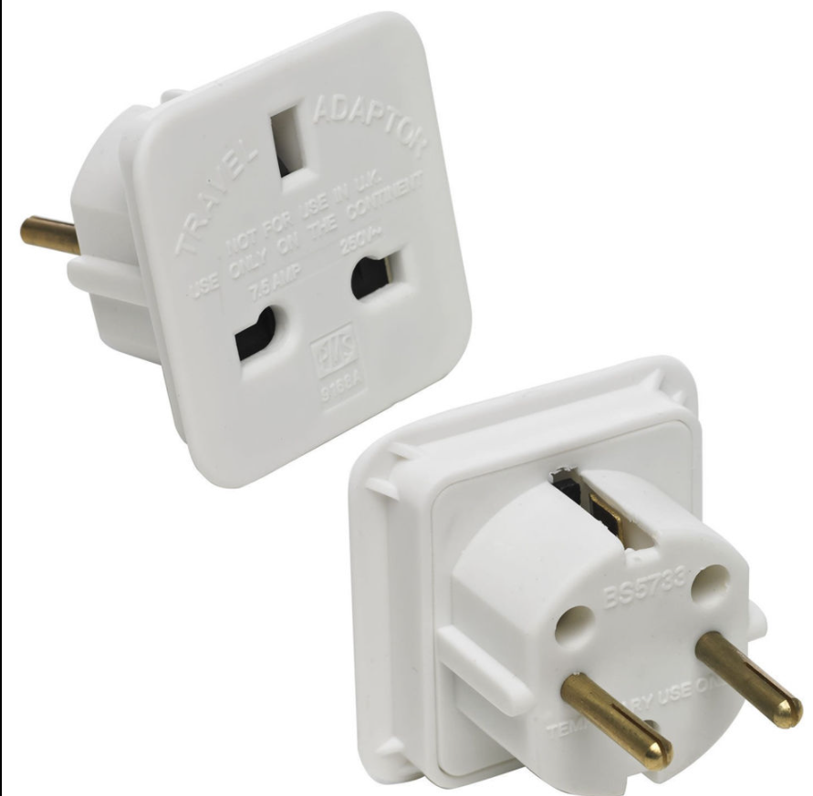
Adapter Design Pattern
Pictorial Representation

Slide 4
Adapter Design Pattern
Types of Adapter Pattern
Object Adaptor
Holds an instance of adaptee. Modifies the response and sends back to compatible type which client expects.
Class Adaptor
Inherits from the Adaptee.
Modifies the response coming from Adaptee
Client calls the Adapter through IAdaptee.

Slide 5
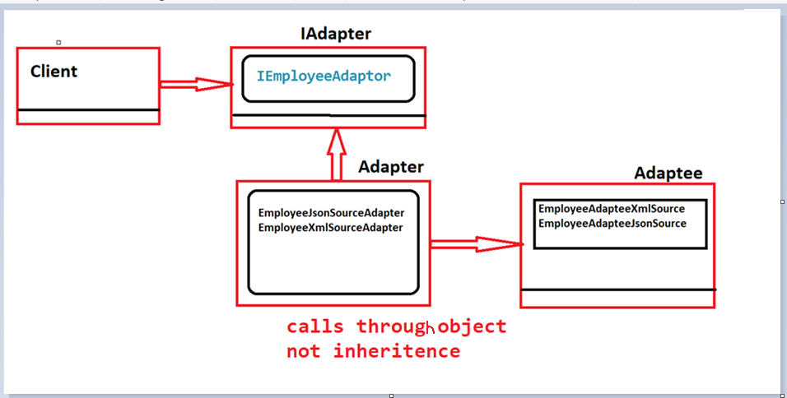
Adapter Design Pattern
Object Adapter Pattern(UML)

Slide 6
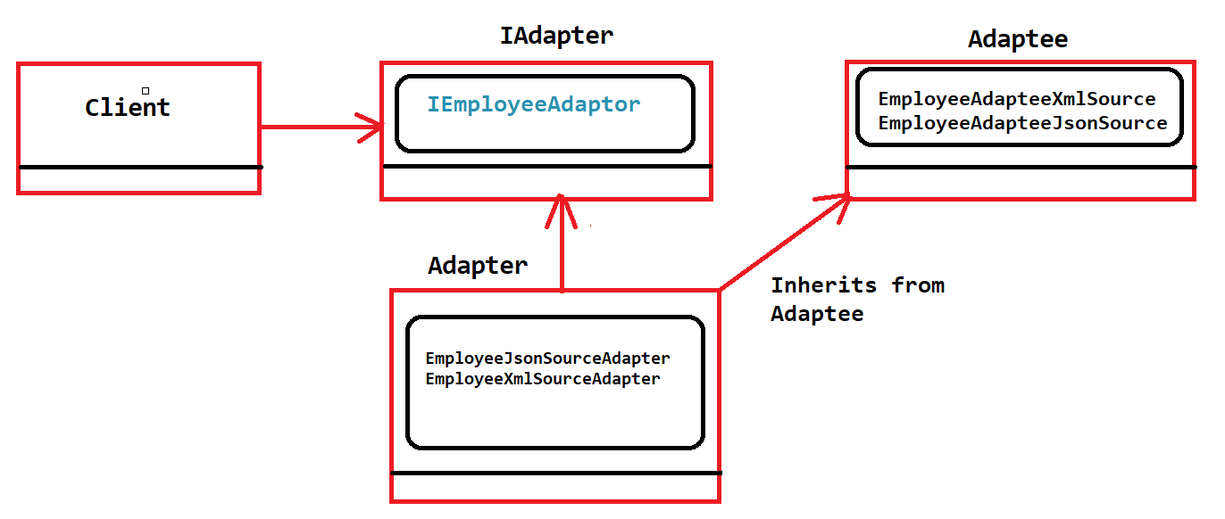
Adapter Design Pattern
Class Adapter Pattern(UML)

Slide 7
Adapter Design Pattern
Key Points
Adaptor design pattern helps in not breaking the Solid Principle
Open closed principle is not broken
Single Responsibility is not broken
Also called as wrapper design pattern
This design pattern comes into picture when already code is existing. For some reason client cannot change the interface, and so the source. Adapter comes into picture to make it compatible.

Slide 8
Bridge Design Pattern
Introduction
This Design pattern is implemented before the actual design has started, unlike the Adapter design pattern.
If not implemented, Class hierarchy increases, which leads to complexity. The Bridge Pattern could help us to separate the and implementation in two independent areas

Slide 9
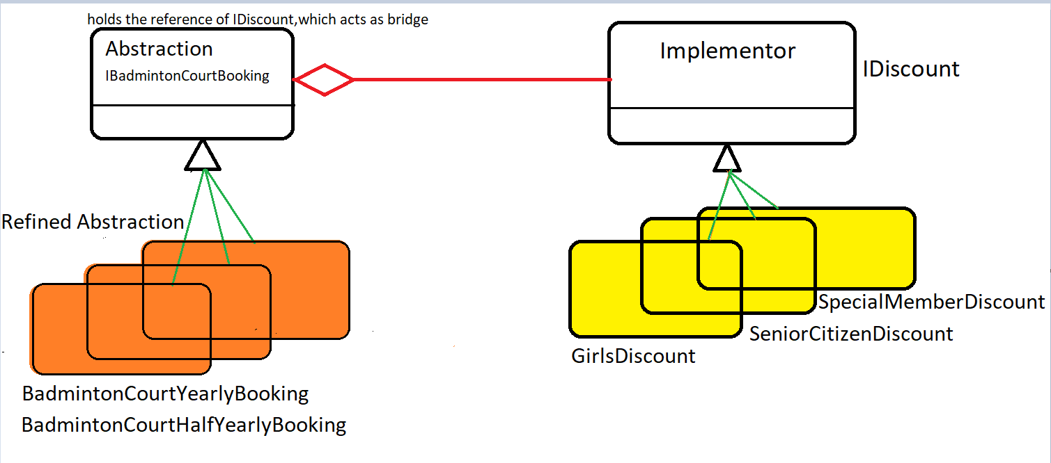
Bridge Design Pattern
UML DIAGRAM
This Design pattern is implemented before the actual design has started, unlike the Adapter design pattern.
If not implemented, Class hierarchy increases, which leads to complexity

Slide 10
Design Pattern
THANK YOU

