Slide 1
🚕
NYC TAXI ANALYTICS
Capstone Project – Microsoft Fabric End-to-End Pipeline
NAME
DATASET
PLATFORM
Anurag Anant Deotale
NYC Green Taxi · 76.5M rows
Microsoft Fabric
Microsoft Fabric • Power BI • Lakehouse • Star Schema

Slide 2
NYC TAXI DATASET – DATA QUALITY & INSIGHTS
76.5M Rows • 23 Columns
“IpepPickupDateTime” , “IpepDropoff” DateTime “ Column maximum Year was 2081 ,2031…
“improvementSurcharge” column was in string form
“tripDistance” Column had values with 0
“passengerCount” Column had “0” values
“puLocationId”, “doLocationId”,”pickupLatitude”,” pickupLongitude”,”dropoffLongitude”,”dropoffLongitude” had NULL VALUES AROUND 40%.
“ehailFee” Column is Completely NULL
“fareAmount”,”extra”,”mtaTax”,”ImprovementSurge”,”tipAmount”,”tollsAmount” Column had many NEGATIVE VALUES

Slide 3
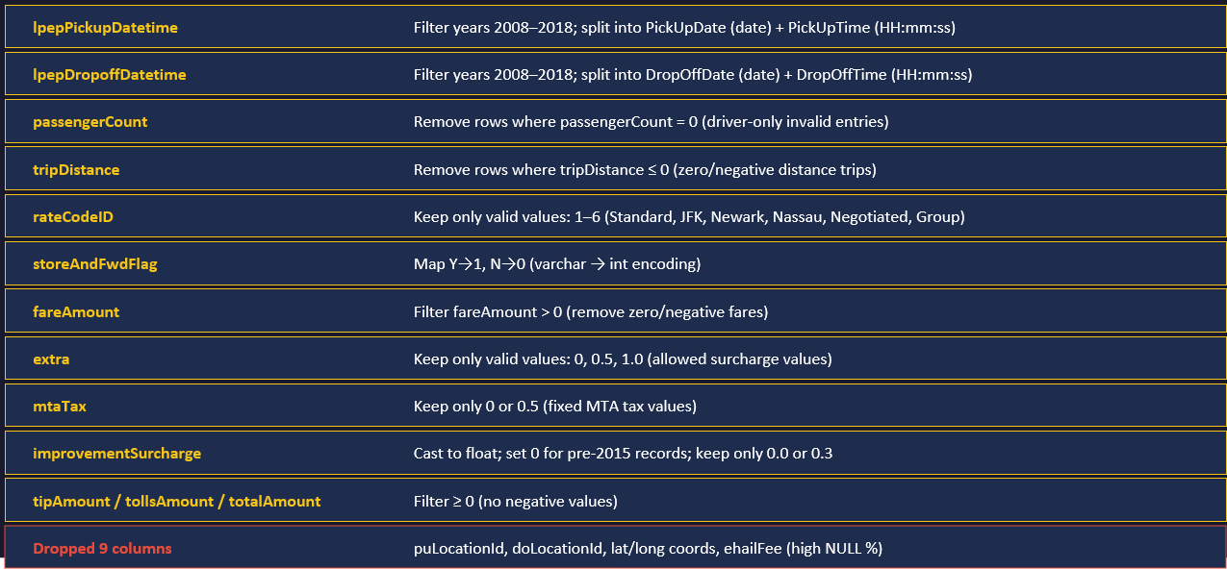
SILVER LAYER – TRANSFORMATIONS
76,513,115 → 71,908,676 rows (−4.7M rows removed by cleaning rules)

Slide 4
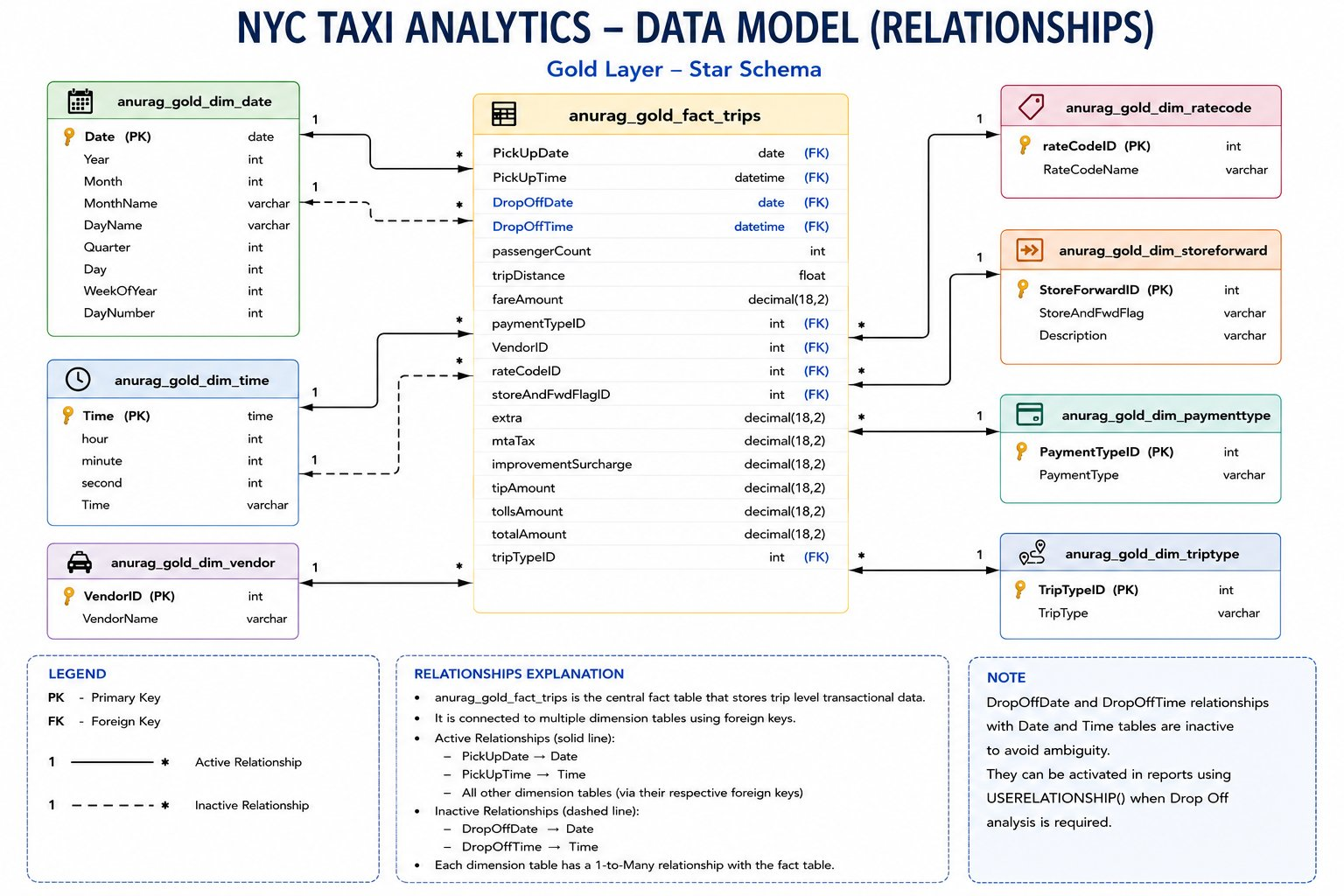
GOLD LAYER – STAR SCHEMA (DATA MODEL)

Slide 5
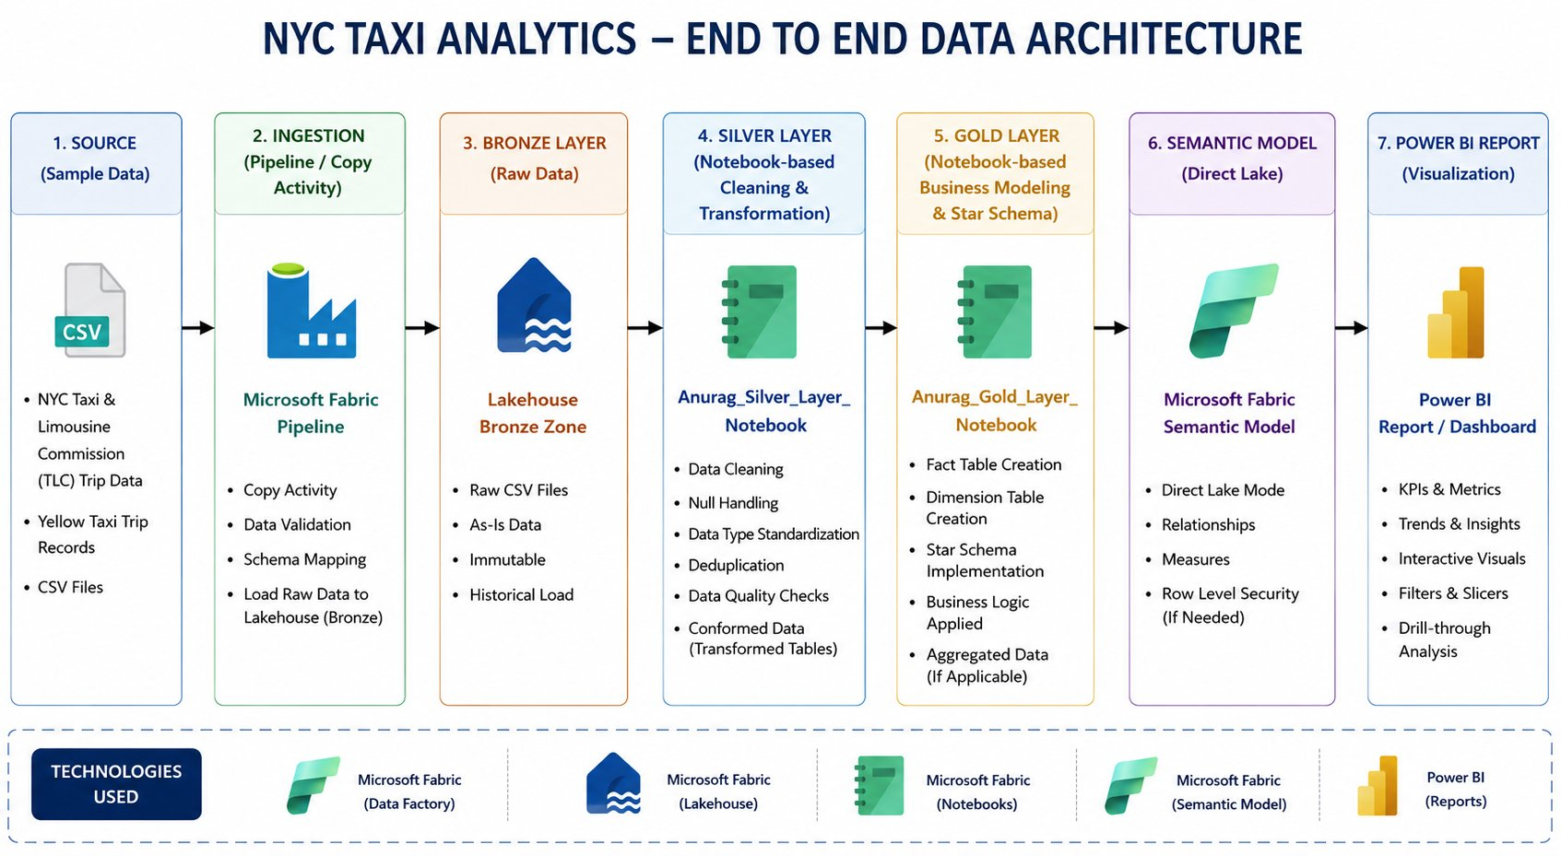
END-TO-END DATA ARCHITECTURE

Slide 6
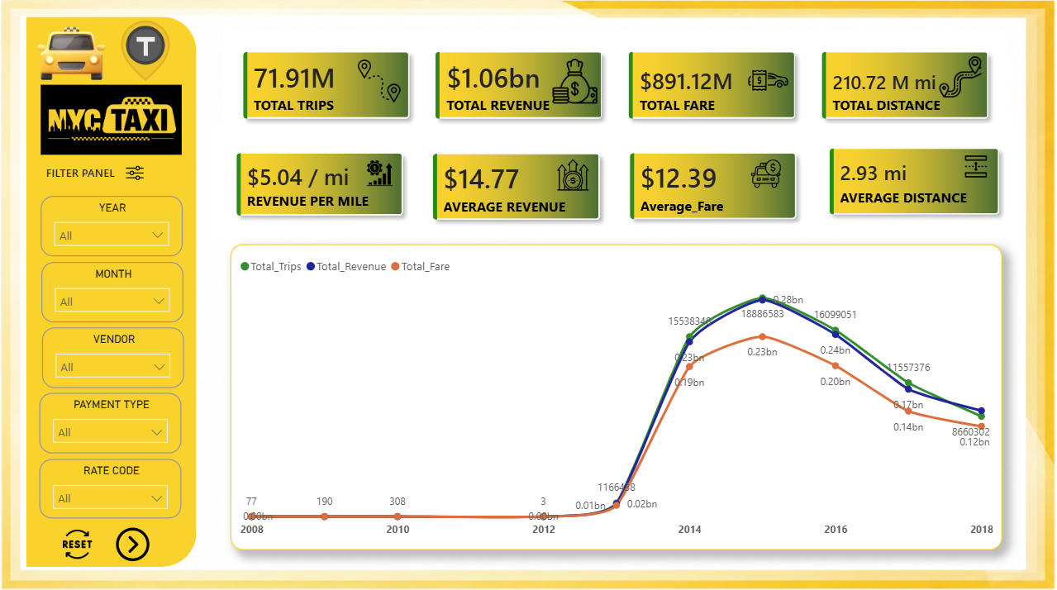
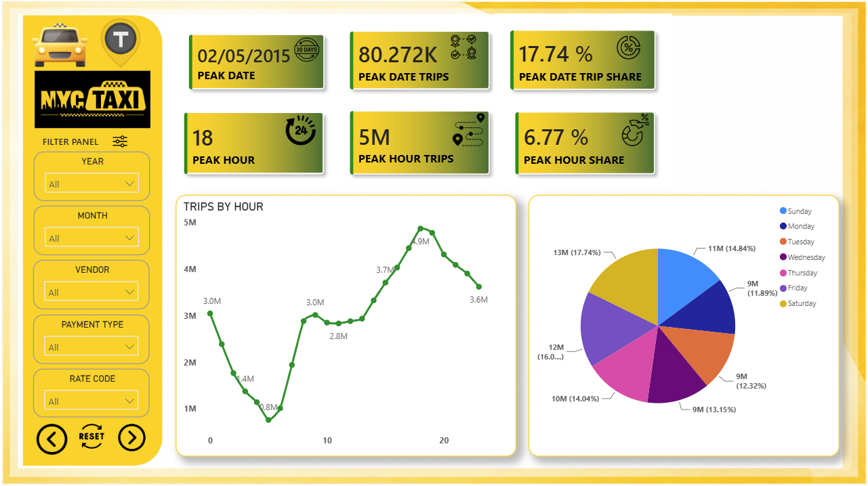
POWER BI DASHBOARD REPORT
Page 1 – Summary KPIs
Page 2 – Date , WeekDay

Slide 7
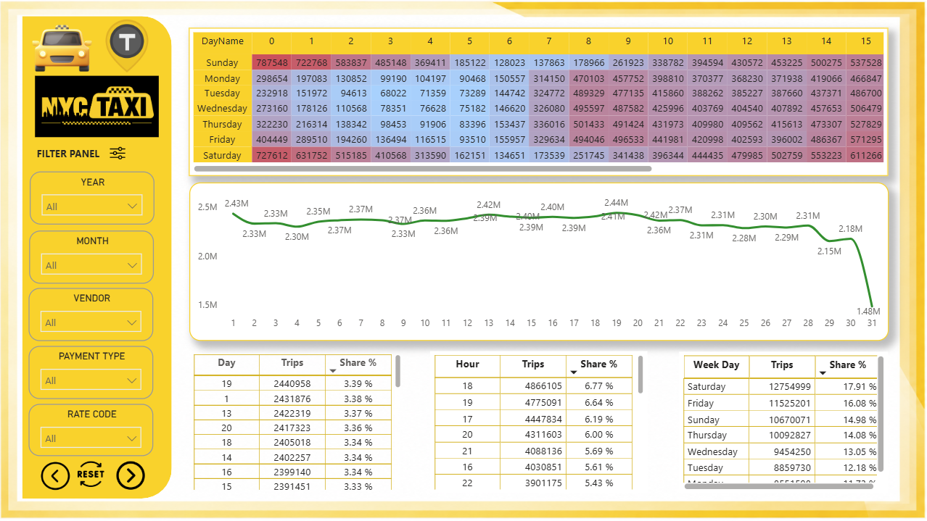
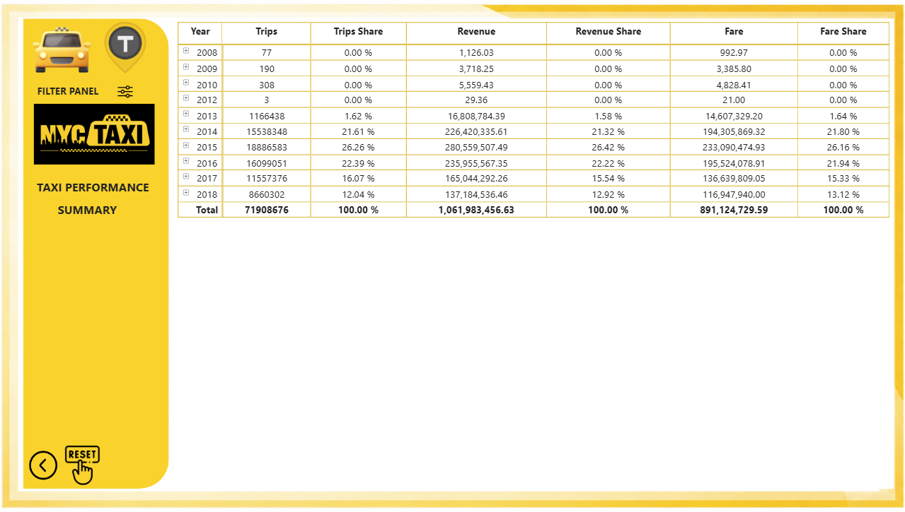
POWER BI DASHBOARD REPORT
Page 3 – Heat Map And Top % Analysis
Page 4 – Drill Table For Summary Analysis

Slide 8
KEY METRICS & INSIGHTS
71.91M
$1.06B
$891.12 M
210.72 M mi
Total Trips
Total Revenue
Total Fare
Total Distance
🕕 Peak Hour 18 (6 PM)
📅 Weekend Lead
👥 Solo Riders Dominate
4.9M trips – busiest hour. Evening rush (16–21h) = ~25% of all trips
Saturday 17.91%, Friday 16.08% – weekends dominate trip volume
83.99% single-passenger trips; 2-passenger at 7.6%
🛣️ Trips Preferred
📆 Seasonal Peak
🏆 Top Year: 2015
1–2 mi = 30.12%, 0–1 mi = 21.3% of all trips
December(9.1%), May (9.02%), May (9.0%) are busiest months
26.26% of trips in 2015; 2016 at 22.39%, 2014 at 21.6%

Slide 9
🚕
THANK YOU
Anurag Anant Deotale · NYC Taxi Analytics
◆ 76.5M rows → 71.9M after cleaning
◆ Bronze → Silver → Gold pipeline
◆ 1 Fact + 7 Dimension tables
◆ 4 page Power BI Dashboard
Microsoft Fabric · Power BI · Lakehouse · Star Schema

