Slide 1
AED INFO 5100 Team – Byte karma
Team Members
Anurag Dhar
Soumavo guria
Kavita patidar

Slide 2
The Problem
What is the problem?
The women and children of many areas in rural India are not getting proper treatment, benefit of all services of ICDS and supervision due to huge load on the supervisors, workers and nurses working for the welfare.
Who has this problem?
The state government is facing this problem as the area and problem is huge but the workforce is less and the government cannot afford to more workforce due to budget constraint.
How can the problem be resolved?
To reduce the work load of workers and supervisors so that their work could be more productive, and they could cover more area and can provide services in effective ways. By this application members at any level can check work progress. Also, it can help upper management to get an idea of demand at field level and accordingly supply of that demands.

Slide 3
ORGANIZATIONS and SCOPE
The three basic organizations who are involved in management of the entire process are:
Welfare Organization
District Level
Sector Level
Health Organization
Doctor
Lab Assistant
Education Organization
Supervisor
Distributor
Block Level
Field Level
Nurse
Teacher

Slide 4
Functionalities of Organizations
WELFARE ORGANIZATIONS
Field Level (FLO) - Provides services to the people. Arrange periodic programs. Refer to the
external Organizations for critical issues. Provide report to supervisor.
Sector Level (SLO) - 40-60 workers are under him/her. On job trainings. Keep track of who are benefitted from this program. Assign workers in centers. Prepare reports at sector level and feed it into MIS of the department.
Block Level (BLO) - Co-ordinates with the external organizations. Keep track of funds. Maintain statistics of each block reports supervisor with statistics and how improve the welfare. Recruit workers for centers.
District Level (DLO) - Overall in-charge of the Office as District Program Officer (ICDS Cell), Submission of proposals to the Directorate in respect of Schemes, Annual Budget, approve new center, sall bills and salaries at district level.

Slide 5
Hospital organization
Doctor – Will receive work request from BLO and assign and assist Lab Assistant and Nurse. Takes care of patient and assigns work to its subordinates.
Lab Assistant – Performs lab test for people and receives request or instructions from doctors. Once the assigned tasks gets completed they notify the doctor.
Nurse – Takes care of patient and receives request or instructions from doctors. Once the assigned tasks gets completed they notify the doctor. They assist doctors and provide services for any kind of health issue.

Slide 6
Education organization
Supervisor – Receives orders and request from BLO. Once they receive they process the request and assign to distributor or teacher depending on the demand of the request.
Distributor – Receives order from Supervisor and execute it accordingly. There main job is to distribute foods and books to poor children. Additionally, they can also request for fund and send request to Supervisor which further gets forwarded to BLO.
Teacher – They provide education to poor children and women. Receives order from Supervisor and execute it accordingly.

Slide 7
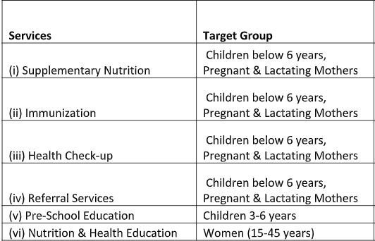
SERIVES PROVIDED BY THESE Organizations and there target group

Slide 8
Scope of work
Every Organization has a dashboard and statistics for each sub-organization. Every person in organization has a work queue for special requests and a particular set of work dedicated to them. Each organization has to perform survey on the lower organization and also check the report from lower organization to prepare his report Each level has access to area/ level under him and can look at the details whenever they want.

Slide 9
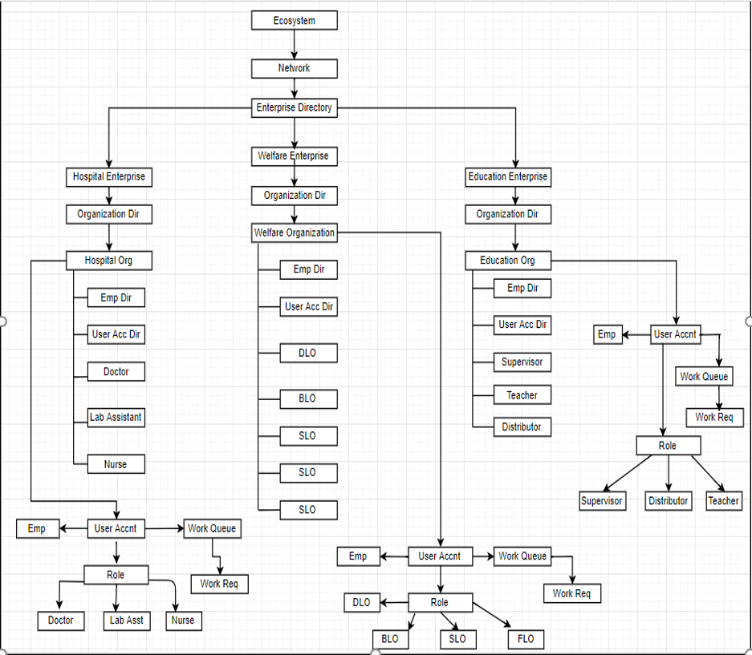
The ECOSYSTEM ARCHITECTURE

Slide 10
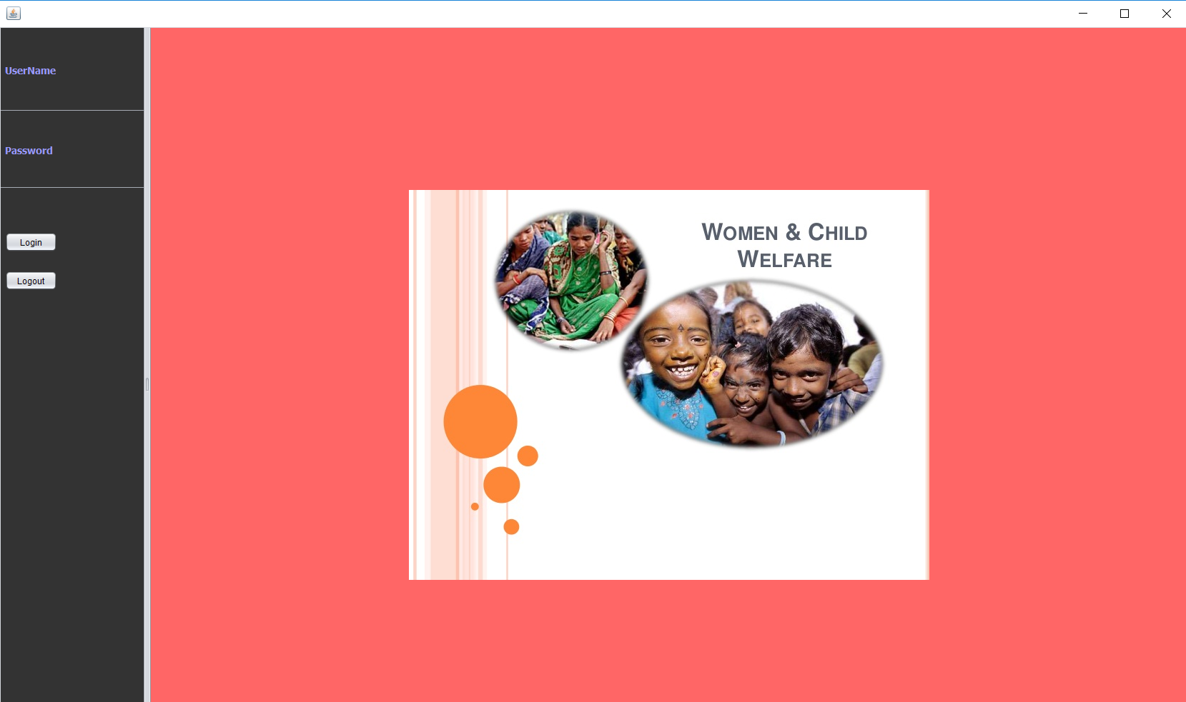
So we have developed this application to streamline the entire process.

Slide 11
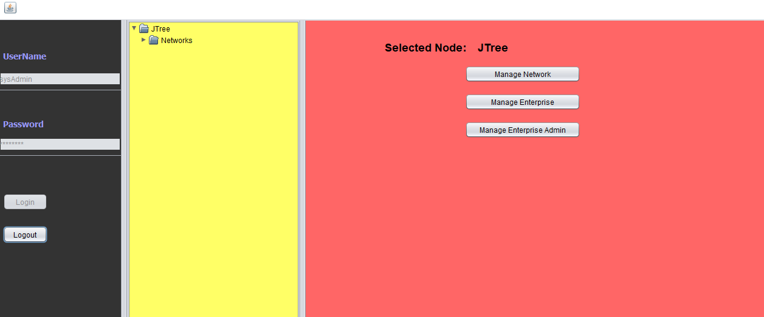
Admin can manage network, enterprise and create enterprise admin

Slide 12
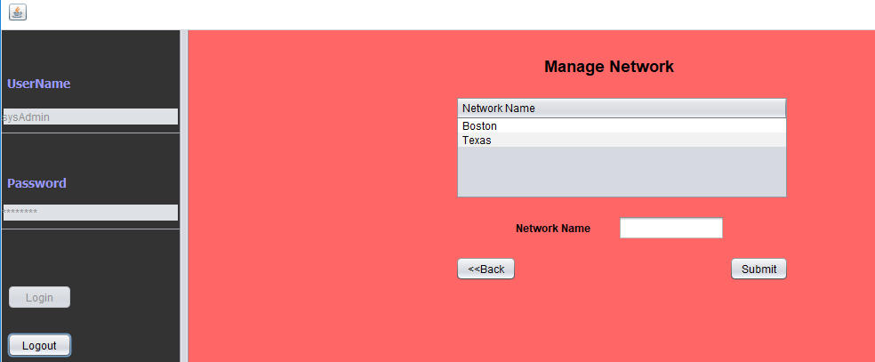
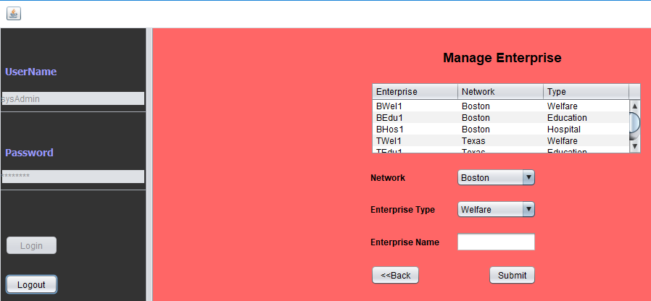
Admin can add network, enterprise and create users

Slide 13
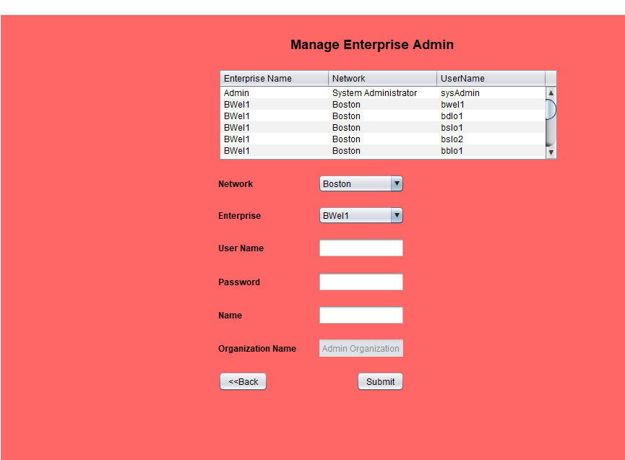

Slide 14
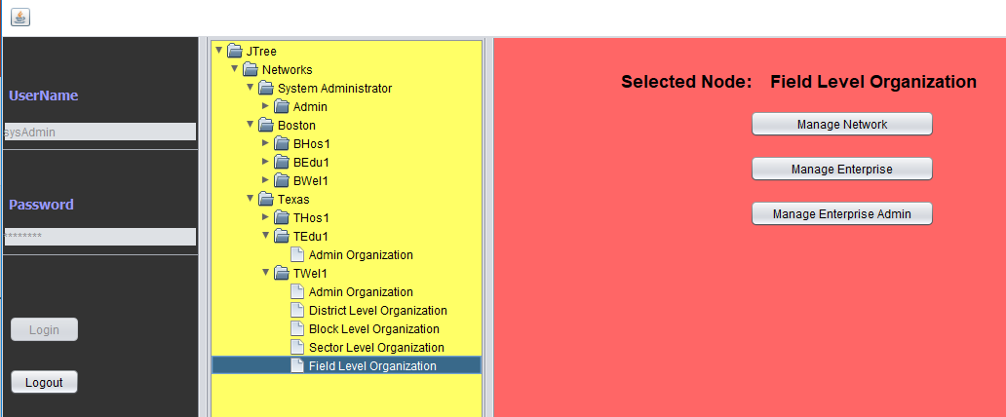
We have implemented JTree feature in the application to track overall network, enterprise and organizations has been created.

Slide 15
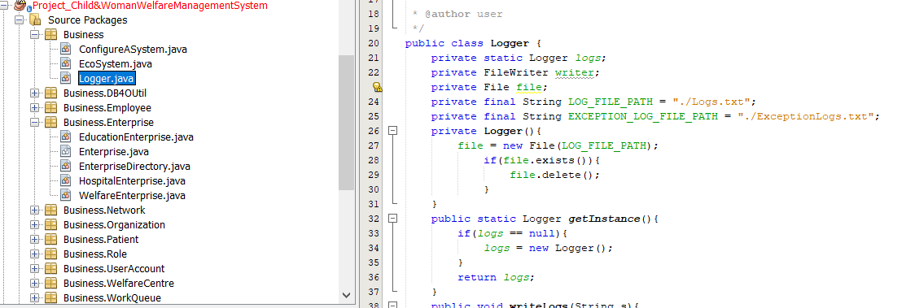
Added logger class to track what actually happening in the system such as User logging and activities and also catch exceptions in the log file.

Slide 16
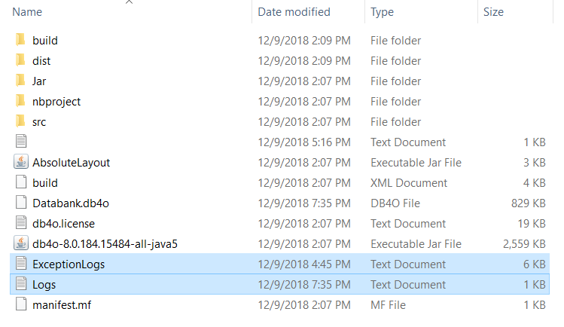
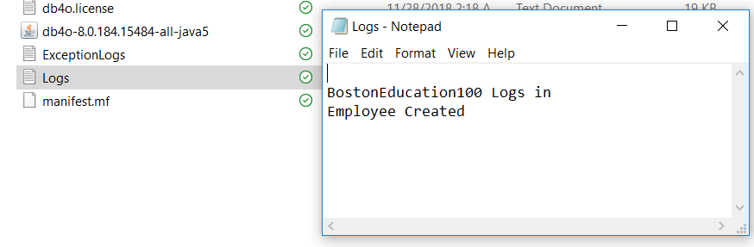
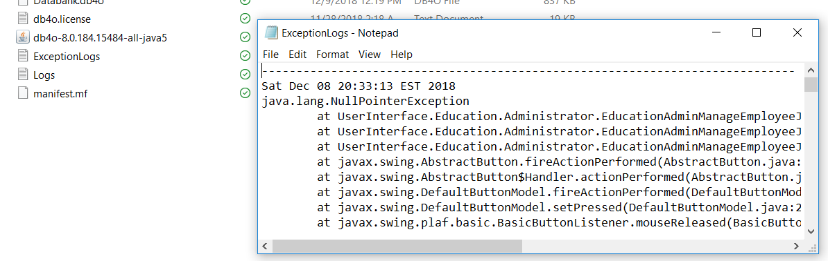
Log files in the system

Slide 17
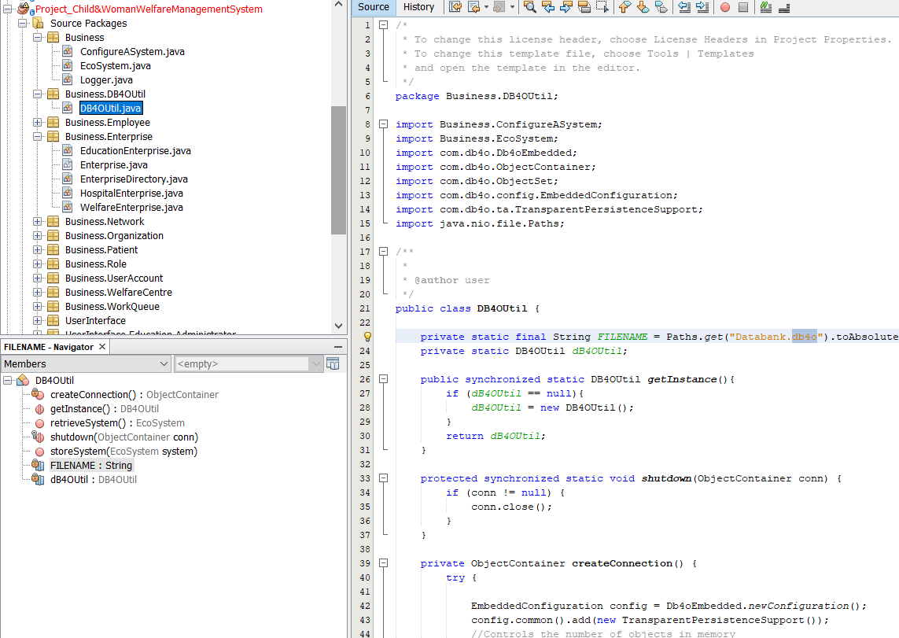
We have used db4o to store data created or used for the application.

Slide 18
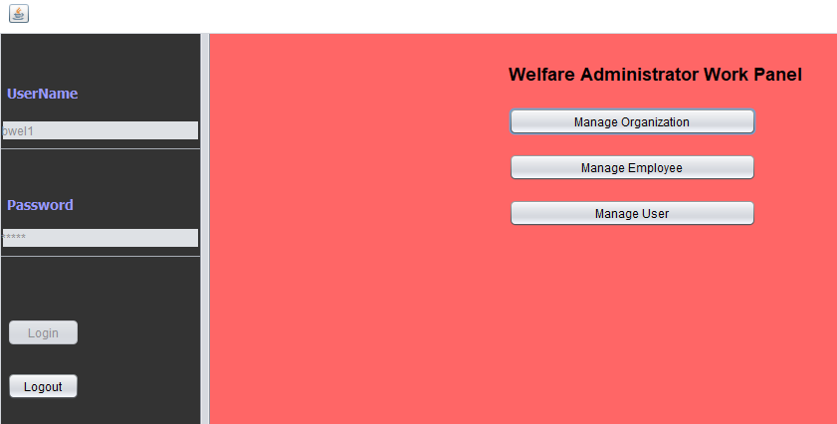
Welfare Enterprise
Welfare Admin Work Area

Slide 19
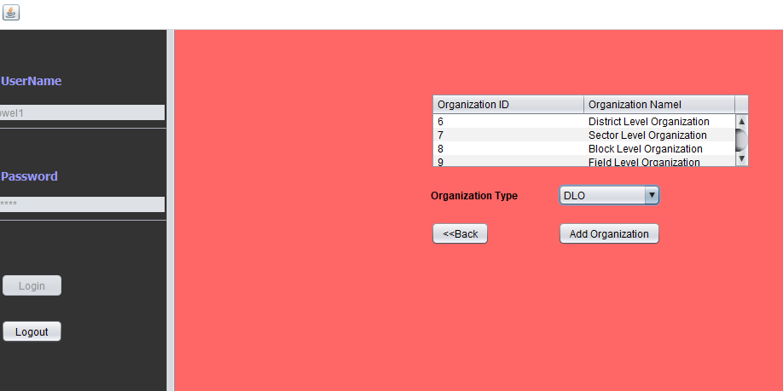
Welfare can add organizations such as BLO, DLO, SLO and FLO

Slide 20
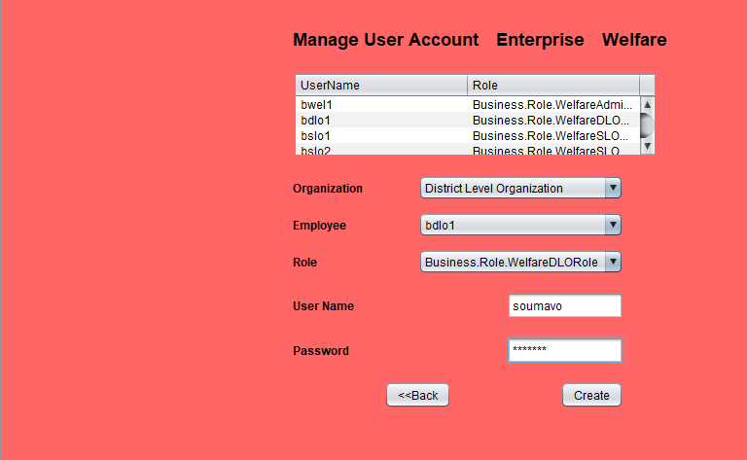
Welfare Admin can add employees and create their Username and Passwords

Slide 21
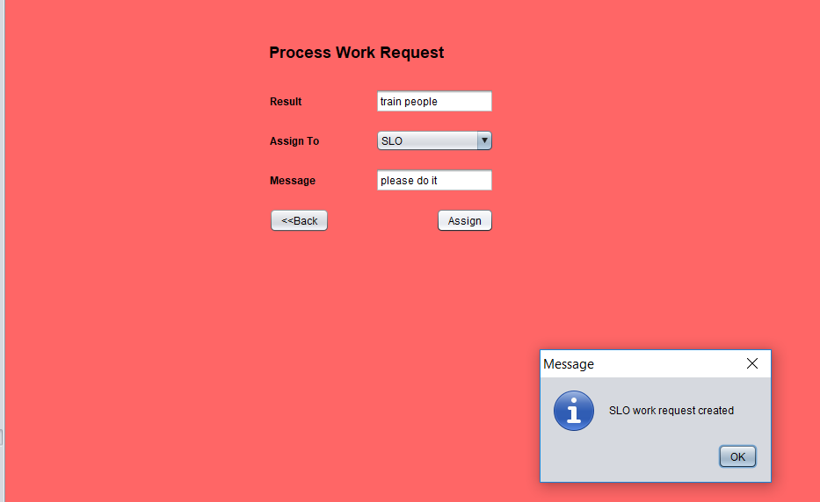
DLO can send request to SLO for executing certain task, which shows flow of request between organization.

Slide 22
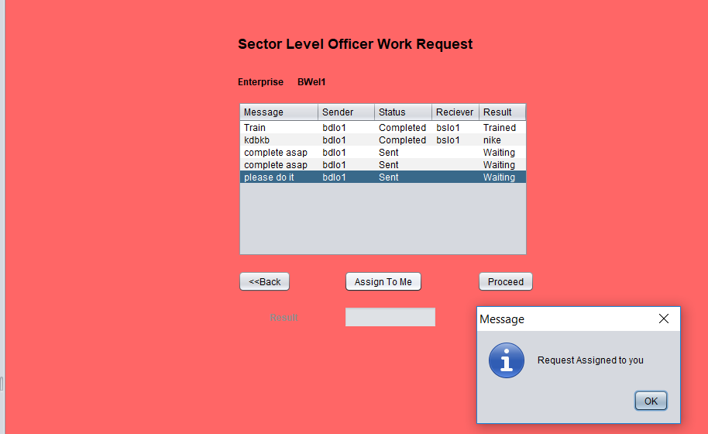
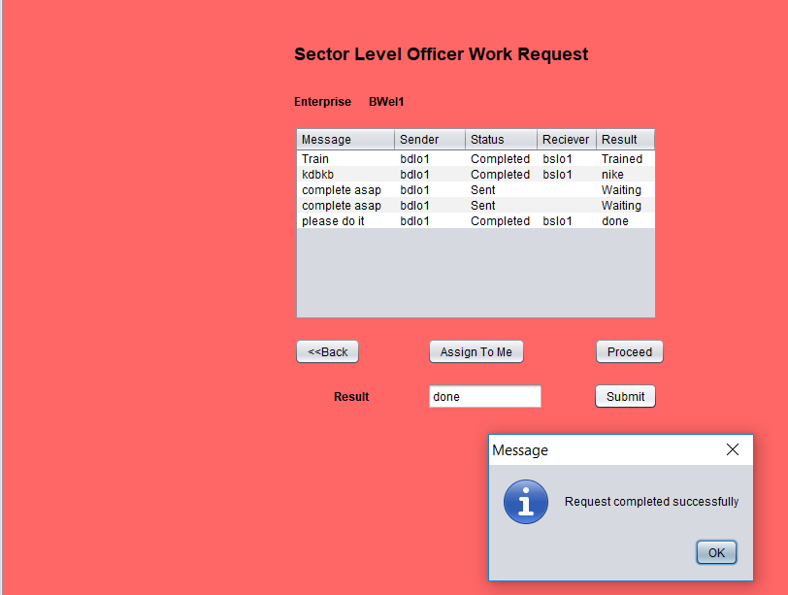
SLO process the same request which DLO sends.

Slide 23
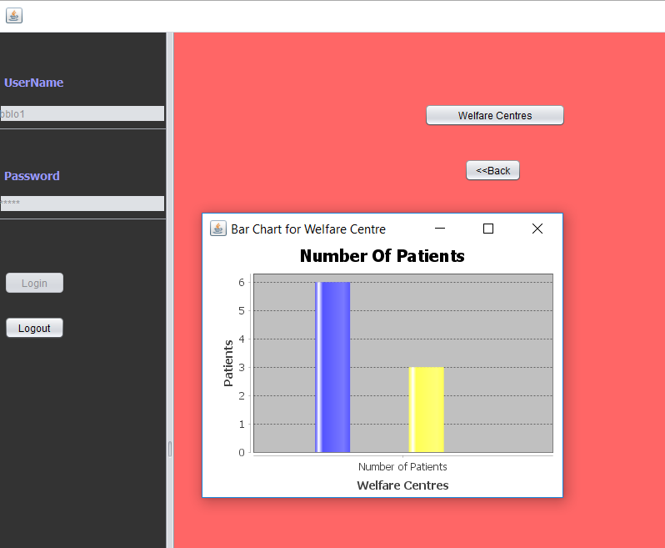
BLO can also see charts to check the status

Slide 24
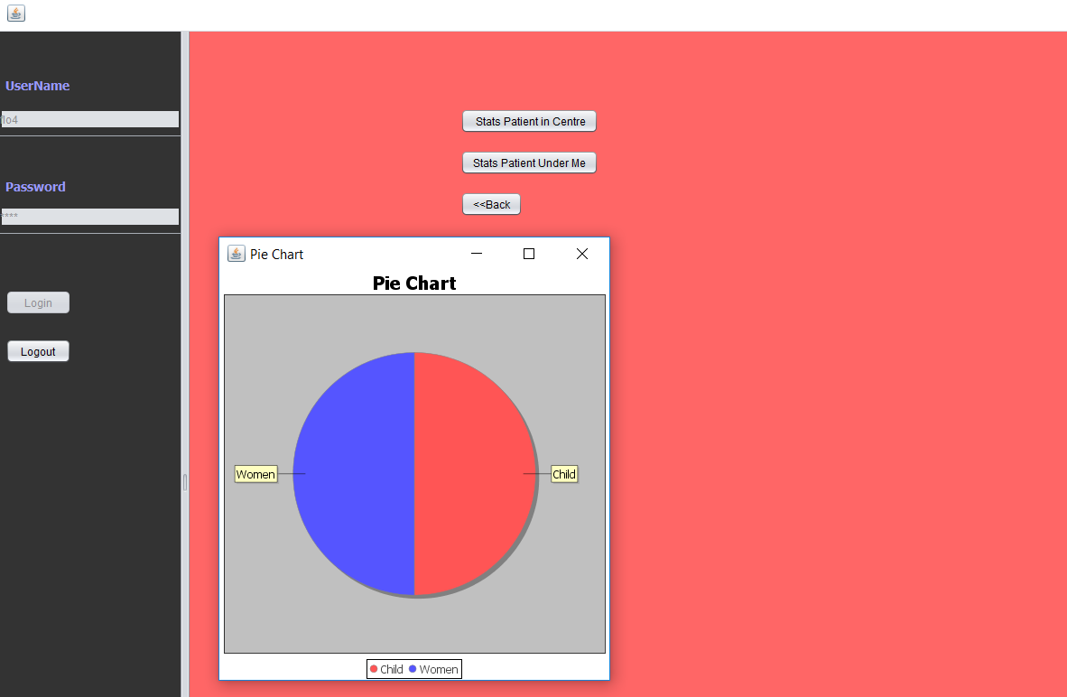
A FLO can also see charts for data visualization

Slide 25
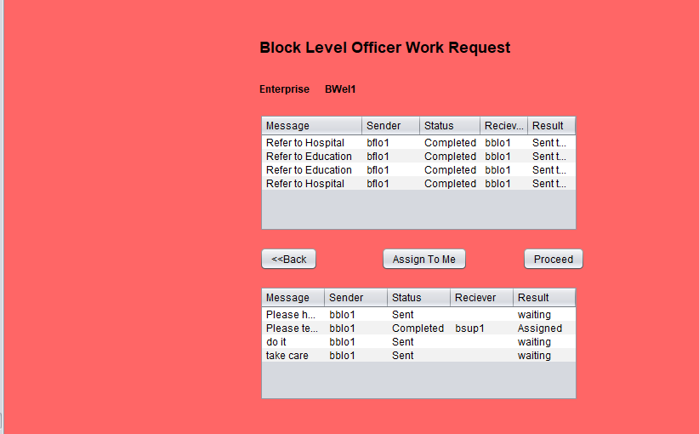
BLO can send request to Education or health department based on requirement which shows navigation of
request between enterprise, i.e from Welfare to Education or Welfare to health.

Slide 26
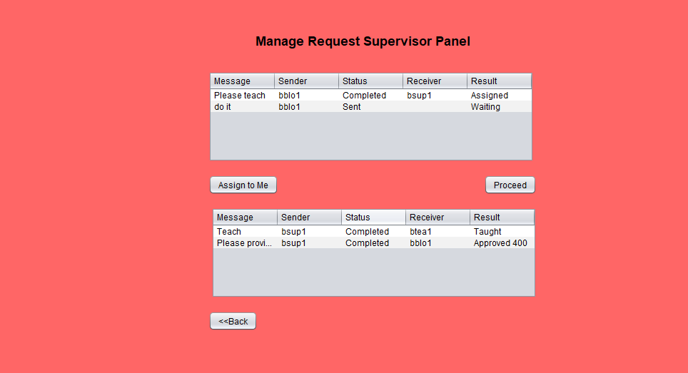
Supervisor gets the request from BLO with a message and task to execute. Supervisor belongs to Education
enterprise

Slide 27
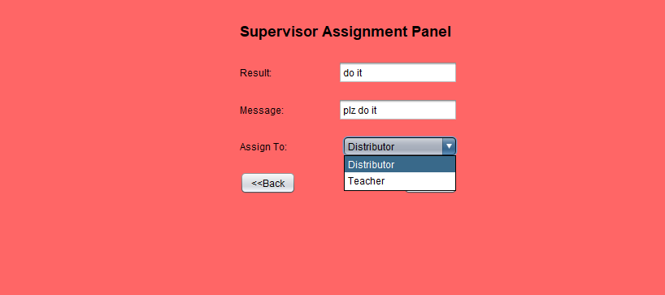
Supervisor can delegate the task to either teacher and distributor

Slide 28
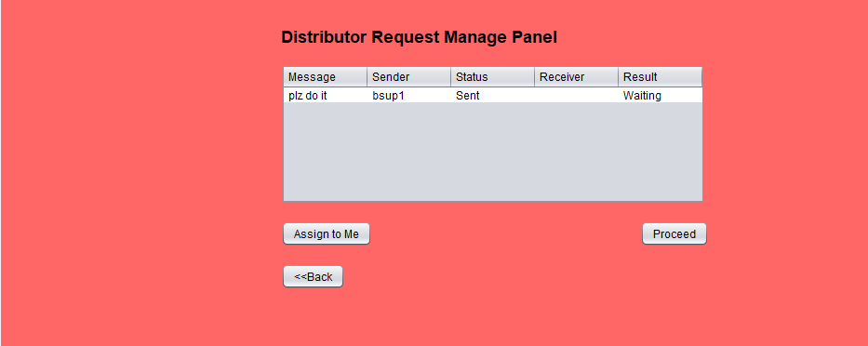
Distributor gets the same request which supervisor sends

Slide 29
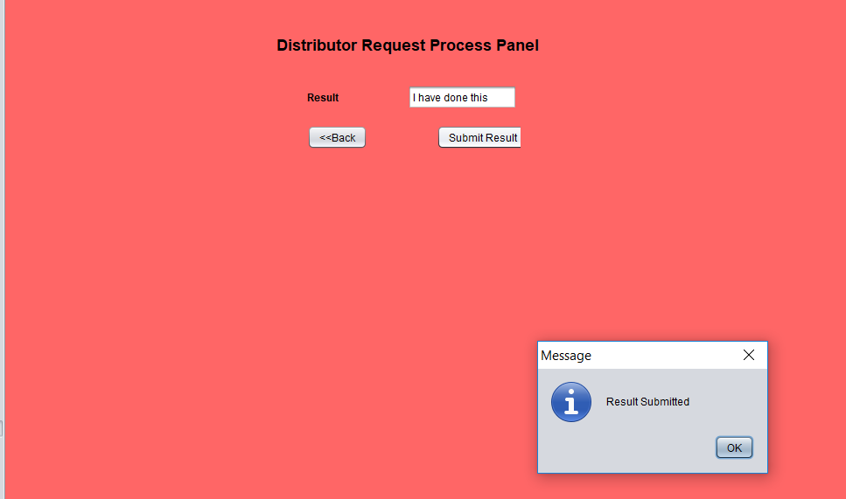
Distributor closes the request from his end once the task gets completed.

Slide 30
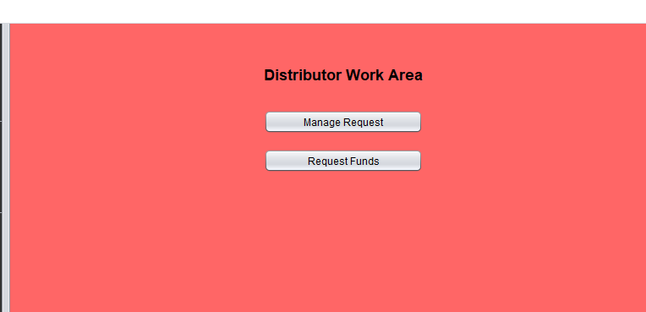
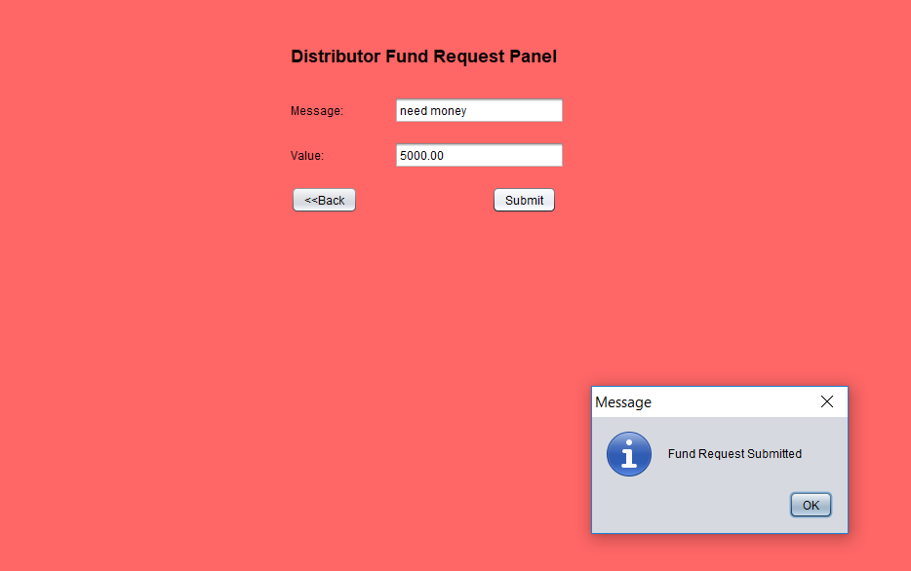
Distributor has additional option to request for funds. So the flow of fund request is
Distributor -> Supervisor -> BLO to approve.

Slide 31
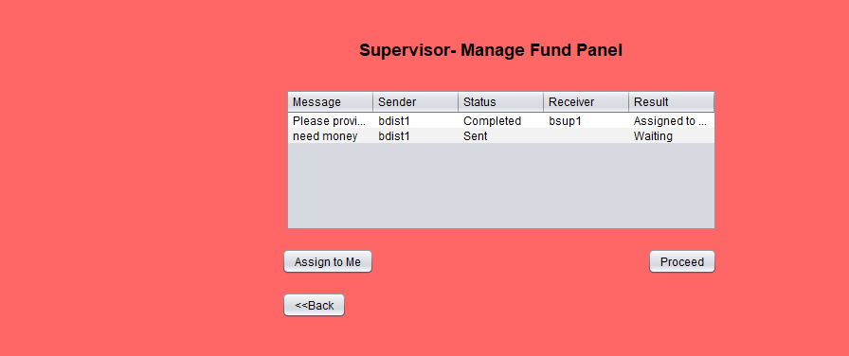
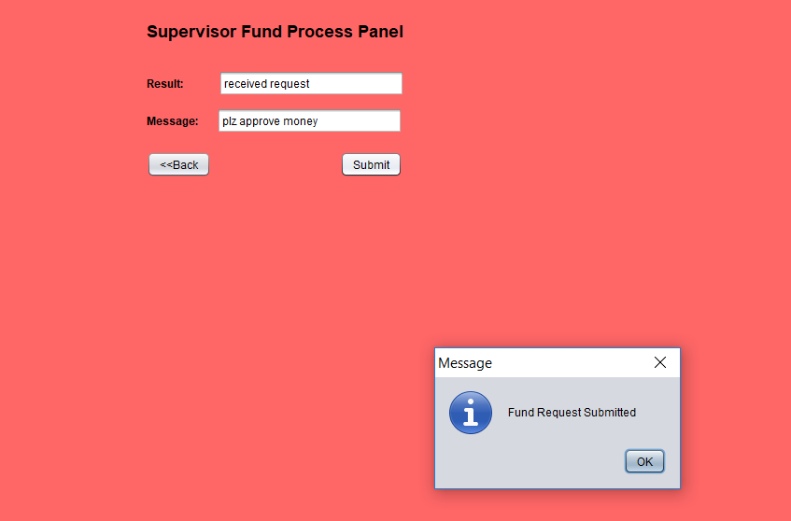
Supervisor receives request from Distributor and checks and forward to BLO to approve which shows flow of request
From bottom-up unlike most cases where it is generally top-down

Slide 32
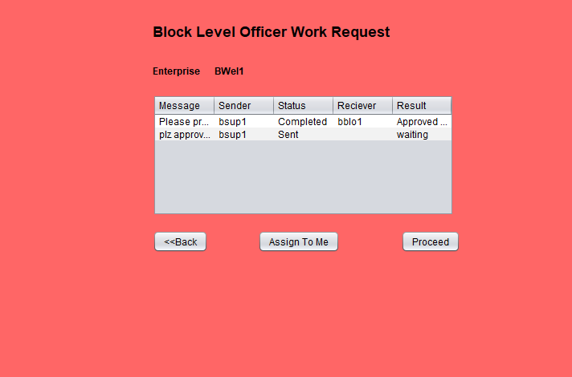
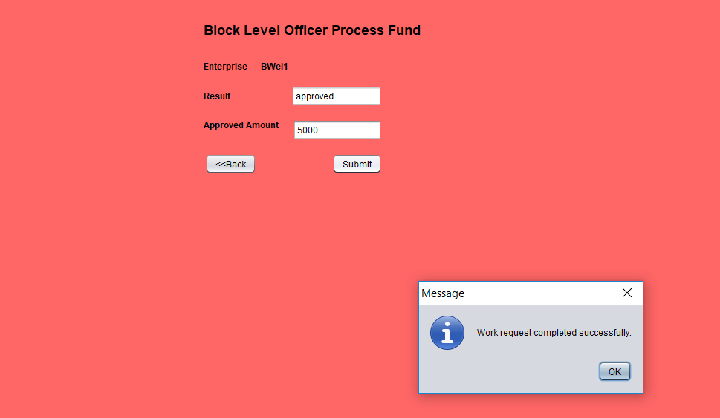
Finally BLO receive the request and approves.

Slide 33

Similarly Health enterprise also can receive request from BLO(Welfare Enterprise)

Slide 34
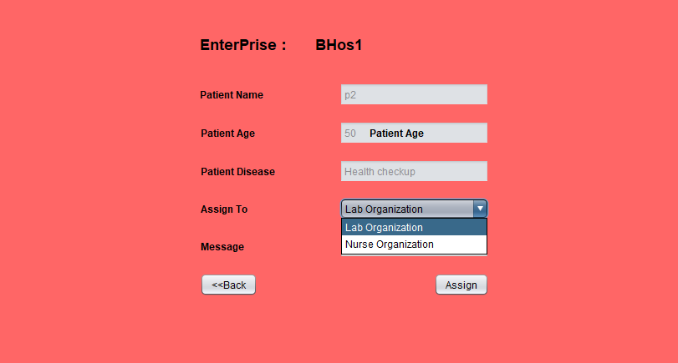
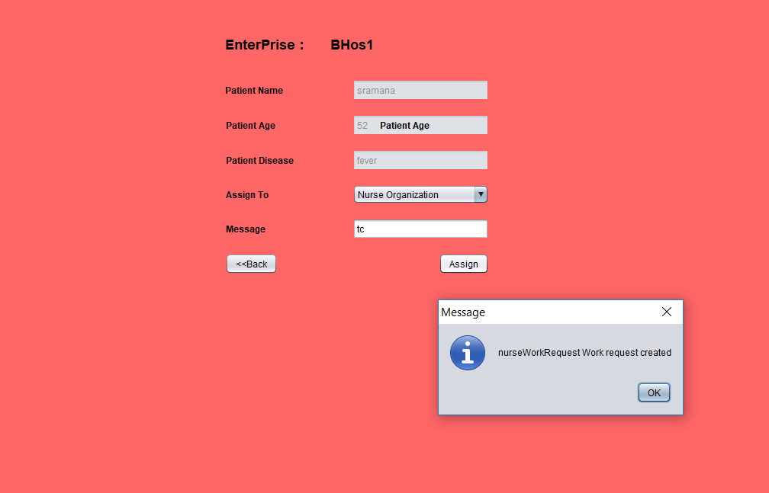
Doctor can check request and assign task to Lab Assistant and Nurse. Once assigned Nurse and Lab assistant
Can complete task from there end.

Slide 35
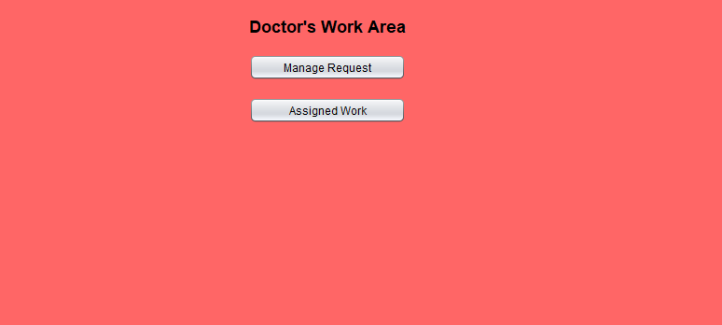
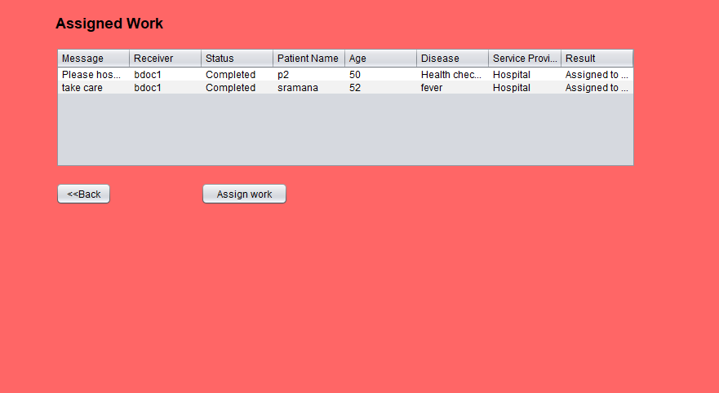
Doctor has additional panel to check what are request which are attended or not.

Slide 36
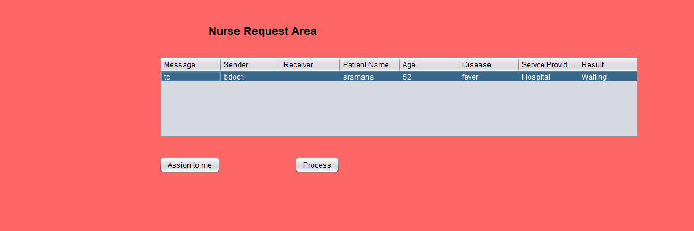
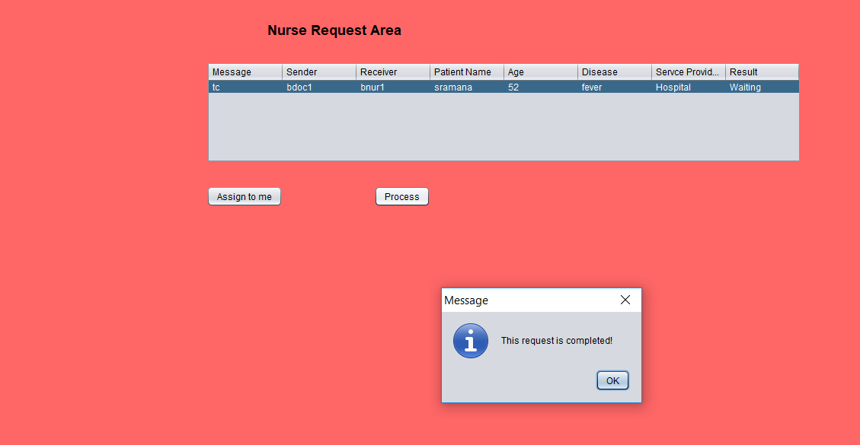
Nurse can process the request assigned by doctor. The same way Lab assistant also processes request

Slide 37
Thank You

