Slide 1
HARDWARE IMPLEMENTATION OF REAL TIME COMMUNICATION USING UART WITH AES 128 ENCRYPTION/DECRYPTION IN VERILOG

Slide 2
Advanced Encryption Standard (AES)
Block cipher: processes blocks of texts of fixed size of 128 bits (16 bytes) and outputs a new block of the same size.
Works on the methods of substitution and permutations.
Symmetric encryption algorithm, same key for both encryption and decryption which is confidential to sender and receiver.

Slide 3
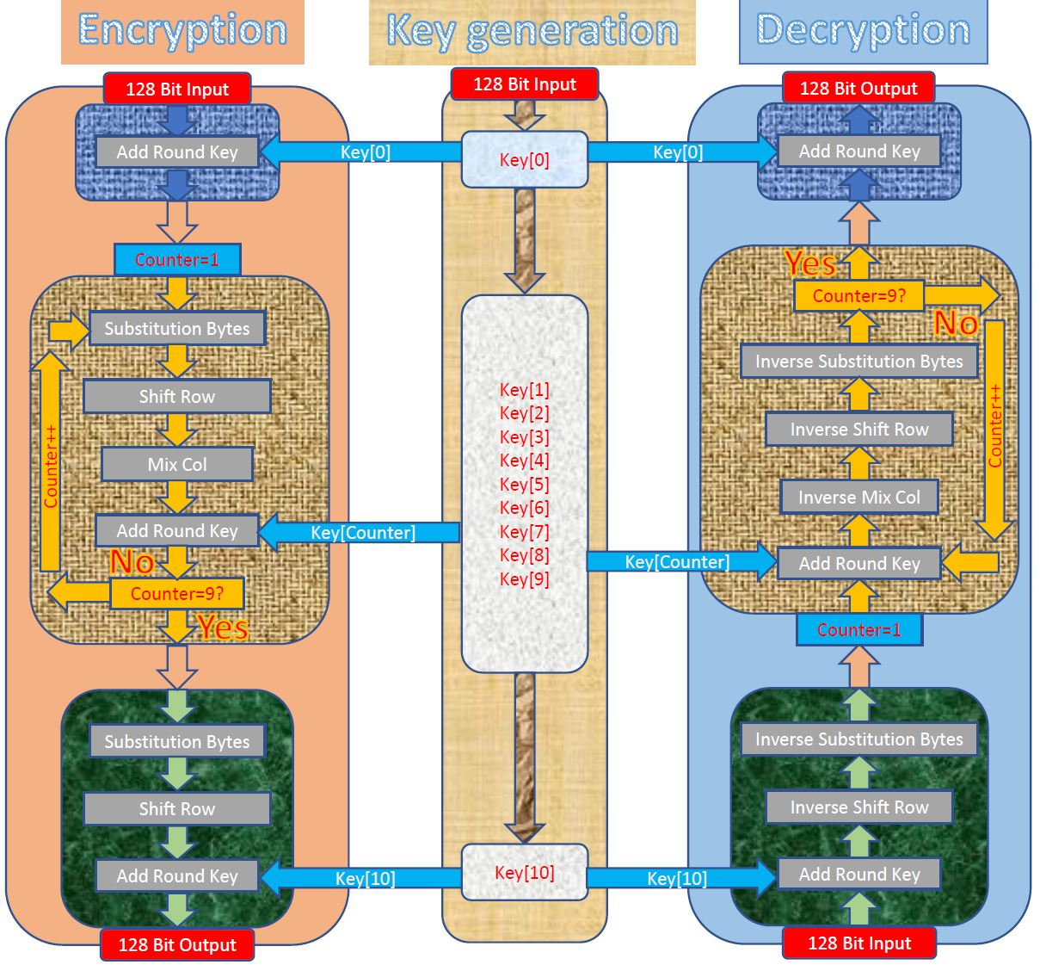
Figure: AES Encryption and Decryption

Slide 4
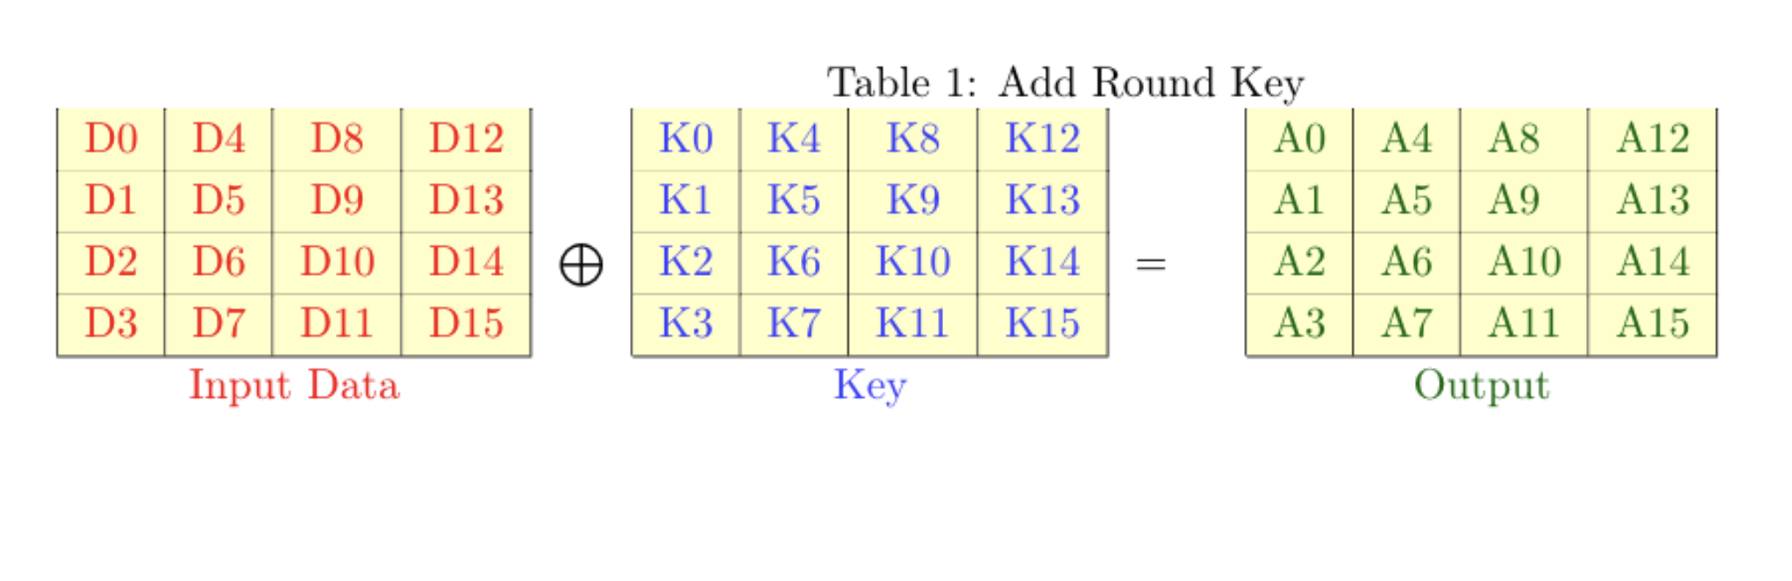
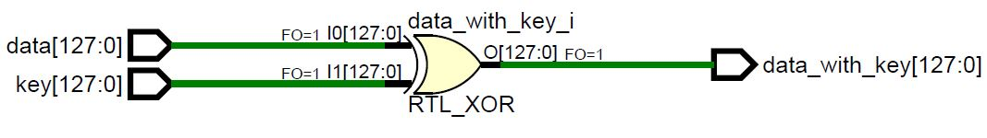
AES Add Round Key
The input data is bitwise Xor’ed with key in this stage

Slide 5
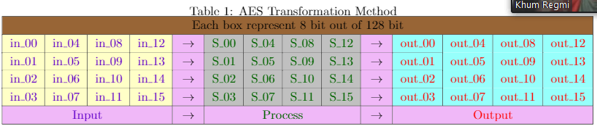
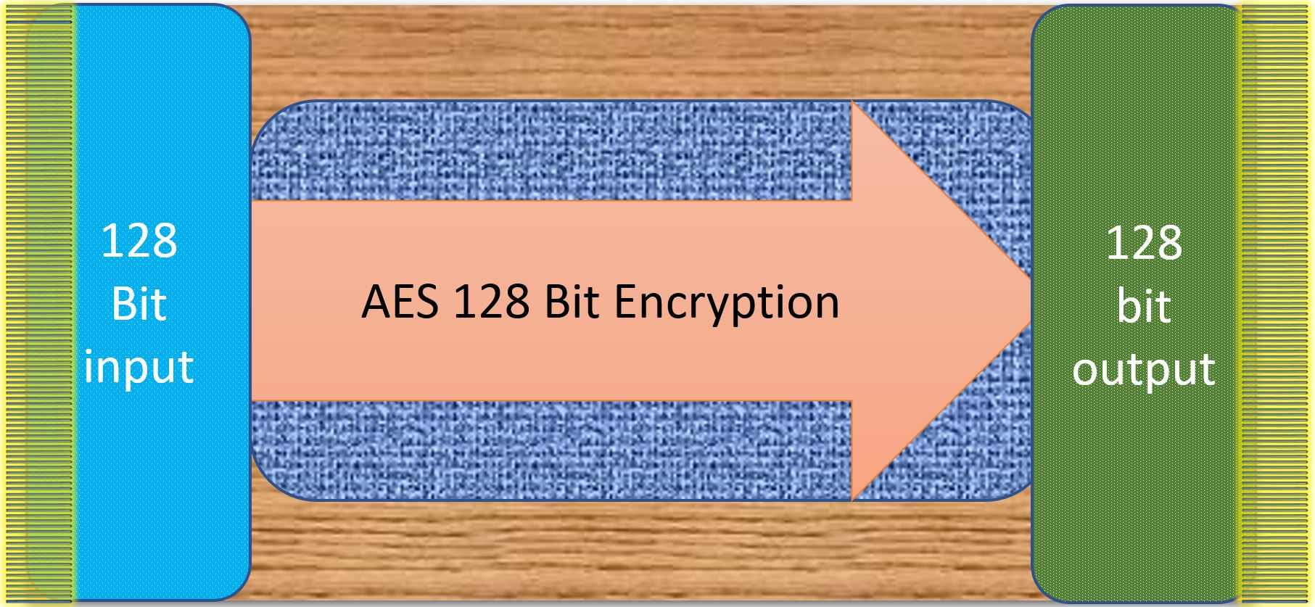
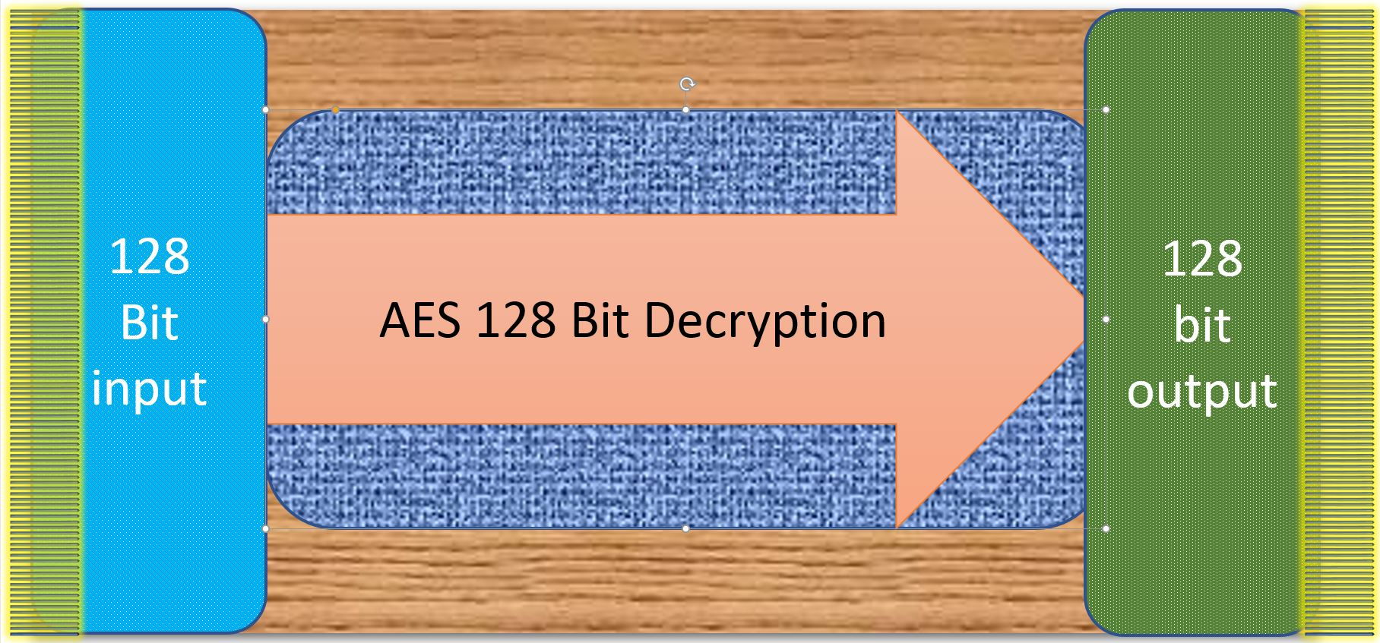

Slide 6
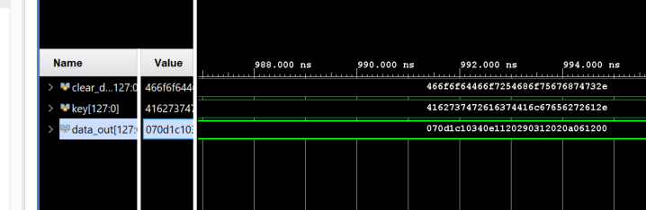
Simulation: ADD Round Key

Slide 7
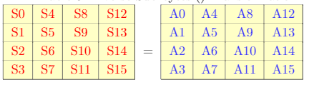
Substitution Bytes ( ) Transformation
Each byte substituted using a well-defined substitution box called S-box.
Contains mapping of each byte from 00 to FF.
For example: {56} is substituted by looking at row 5 and column 6 in the 16 * 16 S-box, the substituted byte is the intersection of row and column.
Data is Mapped to 4*4 matrix

Slide 8
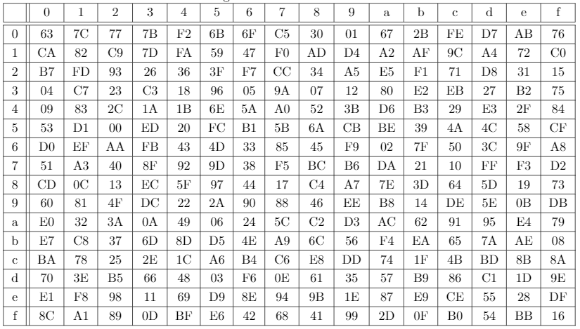
Fig : AES Substitution box

Slide 9
Inverse Substitution Bytes ( ) Transformation
Inverse of the substitution Bytes Transformation.
Inverse Substitution Box is the inverse mapping of the substitution box.
For example: The byte {B1} is transformed to {56} after this operation.
{56} {B1} (Encryption)
{B1} {56} (Decryption)
Data is Mapped to 4*4 matrix

Slide 10
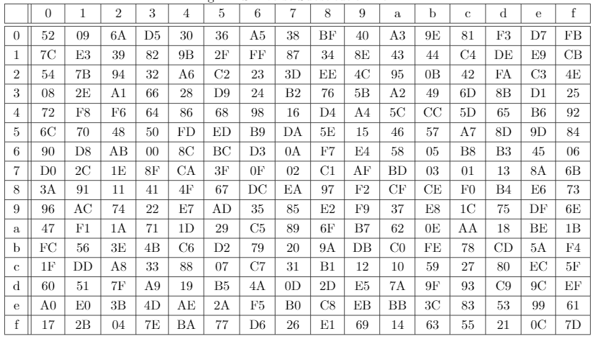
Fig : AES Inverse Substitution box

Slide 11
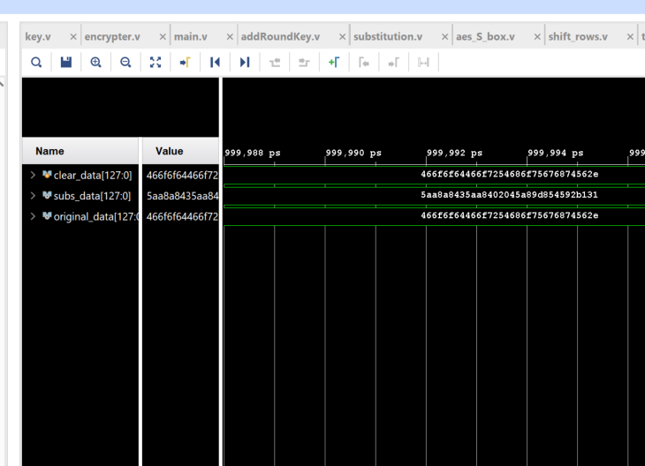
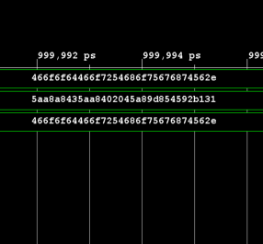
Verification of sub byte and inverse sub byte transformation

Slide 12
Shift Rows ( ) Transformation
The 16-byte data ( or say 128-bit data) is arranged in a 4 x 4 grid.
In each of the four rows,
1st row remains unchanged.
2nd row, each byte is shifted one position to the left.
3rd row, each byte is shifted two positions to the left.
4th row, each byte is shifted three position to the left.

Slide 13
A1 | A5 | A9 | A13
A2 | A6 | A10 | A14
A3 | A7 | A11 | A15
A4 | A8 | A12 | A16
Fig : 4 x 4 array of input data
A1 | A5 | A9 | A13
A6 | A10 | A14 | A2
A11 | A15 | A3 | A7
A16 | A4 | A8 | A12
Fig: 4 x 4 array of shifted data

Slide 14
Inverse Shift Rows ( ) Transformation
Similar to the Shift Rows ( ) transformation in functionality, except the rows are shifted in the reverse order.
​In each of the four rows,
1st row remains unchanged.
2nd row, each byte is shifted one position to the right.
3rd row, each byte is shifted two positions to the right.
4th row, each byte is shifted three position to the right.

Slide 15
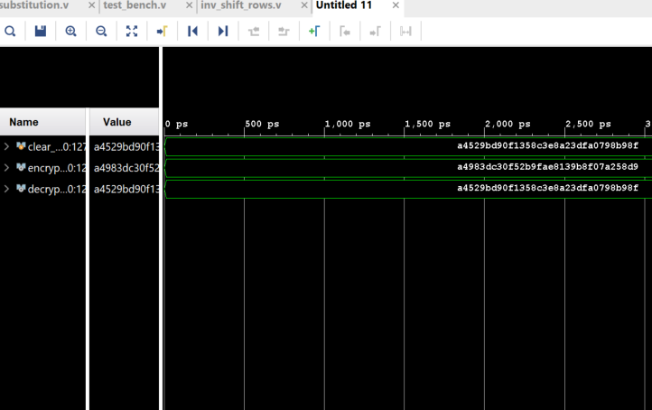
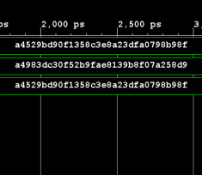
Verification of shift row() and inverse shift row() transformation

Slide 16
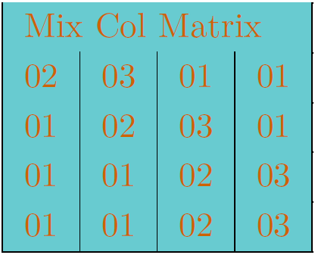
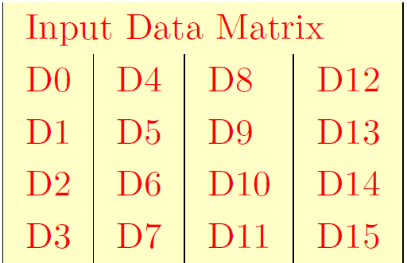
Mix_Column
Performs mixing of column wise data in finite field (GF^8)

Slide 17
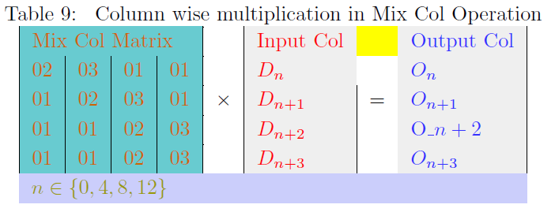
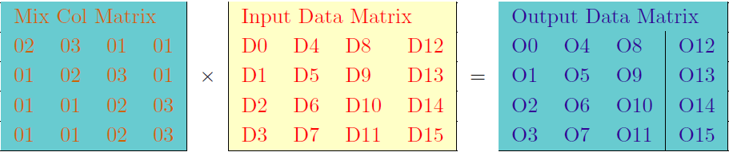
Operation

Slide 18
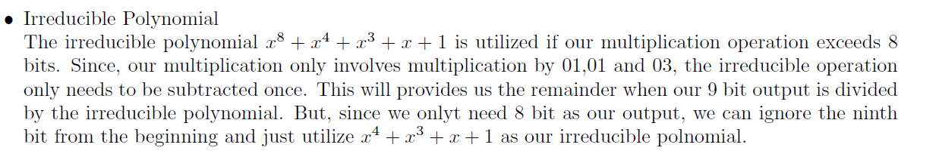
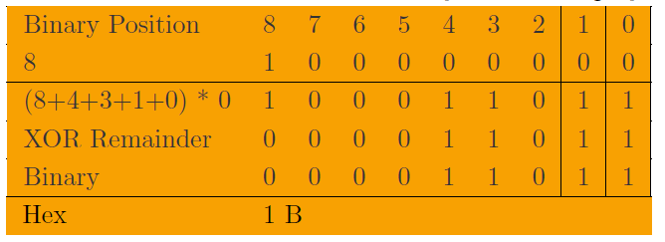
Irreducible Polynomial

Slide 19
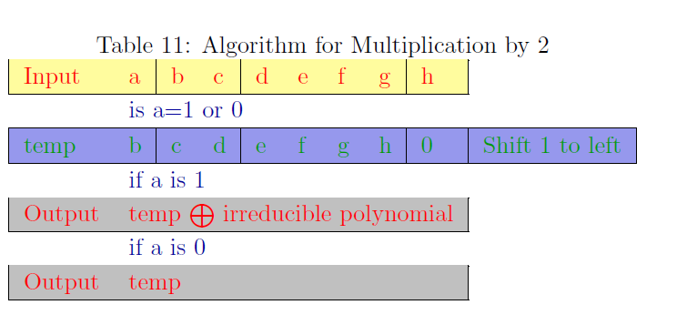
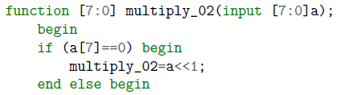
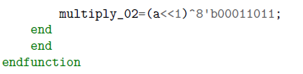
Multiplication by 2
8 bit in
8 bit out
7
6
8 bit
5
0
4
3
2
1
1
XOR
0
0
0
0
1
1
0
1
1
0

Slide 20
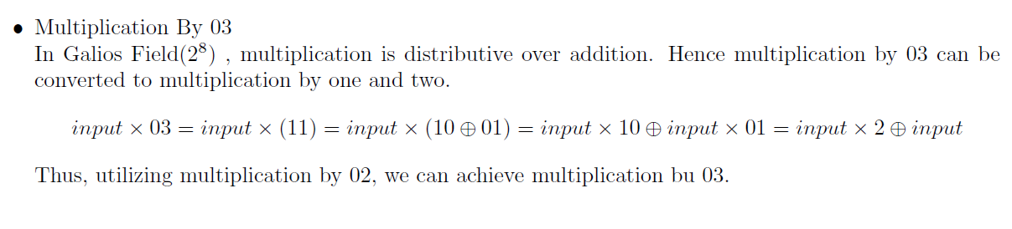
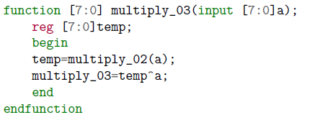
Multiplication by 3
8 bit in
XOR
8 bit out
Multiply_02

Slide 21
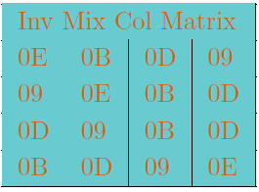
Inverse_Mix_Column
Performs mixing of column wise data in finite field (GF^8)

Slide 22
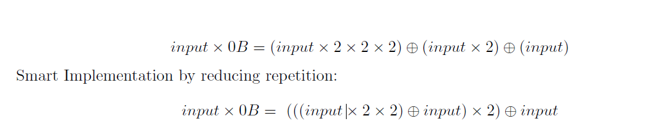
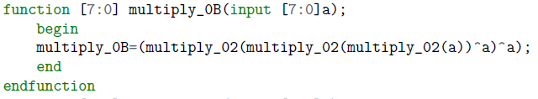
Multiplication by 0B
8 bit in
XOR
XOR
8 bit out
Multiply_02
Multiply_02
Multiply_02

Slide 23
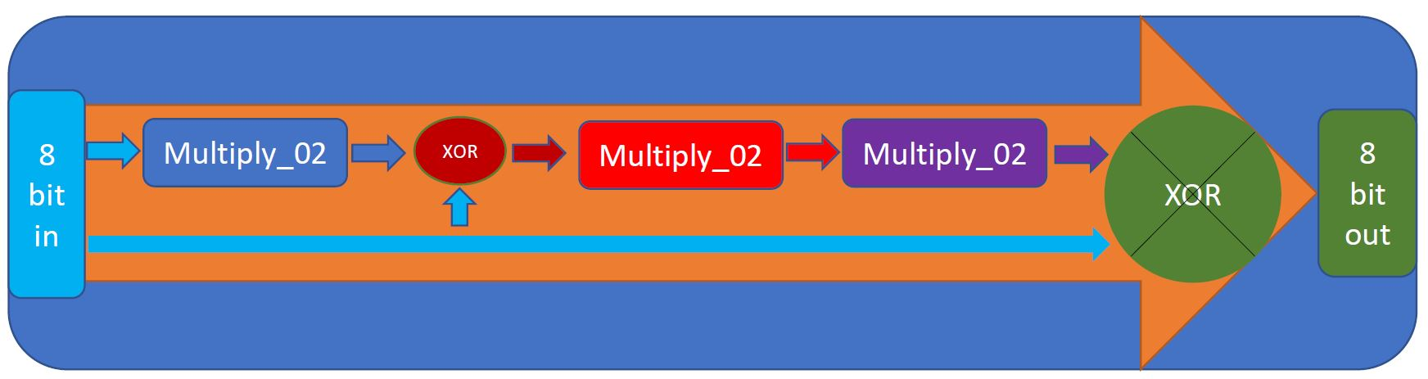
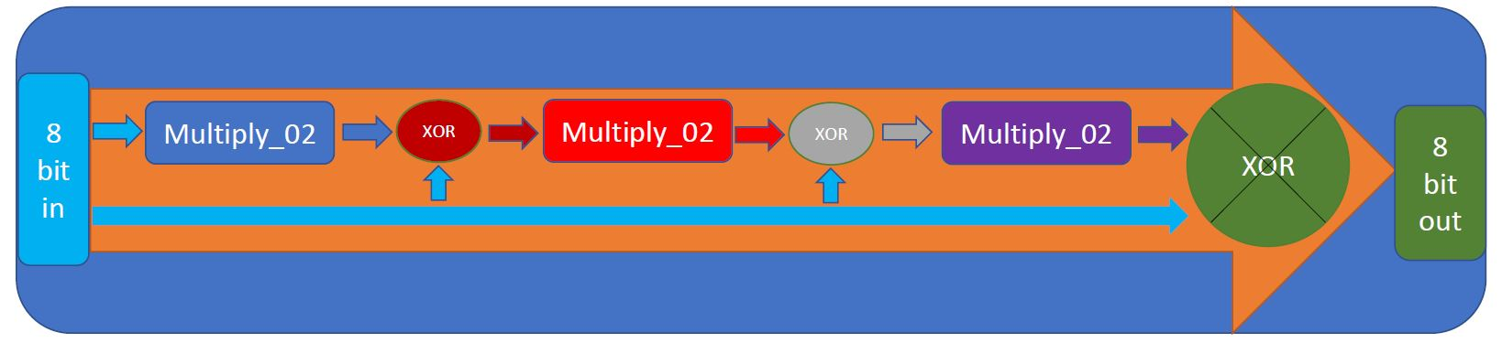
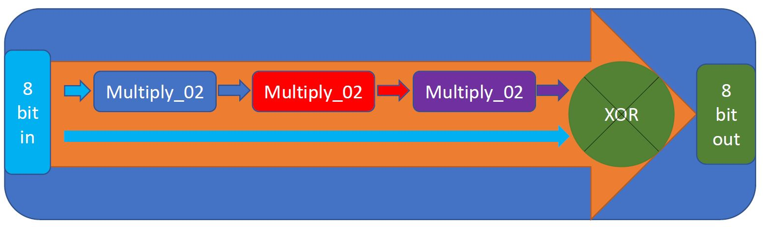
Multiply_0D
Multiply_0E
Multiply_09

Slide 24
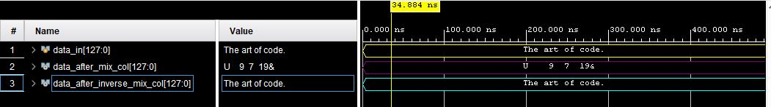
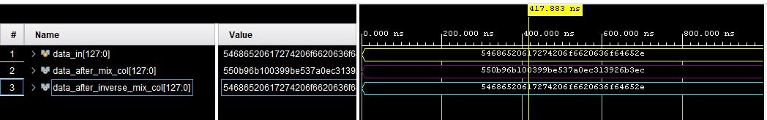
Simulation: Mix Column and Inverse Mix Column
ASCII
Hexadecimal

Slide 25
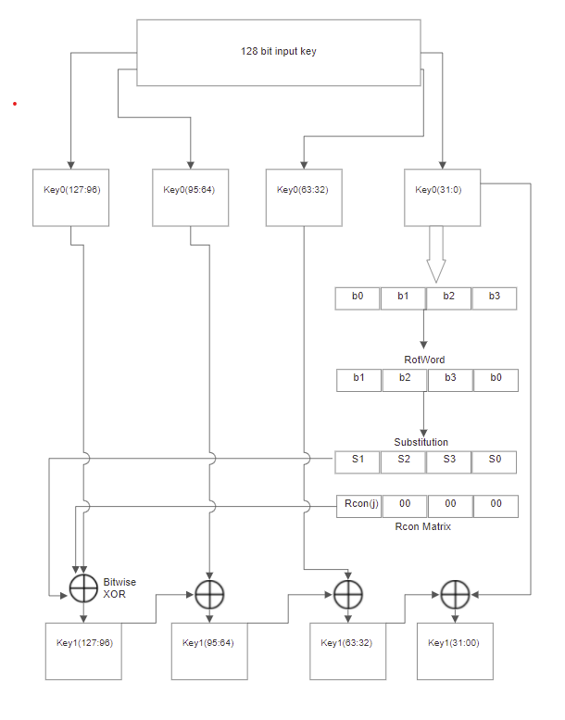
Key EXPANSION
(2)

Slide 26
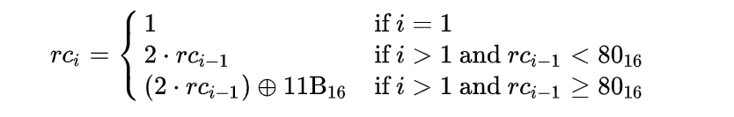


Components
KEY EXPANSION
Three rightmost bytes are always 0.
Multiplication defined over the field GF($2^{8}$).
Multiplication defined over the field GF(2^8).
Varies for each iteration of key expansion round.
RCON Matrix:
$x^{8}{+ x}^{4}$ + $x^{3}$ + $x$ + 1

Slide 27
Components
KEY EXPANSION
Performs byte substitution on input word with word from AES Substitution Box.
RotWord performs a one-byte circular left shift on a word.
RotWord:
Substitution Byte:
This means that an input word [B0, B1, B2, B3] is transformed into [B1, B2, B3, B0].

Slide 28
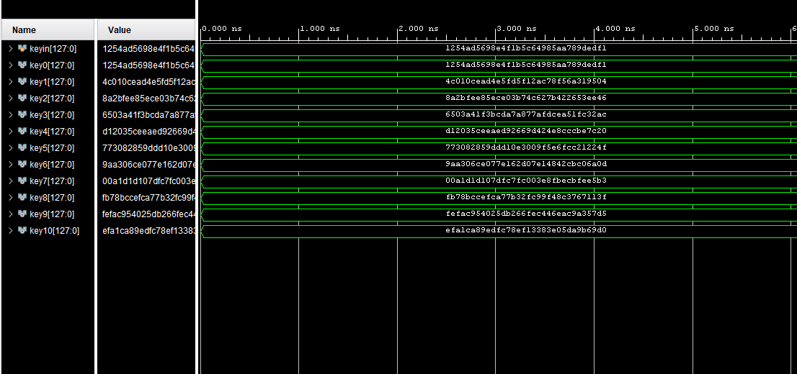
Simulation

Slide 29
UART
UART stands for Universal Asynchronous Receiver/Transmitter
Data transmitted in Serial stream reducing number of wires used to transfer data
Transmitter/Receiver agree on certain parameters:
Baud Rate (9600 bits/sec)
Number of data bits (8 bits)
Parity bit (0)
Stop bits (1)
Flow Control (None)

Slide 30
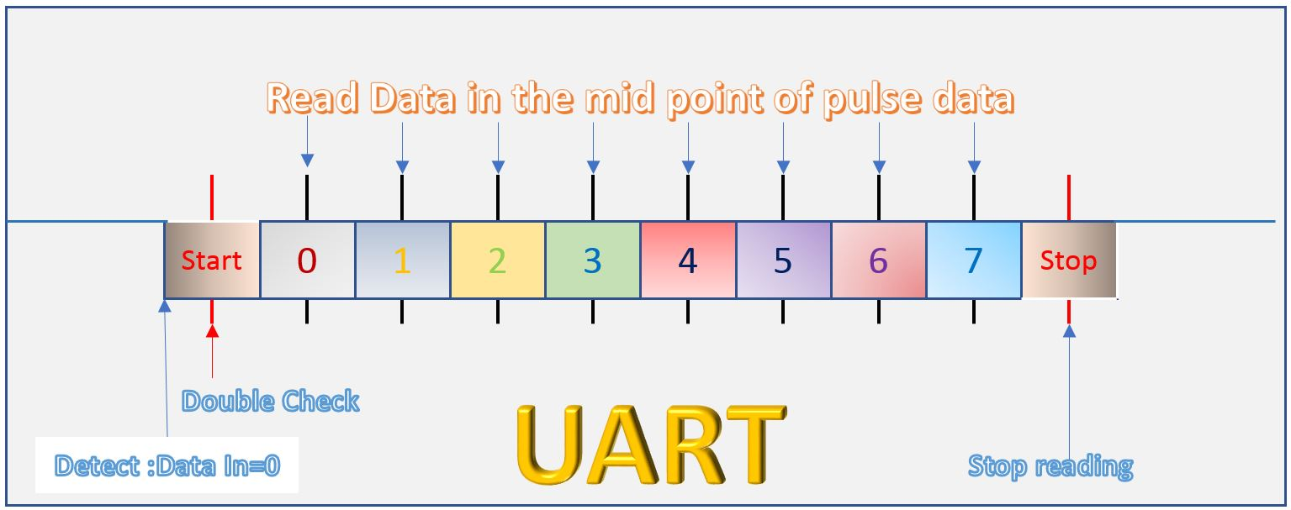
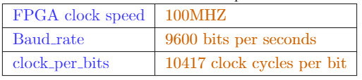
UART PROTOCOL

Slide 31
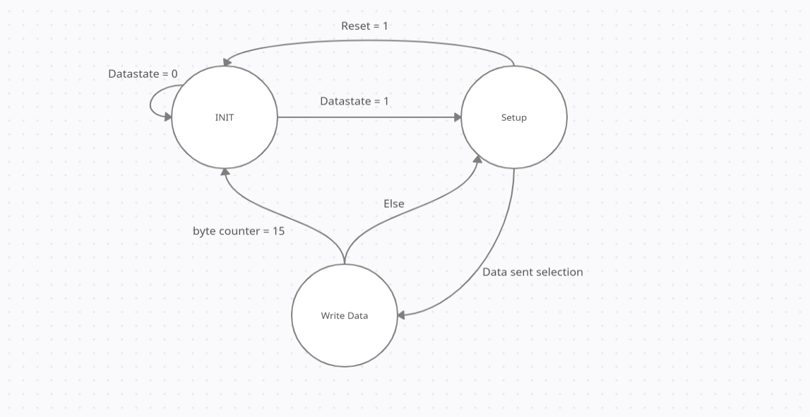
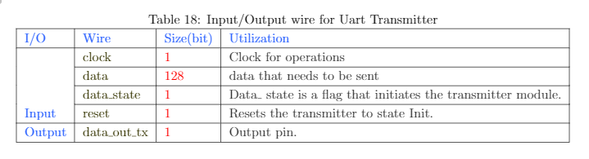
UART Transmitter
State Machine

Slide 32
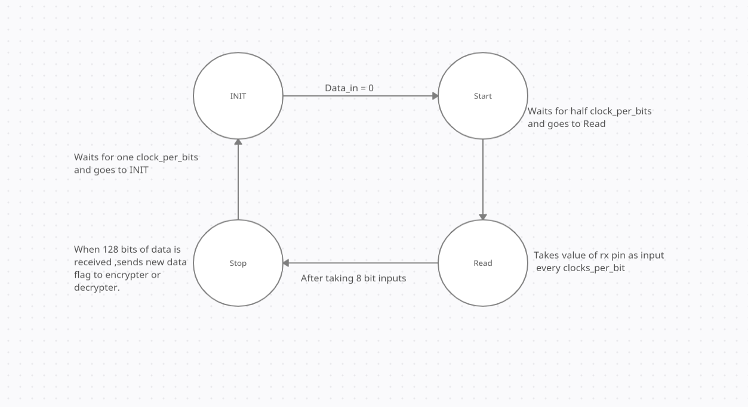
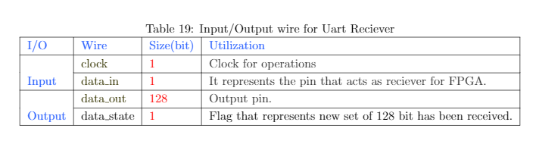
UART Receiver
State Machine

Slide 33
Figure: AES Encryption and Decryption

Slide 34
Encryption
128 Bit Input
Substitution Bytes
Substitution Bytes
Add Round Key
Shift Row
Shift Row
Mix Col
Add Round Key
Add Round Key
No
9
Rounds?
Yes
128 Bit Output

Slide 35
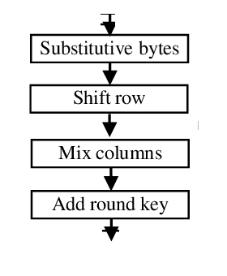
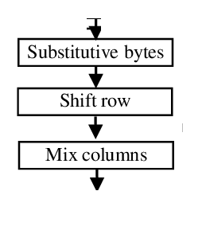
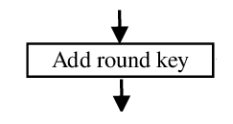
Circuits
Initial
Mid
Final
Substitution Bytes
Substitution Bytes
Shift Row
Add Round Key
Shift Row
Mix Col
Add Round Key
Add Round Key

Slide 36
FSM Circuits
First
Between
Last
Initial
Mid
Mid
Mid
Mid
Final
Mid

Slide 37
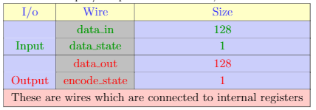
Encrypter
Data_in
First
Data
128 Bit Processed Data
Completion Status
Data
Between
Data
Between
Data
Between
Data
Last
Data_out

Slide 38
Decryption
128 Bit Input
Add Round Key
Add Round Key
Inverse Shift Row
Inverse Mix Col
Inverse
Substitution
Bytes
Add Round Key
Inverse Shift Row
Inverse Substitution Bytes
No
9
Rounds?
Yes
128 Bit Output

Slide 39
Circuits
Initial
Mid
Final
Add Round Key
Add Round Key
Inverse Shift Row
Inverse Mix Col
Add Round Key
Inverse Shift Row
Inverse
Substitution
Bytes
Inverse Substitution Bytes

Slide 40
FSM Circuits
First
Between
Last
Initial
Mid
Mid
Mid
Mid
Mid
Final

Slide 41
Decrypter
Data_in
First
Data
128 Bit Processed Data
Completion Status
Data
Between
Data
Between
Data
Between
Data
Last
Data_out

Slide 42
Complete Implementation
R
E
C
E
I
V
E
R
E
N
C
R
Y
P
T
E
R
T
R
A
N
S
M
I
T
T
E
R
R
E
C
E
I
V
E
R
D
E
C
R
Y
P
T
E
R
T
R
A
N
S
M
I
T
T
E
R
Python Code
Python Code
Computer
Computer

Slide 43
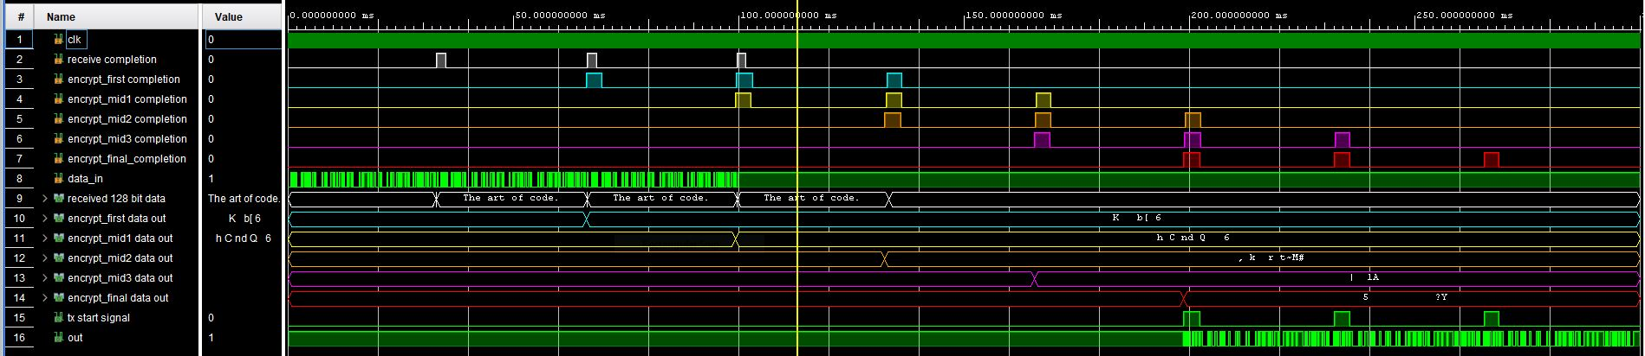
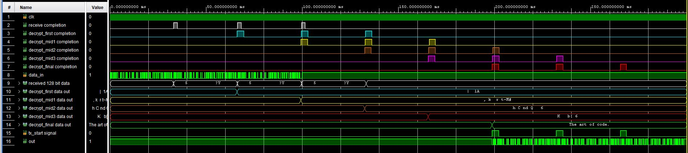
Encryption: Simulation
Decryption: Simulation

Slide 44
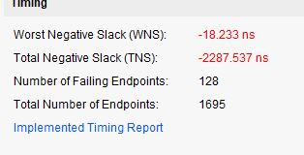
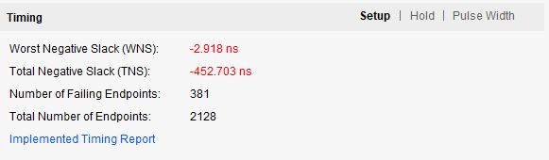

Challenges
Without Pipeline
2 Device Pipeline
5 Device Pipeline

