Slide 1
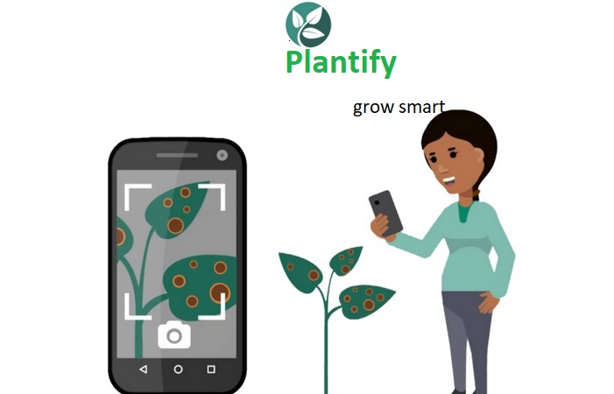

Slide 2
Motivation
The major problem that the farmer around the world face is losses ,because of pest or a disease or a nutrient deficiency.
They depend on the local information that they get from other farmers or experts like extension workers from the agricultural departments.
CAN THEY REACH EVERYONE?
NO!

Slide 3
Existing Systems:-
Farmers of developing countries like India, African nations etc. depends on traditional (age old)methods and the local information that they get from other farmers and experts like extension workers from agricultural department.

Slide 4
PROBLEMS IN THE EXISTING SYSTEM
Time Consuming(Slow Process)
Easily not available
Sometime inaccurate

Slide 5
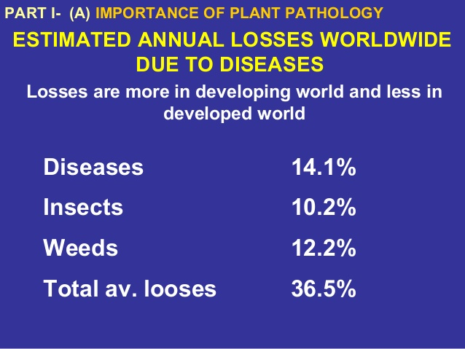
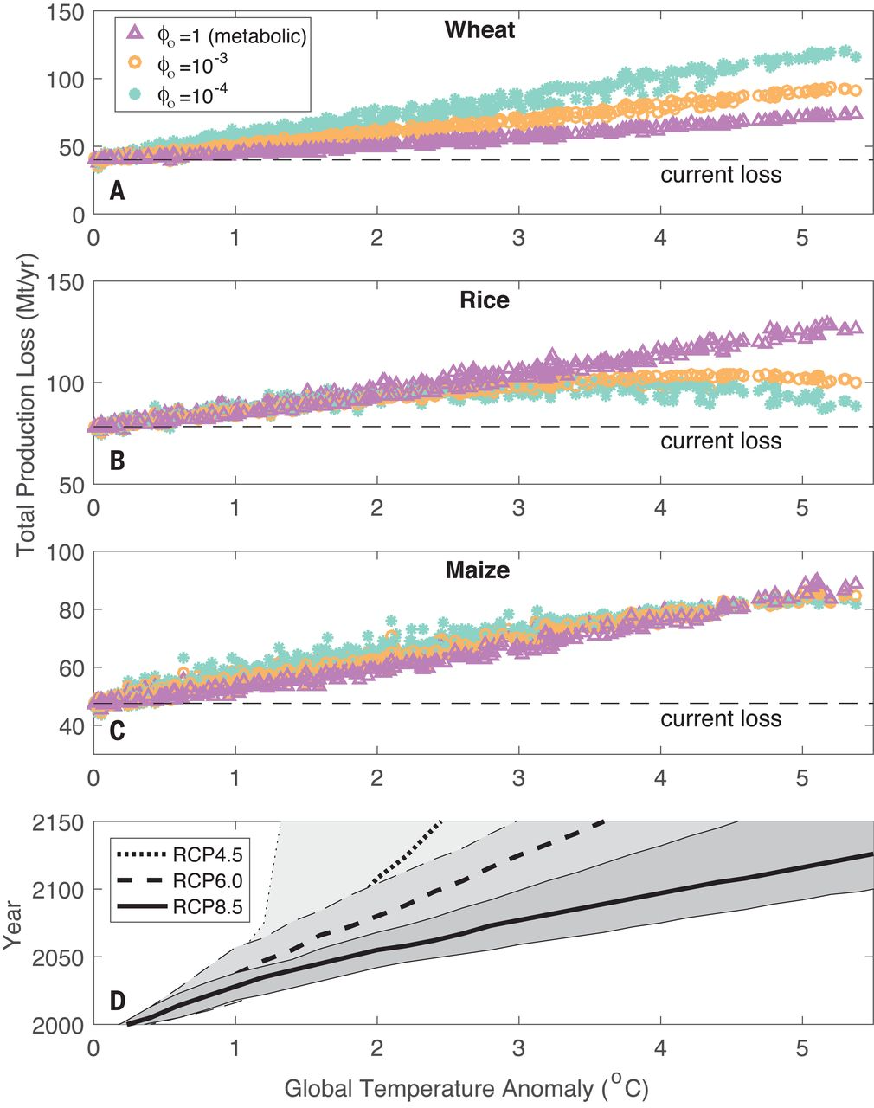
STATISTICS OF CROP LOSSES DUE TO INSECTS AND OTHER DISEASES

Slide 6
HOW WE DO IT
We are developing a digital platform that revolutionizes the farming and gardening with the help of technology.

Slide 7
