Slide 1

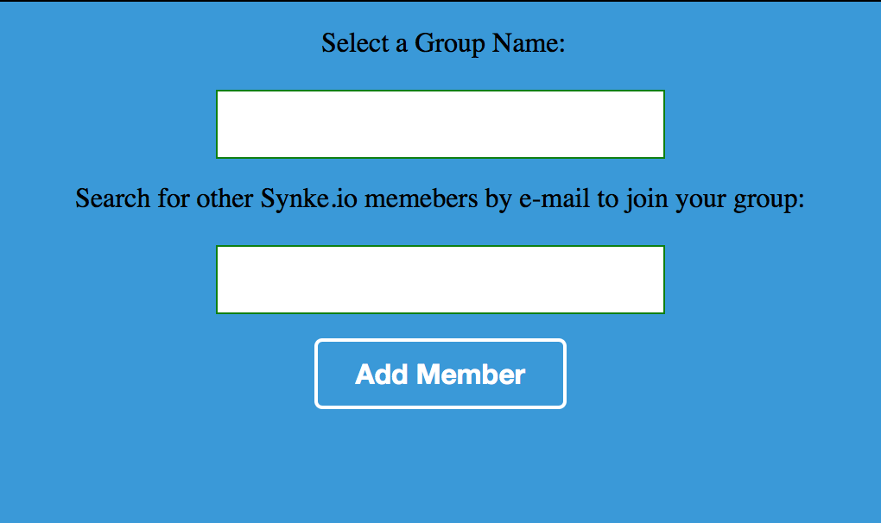
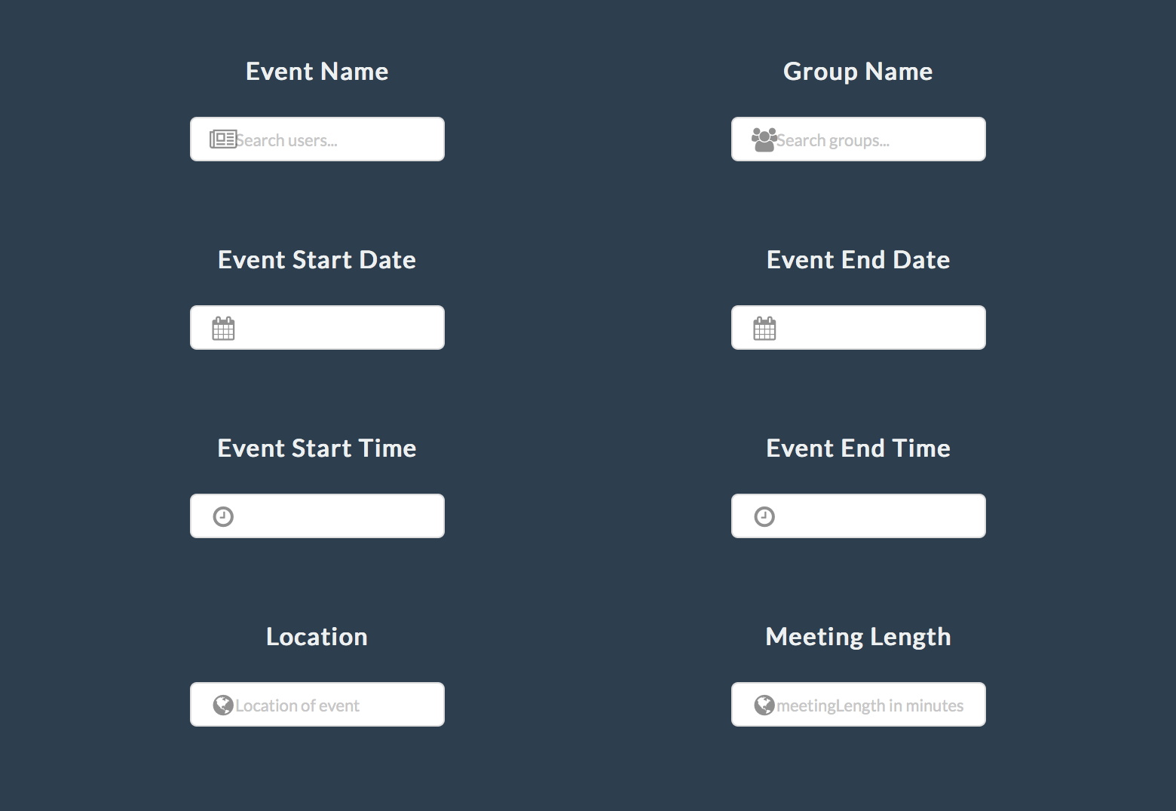
SYNKE.IO IN 3 EASY STEPS!
1
SIGN UP
Sign up using your Google account using the Get Started! button in the upper right hand corner.
2
CREATE A GROUP
You can now choose a group name and add any synke.io member to your group. Groups can contain as many members as you choose and you can be part of as many groups as you want.
3
CREATE AN EVENT
Give us your preferences for your meeting and let us do the magic! We will create your event and update your calendar automatically, making appointments hassle-free. You can then view and manage your calendar through the synke.io user interface.

