Slide 1
PROJECT PRESENTATION
Customer segmentation using machine learning
Presented By:
Anurag Gupta
Kanpur Institute of Technology
Artificial Intelligence and Machine Learning

Slide 2
Outline
Problem Statement
Proposed System/Solution
System Development Approach
Algorithm & Deployment
Results
Conclusion
Future Scope
References

Slide 3
Problem Statement
Customer segmentation is crucial for businesses to tailor
their marketing strategies and improve customer
satisfaction.
Aim: Segment customers based on tenure, monthly charges,
and total charges using machine learning techniques.

Slide 4
Components:
Data Collection: Gathered data from 'Customer_Segmentation.csv‘
containing tenure, monthly charges, total charges, and churn status.
Data Preprocessing: Handled missing values and outliers,
filled missing values, and standardized numerical features.
Proposed Solution

Slide 5
System Development Approach
Exploratory Data Analysis (EDA):
Scatter plot for tenure vs. monthly charges.
Pie chart for tenure distribution.
Line graph for tenure vs. total charges.
Feature Engineering:
Standardized and normalized numerical features using
Standard Scaler and MinMax Scaler.

Slide 6
Algorithm & Deployment
Model Building:
Split data into training and test sets.
Built a Random Forest classifier using standardized features.
Trained and evaluated the model.

Slide 7
Results
Model Performance:
Achieved an accuracy of [77.74%].
Insights from model evaluation and performance metrics.

Slide 8
Conclusion
Summary:
Importance of customer segmentation for businesses.
Machine learning aids in automating segmentation and
improving marketing strategies.
Future Work:
Further analysis to improve model performance.
Exploration of other segmentation techniques.

Slide 9
Future scope
Potential enhancements:
Incorporating additional data sources.
Optimizing algorithms for better performance.
Expanding the system to cover multiple regions.
References
Relevant sources, research papers, and articles used for
developing the solution.

Slide 10
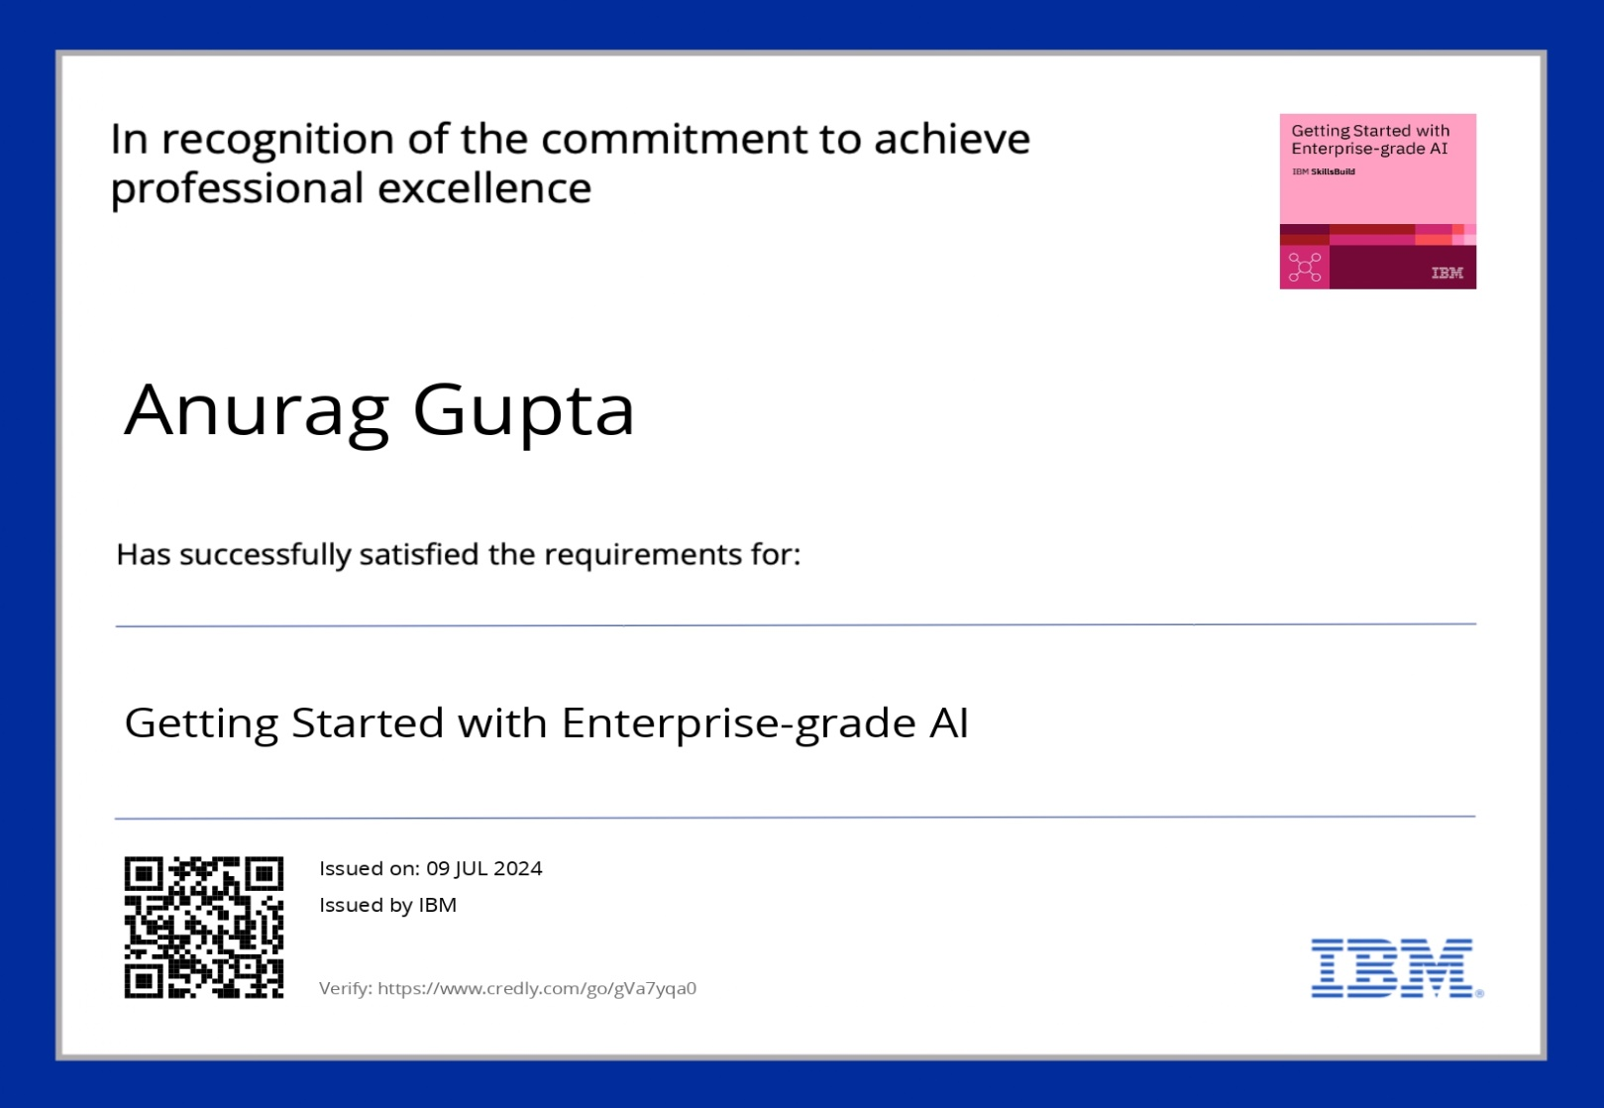
course certificate 1

Slide 11
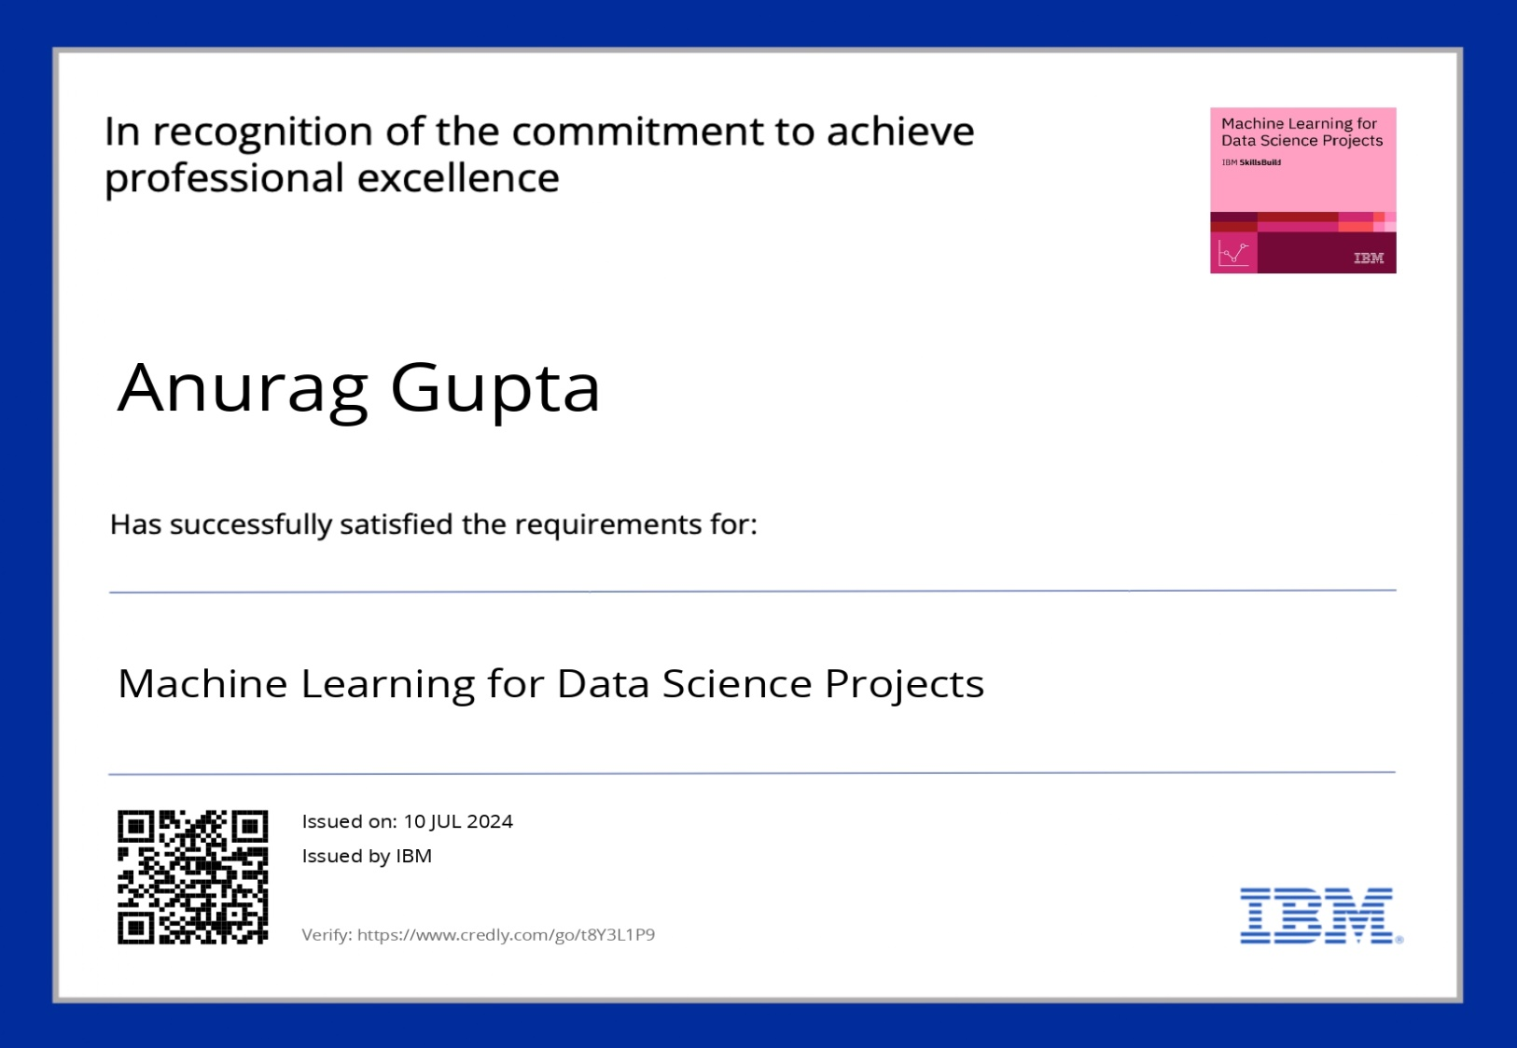
course certificate 2

Slide 12
THANK YOU

