Slide 1
Customer Segmentation using Machine learning
CAPSTONE PROJECT
Presented By :
Anurag Gupta
Kanpur Institute of Technology
Artificial Intelligence and Machine Learning

Slide 2
Outline
Problem Statement
Proposed System/Solution
System Development Approach
Algorithm & Deployment
Results
Conclusion
Future Scope
References

Slide 3
Problem Statement
Customer segmentation is crucial for businesses to tailor their marketing strategies and improve customer satisfaction.
Aim: Segment customers based on tenure, monthly charges, and total charges
using machine learning techniques.

Slide 4
Proposed Solution
Components:
Data Collection : Gathered data from 'Customer_Segmentation.csv' containing tenure, monthly charges, total charges, and churn status.
Data Preprocessing : Handled missing values and outliers, filled missing values, and standardized numerical features.
Exploratory Data Analysis (EDA) ; We visualized the relationship between tenure and monthly charges using a scatter plot and created a pie chart to show the distribution of tenure for a subset of customers.
Feature Engineering : We standardized the numerical features (tenure, monthly charges, total charges) using Standard Scaler and normalized the numerical features using Min Max Scaler.
Model Building : We split the standardized features and the target variable ('Churn') into training and test sets. Built a Random Forest classifier model using the standardized features and trained the model on the training set and evaluated its performance on the test set.

Slide 5
System Development Approach
Exploratory Data Analysis (EDA):
Scatter plot for tenure vs. monthly charges.
Pie chart for tenure distribution.
Line graph for tenure vs. total charges.
Feature Engineering:
Standardized and normalized numerical features using StandardScaler and MinMaxScaler.

Slide 6
Algorithm & Deployment
Python libraries used in different fields
Model Building : sklearn.model_selection
Split data into training and test sets : sklearn - train_test_split
Built a Random Forest classifier using standardized features : sklearn.ensemble
Evaluated the model : sklearn.metrics
Data Visualizations : Matplotlib.pyplot
Addition required : Seaborn, Pandas, Numpy, LogisticRegression, StandardScaler, MinMaxScaler

Slide 7
Results
Model Performance:
Achieved an accuracy of [77.74%].
Acquire the prediction Model.
Insights from model evaluation and performance metrics.
Data Visualization in next slides.

Slide 8
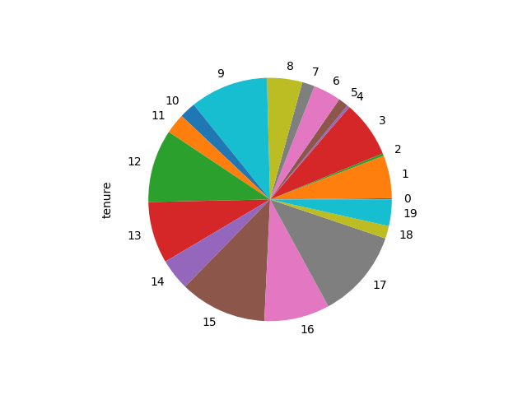
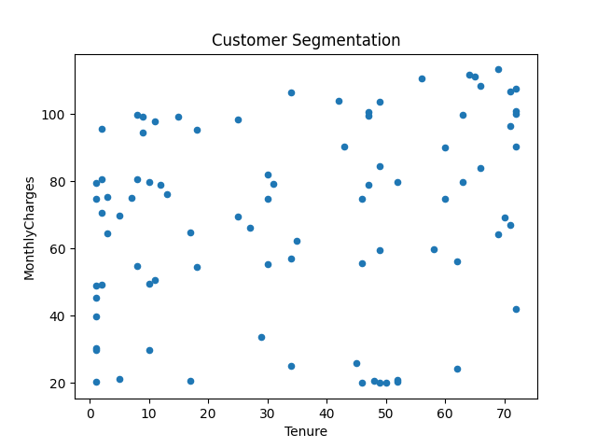

Slide 9
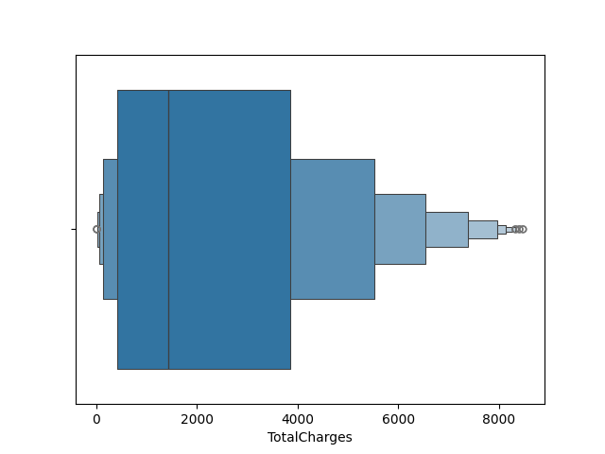
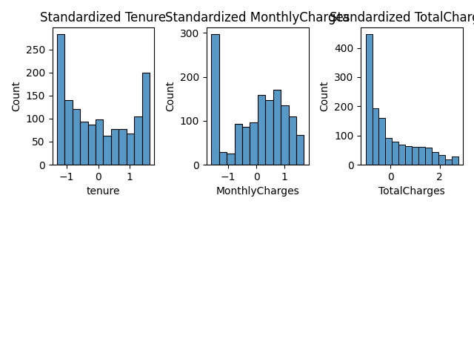
Describe the Outliers

Slide 10
Conclusion
Summary :
Importance of customer segmentation for businesses.
Machine learning aids in automating segmentation and improving marketing strategies.
Future Work:
Further analysis to improve model performance.
Exploration of other segmentation techniques.

Slide 11
Future scope
Potential enhancements:
Incorporating additional data sources.
Optimizing algorithms for better performance.
Expanding the system to cover multiple regions.

Slide 12
References
Relevant sources, research papers, and articles used for developing the solution.
Source Code - Link
CSV File – Link
Testimonial Template - Link

Slide 13
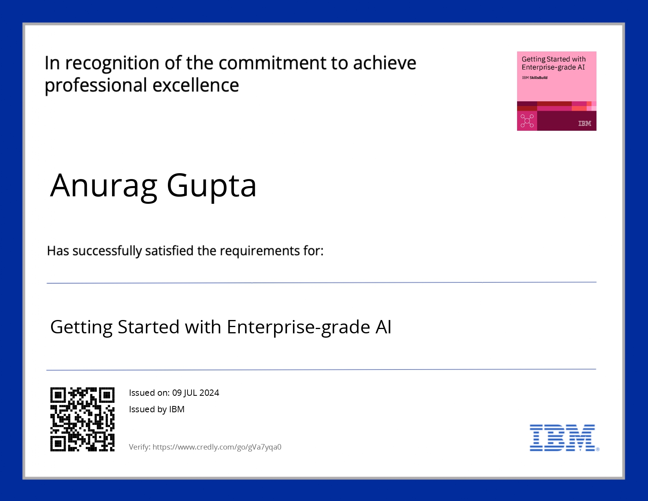
course certificate 1

Slide 14
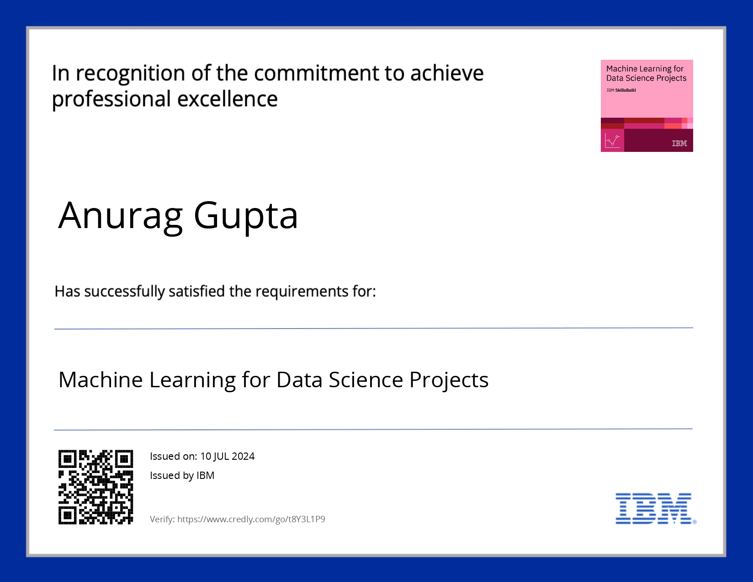
course certificate 2

Slide 15
THANK YOU

